Slide 2
FOREWORD
I’m really pleased to present this, my first annual report as the Director of Public Health for East Sussex.
I arrive in East Sussex at an interesting time. At East Sussex County Council, we are working on our “Core Offer”, which sets out what the authority should offer, from support for those who need it most, to services for everyone; our vision
for a basic but decent level of service for East Sussex, in a difficult financial climate. Alongside this, our integration programmes with the NHS, “East Sussex Better Together” and “Connecting
4 You”, enter a new phase in their development, with a greater focus on working to a county-wide geography.
These changes within the public sector called for a re-evaluation of what is important to the people of the county, and to set out afresh an overview of the needs and intelligence we have about our residents, our economy and our health services and the health of the population.
This report sets these out in a new format using infographics – bold pictures offering a visual representation of information or data – rather than giving an in-depth narrative or numerous tables of numbers. We want you, the readers of this report, to feel free to use the infographics in your own work and reports and to use them to tell your stories of health in East Sussex. The saying “A picture is worth a thousand words” could never have been more appropriate than for how we have designed this report!
East Sussex is a county of contrasts. This report gives a snapshot of some of the differences within the county, both geographical and demographic.
I am only too aware that we have some long-term and stubborn inequalities
in health outcomes between parts of the county, and it is my aim to narrow these as far and as fast as is possible, and to mobilise the resources and actions of others to achieve this.
In Public Health, we have access to a far greater range of data and information than we have included here, and we welcome the free use of this as well. We maintain a specific resource called the Joint Strategic Needs and Assets Assessment, which provides a central resource of local and national information to inform decisions and plans to improve local people’s health and wellbeing and reduce health inequalities in East Sussex. It is available at: www.eastsussexjsna.org.uk
I trust that this report gives you the picture of East Sussex that will enable you and your family, community, or organisation to understand where you fit within the wider context, and what influences your health and wellbeing. I hope that my conclusions will resonate with you and be shared by you, so that we can take these and work together to create the environments and energy to tackle them and commit to improve health for all in our county, and especially to narrow the inequalities which are so unfair.
Acknowledgements
I would like to acknowledge the work of the Interim Director of Public Health, Wendy Meredith, who set the direction and scope for this report before I took up my post.
The East Sussex Public Health Intelligence Team has undertaken the design and production of this report, and I thank all involved in making this report so accessible and enjoyable to read.
This report was created using icons from www.thenounproject.com
Front cover: Newhaven port harbour in Sussex, England, August 23; 2016 (Editorial credit: saranya33/Shutterstock.com)
If using these infographics please cite: East Sussex Public Health Intelligence www.eastsussexjsna.org.uk/ publichealthreports
2
PICTURE EAST SUSSEX - Annual report of the Director of Public Health 2018/19

Slide 3
CONTENTS
1 | INTRODUCTION | PAGE
 | FOREWORD | 2
 | CONTENTS | 3
 | INTRODUCTION | 4
3 | HOW HEALTHY ARE WE | PAGE
 | HEALTH STATUS | 15
 | LIFE EXPECTANCY | 15
 | START WELL | 17
 | BETTER LIVING | 18
 | RISK CONDITIONS | 19
 | PHYSICAL ILLNESS | 20
 | MENTAL ILLNESS | 21
 | SCREENING AND CANCER | 22
 | BETTER AGEING | 23
 | MORTALITY | 24
4 | HOW WE USE SERVICES | PAGE
 | PRIMARY CARE | 25
 | SOCIAL CARE | 26
 | MENTAL HEALTH SERVICES | 27
 | HOSPITAL ACTIVITY | 28-30
2 | WHO WE ARE | PAGE
 | ABOUT EAST SUSSEX | 5
 | HEALTH AND CARE ORGANISATIONS | 6
 | PEOPLE | 7
 | BIRTHS AND DEATHS | 8
 | DEPRIVATION | 9
 | BETTER BEGINNINGS | 10
 | FAIR EMPLOYMENT/WORK | 11
 | STANDARD OF LIVING | 12
 | HEALTHY PLACES | 13
 | ASSETS | 14
5 | CONCLUSION | PAGE
 | CONCLUSION | 31-34
 | REFERENCES | 35
PICTURE EAST SUSSEX - Annual report of the Director of Public Health 2018/19
3

Slide 4
PICTURE EAST SUSSEX
INTRODUCTION
This report presents a profile of the health and wellbeing of East Sussex using creative infographics. It is intended to provide a snapshot, rather than a complete picture, of the key factors that determine our health and collective wellbeing. The indicators and data included are highlights from numerous credible sources of health information.
The report profile includes both determinants of health (the things that make us healthy or unhealthy) and health status (how healthy or unhealthy we are), as well as information on how we use services. The aim of the profile is to stimulate discussion about health in our communities, homes and workplaces; contribute to planning and decision making; and provide a new way of presenting health and care information.
Why does indicator data from different sources differ?
There are several reasons why the statistics presented in the profile may differ from similar statistics generated from other data sources. Data that was collected using different methodology will yield different results. This is particularly true for data that has been self-reported versus data that has
been objectively measured (e.g. physical activity levels or height and weight).
Why are the statistics presented a few years old?
The statistics presented in the health profile are based on the most current data available at the time that the data was analysed. The data sources used in the health profile are routinely updated, therefore for some indicators, new data may have become available before the release of the profile. However, population health issues change slowly over time and big changes are not usually observed from one release to the next.
What does statistical significance mean?
A statistically significant result is one that is not likely due to chance. When results are not statistically significant, the possibility of the result being due to chance cannot be ruled out.
What is an age-standardised rate?
An age-standardised rate is a rate that has been adjusted to remove the effect of age so that groups (e.g. males and females, local authorities) with different age distributions can be compared. When interpreting age-
standardised rates, the focus should be on the trend (e.g. East Sussex higher than England) rather than the value of the rate.
What are income quintiles?
Income quintiles refer to data on income that has been divided into five equally sized groups. In the profile, comparisons for a given indicator are made across these income groups.
Some things to consider when using information in the East Sussex profile
What indicators are included?
Indicators are organised into three sections: who we are, how healthy we are, and how we use our health and care services. Each section includes a broad range of relevant topics. However, each individual topic (e.g. physical activity) is represented by a single or small number of indicators.
Where does the indicator data come from?
The indicator data in the East Sussex profile comes from a number of different sources such as the Census, Public Health Outcomes Framework, Hospital Episodes Statistics and specific community surveys. The year and source of the indicator data are identified in the reference section at the end of the report. Priority was given to data sources where there were national comparators and/or reporting the data by factors such as age, sex, and geography was possible.
4
PICTURE EAST SUSSEX - Annual report of the Director of Public Health 2018/19

Slide 5
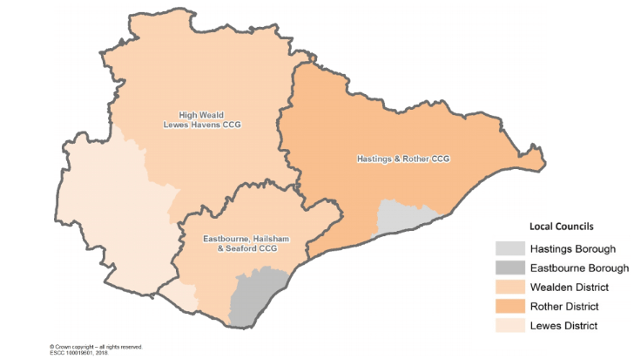
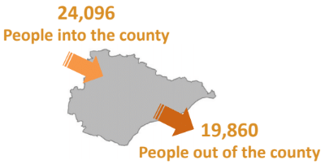
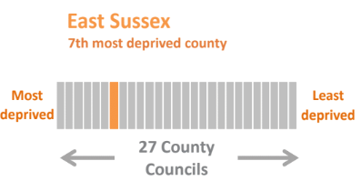
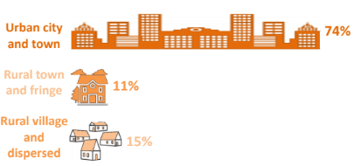
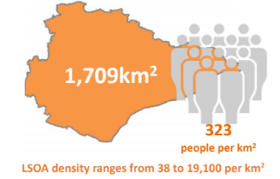
WHO WE ARE
ABOUT EAST SUSSEX
1. OUR POPULATION
2. HEALTH AND LOCAL AUTHORITY GEOGRAPHIES
3. WE ARE CHANGING (2017)
4. DEPRIVATION, INDEX OF MULTIPLE DEPRIVATION, 2015
5. WHERE WE LIVE
6. OUR COUNTY
5
PICTURE EAST SUSSEX - Annual report of the Director of Public Health 2018/19
5

Slide 6
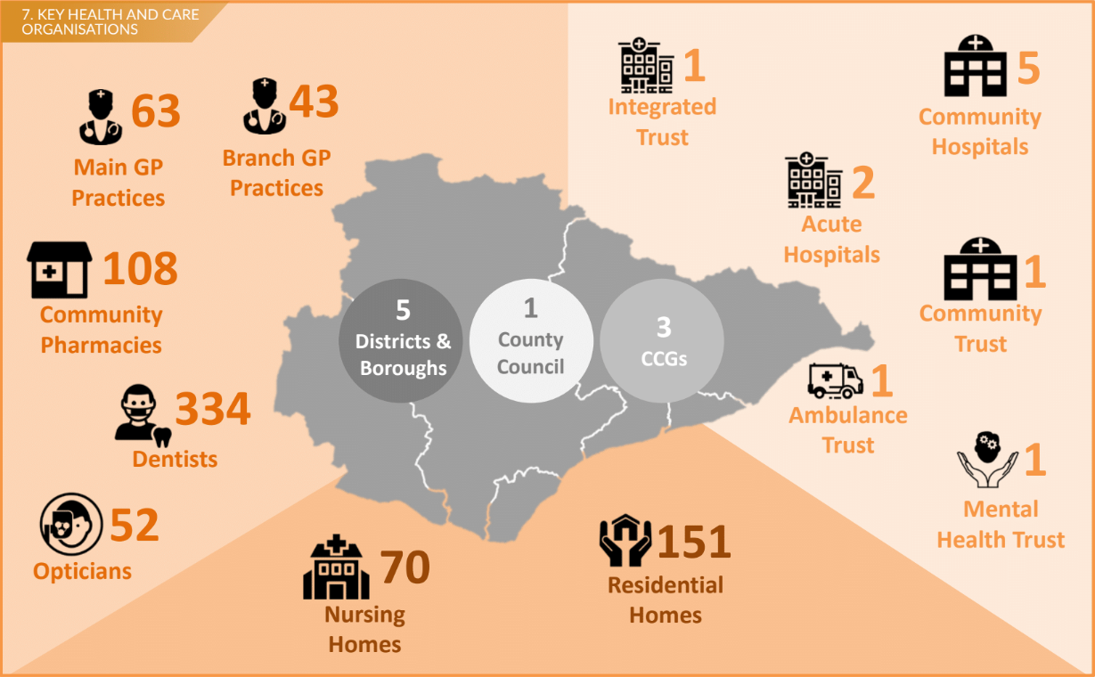
WHO WE ARE
HEALTH AND CARE ORGANISATIONS
6
PICTURE EAST SUSSEX - Annual report of the Director of Public Health 2018/19

Slide 7
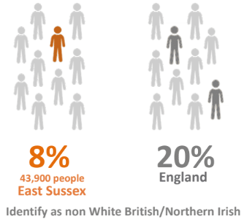
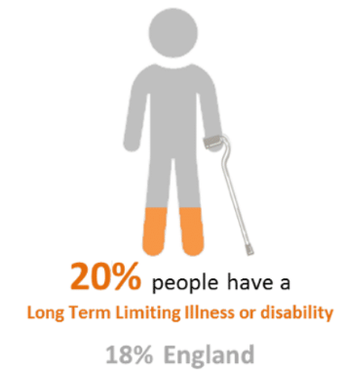
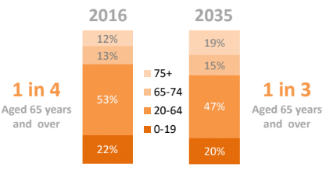
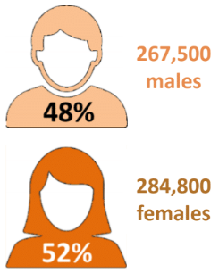
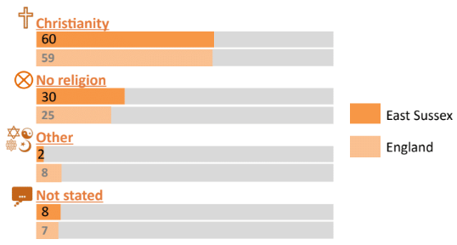
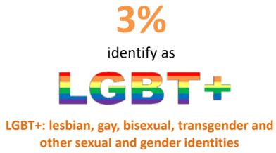
WHO WE ARE
PEOPLE
8. ETHNICITY, 2011
9. POPULATION AGE STRUCTURE AND PREDICTED CHANGE
10. LONG TERM LIMITING ILLNESS OR DISABILITY, 2011
11. GENDER, 2017
12. RELIGIOUS BELIEF, 2011
13. SEXUAL ORIENTATION AND GENDER IDENTITY, 2017
PICTURE EAST SUSSEX - Annual report of the Director of Public Health 2018/19
7

Slide 8
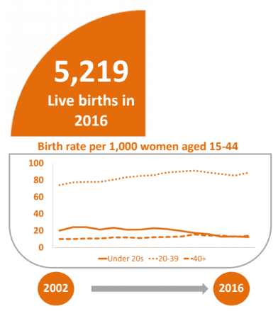
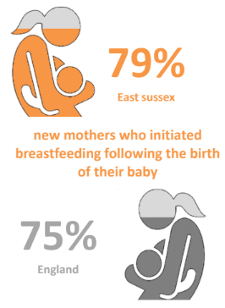
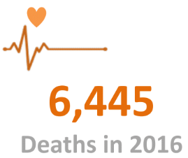
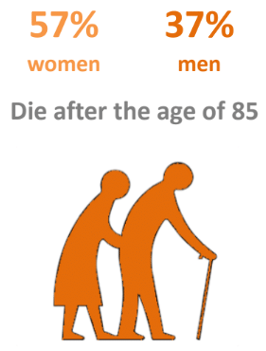
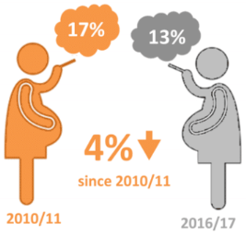
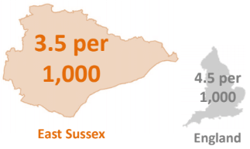
WHO WE ARE
BIRTHS AND DEATHS
14. NUMBER OF BIRTHS
15. BREASTFEEDING INITIATION, 2016/17
16. NUMBER OF DEATHS
19. AGE AT DEATH
18. SMOKING AT TIME OF DELIVERY
17. RATE OF STILLBIRTHS 2014/16
8
PICTURE EAST SUSSEX - Annual report of the Director of Public Health 2018/19

Slide 9
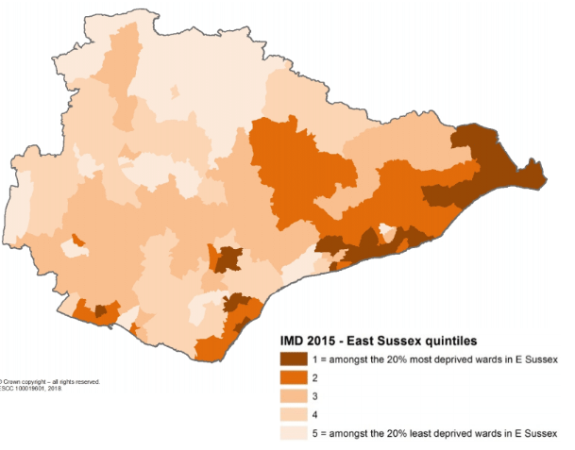
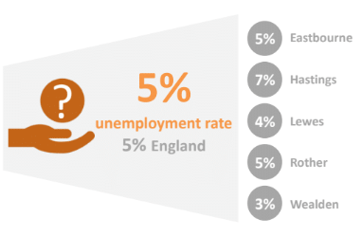
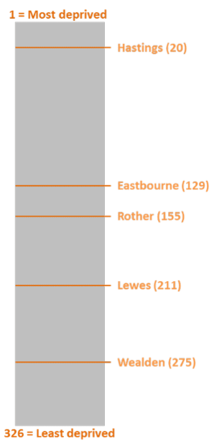
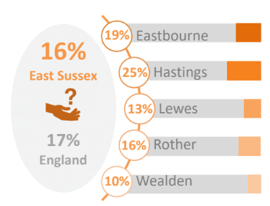
WHO WE ARE
DEPRIVATION
20. DEPRIVATION IN EAST SUSSEX
22. DEPRIVATION BY LOWER TIER LOCAL AUTHORITY, INDEX OF MULTIPLE DEPRIVATION, 2015
23. UNEMPLOYMENT, 2016
24. CHILDREN AGED 16 AND UNDER IN LOW INCOME FAMILIES, 2015
21. PEOPLE AGED 65 AND OVER LIVING IN POVERTY, 2015
PICTURE EAST SUSSEX - Annual report of the Director of Public Health 2018/19
9

Slide 10
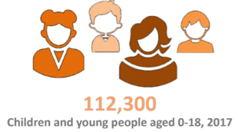
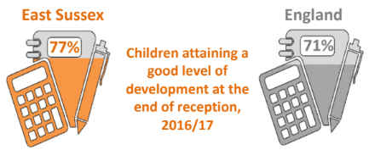
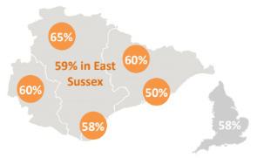
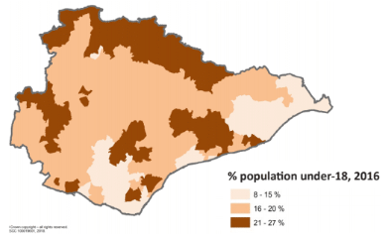
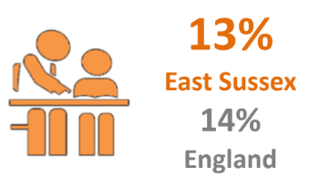
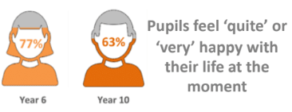
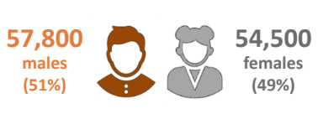
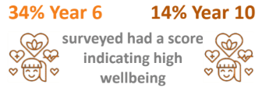
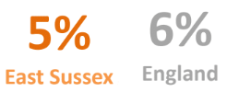
WHO WE ARE
BETTER BEGINNINGS
25. OUR YOUNG POPULATION
26. SCHOOL READINESS
27. ACHIEVING 5 A*-C AT GCSE, 2015/16
28. WHERE YOUNG PEOPLE LIVE
29. EDUCATION AND HEALTH CARE PLAN, 2016
30. HAPPINESS, 2017
33. 0-18 YEAR OLDS, 2017
31. WELLBEING, 2017
32. NOT IN EDUCATION EMPLOYMENT OR TRAINING, 2016
10
PICTURE EAST SUSSEX - Annual report of the Director of Public Health 2018/19

Slide 11
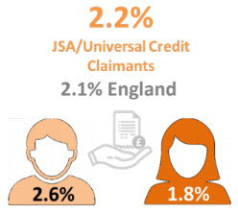
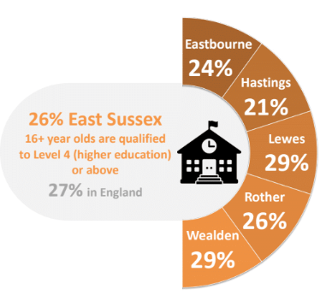
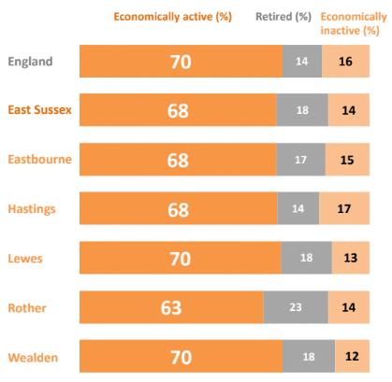
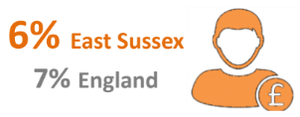
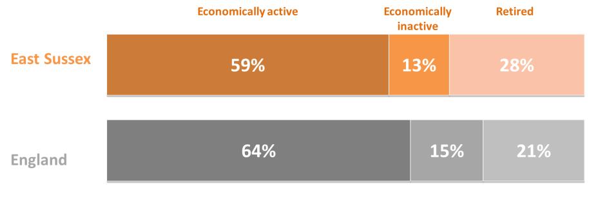
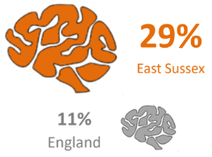
WHO WE ARE
FAIR EMPLOYMENT/WORK
34. QUALIFICATIONS, 2011
35. EMPLOYMENT STATUS, 2011
36. UNIVERSAL CREDIT CLAIMANTS, JULY 2018
38. SUPPORTED ADULTS WITH LEARNING DISABILITIES IN PAID EMPLOYMENT, 2015/16
39. SOCIAL CARE CLIENTS ON SELF-DIRECTED PAYMENTS, MENTAL HEALTH, 2013/14
37. EMPLOYMENT OF UNPAID CARERS, 2011
PICTURE EAST SUSSEX - Annual report of the Director of Public Health 2018/19
11

Slide 12
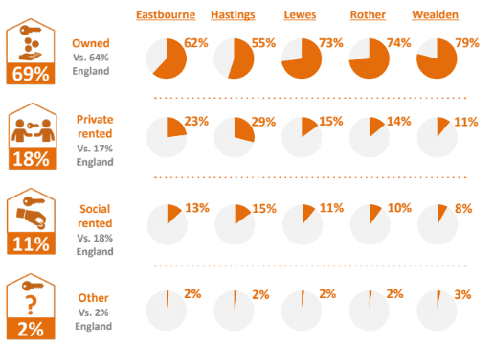
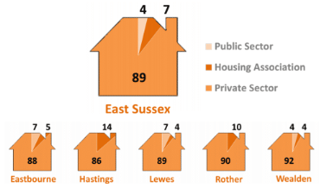
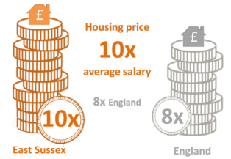
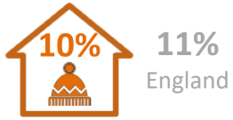
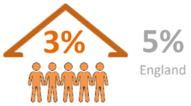
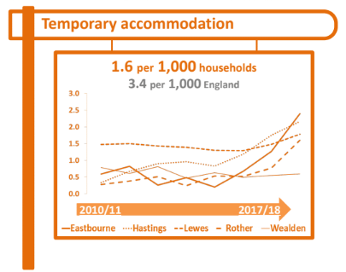
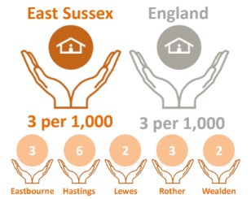
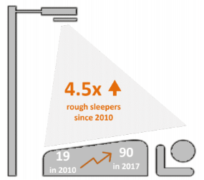
WHO WE ARE
STANDARD OF LIVING
40. HOUSING TENURE, 2011
41. HOUSING STOCK, 2017
42. HOUSING AFFORDABILITY, 2017
44. FUEL POVERTY, 2016
45. OVERCROWDING, 2011
43. HOUSEHOLDS IN TEMPORARY ACCOMMODATION
46. HOMELESS HOUSEHOLDS IN PRIORITY NEED, 2017/18
47. ROUGH SLEEPERS
12
PICTURE EAST SUSSEX - Annual report of the Director of Public Health 2018/19

Slide 13
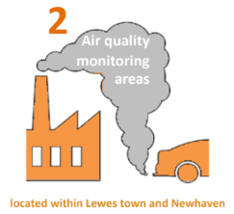
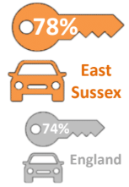
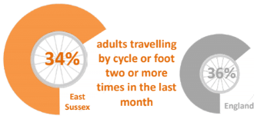
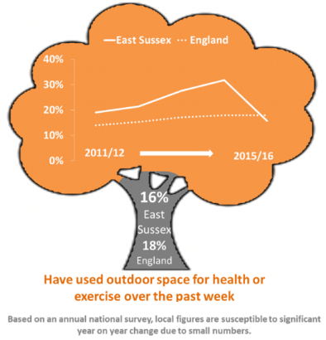
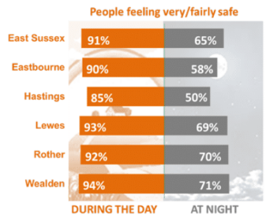
WHO WE ARE
HEALTHY PLACES
48. USE OF OUTDOOR SPACE FOR EXERCISE/HEALTH REASONS BY PEOPLE AGED 16+
49. AIR QUALITY
50. CAR OWNERSHIP, 2011
51. ACTIVE TRAVEL, NOVEMBER 2016/17
53. FEELING SAFE, 2017
52. SENSE OF BELONGING, 2017
54. GREEN SPACE IN EAST SUSSEX
55. TRANSPORT NETWORK, 2017
PICTURE EAST SUSSEX - Annual report of the Director of Public Health 2018/19
13

Slide 14
WHO WE ARE
ASSETS
56. 2017 EAST SUSSEX COMMUNITY SURVEY
85%
Satisfied with the local area as a place to live
Living comfortably or doing alright financially
46%
and
50%
Feel lonely often or some of the time
Formally Volunteered
Informally Volunteered
in the last year
14
14
PICTURE EAST SUSSEX - Annual report of the Director of Public Health 2018/19

Slide 15
HOW HEALTHY ARE WE
HEALTH STATUS
57. SELF-REPORTED GOOD HEALTH, 2018
58. SELF-REPORTED POOR MENTAL HEALTH, 2016/17
59. LONG TERM LIMITING ILLNESS OR DISABILITY, 2011
60. WELLBEING SCORE, 2018
61. LOW LIFE SATISFACTION, 2016/17
62. HEALTH RELATED QUALITY OF LIFE, 2011
63. DISABILITY BENEFITS, 2016
PICTURE EAST SUSSEX - Annual report of the Director of Public Health 2018/19
15

Slide 16
HOW HEALTHY ARE WE
LIFE EXPECTANCY
64. LIFE EXPECTANCY, 2014/16
65. HEALTHY LIFE EXPECTANCY, 2014/16
66. CHANGES IN LIFE EXPECTANCY
67. CHANGES IN HEALTHY LIFE EXPECTANCY
16
PICTURE EAST SUSSEX - Annual report of the Director of Public Health 2018/19

Slide 17
HOW HEALTHY ARE WE
START WELL
68. OBESE AND OVERWEIGHT, 2016/17
69. MMR VACCINE: 2 DOSES BY AGE 5, 2016/17
70. HEALTH RELATED BEHAVIOUR SURVEY: 14/15 YEAR OLDS
72. AVERAGE DECAYED MISSING FILLED TEETH AT AGE 5, 2016/17
71. TEEN CONCEPTIONS AND TERMINATIONS, 2016
PICTURE EAST SUSSEX - Annual report of the Director of Public Health 2018/19
17

Slide 18
HOW HEALTHY ARE WE
BETTER LIVING
73. PHYSICALLY ACTIVE, 2016/17
74. POPULATION AGED 20-64, 2017
75. PHYSICALLY INACTIVE, 2016/17
77. PEOPLE DRINKING MORE THAN 14 UNITS OF ALCOHOL A WEEK, 2017
78. COMPLETED TREATMENTS FOR SUBSTANCE MISUSE, 2016
76. SMOKING PREVALENCE, 2017
79. BINGE DRINKING, 2011-14
18
PICTURE EAST SUSSEX - Annual report of the Director of Public Health 2018/19

Slide 19
HOW HEALTHY ARE WE
RISK CONDITIONS
80. HYPERTENSION, 2015
81. OBESE OR OVERWEIGHT, 2016/17
82. SEXUAL HEALTH
83. ESTIMATED PREVALENCE OF
NON-DIABETIC HYPERGLYCAEMIA, 2015
PICTURE EAST SUSSEX - Annual report of the Director of Public Health 2018/19
19

Slide 20
HOW HEALTHY ARE WE
PHYSICAL ILLNESS
CORONARY HEART DISEASE (CHD)
DIABETES
84. ESTIMATED CHD PREVALENCE IN 55-79 YEAR OLDS, 2015
85. PEOPLE WITH CHD WHOSE BLOOD PRESSURE IS CONTROLLED, 2016/17
86. ESTIMATED PREVALENCE OF DIABETES, 2016/17
87. RECEIVING ALL 8 DIABETES CARE PROCESSES, 2015
RESPIRATORY DISEASE
88. CHRONIC OBSTRUCTIVE PULMONARY DISEASE PREVALENCE, 2016/17
89. ASTHMA PREVALENCE BY CCG PRACTICE POPULATION 2016/17
90. NUMBER OF PEOPLE WITH TWO OR MORE LONG TERM HEALTH CONDITIONS
20
PICTURE EAST SUSSEX - Annual report of the Director of Public Health 2018/19

Slide 21
HOW HEALTHY ARE WE
MENTAL ILLNESS
COMMON AND SEVERE MENTAL ILLNESS
93. PREDICTED DEMENTIA CASES
91. ONSET OF MENTAL ILLNESS
92. ESTIMATED PREVALENCE OF MENTAL ILL HEALTH IN YOUNG PEOPLE, 2015
97. GP RECORDED PREVALENCE OF DEMENTIA, 2016/17
94. ESTIMATED PREVALENCE OF MENTAL HEALTH CONDITIONS
95. GP RECORDED PREVALENCE OF SEVERE MENTAL ILLNESS, 2016/17
96. GP RECORDED PREVALENCE OF DEPRESSION, 2016/17
98. PREVENTING DEMENTIA
PICTURE EAST SUSSEX - Annual report of the Director of Public Health 2018/19
21

Slide 22
HOW HEALTHY ARE WE
SCREENING AND CANCER
99. CANCER
100. CANCER SCREENING UPTAKE, 2016/17
22
PICTURE EAST SUSSEX - Annual report of the Director of Public Health 2018/19

Slide 23
HOW HEALTHY ARE WE
BETTER AGEING
101. POPULATION GROWTH IN PEOPLE AGED 65 AND OVER
102. ESTIMATED MODERATE AND SEVERE FRAILTY IN PEOPLE AGED 65+
105. PLACE OF DEATH 65 AND OVER, 2016
103. POPULATION AGED 65 AND OVER, 2017
104. EXCESS WINTER DEATHS
PICTURE EAST SUSSEX - Annual report of the Director of Public Health 2018/19
23

Slide 24
HOW HEALTHY ARE WE
MORTALITY
106. LEADING CAUSES OF DEATH,
AGE-STANDARDISED RATE PER 100,000
107. ALL-CAUSE MORTALITY,
AGE-STANDARDISED RATE PER 100,000 POPULATION
110. PREMATURE ALL-CAUSE MORTALITY, UNDER 75 YEARS, AGE-STANDARDISED RATE PER 100,000 POPULATION
108. ALCOHOL AND SUBSTANCE MISUSE MORTALITY, AGE-STANDARDISED RATE PER 100,000 POPULATION
109. SUICIDE RATE, AGE-STANDARDISED RATE PER 100,000 POPULATION, 2014/16
24
24
PICTURE EAST SUSSEX - Annual report of the Director of Public Health 2018/19

Slide 25
HOW WE USE SERVICES
PRIMARY CARE
111. PRIMARY CARE PROVISION PER 1,000 POPULATION
112. AVERAGE PRACTICE POPULATION
113. 20 MINUTES WALK TO GP, SEPTEMBER 2018
114. PRACTICE POPULATIONS
115. GOOD EXPERIENCE OF MAKING A GP APPOINTMENT
25
Health 2018/19 25
PICTURE EAST SUSSEX - Annual report of the Director of Public Health 2018/19
25

Slide 26
HOW WE USE SERVICES
SOCIAL CARE
CARERS
CHILDREN
116. HOURS SPENT CARING PER WEEK, 2011
117. CARERS ALLOWANCE CLAIMANTS, AGED 16+, FEBRUARY 2018
118. FIXED TERM EXCLUSIONS, 2015/16
119. LOOKED AFTER CHILDREN, MARCH 2017
ADULTS
120. HEALTH AND SOCIAL CARE CONNECT (HSCC) CONTACTS AND REFERRALS
121. SAFEGUARDING CONTACTS FOR PEOPLE AGED 18+, 2017/18
122. RECEIVING LONG TERM SUPPORT
26
PICTURE EAST SUSSEX - Annual report of the Director of Public Health 2018/19

Slide 27
HOW WE USE SERVICES
MENTAL HEALTH SERVICES
123. MENTAL HEALTH HOSPITAL ADMISSIONS, Q4 2018
124. PEOPLE ENTERING TALKING THERAPIES, MARCH 2018
125. EMERGENCY ADMISSIONS FOR INTENTIONAL SELF-HARM - CHILDREN AND YOUNG PEOPLE, 2015/16
126. ADMISSIONS TO CHILD AND ADOLESCENT MENTAL HEALTH SERVICES WARDS, Q2 2016
PICTURE EAST SUSSEX - Annual report of the Director of Public Health 2018/19
27

Slide 28
HOW WE USE SERVICES
HOSPITAL ACTIVITY
127. HOSPITAL ACTIVITY BY TYPE, 2017/18
128. ELECTIVE ADMISSIONS BY TYPE
129. HOSPITAL ACTIVITY BY PROVIDER, 2017/18
130. ELECTIVE ADMISSIONS BY AGE GROUP
28
PICTURE EAST SUSSEX - Annual report of the Director of Public Health 2018/19

Slide 29
HOW WE USE SERVICES
HOSPITAL ACTIVITY
131. A&E ATTENDANCES
132. PATIENTS ATTENDING A&E 5 OR MORE TIMES IN A YEAR
133. A&E ATTENDANCES BY AGE GROUP
134. EMERGENCY ADMISSIONS BY LENGTH OF STAY
PICTURE EAST SUSSEX - Annual report of the Director of Public Health 2018/19
29

Slide 30
HOW WE USE SERVICES
HOSPITAL ACTIVITY
135. REASONS FOR EMERGENCY ADMISSIONS
136. HOSPITAL ADMISSIONS DUE TO INJURIES, 0-4 YEAR OLDS, 2016/17
138. ADMISSIONS DUE TO FALLS, 2016/17
139. ADMISSIONS FOR HIP FRACTURES, 2016/17
137. UNPLANNED ADMISSIONS FOR LONG TERM CONDITIONS NOT USUALLY REQUIRING HOSPITALISATION, 2017/18
140. ADMISSIONS DUE TO ALCOHOL SPECIFIC CONDITIONS, UNDER 18 YEARS
30
30
PICTURE EAST SUSSEX - Annual report of the Director of Public Health 2018/19

Slide 31
PICTURE EAST SUSSEX
CONCLUSION
A person’s chance of enjoying good health and a longer life is influenced by the social and economic conditions in which they are born, grow, work, live and age. These conditions affect the way people look after their own
health and use services throughout their life. The impact of social conditions can be seen in the continuing and striking gradient in health. That is, the poorer your circumstances the more likely you are to have poor health
and wellbeing, spend more of your life with life-limiting illness, and die prematurely.
The population and communities within East Sussex have many strengths and assets, reflected in the generally high levels of health and wellbeing within the county. However, variation does exist, and not all communities or people benefit from the same advantage. Addressing health inequalities and moving towards a fairer distribution of good health requires a life course approach and action to be taken across the whole of society. What happens in childhood is important as it has an impact on health and wellbeing in later life.
Actions are required to:
Involve and empower patients to manage their own health
Address individual-level lifestyle factors
Adopt whole systems approach to social determinants of health
As we continue to transform our health and social care system, it is critical that appropriate attention is given to the prevention of disease and injury, along with the provision of high quality health care. To do this, increased understanding of the root causes of poor health and the development
of social, economic and physical environments that better support our collective wellbeing are critical. This health and care profile of East Sussex provides the beginnings of a shared understanding of the population of the county, the way services are currently used and what demands may be placed on them in the future.
Gestation times for different preventative interventions Adapted from: Health Inequalities National Support Team (HINST), 2010
Here are ten of the important points this report makes about our health today and what it means for our future.
PICTURE EAST SUSSEX - Annual report of the Director of Public Health 2018/19
31

Slide 32
PICTURE EAST SUSSEX
CONCLUSION
OUR POPULATION IS AGEING
CHILDREN NEED THE BEST START IN LIFE
The over 65s now represent a quarter of the county’s population and are projected to make up nearly a third of all people by 2035. By 2035 there will be a 46% increase in our 65 and over population. The fastest rate of growth will be seen in the 85 and over group.
This ageing population is placing additional pressures on social care and the NHS, as well as impacting on families, and our workplaces. Those aged 85 and over are the largest users of health and social services.
Older people have a significant contribution to make to society. To maximise these contributions a focus on health and wellbeing throughout life is critical. To enable older people to achieve their own ambitions, enjoy good health and maintain independence for as long as possible.
What happens during pregnancy and the first few years of life influences physical, cognitive and emotional development in childhood and may have an effect on health and wellbeing outcomes in later life.
Although children and young people in East Sussex report increasingly healthier behaviours,
we see some clear differences in outcomes, such as hospital admissions for alcohol, significantly higher in Hastings.
Challenges in emotional health and wellbeing remain and the level of need for child and adolescent mental health services are high.
Educational achievement is variable across the county and exclusion from school is above the England average.
Enabling children to achieve their full potential and be physically and emotionally healthy provides the cornerstone for a healthy, productive childhood and adulthood.
SECURE INCOME AND HOUSING ARE UNEVENLY DISTRIBUTED
In order to improve health and wellbeing, we need to remember that good health is about much more than just good health care services. There are a number of other factors at play such as getting a good education, a good job, and a safe place to live.
Having enough money for daily living is one of the biggest determinants of health outcomes. In our community survey 8 in 10 felt they were financially alright. However, across East Sussex 16% of children live in low income families and 13% of older people live in poverty. These figures hide stark differences in the county with 1 in 4 children and 1 in 5 older people living in these conditions in Hastings, compared to 1 in 10 in Wealden.
At its most basic, access to safe and secure housing is a key determinant of health. Across the county there are increasing numbers of people who do not have access to housing or whose housing is temporary.
Poor housing impacts on both physical and mental health and wellbeing. It is estimated that poor housing costs the NHS over £1 billion annually. Poor and unsafe housing can occur in all forms of home ownership and occupancy, but in general the private rented sector has the highest rates of poorer housing. Rates of private tenancy vary across the county, accounting for 1 in 3 households in Hastings to 1 in 10 in Wealden.
We cannot ignore the role that income and housing play in sustaining good health and maintaining independence.
32
PICTURE EAST SUSSEX - Annual report of the Director of Public Health 2018/19

Slide 33
PICTURE EAST SUSSEX
CONCLUSION
THERE ARE DIFFERENCES IN HOW LONG WE LIVE
NO SINGLE PROJECT OR INITIATIVE CAN BEAT OBESITY
Life expectancy continues to improve in the county. A girl born in East Sussex today can expect to live to 84, and a boy to 80.
Although life expectancy has continued to rise, the number of years we can expect to live in good health has not kept pace. Healthy life expectancy has increased for males from 62 to 65 between 2009/11 and 2014/16, but for females it has fallen from 65 to 63 years.
For both indicators health inequalities persist. Those living in our most deprived communities have the lowest life expectancy and can expect to live fewer years in good health. There is a 16 year gap between those who have the highest life expectancy and those who have the lowest. There is a 13 year gap between those with the longest healthy life expectancy and those have the shortest.
To increase the number of years we live in good health and reduce inequalities we must look beyond just the absence of disease and include the conditions and influences that create good health and wellbeing.
In East Sussex 2 in 10 reception age children; 3 in 10 children in year six; and 6 in 10 adults are overweight or obese.
Along with smoking, obesity is among the leading risk factors for poor health. It is associated with a range of conditions, including cardiovascular disease, musculoskeletal conditions, respiratory disease, diabetes and many cancers.
The NHS spends over £6 billion each year on treating overweight and diabetes related ill health.
Obesity is a complex problem with a large number of different but often interlinked causes. No single measure is likely to be effective on its own in tackling obesity. To have a significant impact on obesity everybody needs to get involved.
IT’S TIME TO TALK MENTAL HEALTH
1 in 4 of us will experience mental ill-health at some point in our lives. Mental illnesses constitute the largest single burden of disease nationally at almost a quarter of the total. Mental illness also has a considerable economic cost to our health and care system, and also to individuals, families and communities. In East Sussex, the GP recorded prevalence of severe mental illness; depression and dementia are all higher than England.
Mental ill-health often begins earlier than other causes of disability and there is continuity between mental illness in childhood and adulthood; we know that over half of people with a lifetime mental illness at the age of 26 will have met the diagnostic criteria first by the age of 14. Admissions to acute child and adolescent mental health services are twice as high in East Sussex as they are nationally.
Mental health is a lifetime issue, requiring a joined up approach across the lifespan. We need to promote good mental health for all and the importance of early intervention, particularly in childhood and the teenage years, both to prevent mental illness from developing and to mitigate its effects when it does.
PICTURE EAST SUSSEX - Annual report of the Director of Public Health 2018/19
33

Slide 34
PICTURE EAST SUSSEX
CONCLUSION
WE NEED TO BE DEMENTIA FRIENDLY
WE NEED A SHARED UNDERSTANDING OF DEMAND FOR SERVICES
It is estimated that by 2035 there will be an additional 7500 people with dementia in the county.
Dementia is the leading cause of death for women in the county and has risen to the second leading cause for men.
1 in 3 cases of dementia could be prevented through lifestyle and social changes. The NHS Health Check, for adults in England aged 40 to 74, is an ideal opportunity for GPs and other healthcare professionals to offer advice to promote a healthier lifestyle.
It is important that we build dementia-friendly communities, where people are aware of and understand dementia. This will help people with dementia to continue to live in the way they want to and in the community they choose.
The demand for services, both health and social care, continues to increase. This is in part due to our aging population and the challenges it brings. However, it is also due to some of the inbuilt inefficiencies within our systems.
Despite knowing a large amount about a small part of the health sector, hospital activity, we know very little about what happens at a population level in other settings and sectors.
Understanding how people move between services and organisations, and identifying how and when an individual’s level of need changes requires better information and shared data.
Making a shift towards population health management requires collaboration across a range of sectors and winder communities – between local authorities, the NHS, the third sector and patients and the public themselves working together as a system.
WE CAN BUILD ON OUR STRONG COMMUNITIES
THE PATTERN OF ILLNESS IS BECOMING MORE COMPLEX
Many of the communities in East Sussex already have a secure identity with 7 in 10 people reporting they have a strong sense of belonging and more than 8 in 10 satisfied with
their local area. People are engaged and willing to support each other with half of those responding to our community survey reporting they have volunteered in the past year.
The growing demands, in the context of and aging population, increasing prevalence of long term conditions and multi-morbidity, highlight the importance of focusing on prevention
and early intervention. However, we also need to concentrate our efforts on improving and sustaining good health and positive wellbeing.
In order to achieve this we must empower individuals and local communities by involving them in designing and delivering the services they use. This asset based approach involves building and mobilising the skills and knowledge of individuals, and the connections and resources within communities and organisations.
By taking a strengths and assets approach we have a better chance of making a positive impact on the health and wellbeing of our population. Promoting independence
and developing a sustainable health and care system requires us to value everyone’s contributions.
Much of the demand for health and social care in the future will be driven by the increasingly complex management of people with multiple long term conditions and those who are becoming progressively more frail. By 2028 it is estimated that there will be an additional 22,000 people with two or more conditions in East Sussex. Alongside this increase, there will be an additional 16,000 people who will be moderately or severely frail in the county.
Multi-morbidity is often thought of as a condition that affects only older people. However, the risk of exposure to unhealthy lifestyle factors in early life is relatively high in more deprived areas and multi-morbidity is known to develop
at least 10-15 years earlier. Of the estimated 160,000 people with more than two conditions 43% are under the age of 65 in East Sussex.
These changes pose major challenges to our health and care systems and highlight the need to invest in and strengthen timely prevention activities. Proactive, targeted case finding for both multi-morbidity and frailty and use of risk stratifying tools in can help early identification.
34
PICTURE EAST SUSSEX - Annual report of the Director of Public Health 2018/19

Slide 35
REFERENCES
Indicator | Source
1 | ONS mid year population estimates 2017
2 | East Sussex Public Health Intelligence Team
3 | ONS mid year population estimates 2017
4 | DCLG, Index of Multiple Deprivation 2015
5 | ONS mid year population estimates for 2016 by LSOA grouped by ONS rural-urban classifications from 2011 Census
6 | ONS mid year population density estimates 2017
7 | East Sussex Public Health Intelligence Team
8 | ONS Census 2011
9 | ESCC population projections, April 2018
10 | ONS Census 2011
11 | ONS mid year population estimates 2017
12 | ONS Census 2011
13 | ESCC East Sussex Community Survey 2017
14 | ONS vital statistics 2016
15 | PHE fingertips profile, Public Health Outcomes Framework
16 | ONS vital statistics 2016
17 | PHE fingertips profile, Child and Maternal Health
18 | PHE fingertips profile, Public Health Outcomes Framework
19 | ONS mortality statistics, derived from Primary Care Mortality Database supplied by NHS Digital
20 | DCLG, Index of Multiple Deprivation 2015
21 | DCLG, Income Deprivation Affecting Older People Index 2015
22 | DCLG, Index of Multiple Deprivation 2015
23 | PHE fingertips profile, Wider Determinants of Health
24 | DWP, Children in low-income families local measure
25 | ONS mid year population estimates 2017
26 | PHE fingertips profile, Public Health Outcomes Framework
27 | PHE fingertips profile, Child and Maternal Health
28 | ONS mid year population estimates 2016
29 | PHE fingertips profile, Child and Maternal Health
30 - 31 | ESCC Health Related Behaviour Survey, 2017
32 | PHE fingertips profile, Child and Maternal Health
33 | ONS mid year population estimates 2017
34 - 25 | ONS Census 2011
36 | ONS NOMIS
37 | ONS Census 2011
38 - 39 | PHE fingertips profile, Learning Disability
40 | ONS Census 2011
41 | MHCLG, Housing statistics
42 | ONS, Housing affordability 2017
43 | MHCLG, Live tables on homelessness
44 | DBEIS, Sub-regional fuel poverty data 2016
45 | ONS Census 2011
46 - 47 | MHCLG, Homelessness statistics
48 | PHE fingertips profile, Public Health Outcomes Framework
47 | MHCLG, Homelessness statistics
48 | PHE fingertips profile, Public Health Outcomes Framework
49 | ESCC East Sussex Air Quality Briefing 2017
50 | ONS Census 2011
51 | Sport England, Active Lives Survey
52 - 53 | ESCC East Sussex Community Survey 2017
54 | ESCC, Research and Information Team
55 | DfT, Road lengths in Great Britain statistics 2017
56 - 57 | ESCC East Sussex Community Survey 2017
58 | PHE fingertips profile, Common Mental Health Disorders
59 | ONS Census 2011
60 | ESCC East Sussex Community Survey 2017
61 | ONS, Annual Population Survey
62 | PHE fingertips profile, Public Health Outcomes Framework
63 | ONS NOMIS
64 | ONS, Life Expectancy statistics, 2014-16 for East Sussex and England, 2009-13 for wards
65 | ONS, Healthy Life Expectancy statistics, 2014-16 for East Sussex and England, 2009-13 for wards
66 - 69 | PHE fingertips profile, Public Health Outcomes Framework
70 | ESCC Health Related Behaviour Survey, 2017
71 | ONS conception statistics 2016
72 | PHE fingertips profile, Child and Maternal Health
73 | PHE fingertips profile, Public Health Outcomes Framework
74 | ONS mid year population estimates 2017
75 | PHE fingertips profile, Public Health Outcomes Framework
76 | PHE fingertips profile, Local Tobacco Control
77 | PHE fingertips profile, Local Alcohol Profiles for England
78 | PHE fingertips profile, Public Health Outcomes Framework
79 | PHE fingertips profile, Local Alcohol Profiles for England
80 | Health Survey for England
81 | PHE fingertips profile, Public Health Outcomes Framework
82 | PHE fingertips profile, Sexual and Reproductive Health
83 | PHE, Estimates of non-diabetic hyperglycaemia in local authorities in England 2015
84 | PHE fingertips profile, Modelled Prevalence Estimates
85 | NHS Digital, QOF 2016/17
86 | PHE fingertips profile, Modelled Prevalence Estimates
87 | NHS Digital, National Diabetes Audit
88 - 89 | NHS Digital, QOF 2016/17
90 | PHE, Estimating the prevalence of multi-morbidity in the South East Region of England, August 2018
91 | Kessler RC, et al (2005). Lifetime Prevalence
92 | PHE fingertips profile, Children and Young Peoples Mental Health and Wellbeing
93 | ESCC population projections, April 2018
94 | PHE fingertips profile, Common Mental Health Disorders
95 | NHS Digital, QOF 2016/17
96 | PHE fingertips profile, Common Mental Health Disorders
97 | NHS Digital, QOF 2016/17
98 | Norton, S. et al (2014) Potential for primary prevention of Alzheimer’s dis- ease: an analysis of population–based data. Lancet.neurol.13, 788.
99 | PHE, National Cancer Registration and Analysis Service, CancerStats tool
100 | PHE fingertips profile, Public Health Outcomes Framework
101 | ESCC population projections, April 2018
102 | NHS England, eFI frailty index
103 | ONS mid year population estimates 2017
104 | PHE fingertips profile, Public Health Outcomes Framework
105 | PHE fingertips profile, End of Life Care
106 | ONS mortality statistics, derived from Primary Care Mortality Database supplied by NHS Digital
107 | ONS mortality statistics
108 | ONS, Deaths related to drug poisoning in England and Wales 2017
109 | PHE fingertips profile, Public Health Outcomes Framework
110 | PHE fingertips profile, Local Authority Health Profile
111 | NHS Digital for GP practice workforce data , ESCC Pharmaceutical Needs Assessment 2017, NHS Dental Services, NHS England for Optical services
112 | NHS Digital, Patients registered at a practice, March 2018
113 | PHE, SHAPE tool
114 | ESCC population projections, April 2018
115 | NHS England, GP Patient Survey
116 | ONS Census 2011
117 | DWP, Stats-xplore, Cases in payment February 2018
118 | PHE fingertips profile, Child Health Profile
119 | ESCC Childrens Services
120 - 123 | ESCC Adult Social Care Services
123 | PHE fingertips profile, Mental Health and Wellbeing JSNA
124 | PHE fingertips profile, Common Mental Health Disorders
125 | PHE fingertips profile, Children and Young Peoples Mental Health and Wellbeing
126 | PHE fingertips profile, Mental Health and Wellbeing JSNA
127 - 135 | Hospital Episode Statistics, derived from HDIS2 database supplied by NHS Digital
136 | PHE fingertips profile, Public Health Outcomes Framework
137 | NHS Digital, CCG Outcome Indicator Set - Indicator 2.6
138 - 139 | PHE fingertips profile, Public Health Outcomes Framework
140 | PHE fingertips profile, Local Alcohol Profiles for England
PICTURE EAST SUSSEX - Annual report of the Director of Public Health 2018/19
35

Slide 36
www.eastsussex.gov.uk
EAST SUSSEX COUNTY COUNCIL
Address:
COUNTY HALL
ST ANNE’S CRESCENT LEWES BN7 1UE 01273 481932
01273 481261
www.eastsussex.gov.uk
Tel: Fax: Web:
If you would prefer this information in an alternative format or language please phone Health and Social Care Connect on 0345 60 80 191
PUBLISHED DECEMBER 2018
Cover and report design by Rebecca Scambler: www.rebeccascambler.com

