Slide 1
Health inequalities slides
Rother
January 2020
Version 1.1

Slide 2
Why health inequalities are important
"Reducing health inequalities is a matter of fairness and social justice. In England, the many people who are currently dying prematurely each year as a result of health inequalities would otherwise have enjoyed, in total, between 1.3 and 2.5 million extra years of life."
Fair society, healthy lives (The Marmot Review): Strategic Review of Health Inequalities in England post-2010
http://www.instituteofhealthequity.org/resources-reports/fair-society-healthy-lives-the-marmot-review
Health Inequalities in Rother Version 1.1 Released Jan 2020

Slide 3
About the slides
l
l
l
l
l
The Global Burden of Disease (GBD) Study 2017 highlights the conditions causing the largest burden (in terms of disability-adjusted life years) in Rother
The purpose of this slide set is to demonstrate inequalities in important high-burden diseases - defined either because they are high-burden as measured by the GBD, or because they reflect a national strategic priority
This slide set also includes a number of Local Health indicators where there is a particularly strong statistical linear relationship with deprivation as measured by the Index of Multiple Deprivation 2019 (IMD 2019) at ward level
It uses routinely available data from the Local Health website
It uses 2018 ward and local authority boundaries
(www.localhealth.org.uk, downloaded August 2019)
Health Inequalities in Rother Version 1.1 Released Jan 2020
Notes:
This slide set has been produced by PHE's Local Knowledge & Intelligence Service
Indicator data is taken from Local Health 2019: www.localhealth.org.uk
English indices of deprivation 2019: https://www.gov.uk/government/statistics/english-indices-of-deprivation-2019
Global Burden of Disease Study 2017: http://www.healthdata.org/gbd
You may re-use the information (not including logos) free of charge in any format or medium, under the terms of the Open Government Licence. To view this licence, visit www.nationalarchives.gov.uk/doc/open-government-licence/version/3/

Slide 4
Glossary of Technical Terms Used
Linear Regression Model
Linear regression has been used in the analyses presented in this slide set in an attempt to model the relationship between deprivation, as measured by IMD 2019, and outcome indicators from Local Health. The results from the linear regression models are presented as scatter plots with the line-of-best-fit and R-squared value shown for the observed data. The rank of IMD 2019 overall score for wards has been used as the independent variable in the models and all of the regression models in this presentation are weighted by ward population size (2017).
R-Squared
This is a statistical term which indicates how close the data is to a line-of-best-fit in linear regression. It represents the proportion of variation in the dependent variable (in this case, indicators from Local Health) that is explained by the independent variable (in this case IMD 2019 rank of score). It ranges from 0 (no relationship between the variables) to 1 (a perfect relationship).
Note: In the real world, a value of 1 is extremely unlikely!
Health Inequalities in Rother Version 1.1 Released Jan 2020
Notes:
Please note that we have tried to keep this slide-set in a format which allows it to be accessible to a lay audience. However, we understand that some users will appreciate a more technical explanation and it is hoped that this glossary provides that.

Slide 5
Glossary of Technical Terms Used
Standardised Mortality Ratio (SMR)
SMR = Observed/Expected x 100
An SMR is the ratio of the observed number of deaths in a ward to the number expected if the ward had the same age-specific rates as England.
Standardised Admission Ratio (SAR)
SAR = Observed/Expected x 100
An SAR is the ratio of the observed number of admissions in a ward to the number expected if the ward had the same age-specific rates as England.
Standardised Incidence Ratio (SIR)
SIR = Observed/Expected x 100
An SIR is the ratio of the observed number of incidences in a ward to the number expected if the ward had the same age-specific rates as England.
Health Inequalities in Rother Version 1.1 Released Jan 2020

Slide 6
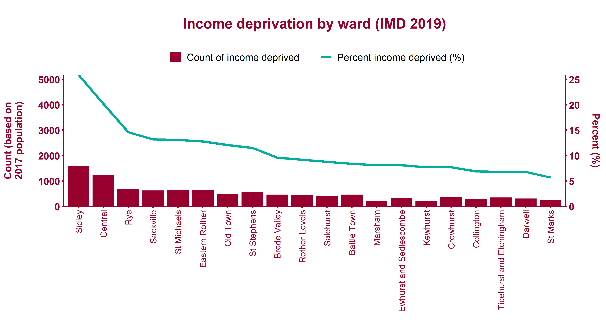
Distribution of income deprivation across Rother
Health Inequalities in Rother Version 1.1 Released Jan 2020
Notes:
English Indices of Deprivation 2019 - Income Deprivation Domain Score by ward.
Estimated count calculated by applying rate to 2017 population (persons of all ages).

Slide 7
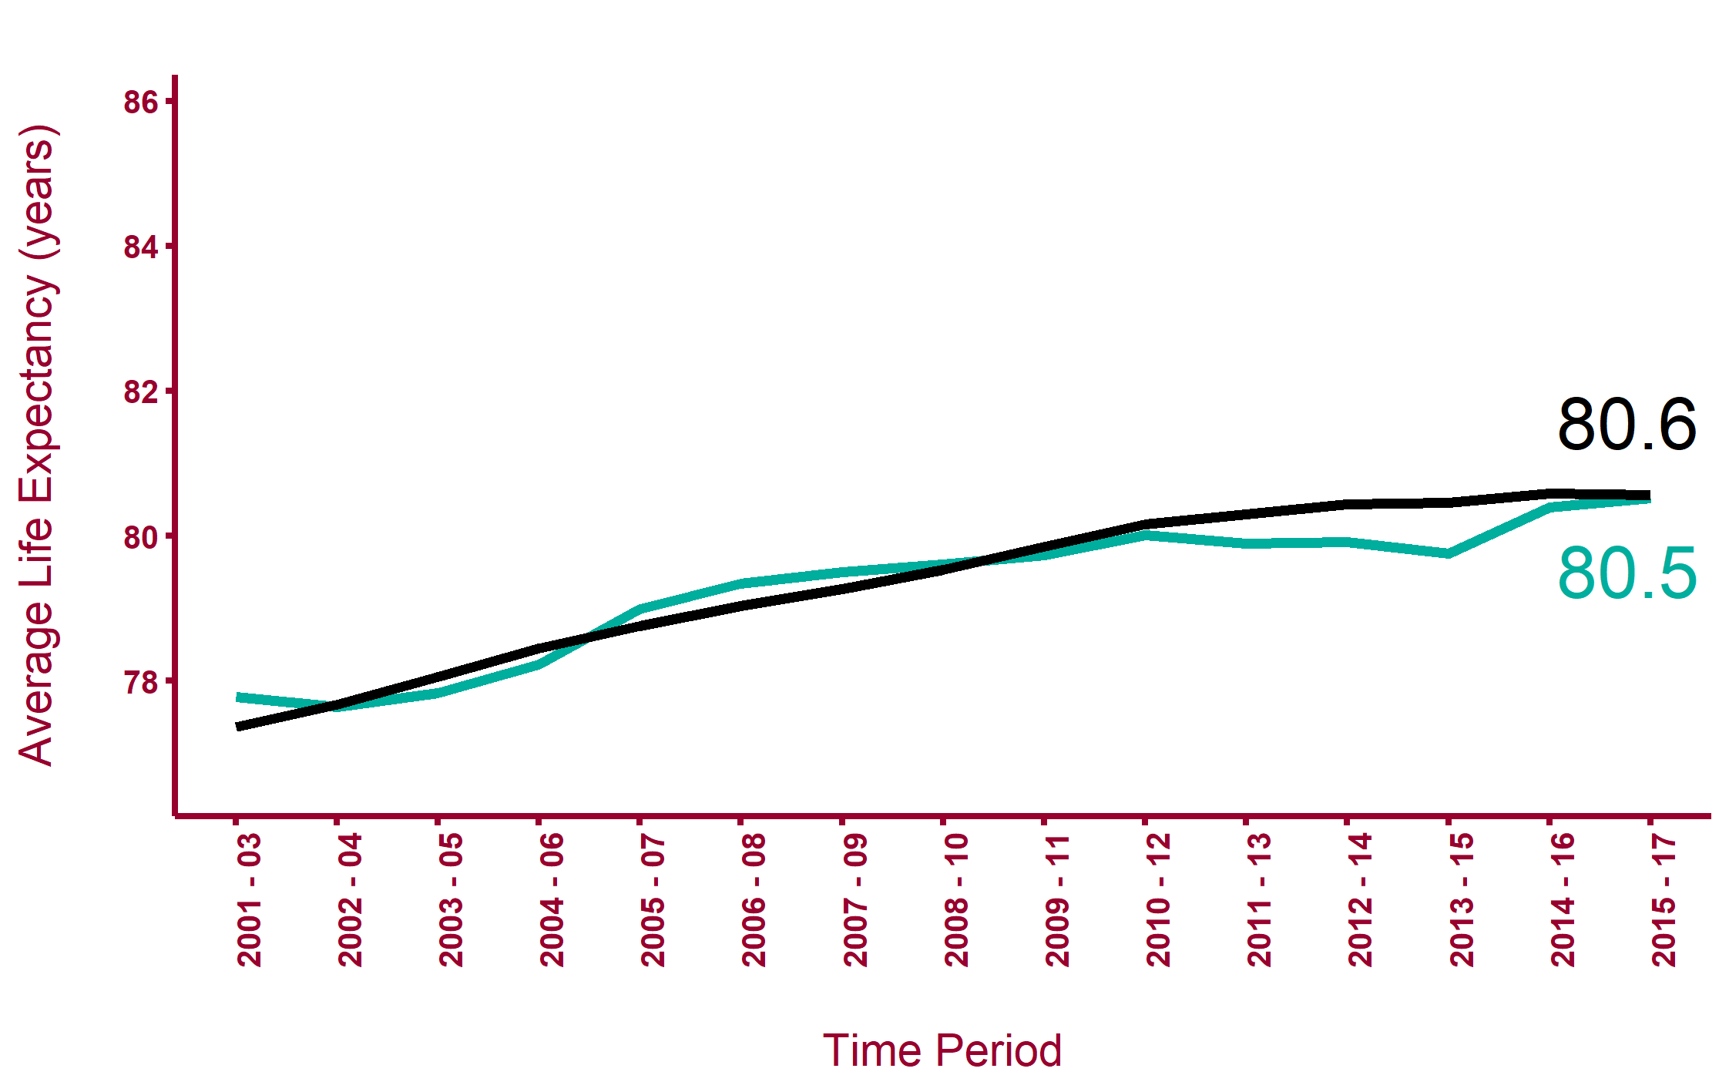

Life expectancy at birth (male)
South East
Rother
Health Inequalities in Rother Version 1.1 Released Jan 2020
Health Inequalities in Rother Version 1.1 Released Jan 2020
Notes:
Public Health England Outcome Indicator 0.1ii - Life Expectancy at birth (Males)
Local and regional average
www.phoutcomes.info

Slide 8
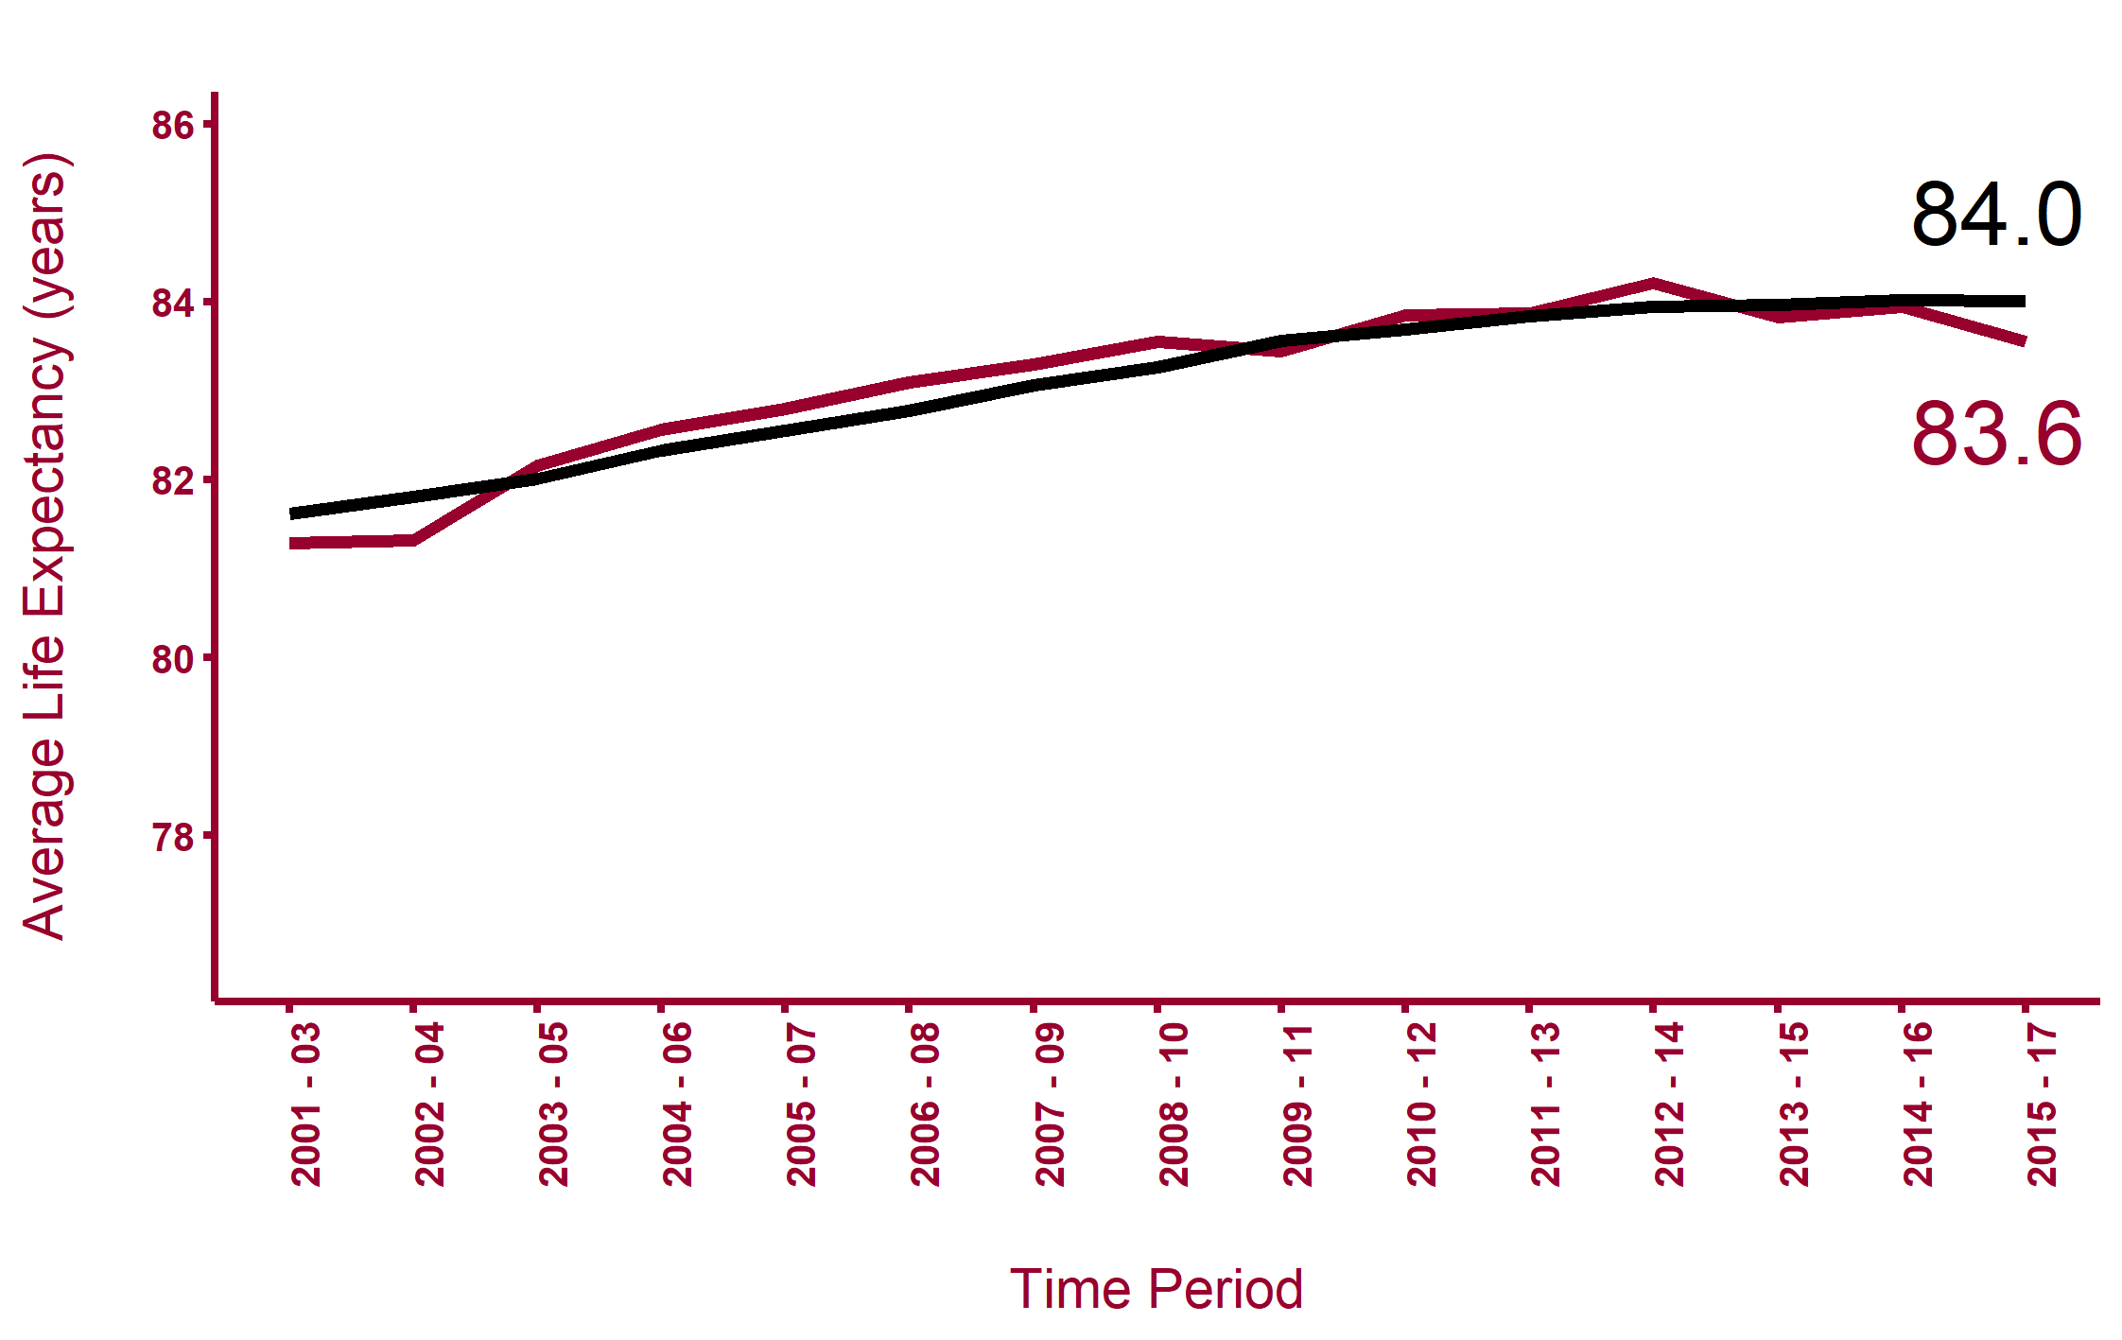

Life expectancy at birth (female)
South East
Rother
Health Inequalities in Rother Version 1.1 Released Jan 2020
Health Inequalities in Rother Version 1.1 Released Jan 2020
Notes:
Public Health England Outcome Indicator 0.1ii - Life Expectancy at birth (Females)
Local and regional average
www.phoutcomes.info

Slide 9
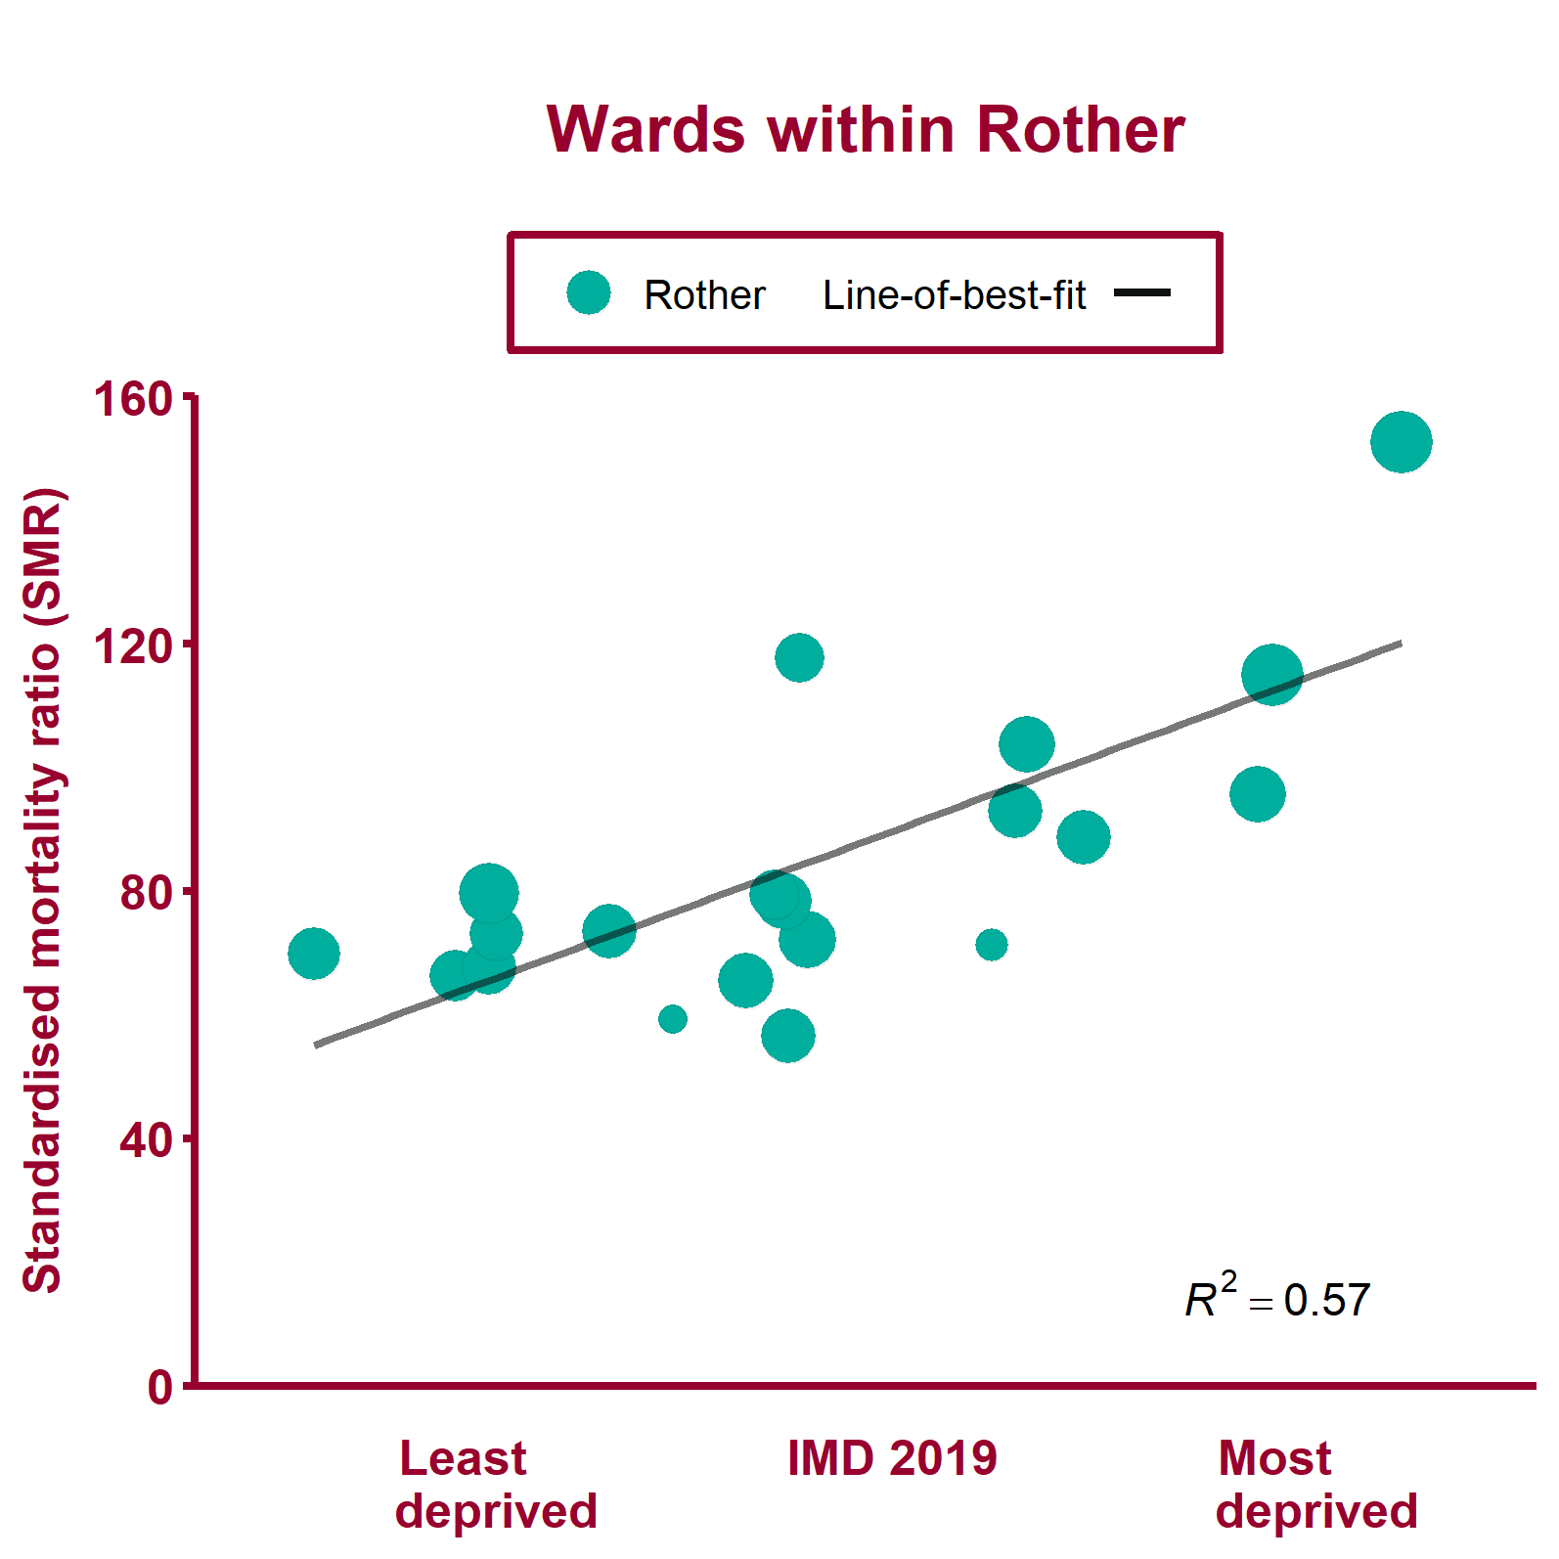
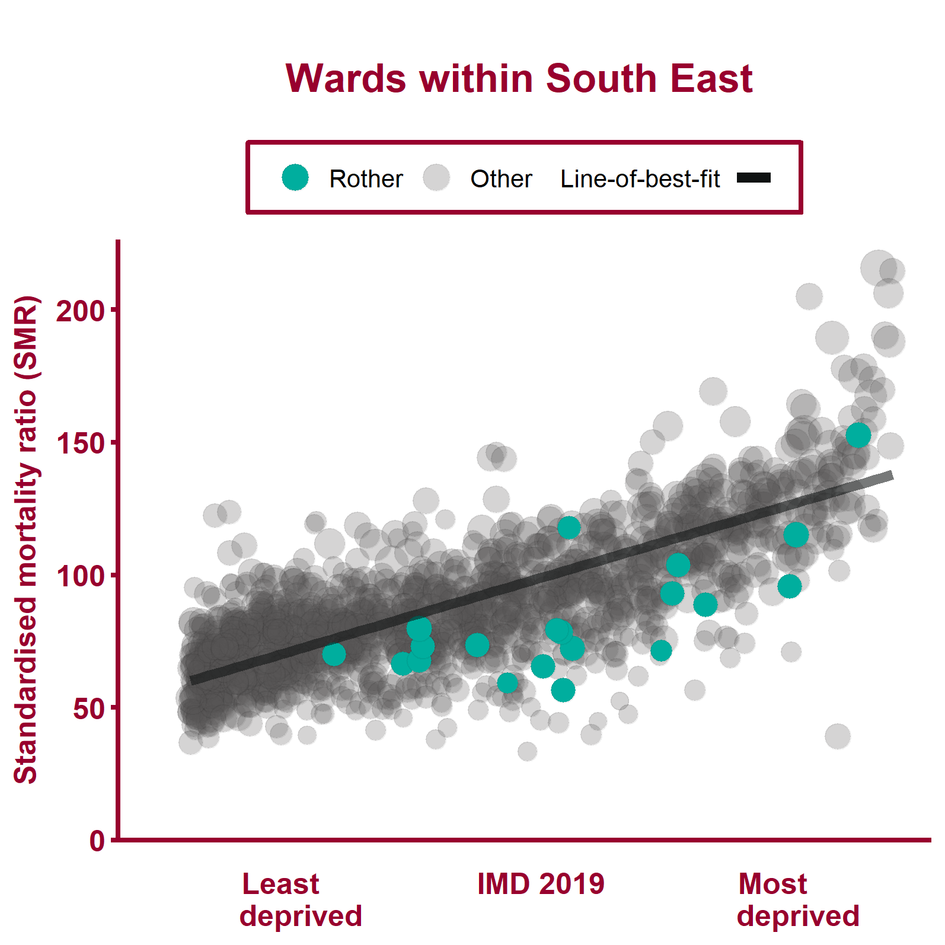
Deaths from all causes, under 75 years (2013 - 17)
Health Inequalities in Rother Version 1.1 Released Jan 2020
Notes:
Note: A different scale may be used for local data compared to regional data. The ward data points are sized according to their 2017 total population.
For metadata see Local Health tool at: www.localhealth.org.uk

Slide 10
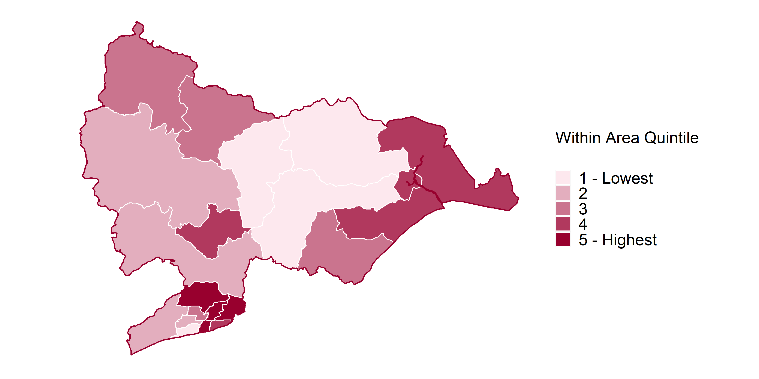
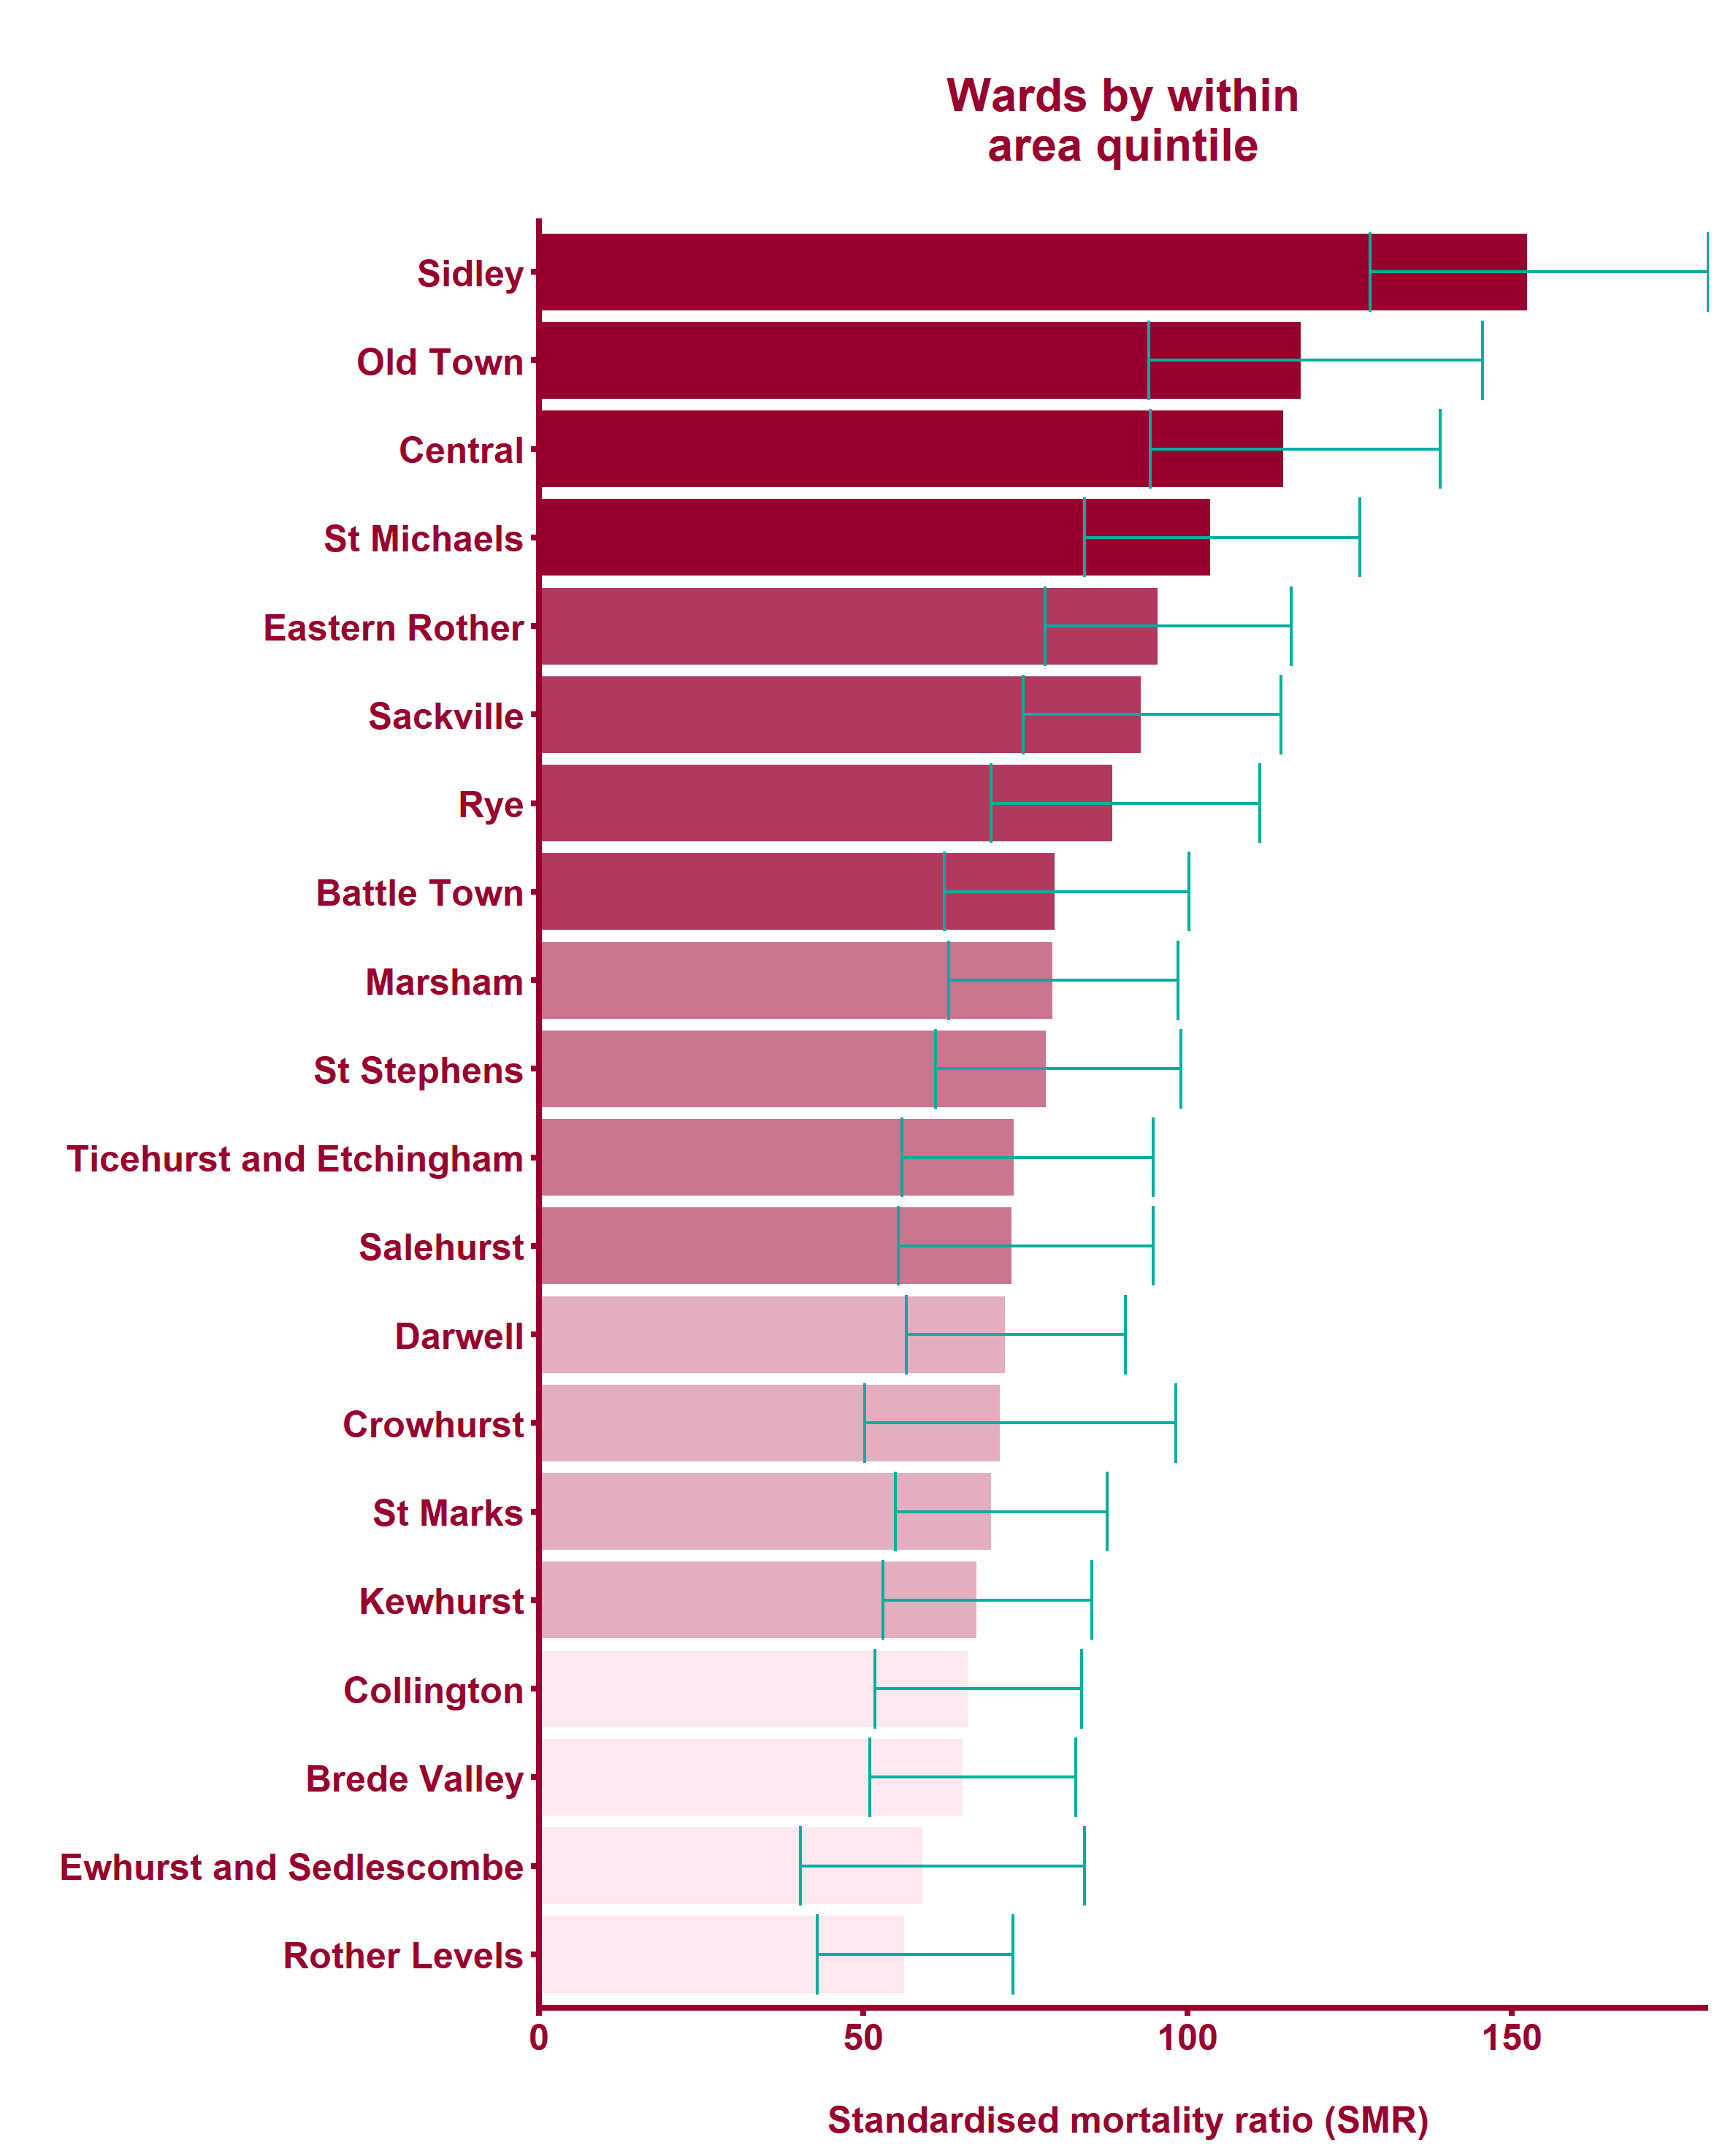
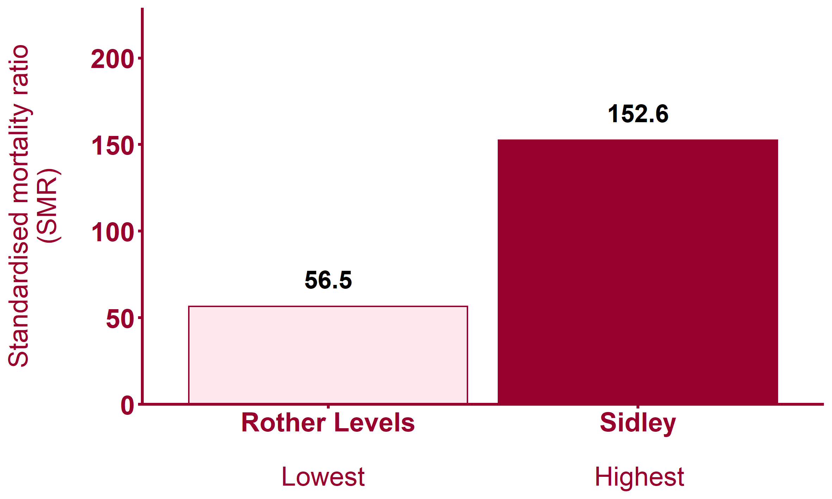
Deaths from all causes, under 75 years (2013 - 17)
Health Inequalities in Rother Version 1.1 Released Jan 2020
Notes:
Note: maps show wards shaded by within-area quintile for each indicator. Where wards are shaded yellow this indicates that the data is missing from Local Health.
For metadata see Local Health tool at: www.localhealth.org.uk

Slide 11
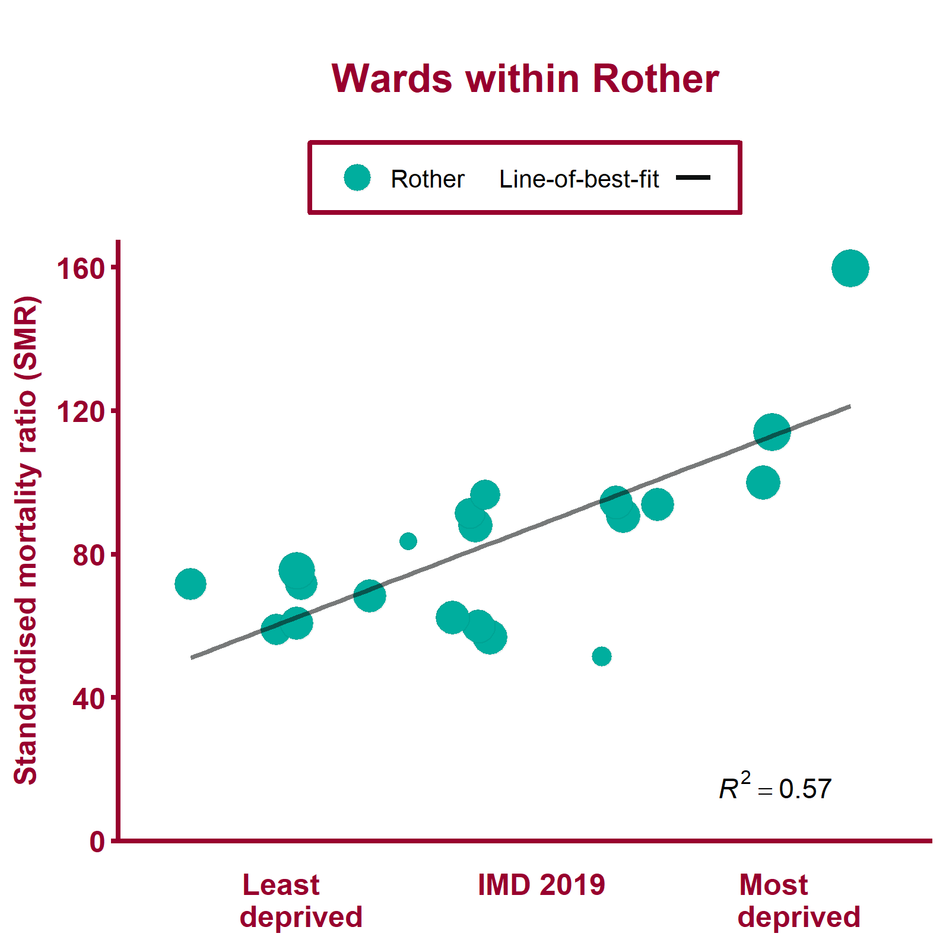
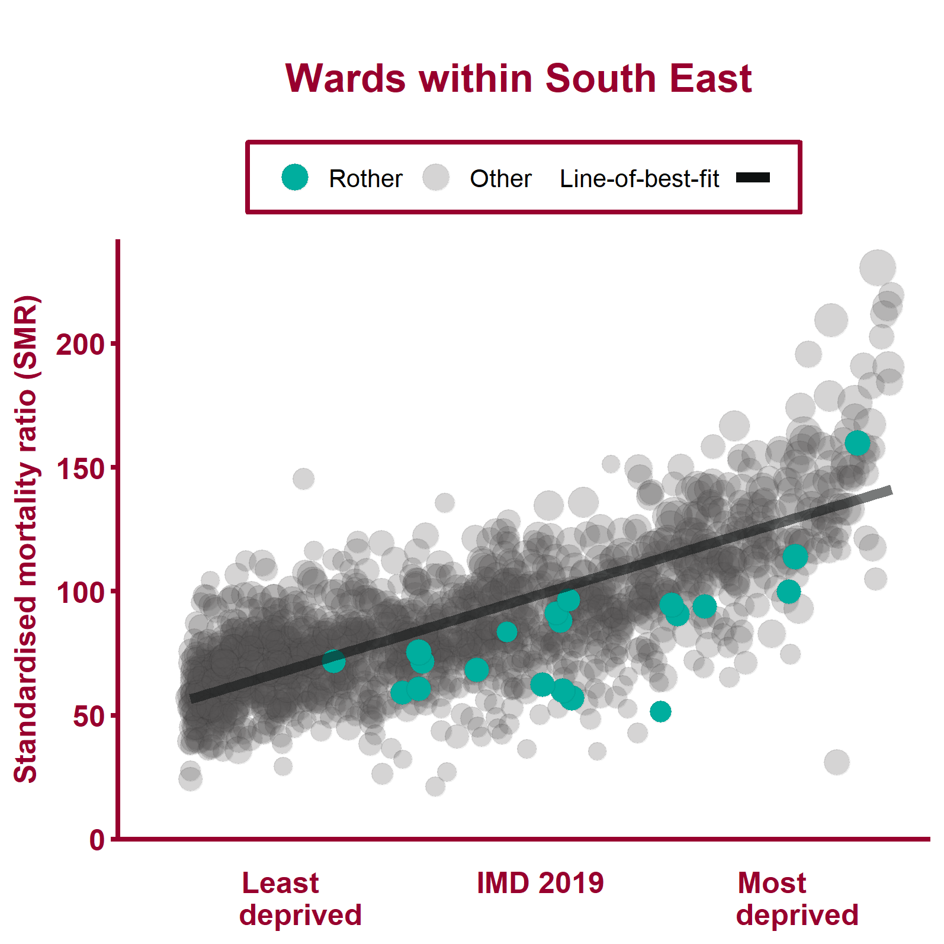
Deaths from causes considered preventable, all ages (2013 - 17)
Health Inequalities in Rother Version 1.1 Released Jan 2020
Notes:
Note: A different scale may be used for local data compared to regional data. The ward data points are sized according to their 2017 total population.
For metadata see Local Health tool at: www.localhealth.org.uk

Slide 12
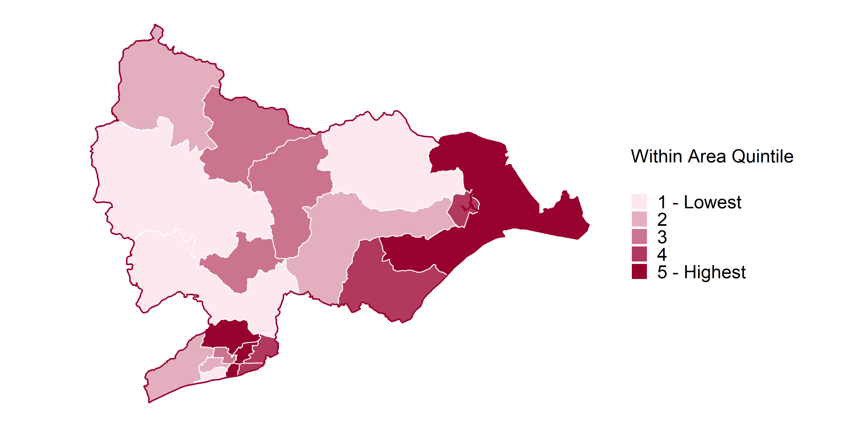
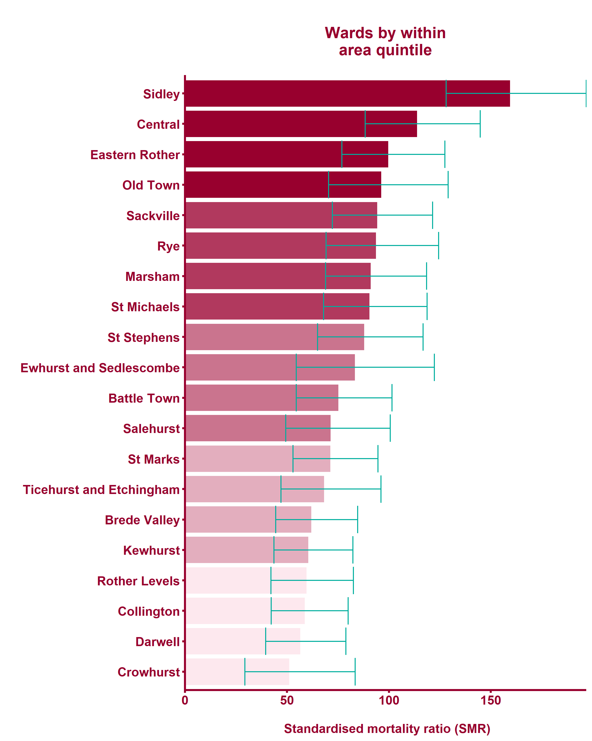
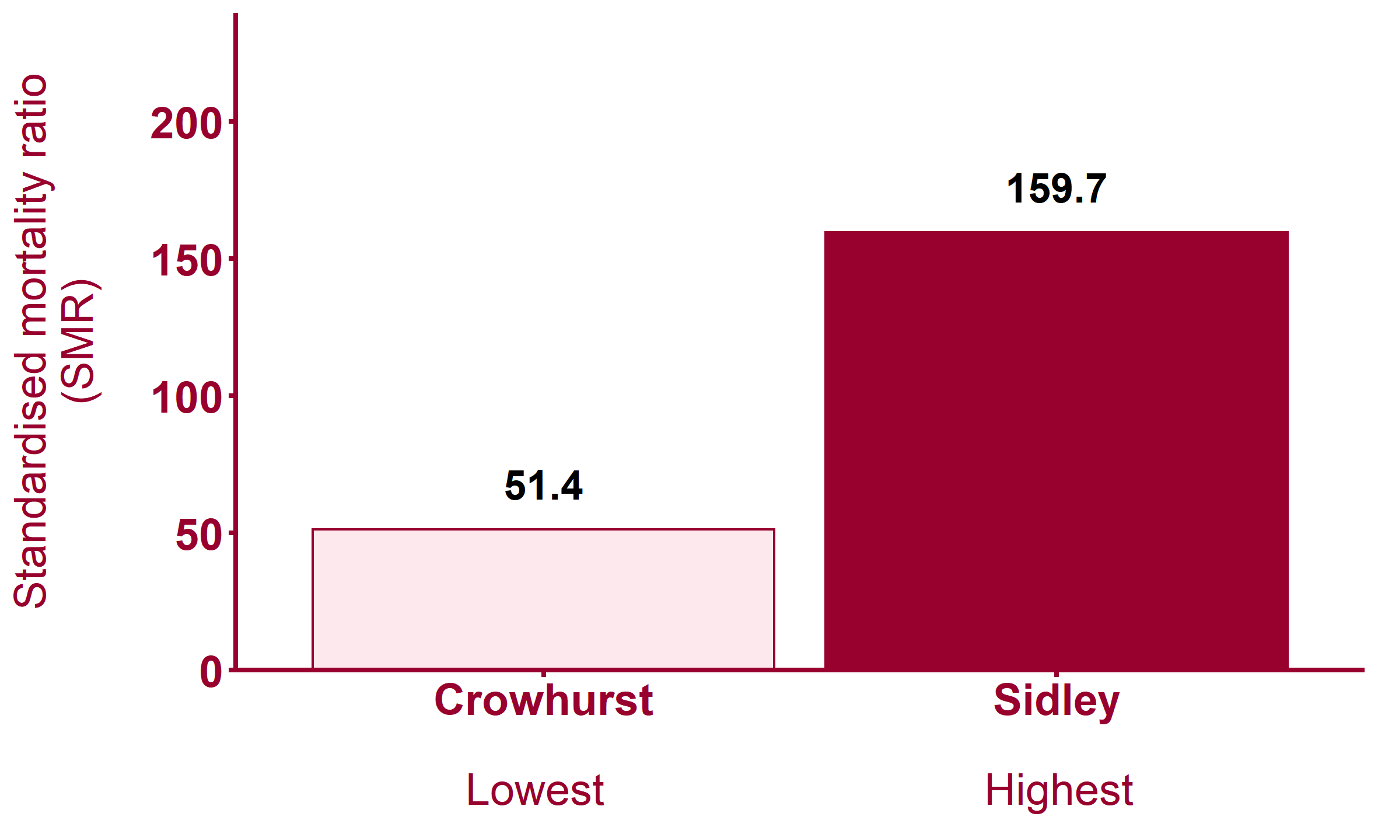
Deaths from causes considered preventable, all ages (2013 - 17)
Health Inequalities in Rother Version 1.1 Released Jan 2020
Notes:
Note: maps show wards shaded by within-area quintile for each indicator. Where wards are shaded yellow this indicates that the data is missing from Local Health.
For metadata see Local Health tool at: www.localhealth.org.uk

Slide 13
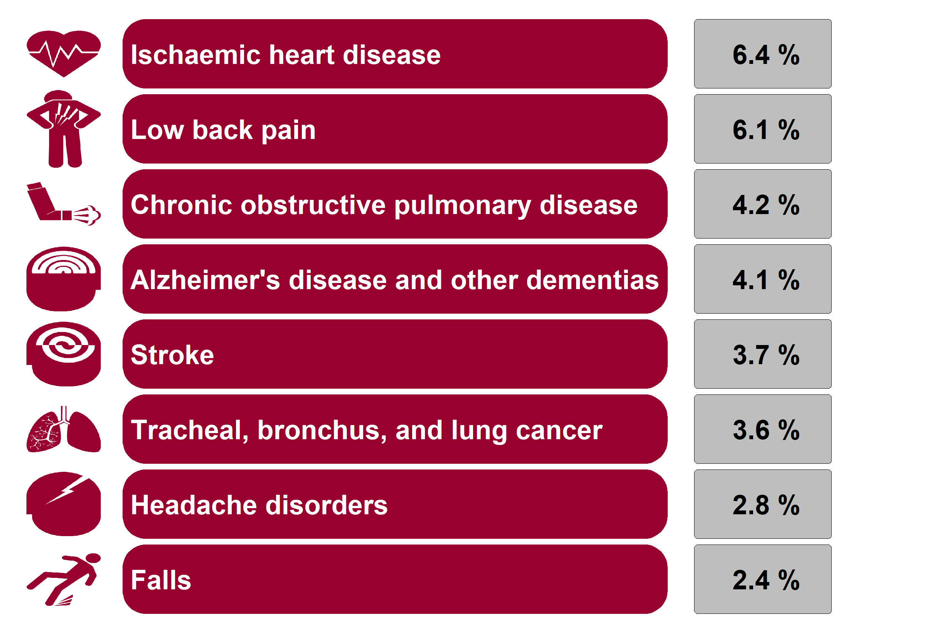
GBD cause: Rother
Causes ranked by percentage of total disability-adjusted life years
Health Inequalities in Rother Version 1.1 Released Jan 2020
Notes:
Global Burden of Disease (GBD) is a tool which can be used to quantify health loss from hundreds of diseases, injuries, and risk factors, so that health systems can be improved and disparities can be eliminated.See http://www.healthdata.org/gbd/about.
This slide lists the top 8 conditions in this unitary authority (or the top 8 conditions in the county for county districts) as measured by disability-adjusted life years (DALYs).
DALYs is a measure that includes the burden of both deaths (years of life lost) and illness (years lived with a disability). See http://www.healthdata.org/gbd/data-visualizations.

Slide 14
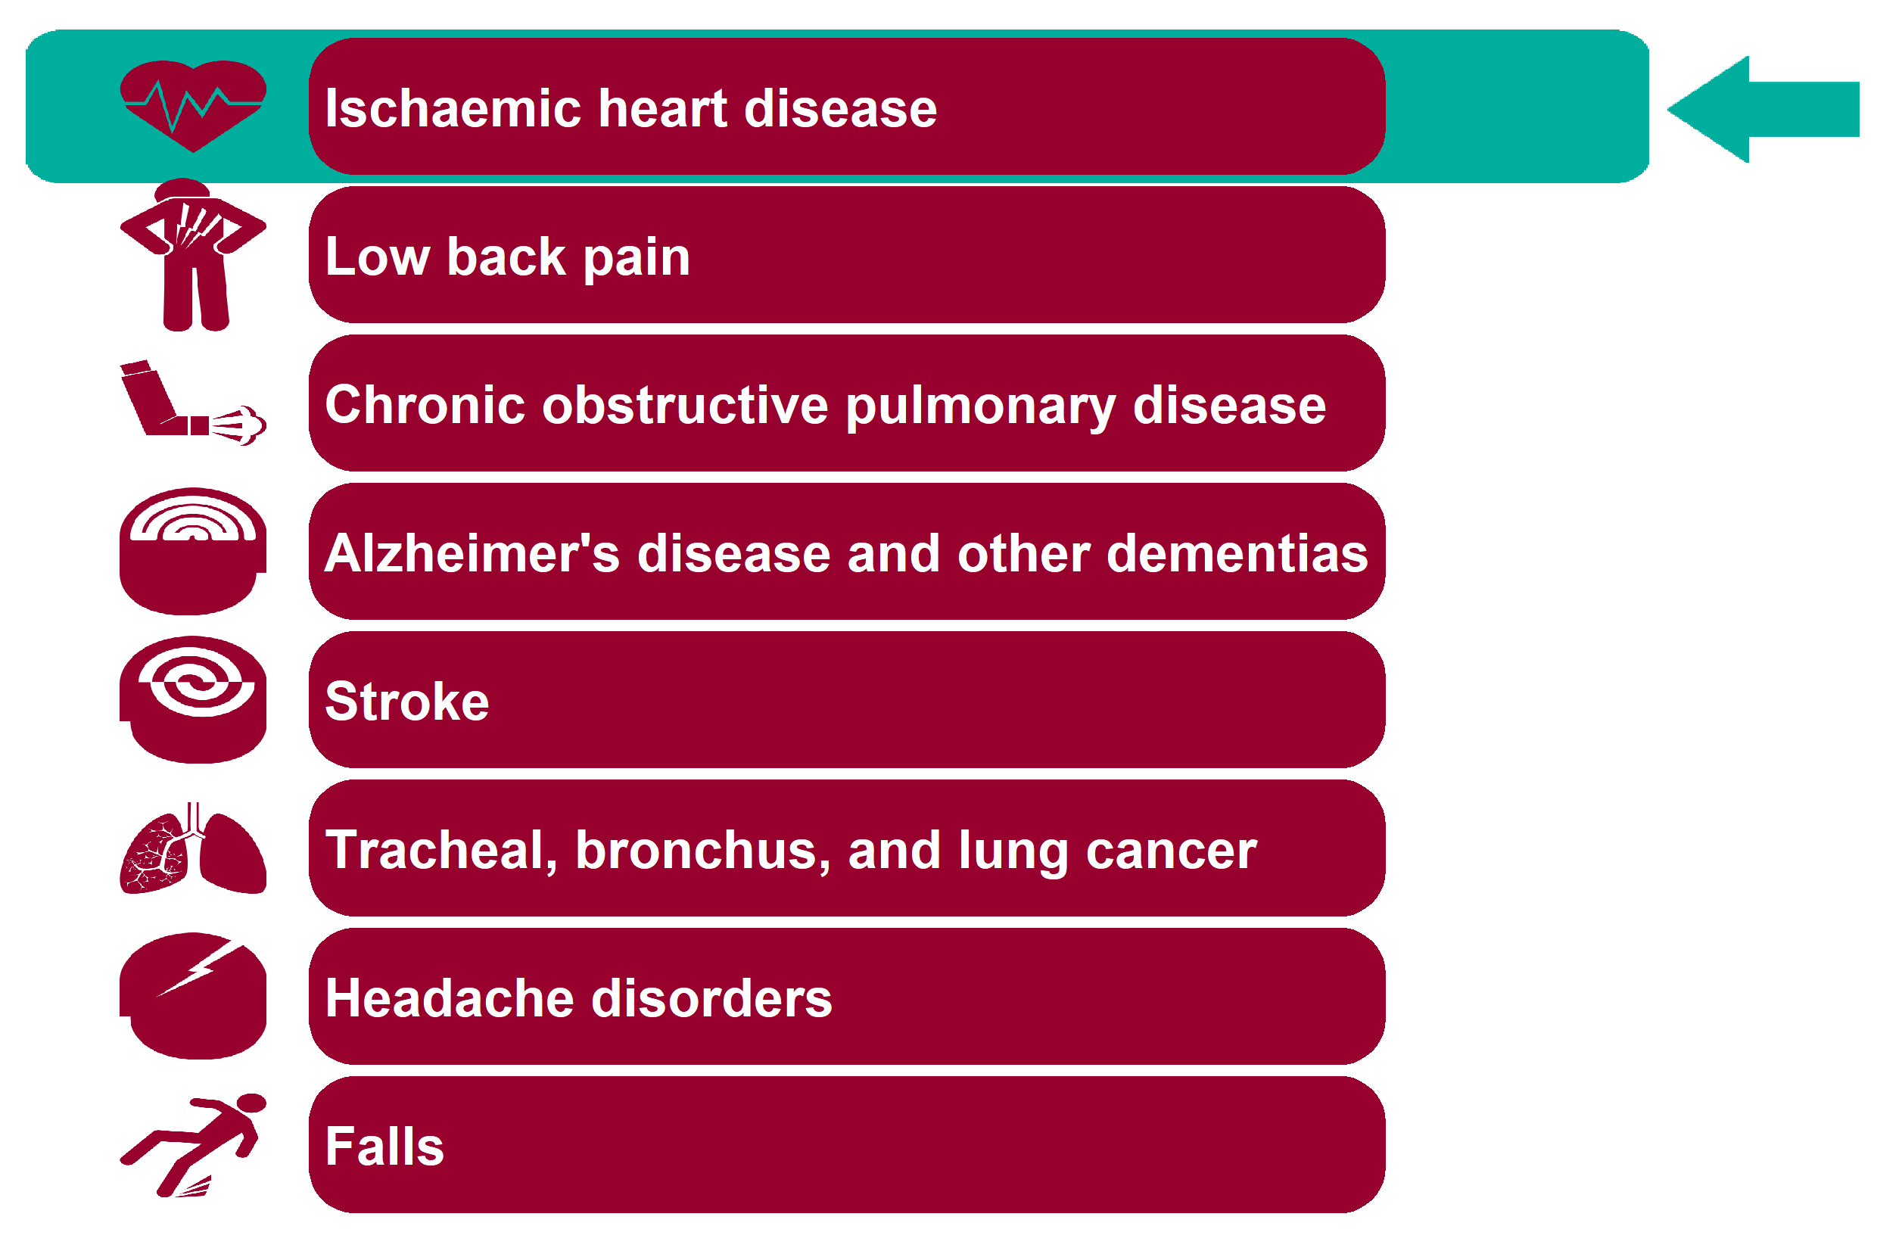
Global Burden of Disease: Ischaemic heart disease
Health Inequalities in Rother Version 1.1 Released Jan 2020

Slide 15
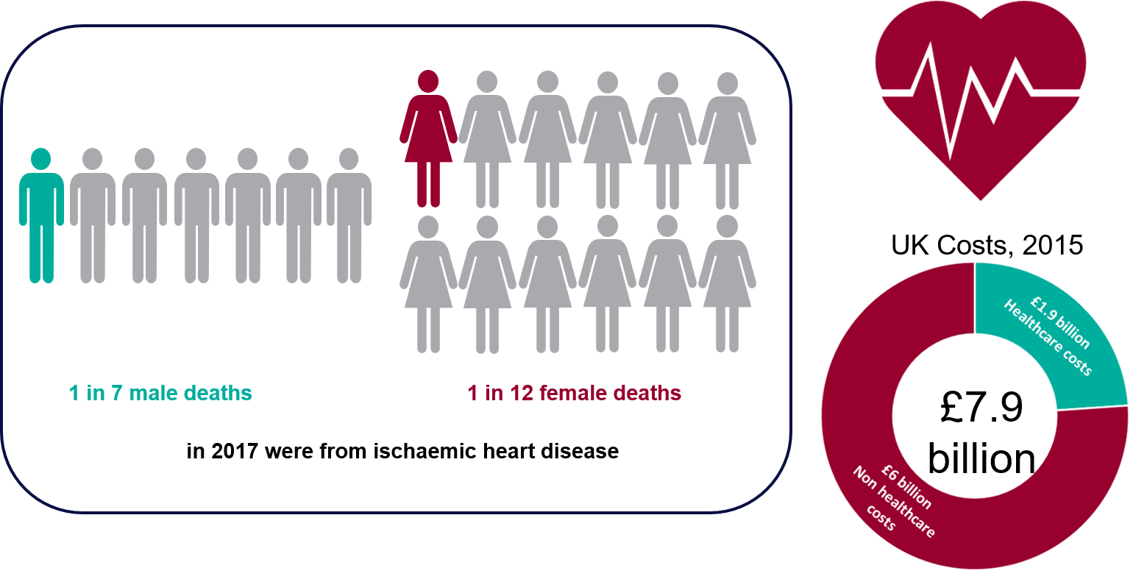
Ischaemic heart disease - National picture
Health Inequalities in Rother Version 1.1 Released Jan 2020
Notes:
Of the 496,310 deaths in England in 2017, 13.7% male deaths and 8.1% female deaths had an underlying cause of death recorded as Ischaemic heart disease (ICD10 I20-I25) in 2017.
Source: ONS Annual Death registration extracts, 2017.
£7.9 billion IHD costs for UK in 2015. Non healthcare costs include production losses due to mortality/morbidity and informal care costs.
Source: European Cardiovascular Disease Statistics, 2017 edition.
http://www.ehnheart.org/images/CVD-statistics-report-August-2017.pdf

Slide 16
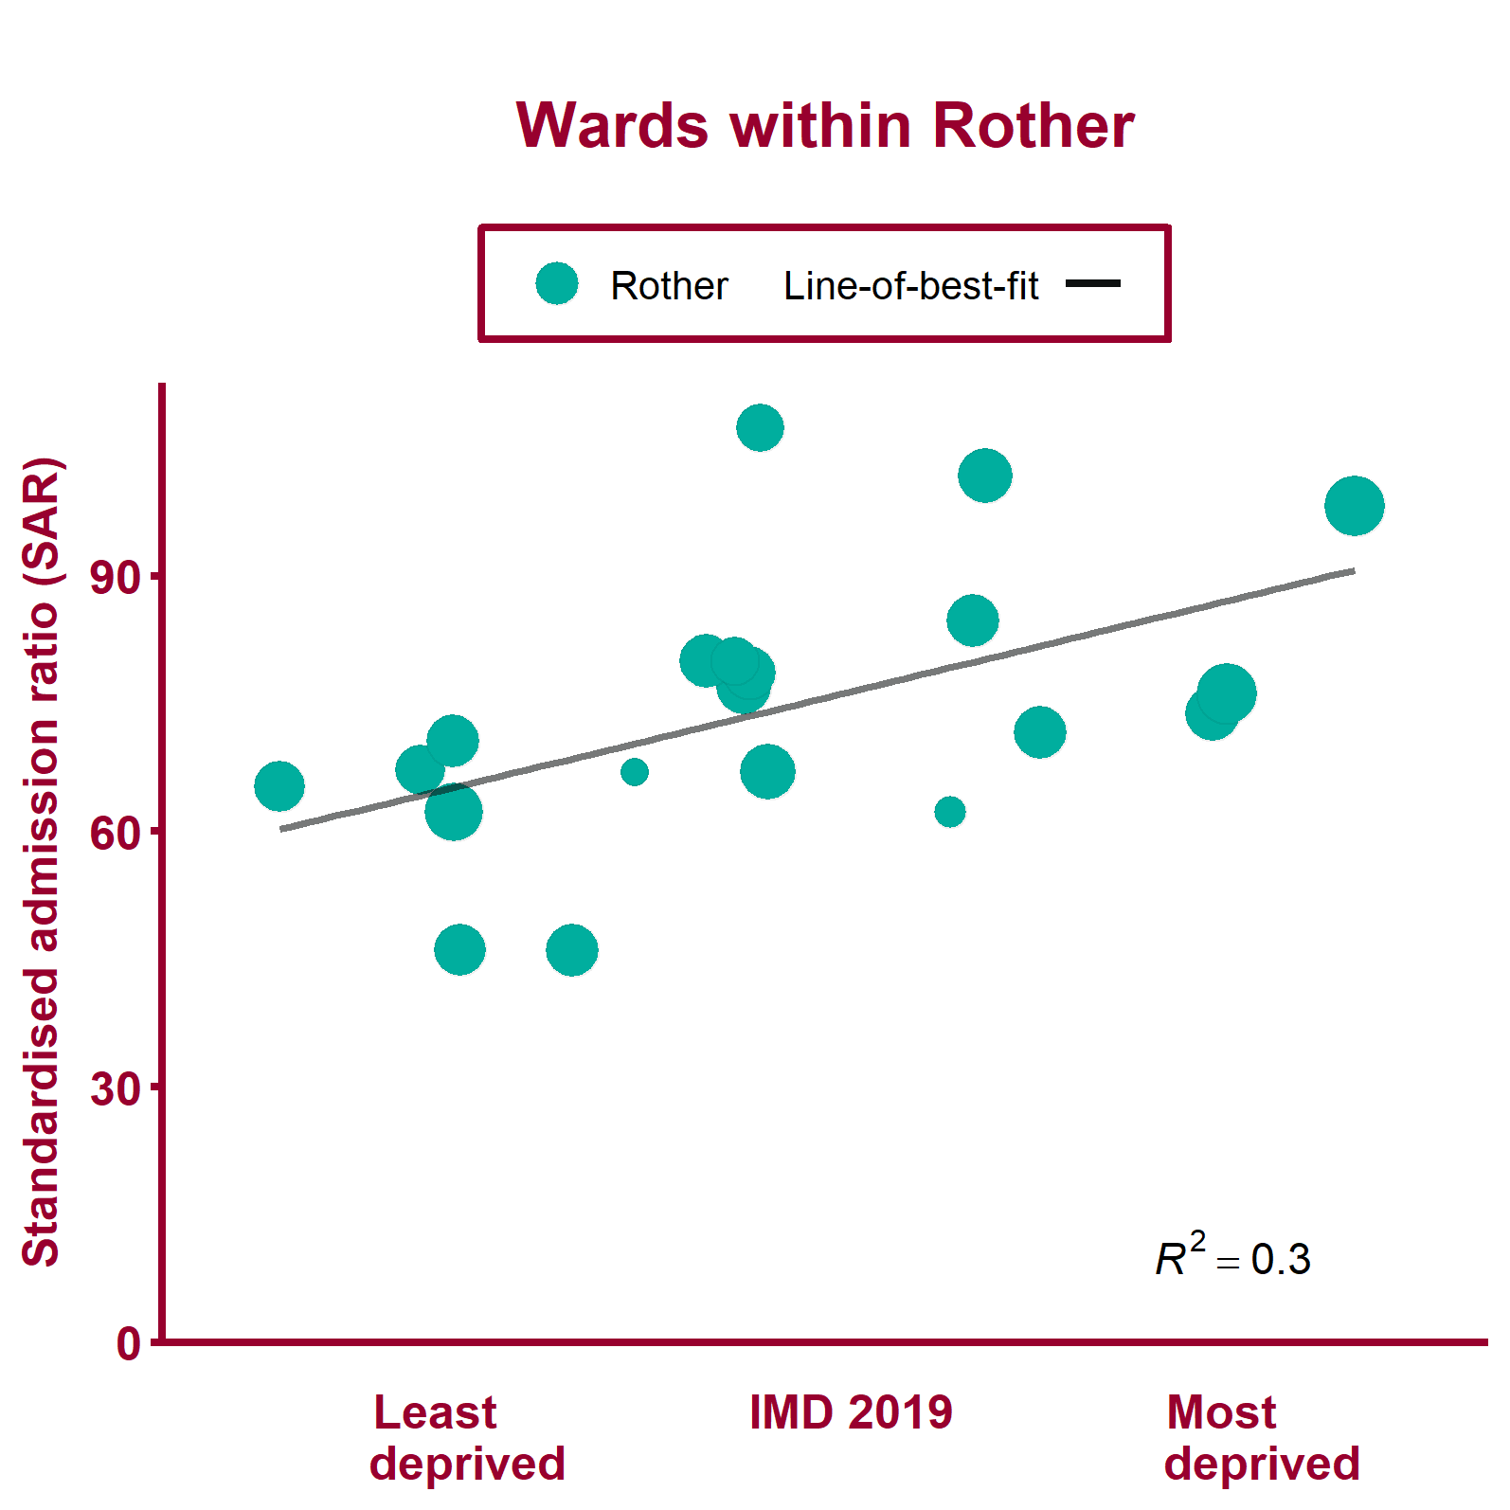
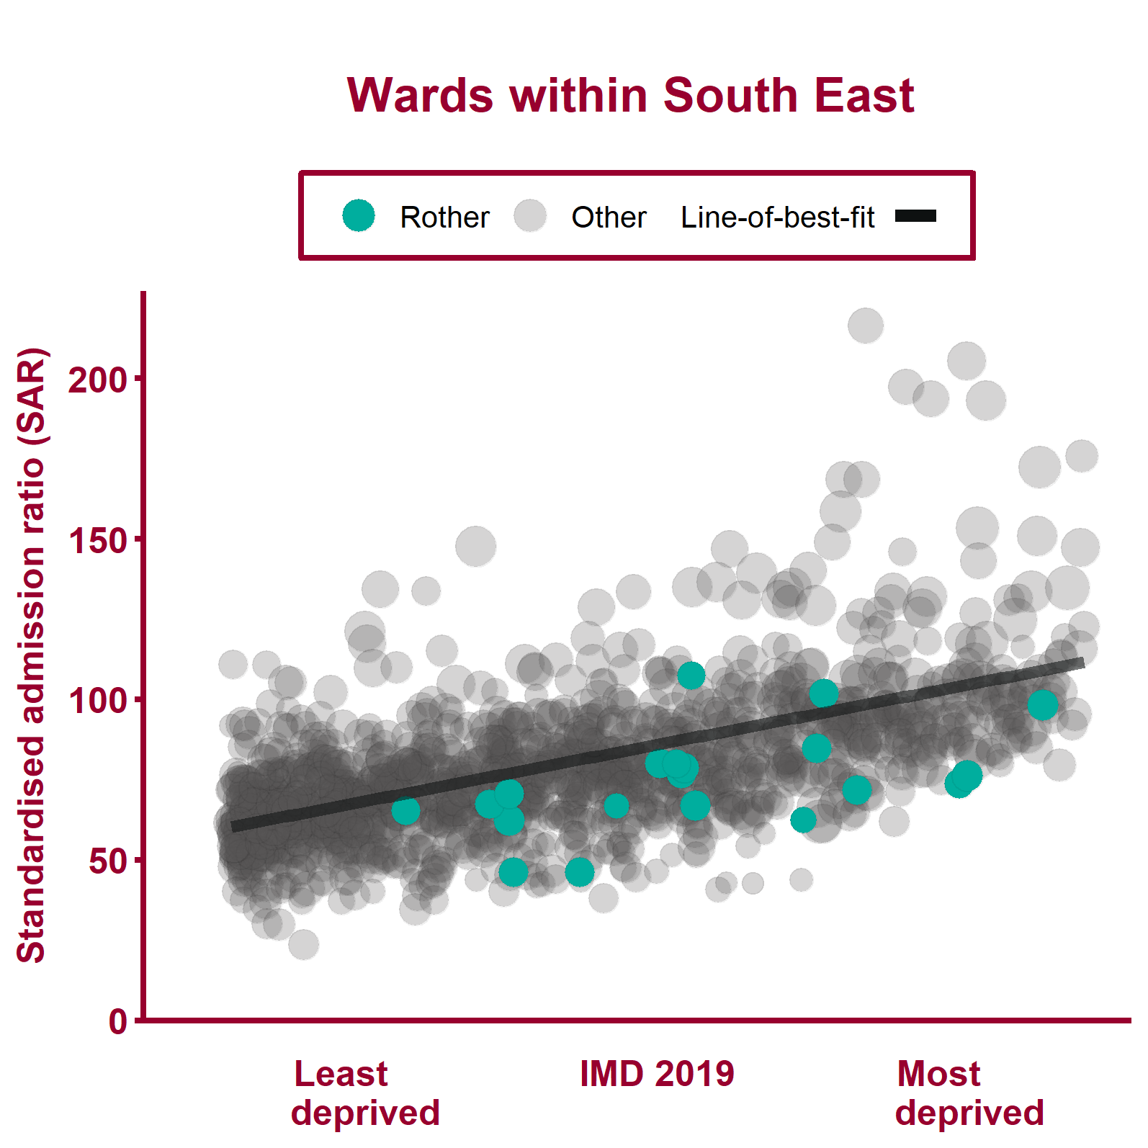
Emergency hospital admissions for CHD (2013/14 - 2017/18)
Health Inequalities in Rother Version 1.1 Released Jan 2020
Notes:
Note: A different scale may be used for local data compared to regional data. The ward data points are sized according to their 2017 total population.
For metadata see Local Health tool at: www.localhealth.org.uk

Slide 17
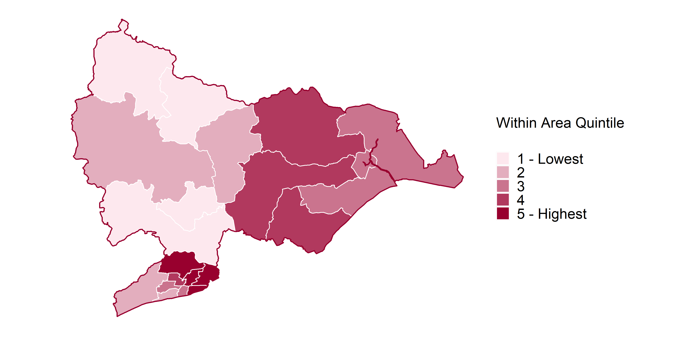
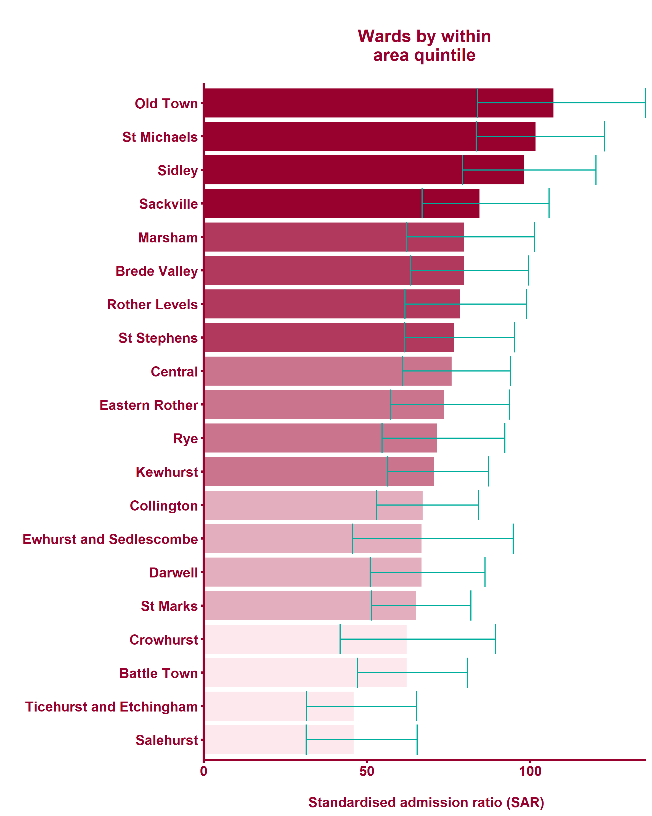
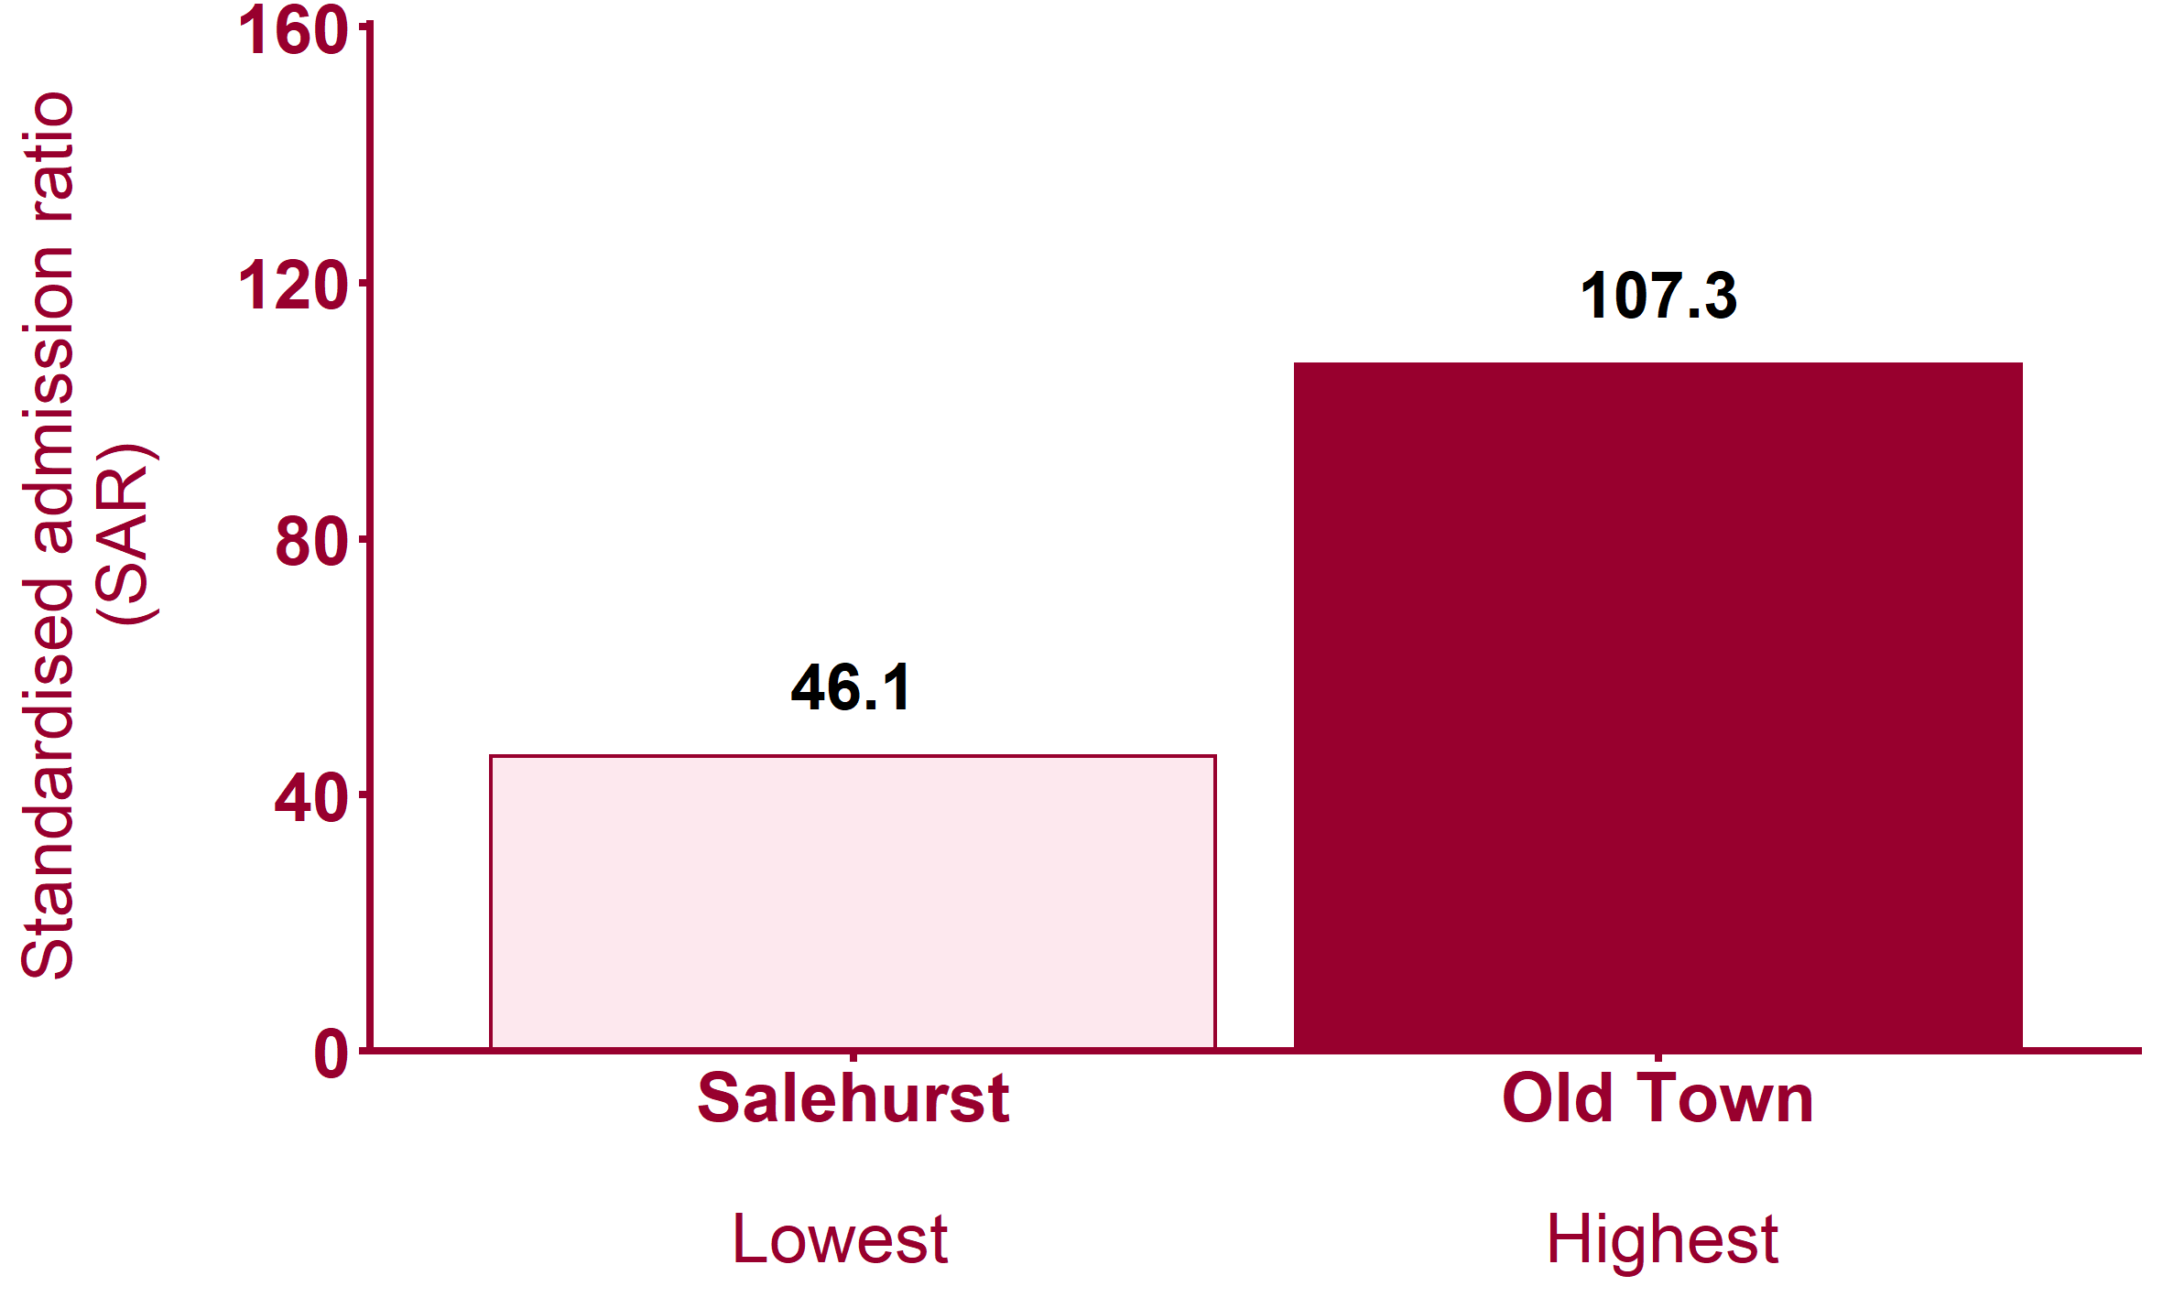
Emergency hospital admissions for CHD (2013/14 - 2017/18)
Health Inequalities in Rother Version 1.1 Released Jan 2020
Notes:
Note: maps show wards shaded by within-area quintile for each indicator. Where wards are shaded yellow this indicates that the data is missing from Local Health.
For metadata see Local Health tool at: www.localhealth.org.uk

Slide 18
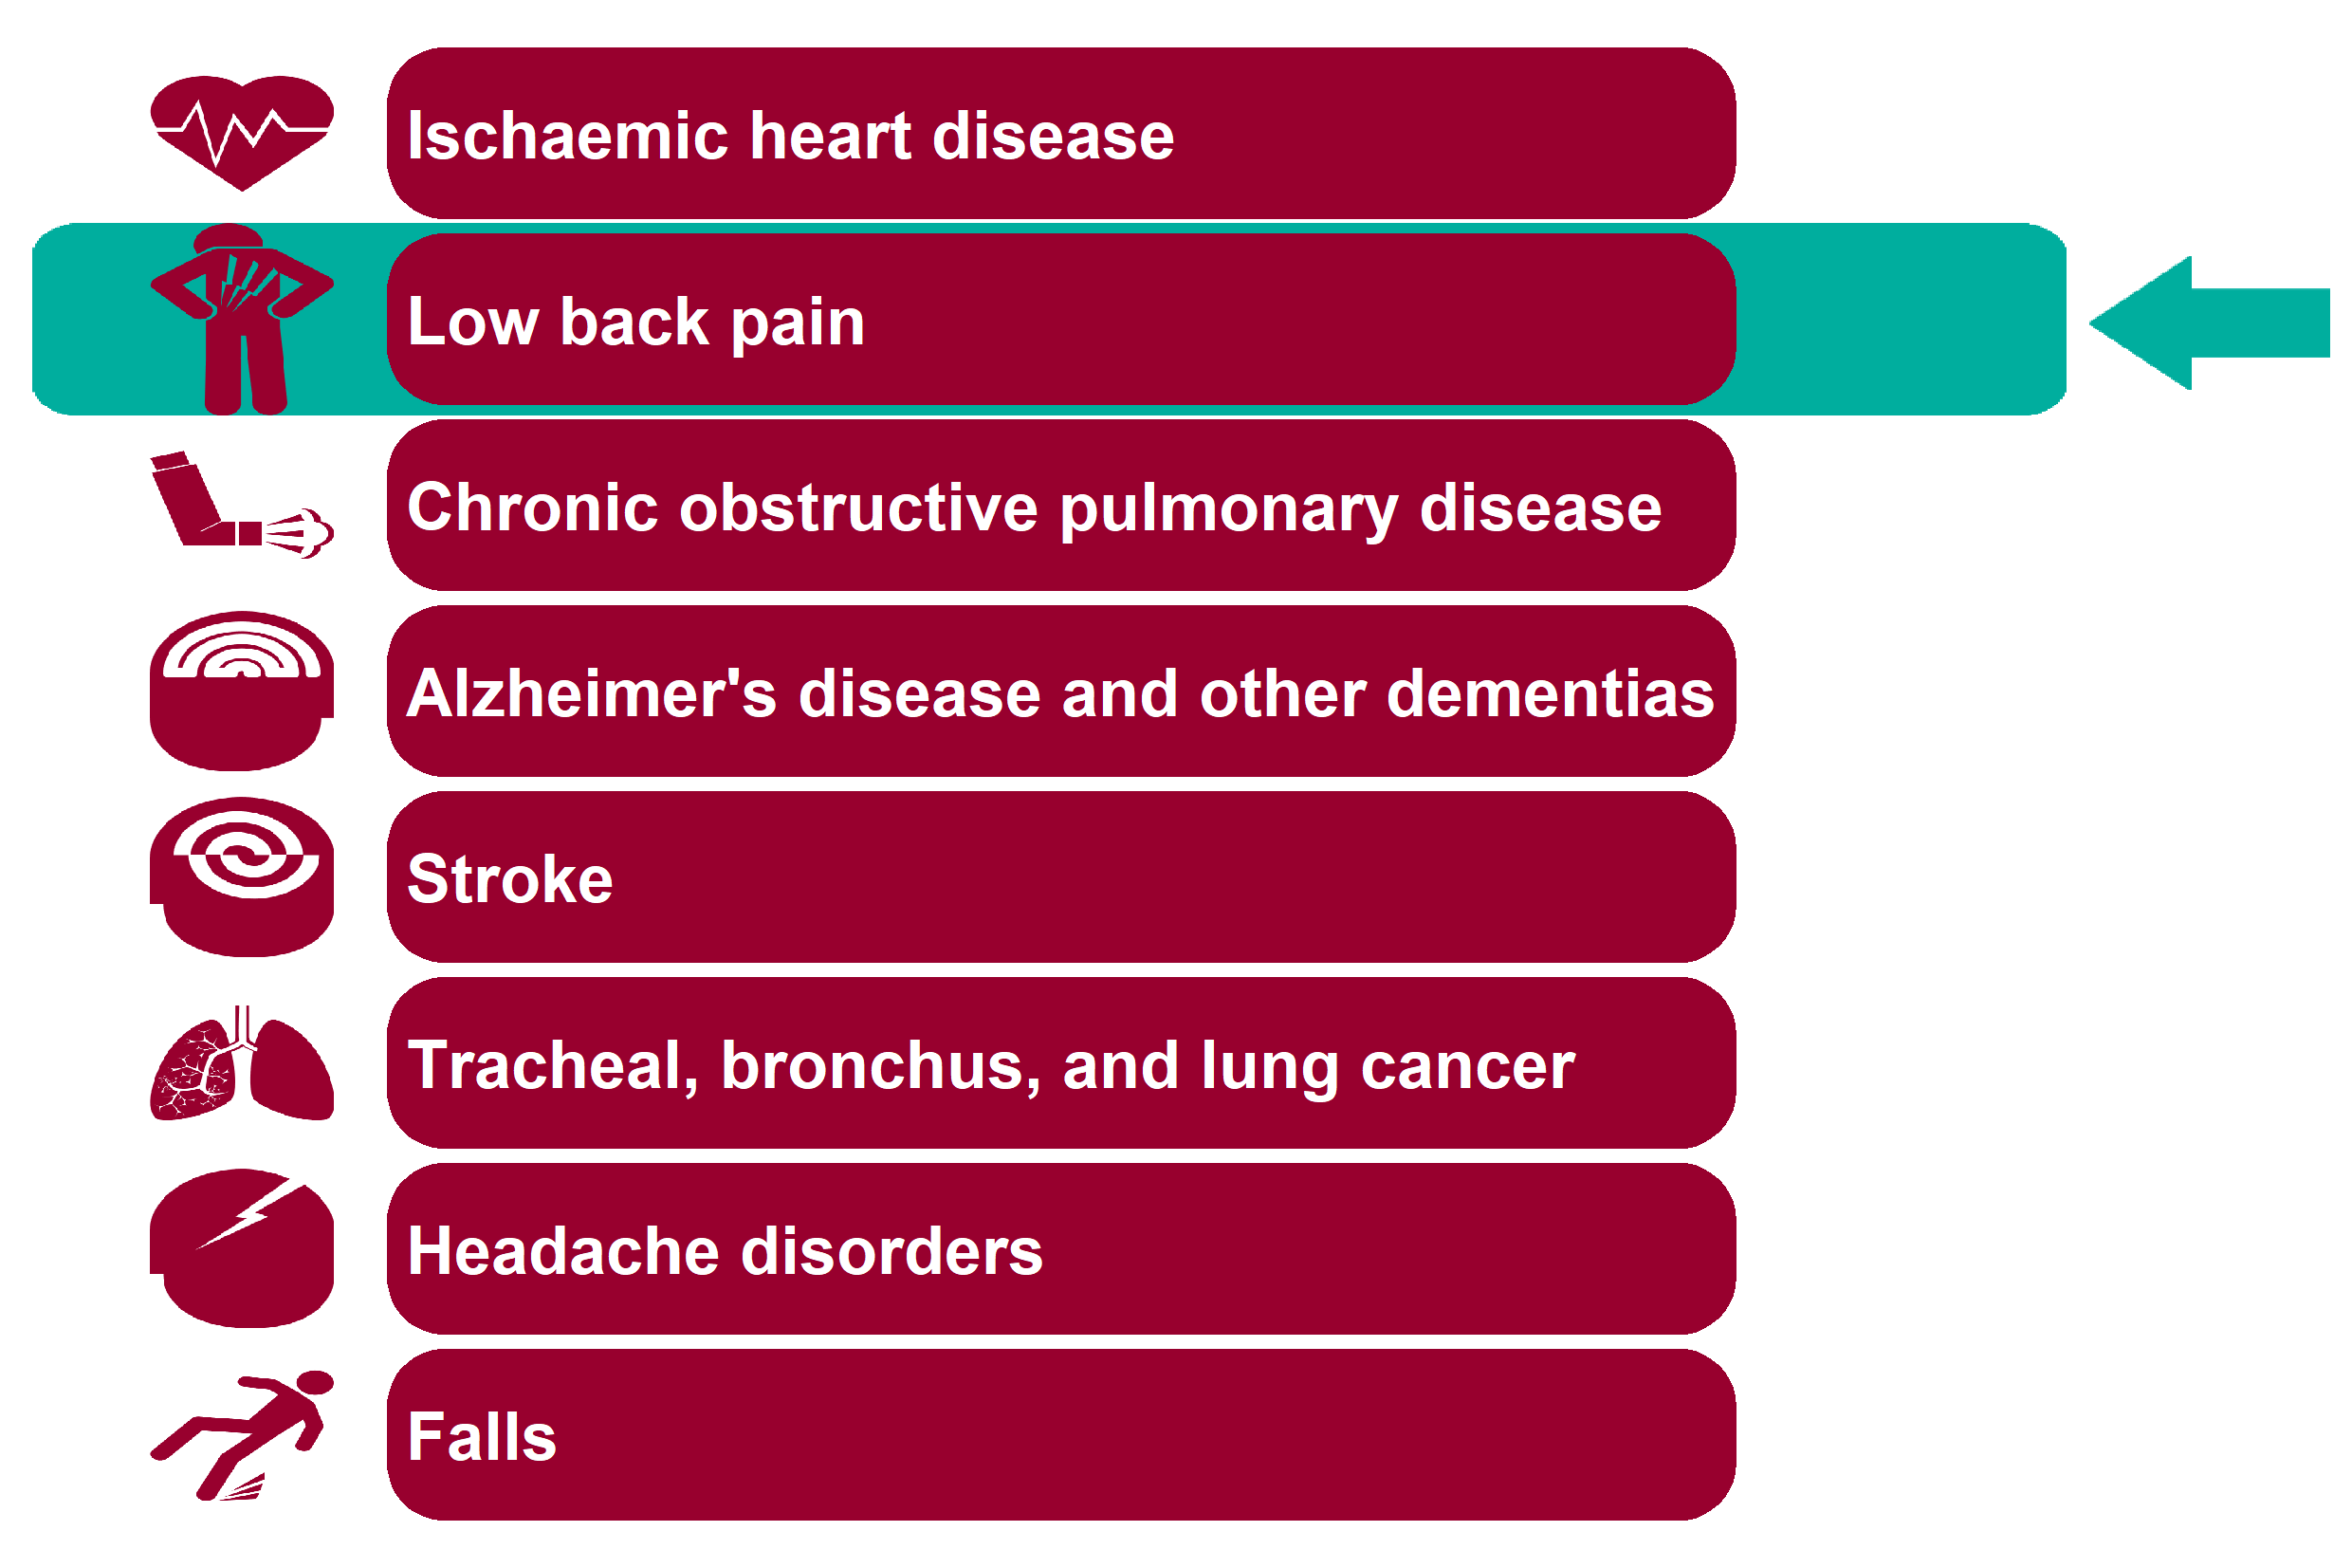
Global Burden of Disease: Low back pain
Health Inequalities in Rother Version 1.1 Released Jan 2020

Slide 19
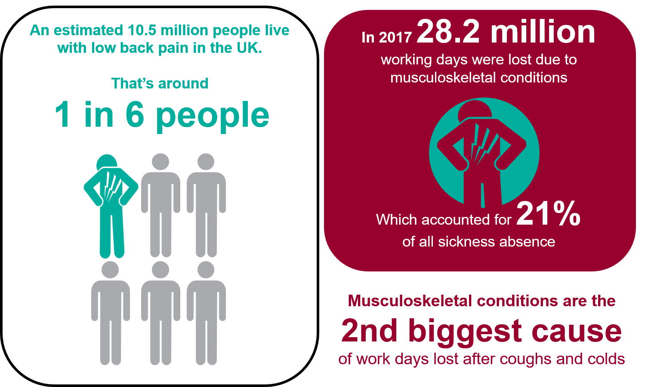
Low back pain - National picture
Health Inequalities in Rother Version 1.1 Released Jan 2020
Notes:
An estimated 10.5 million people live with low back pain in the UK. That's around 15.7% of the total population. (UK, 2017; Global Burden of Disease Collaborative Network. 'Global Burden of Disease Study 2017 (GBD 2017) Results'. Institute for Health Metrics and Evaluation (IHME). Seattle, 2019).
In 2017 over 28.2 million working days are lost due to MSK conditions (UK, 2017; Source: ONS Labour Force Survey).
That accounts for 21% of sickness absence (UK, 2017; Source: ONS Labour Force Survey).
MSK 2nd biggest cause of days lost in work after coughs and colds (UK, 2017; Source: ONS Labour Force Survey).

Slide 20
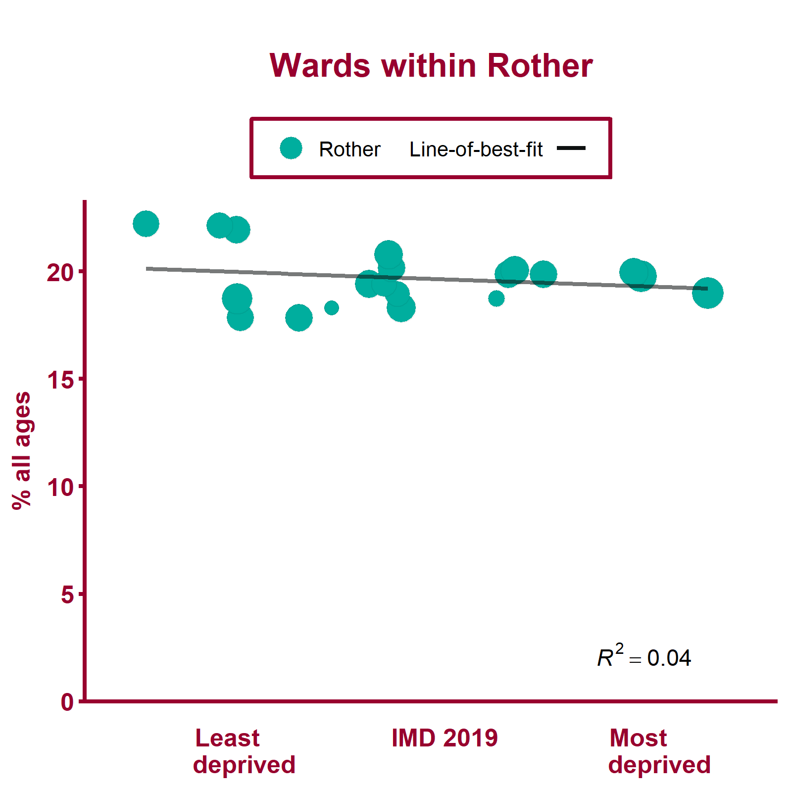
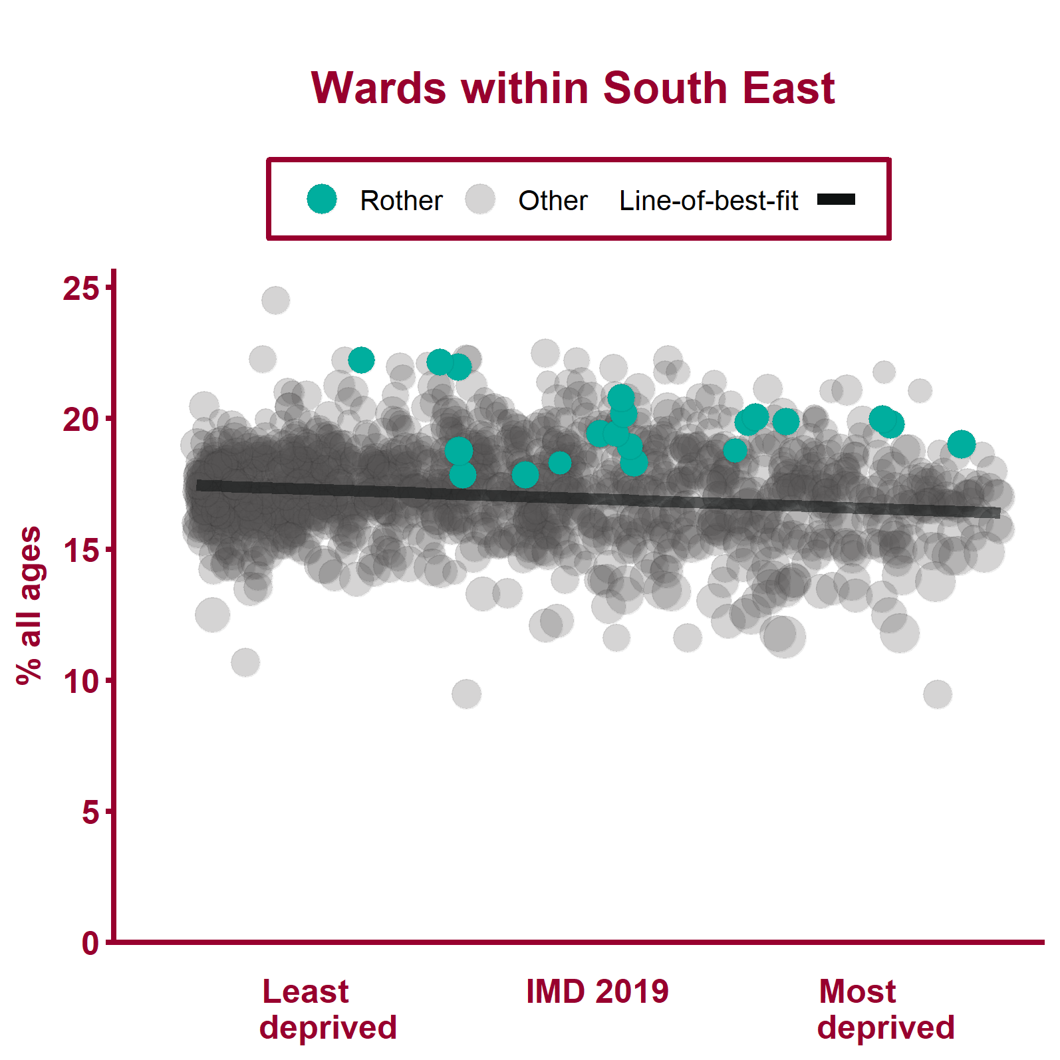
Modelled back pain prevalence (2012)
Health Inequalities in Rother Version 1.1 Released Jan 2020
Notes:
Note: A different scale may be used for local data compared to regional data. The ward data points are sized according to their 2017 total population.
For metadata see Local Health tool at: www.localhealth.org.uk

Slide 21
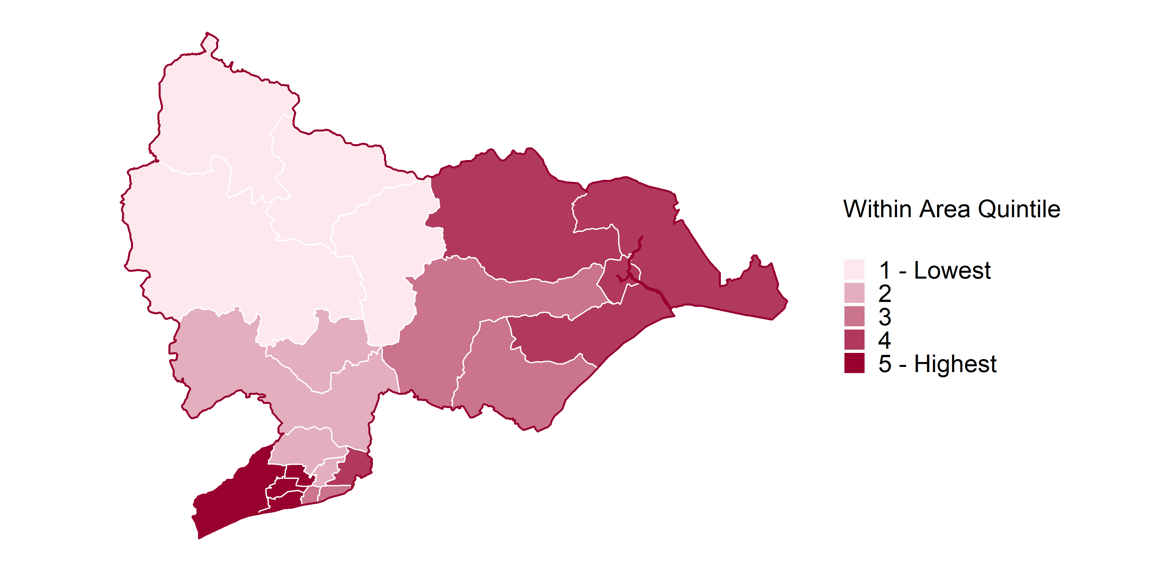
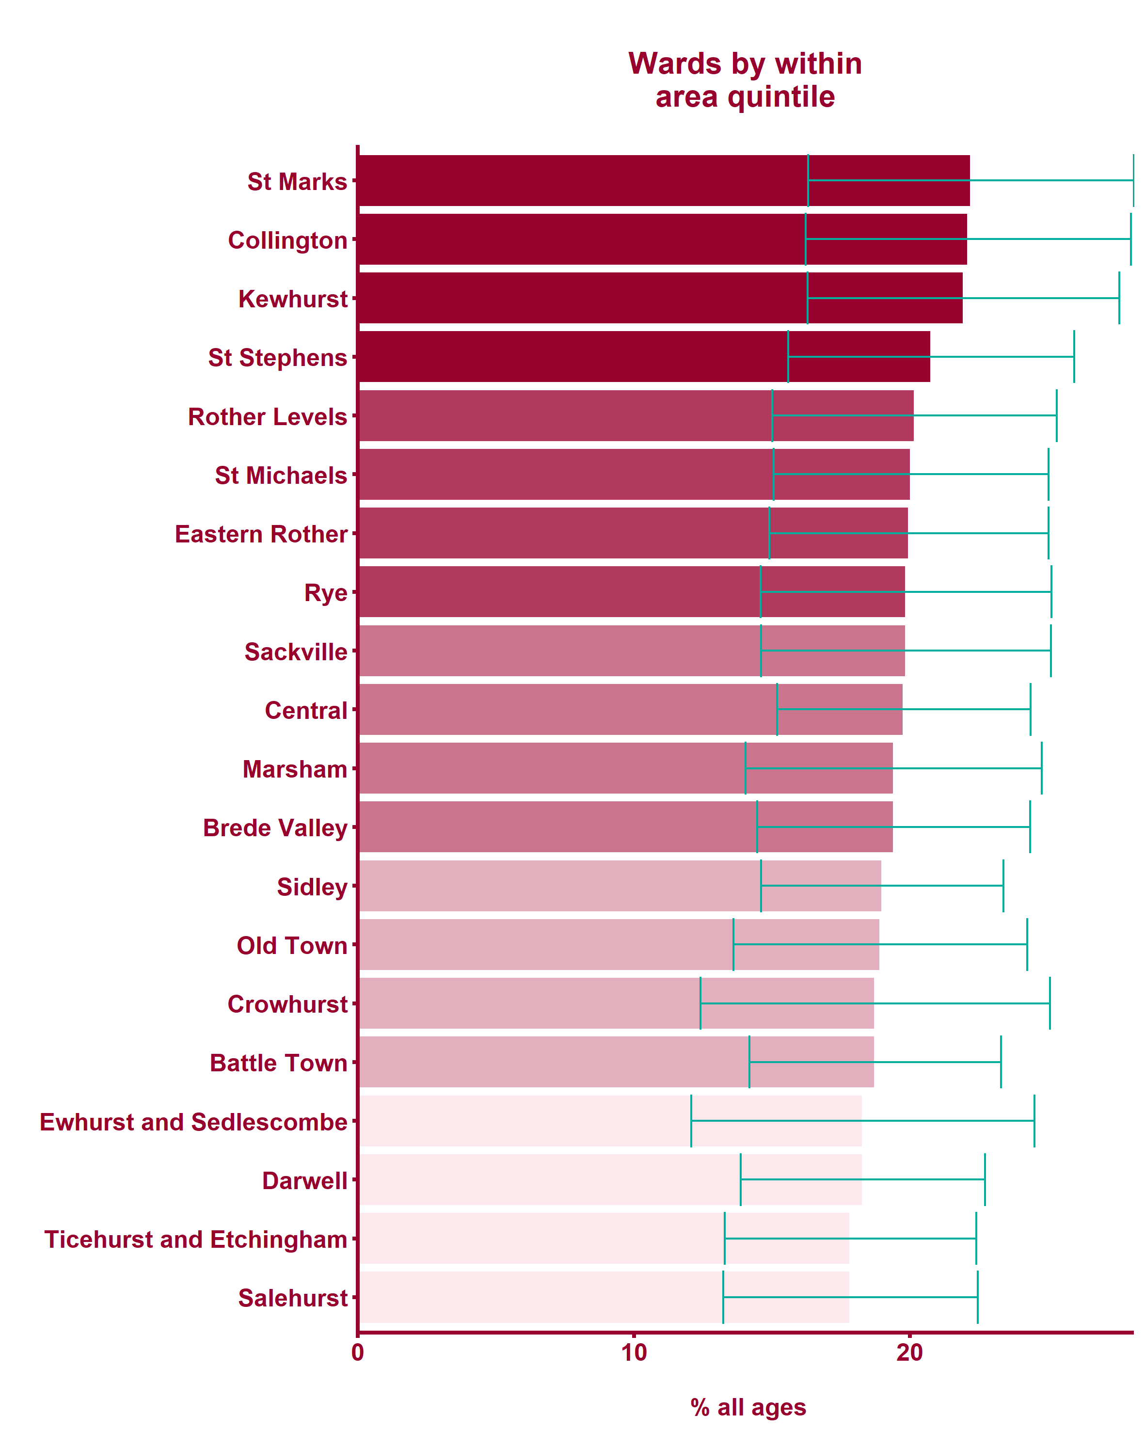
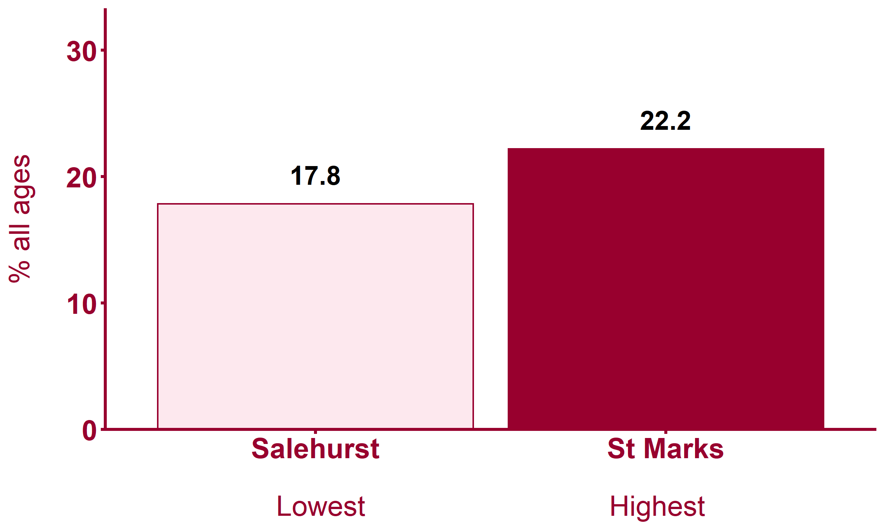
Modelled back pain prevalence (2012)
Health Inequalities in Rother Version 1.1 Released Jan 2020
Notes:
Note: maps show wards shaded by within-area quintile for each indicator. Where wards are shaded yellow this indicates that the data is missing from Local Health.
For metadata see Local Health tool at: www.localhealth.org.uk

Slide 22
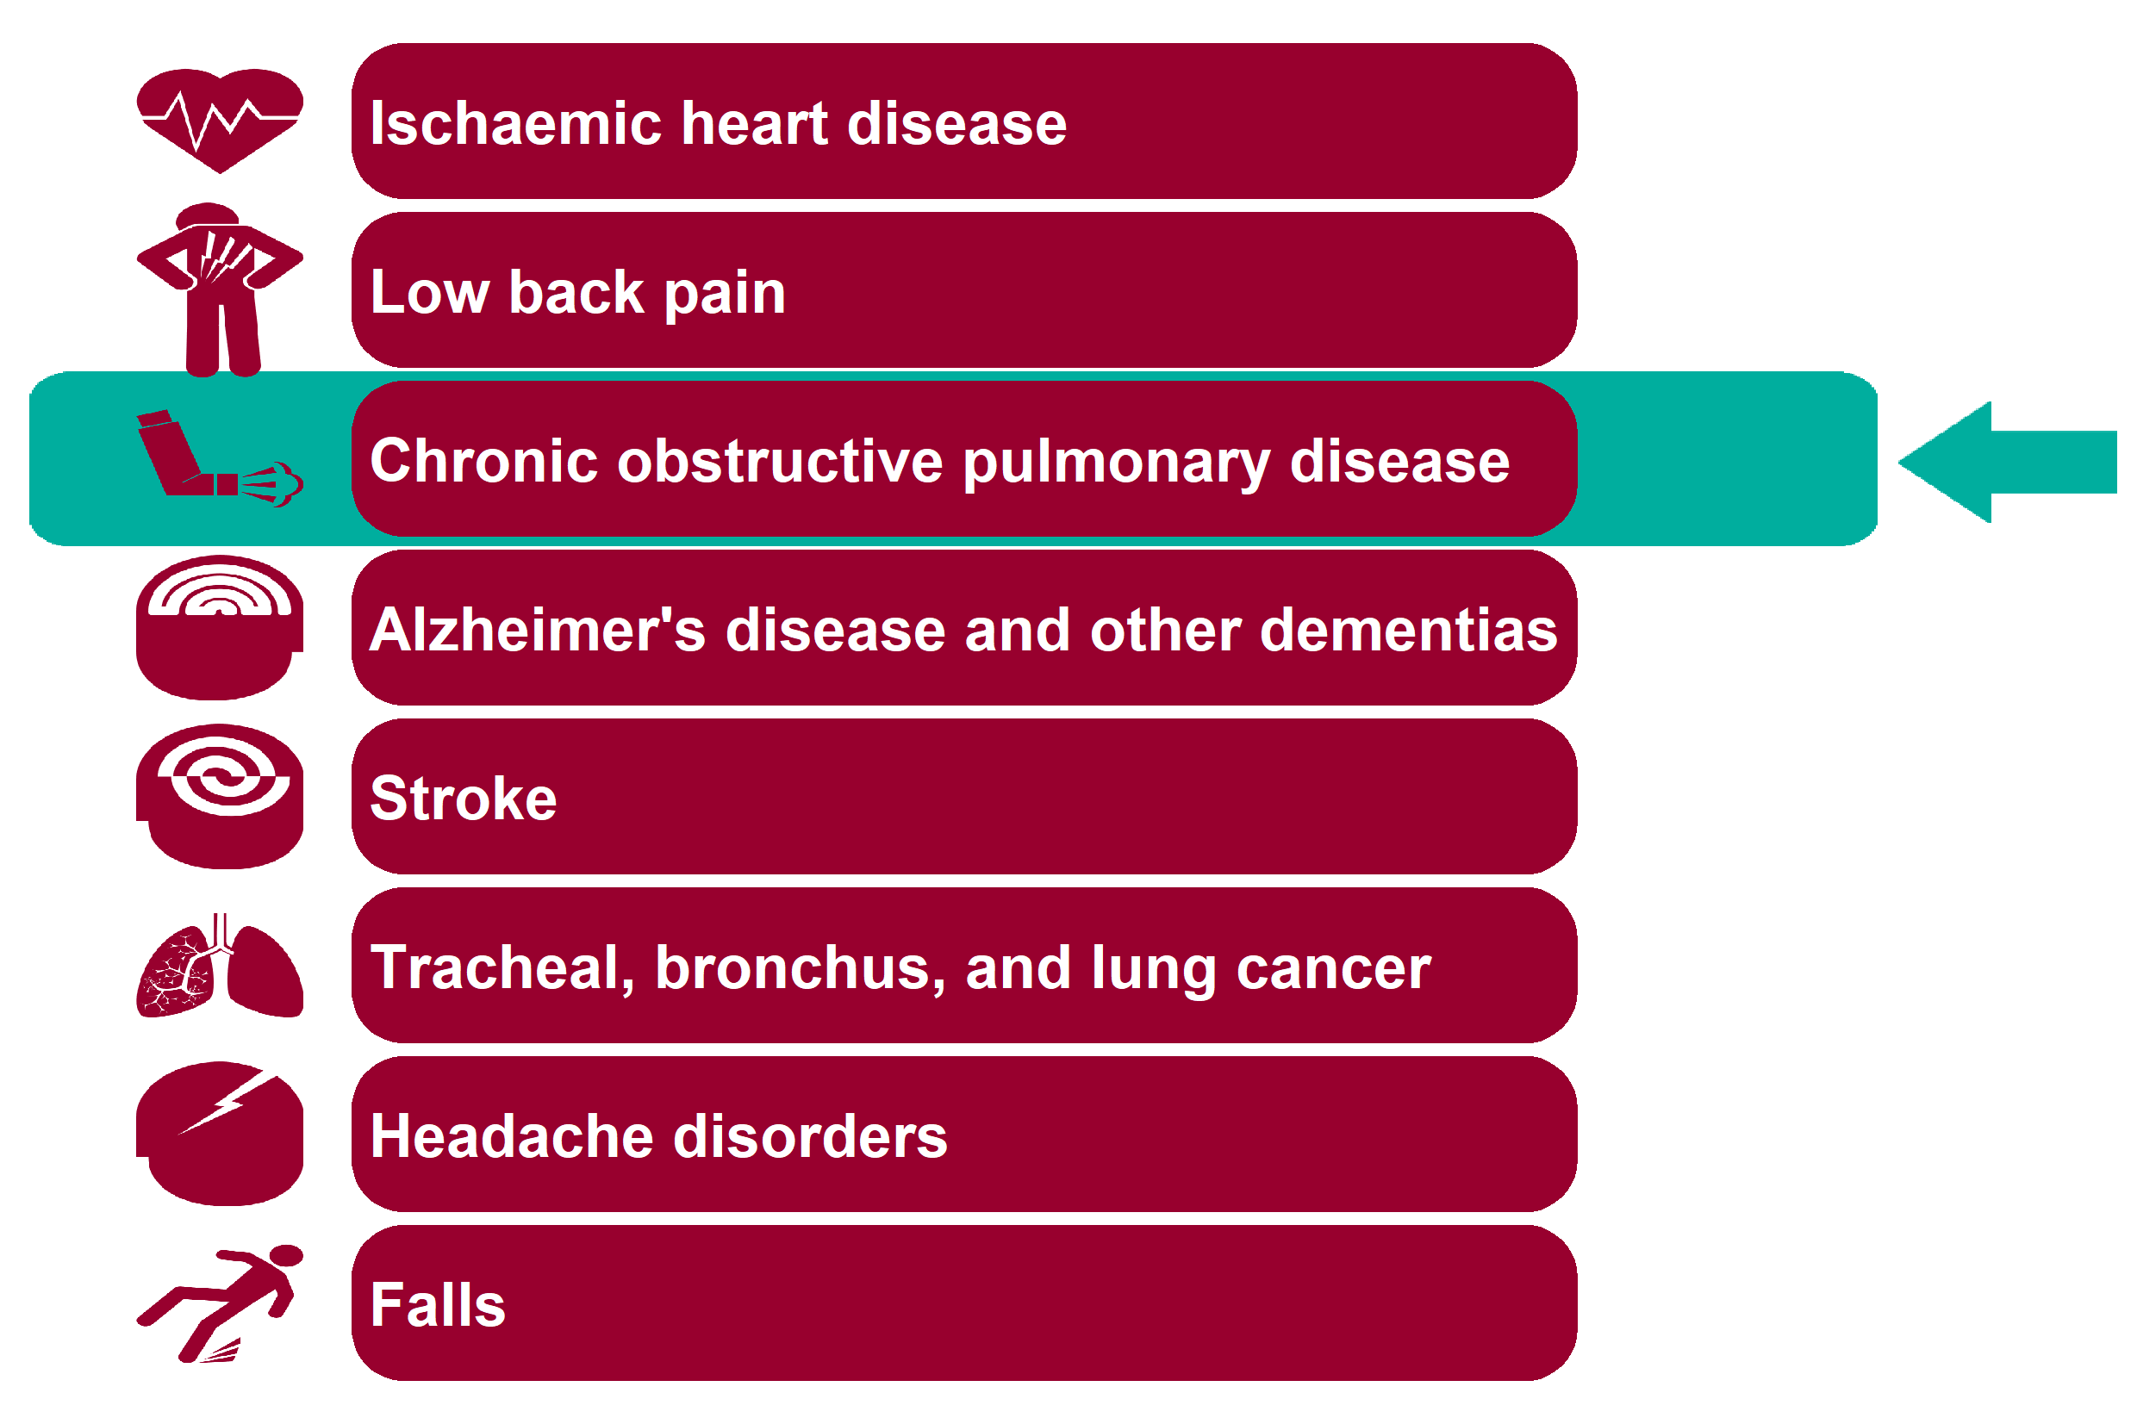
Global Burden of Disease: Chronic obstructive pulmonary disease
Health Inequalities in Rother Version 1.1 Released Jan 2020

Slide 23
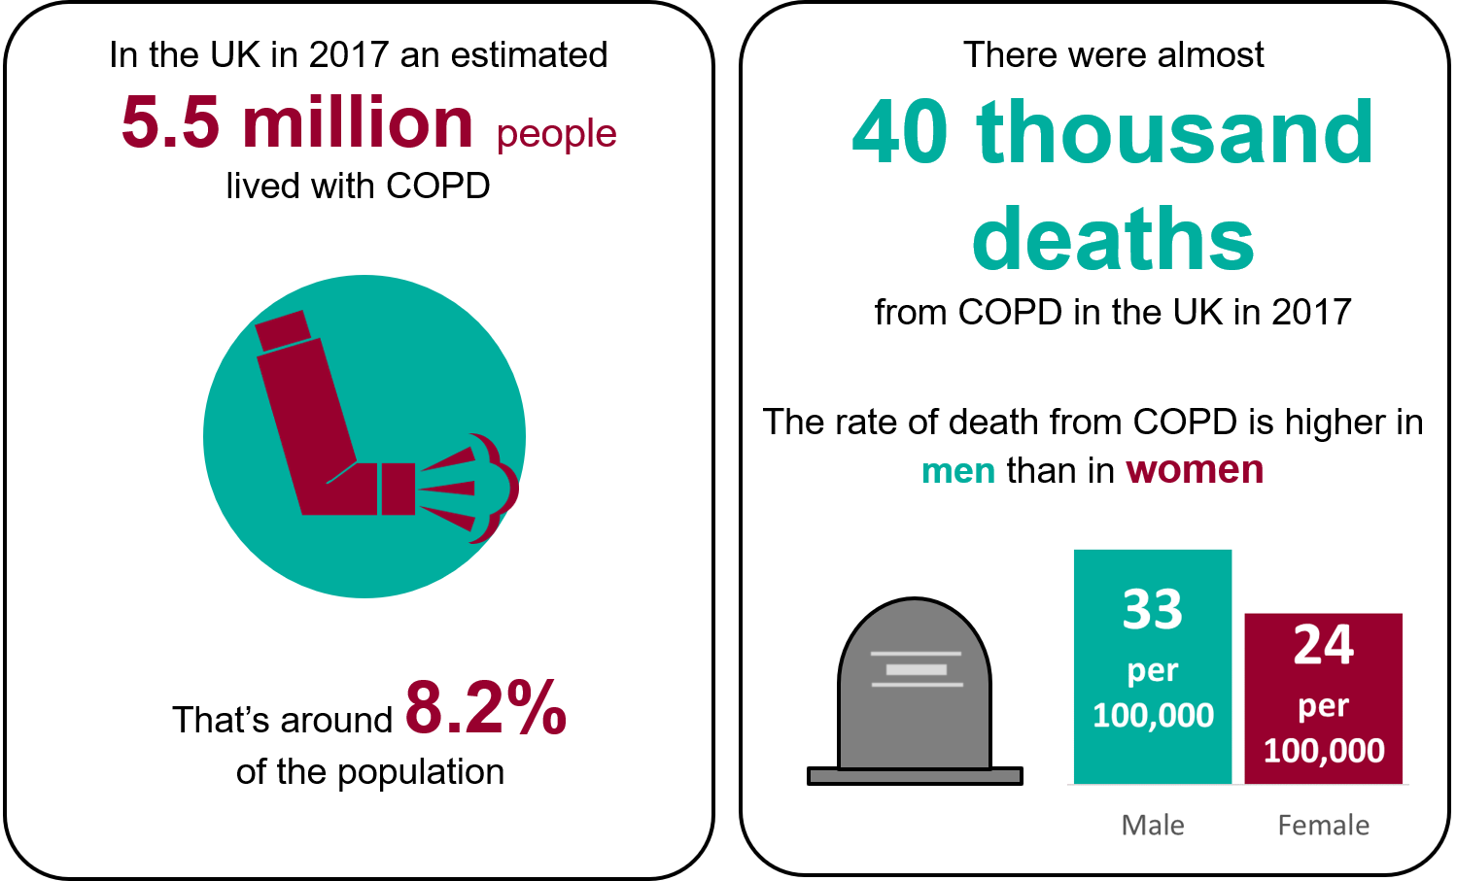
Chronic obstructive pulmonary disease - National picture
Health Inequalities in Rother Version 1.1 Released Jan 2020
Notes:
An estimated 5.5 million people live with COPD in the UK. That's around 8.2% of the total population. (UK, 2017; Global Burden of Disease Collaborative Network. 'Global Burden of Disease Study 2017 (GBD 2017) Results'. Institute for Health Metrics and Evaluation (IHME). Seattle, 2019)).
There were an estimated 39,726 deaths from COPD in the UK (UK, 2017; Global Burden of Disease Collaborative Network. 'Global Burden of Disease Study 2017 (GBD 2017) Results'. Institute for Health Metrics and Evaluation (IHME).
Seattle, 2019)).
Deaths due to COPD are higher in men (32.67 per 100,000 population) than in women (23.89 per 100,000) (UK, age standardised, 2017; Global Burden of Disease Collaborative Network. 'Global Burden of Disease Study 2017 (GBD 2017)
Results'. Institute for Health Metrics and Evaluation (IHME). Seattle, 2019)).

Slide 24
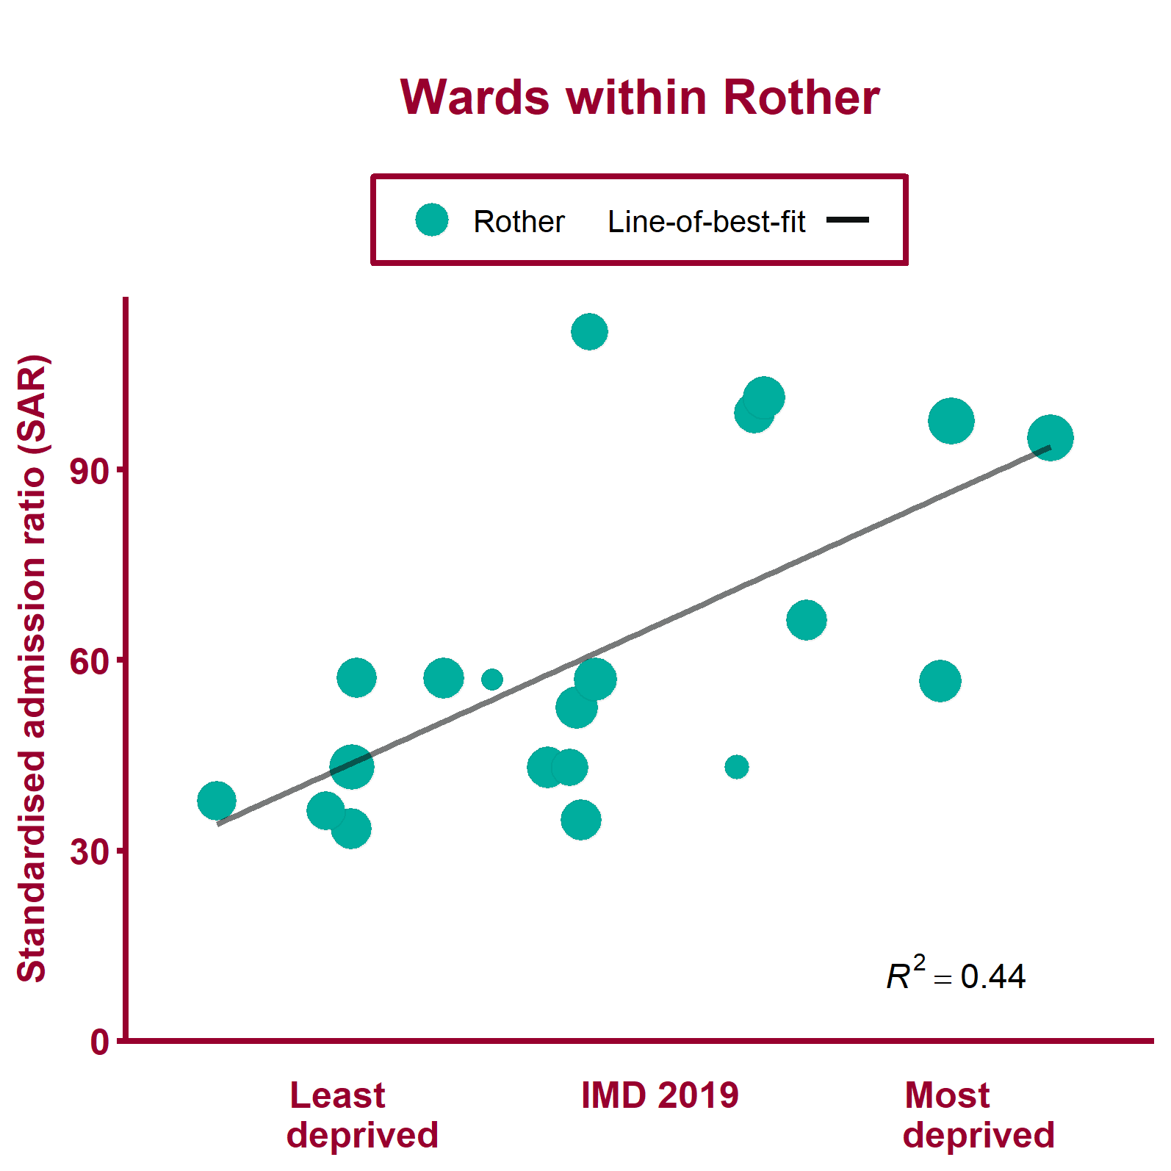
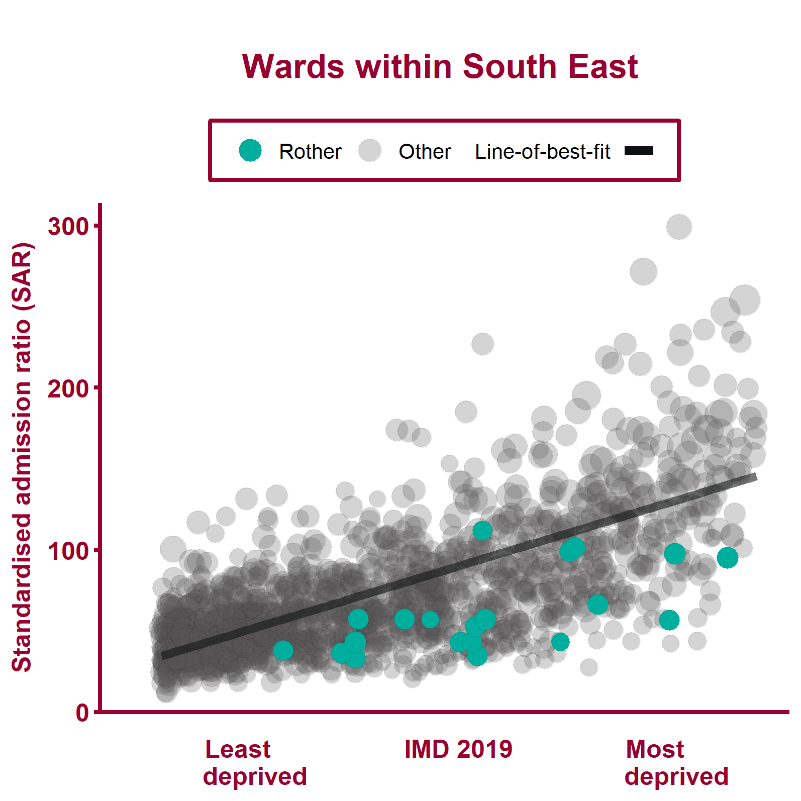
Emergency hospital admissions for COPD (2013/14 - 2017/18)
Health Inequalities in Rother Version 1.1 Released Jan 2020
Notes:
Note: A different scale may be used for local data compared to regional data. The ward data points are sized according to their 2017 total population.
For metadata see Local Health tool at: www.localhealth.org.uk

Slide 25
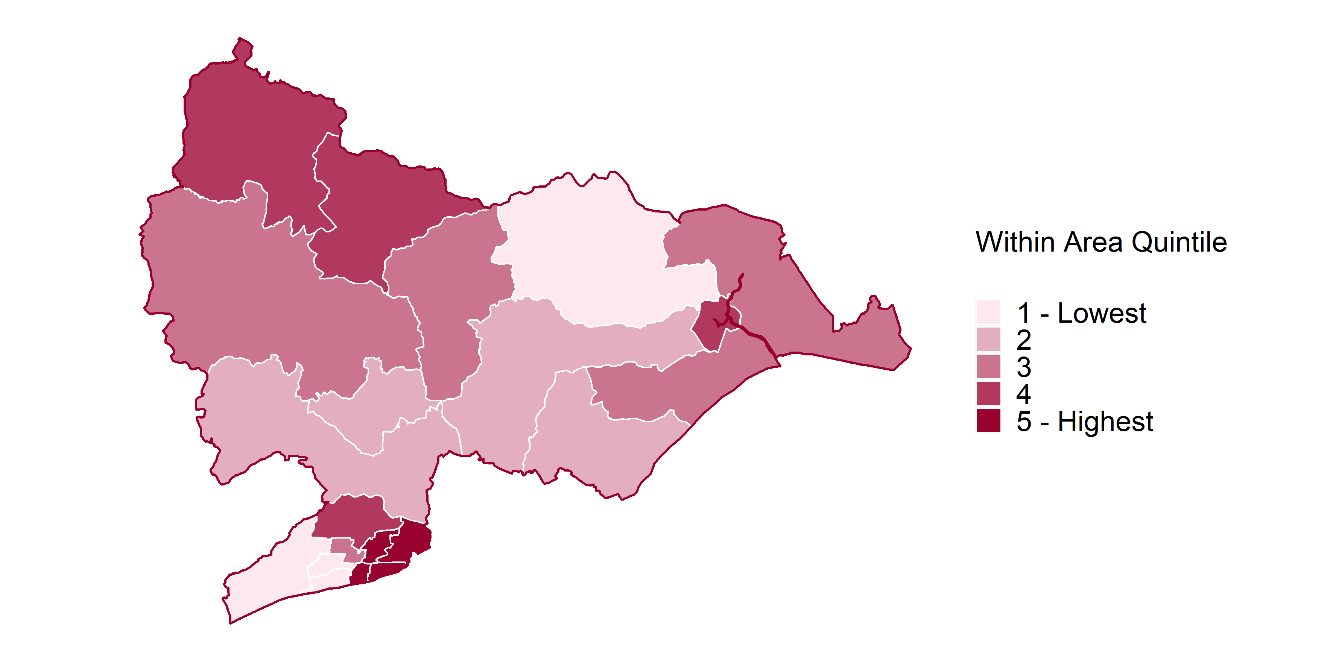
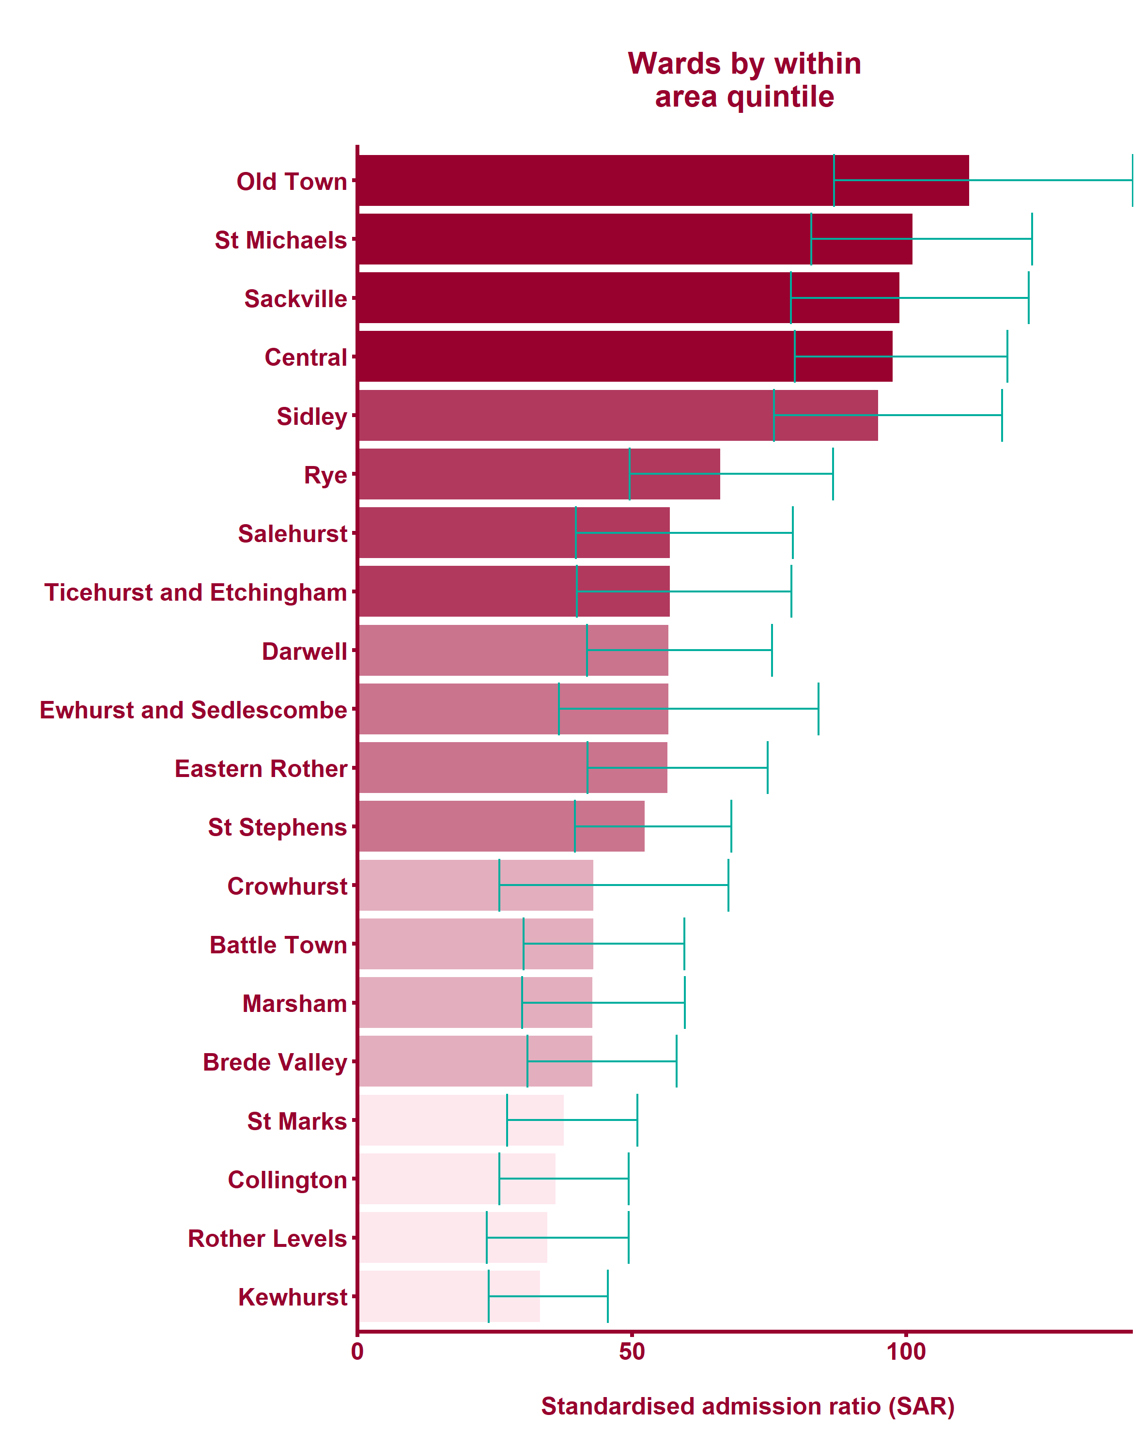
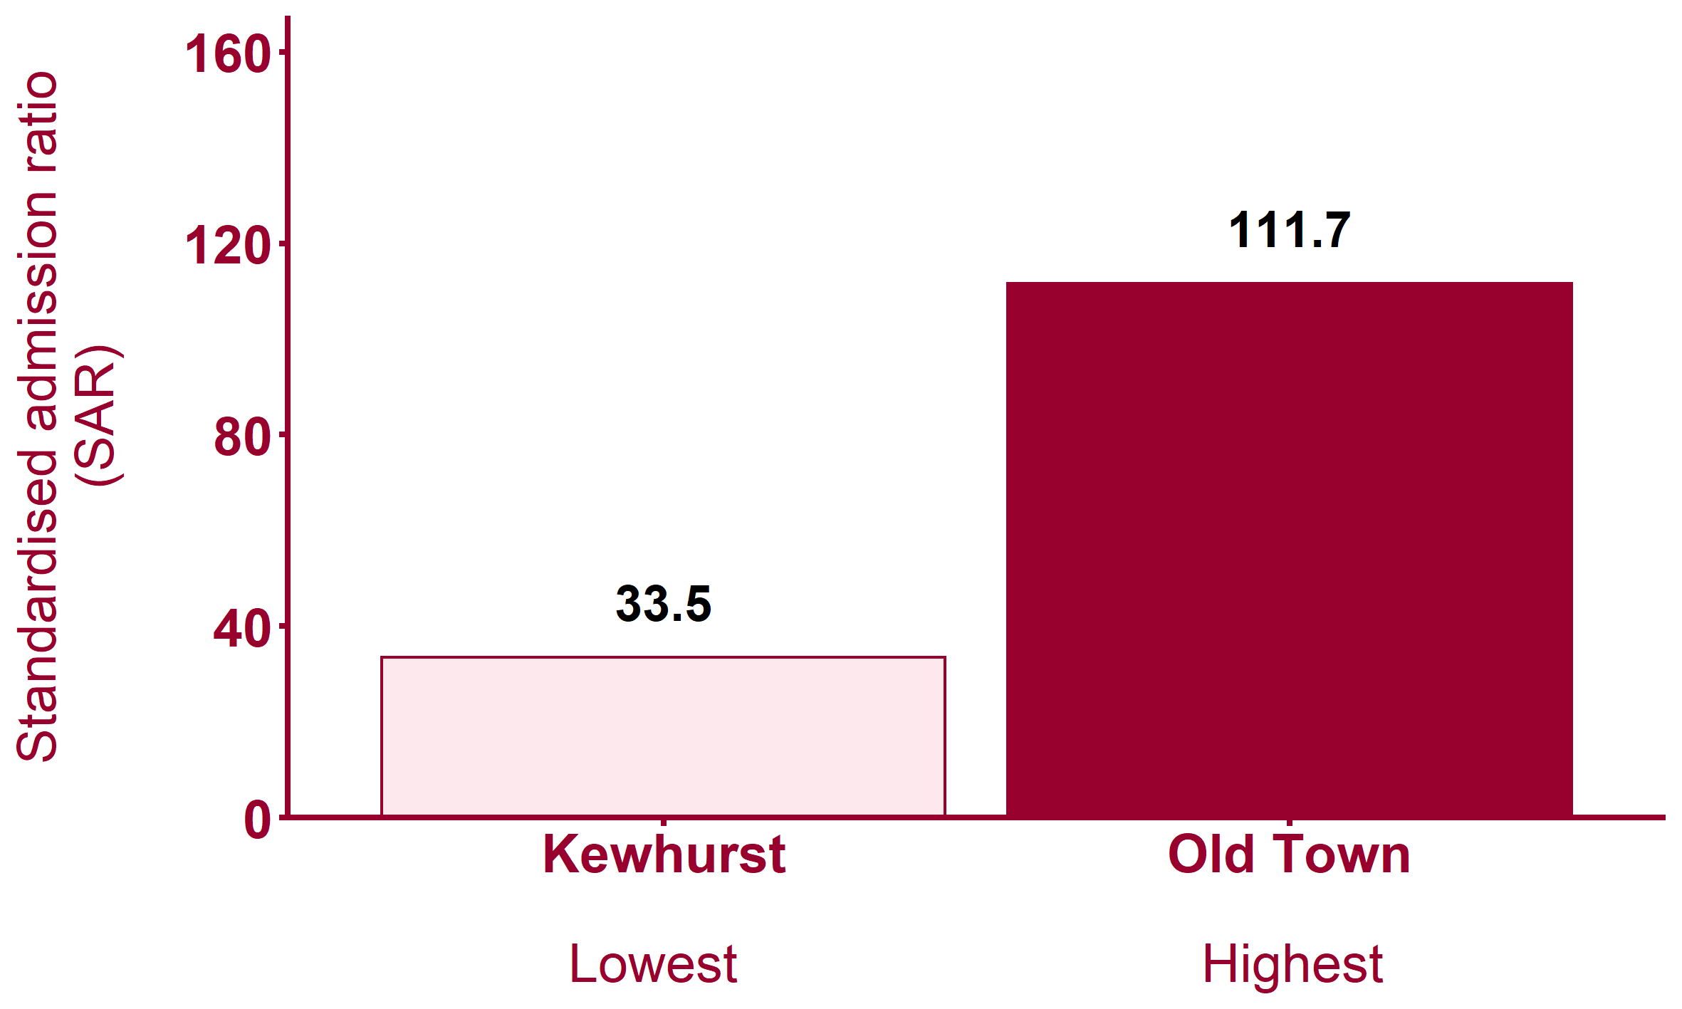
Emergency hospital admissions for COPD (2013/14 - 2017/18)
Health Inequalities in Rother Version 1.1 Released Jan 2020
Notes:
Note: maps show wards shaded by within-area quintile for each indicator. Where wards are shaded yellow this indicates that the data is missing from Local Health.
For metadata see Local Health tool at: www.localhealth.org.uk

Slide 26
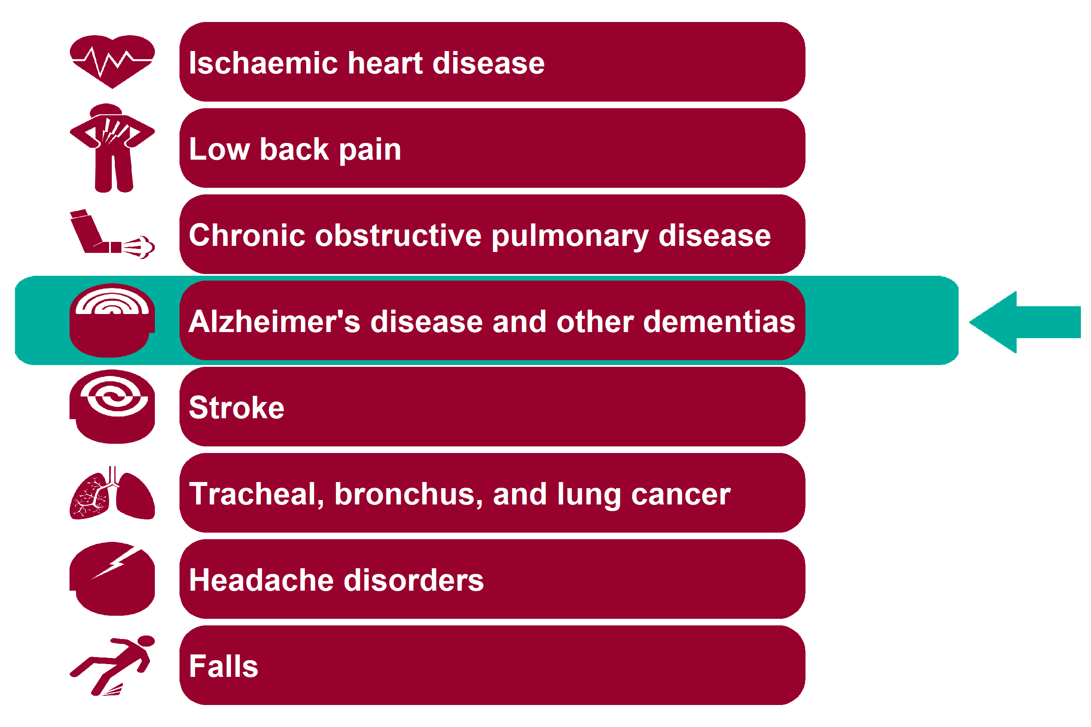
Global Burden of Disease: Alzheimer's disease and other dementias
Health Inequalities in Rother Version 1.1 Released Jan 2020

Slide 27
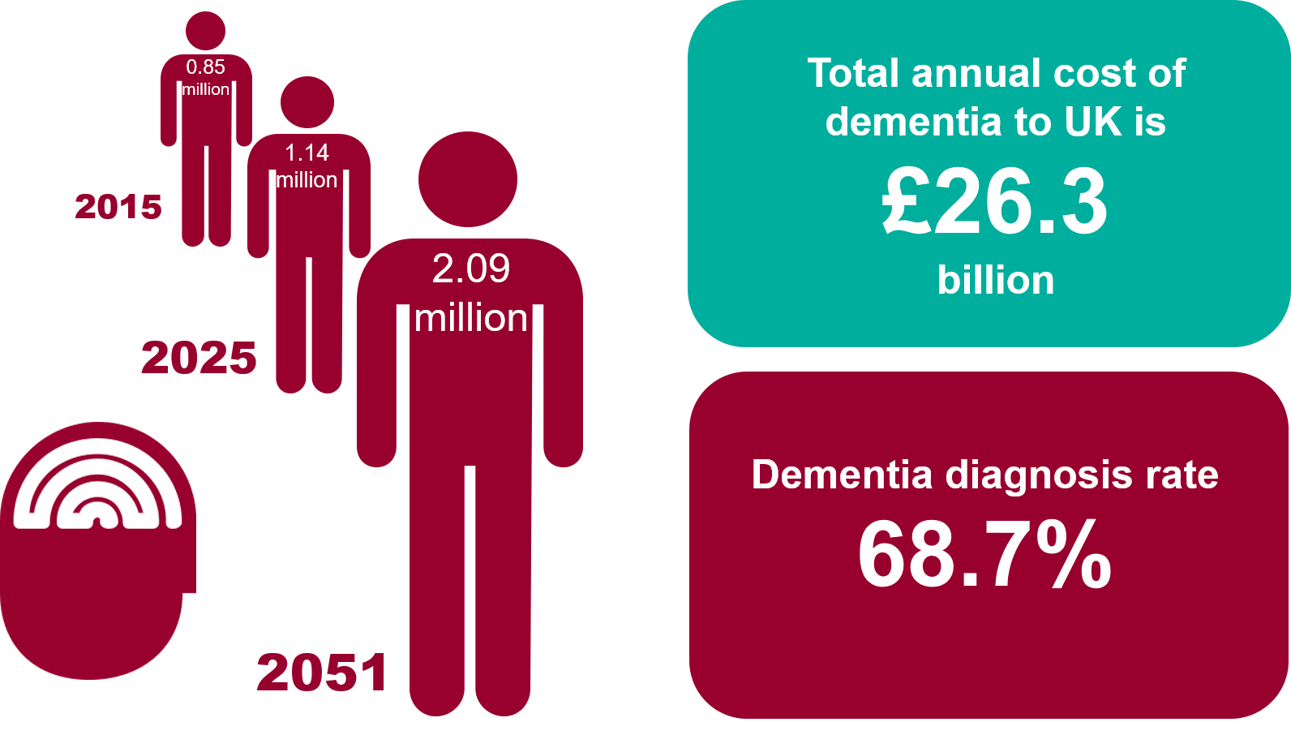
Alzheimer's disease and other dementias - National picture
Health Inequalities in Rother Version 1.1 Released Jan 2020
Notes:
Note: No local data on Alzheimer's disease and other dementias is currently available from Local Health.
Estimates from the Alzheimer's Society predict a rise to over 2 million people living with dementia in the UK by 2051. Dementia is estimated to cost the UK 26.3 billion a year.
Both above facts taken from 'Dementia UK: Update' published by the Alzheimer's Society in November 2014:
https://www.alzheimers.org.uk/about-us/policy-and-influencing/dementia-uk-report
Dementia diagnosis rate taken from the Dementia Profile on PHE Fingertips and is based on data as at March 2019:
https://fingertips.phe.org.uk/profile-group/mental-health/profile/dementia. It is the % of the estimated prevalence of dementia in people aged 65+ which has been formally diagnosed.

Slide 28
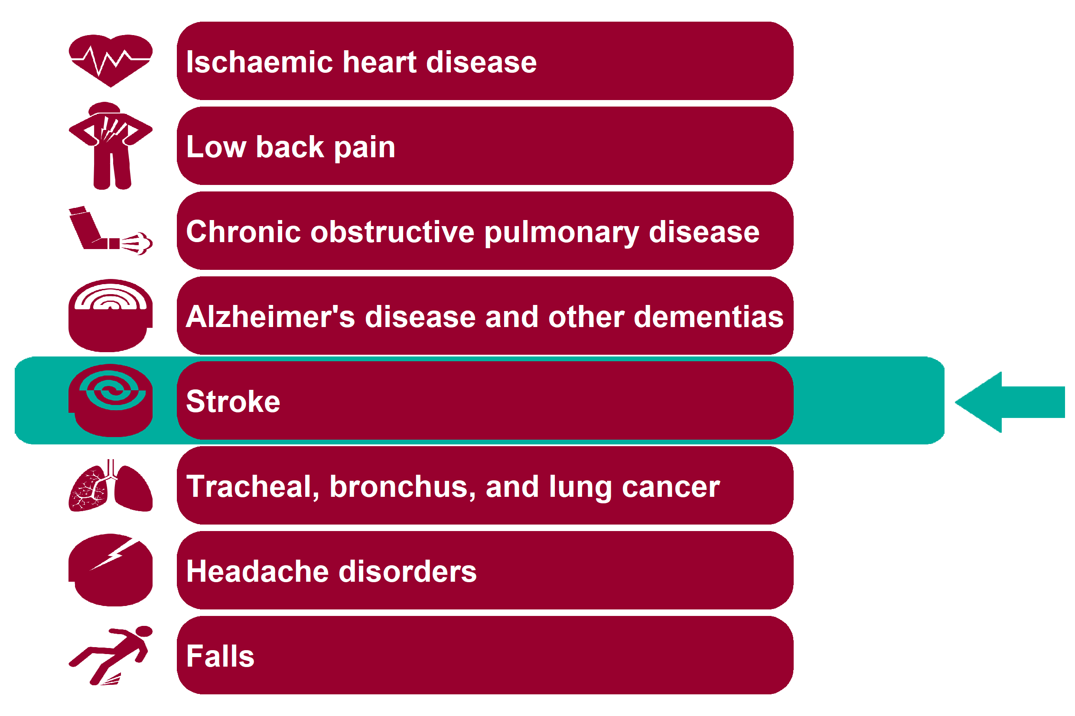
Global Burden of Disease: Stroke
Health Inequalities in Rother Version 1.1 Released Jan 2020

Slide 29
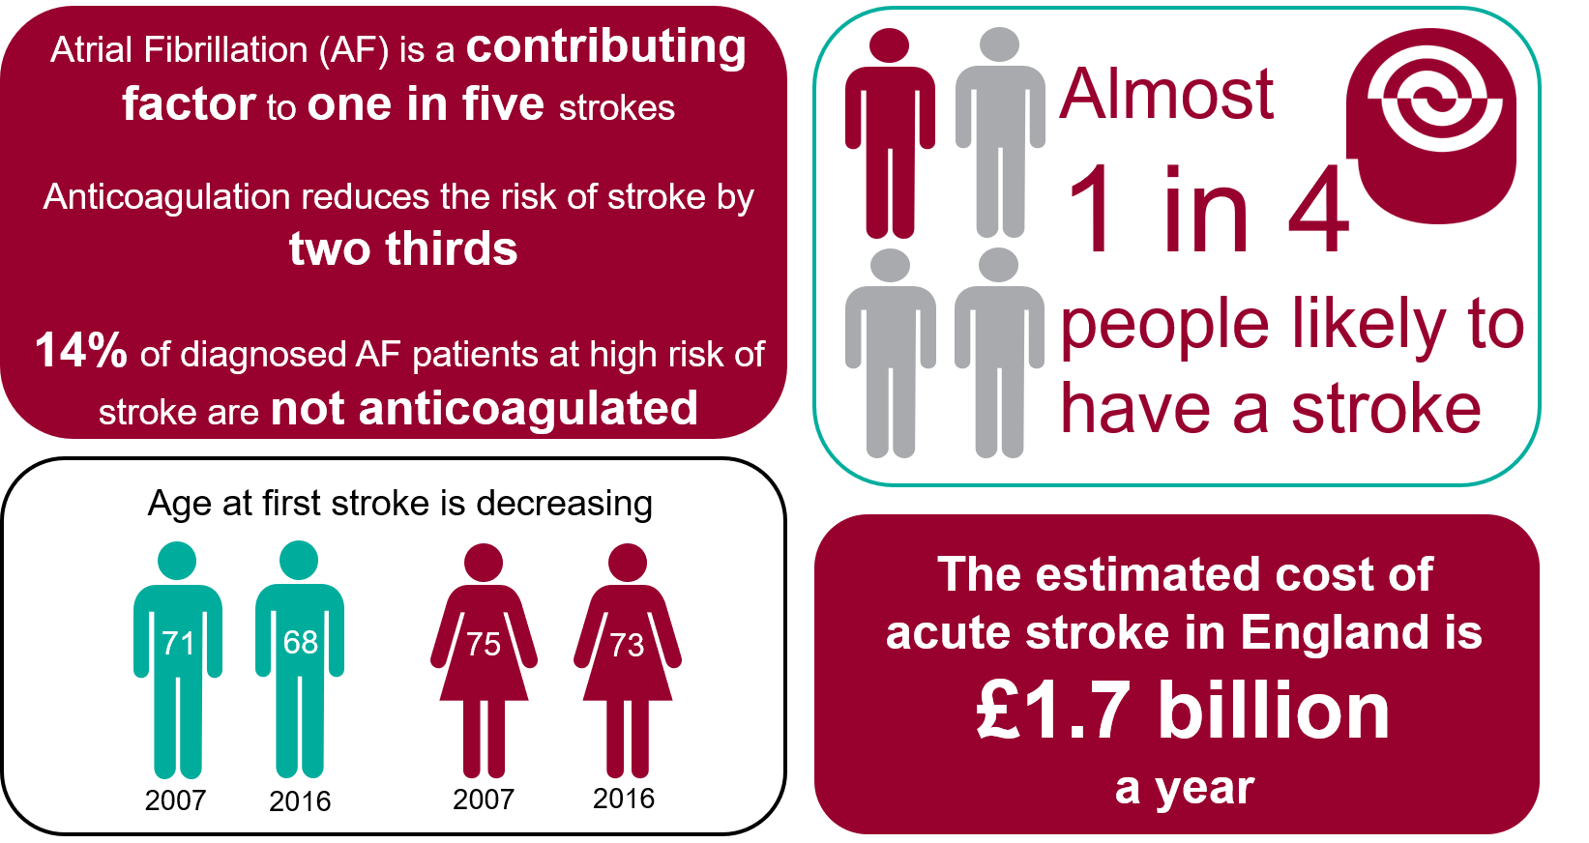
Stroke - National picture
Health Inequalities in Rother Version 1.1 Released Jan 2020
Notes:
'AF is a major risk factor for stroke and a contributing factor to one in five strokes. Anticoagulation reduces the risk of stroke in someone with AF by two thirds.'
Source: Stroke Association, AF: How can we do better?
http://www.stroke.org.uk/sites/default/files/af-data_2018_england_eng_2.pdf
Number of AF strokes and number not on anticoagulation (national).
Source: SSNAP National Results - Clinical: Outcome data for patients with prior AF.
https://www.strokeaudit.org/results/Clinical-audit/National-Results.aspx
1 in 4 people likely to have a stroke: The lifetime risk of stroke from the age of 25 years onward for Western Europe was 22.7%.
Source: Global, Regional, and Country-Specific Lifetime Risks of Stroke, 1990 and 2016, The GBD 2016 Lifetime Risk of Stroke Collaborators (2018).
https://www.nejm.org/doi/full/10.1056/NEJMoa1804492
Age at first stroke is decreasing: The average age for males having a stroke fell from 71 to 68 years and for females, 75 to 73 years between 2007 and 2016.
Source: PHE Briefing document: First incidence of stroke Estimates for England 2007 to 2016.
https://assets.publishing.service.gov.uk/government/uploads/system/uploads/attachment_data/file/678444/Stroke_incidence_briefing_document_2018.pdf
The estimated cost of acute stroke in England is £1.7 billion a year. (NHS = £1.03 billion, Social care = £633 million).
Source: Sentinel Stroke National Audit Programme: Cost and Cost-effectiveness analysis - Technical Report, 2016.
https://www.strokeaudit.org/SupportFiles/Documents/Health-Economics/Health-economic-report-2016.aspx

Slide 30
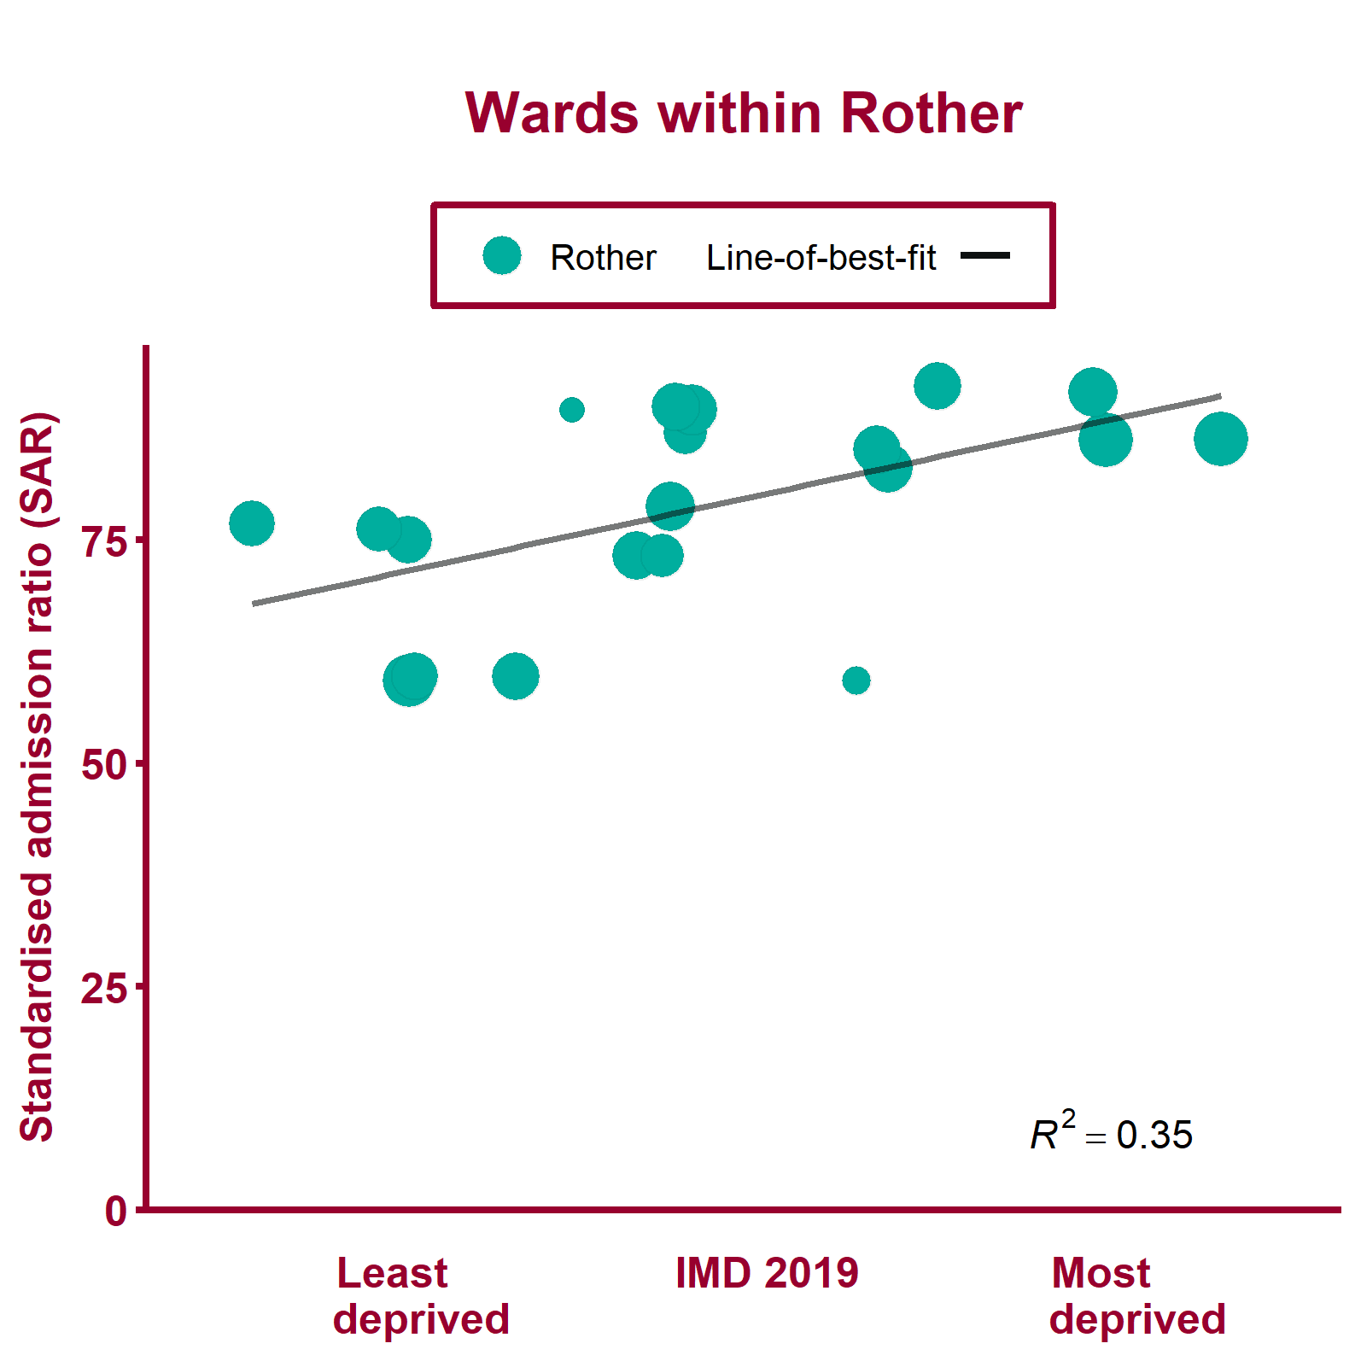
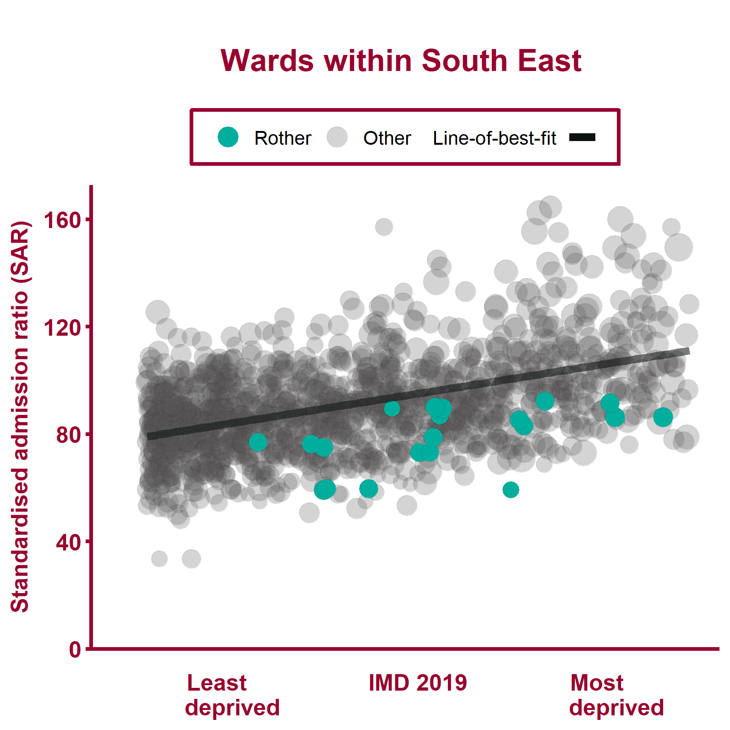
Emergency hospital admissions for stroke (2013/14 - 2017/18)
Health Inequalities in Rother Version 1.1 Released Jan 2020
Notes:
Note: A different scale may be used for local data compared to regional data. The ward data points are sized according to their 2017 total population.
For metadata see Local Health tool at: www.localhealth.org.uk

Slide 31
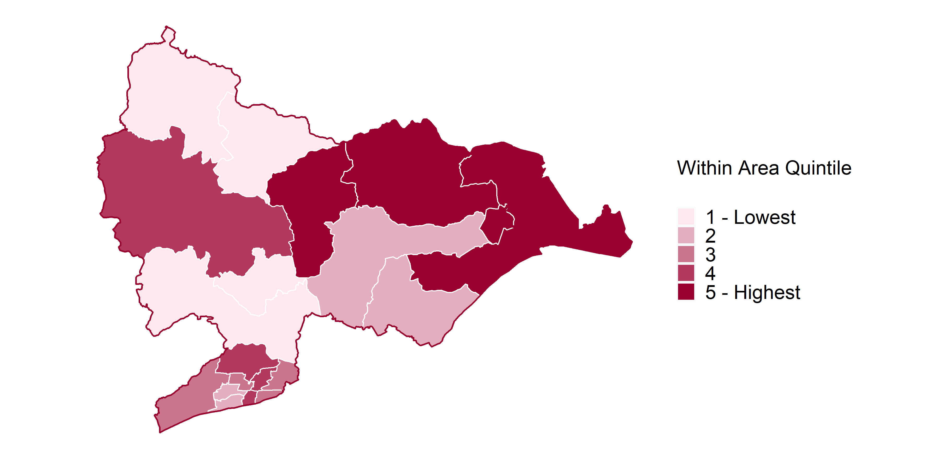
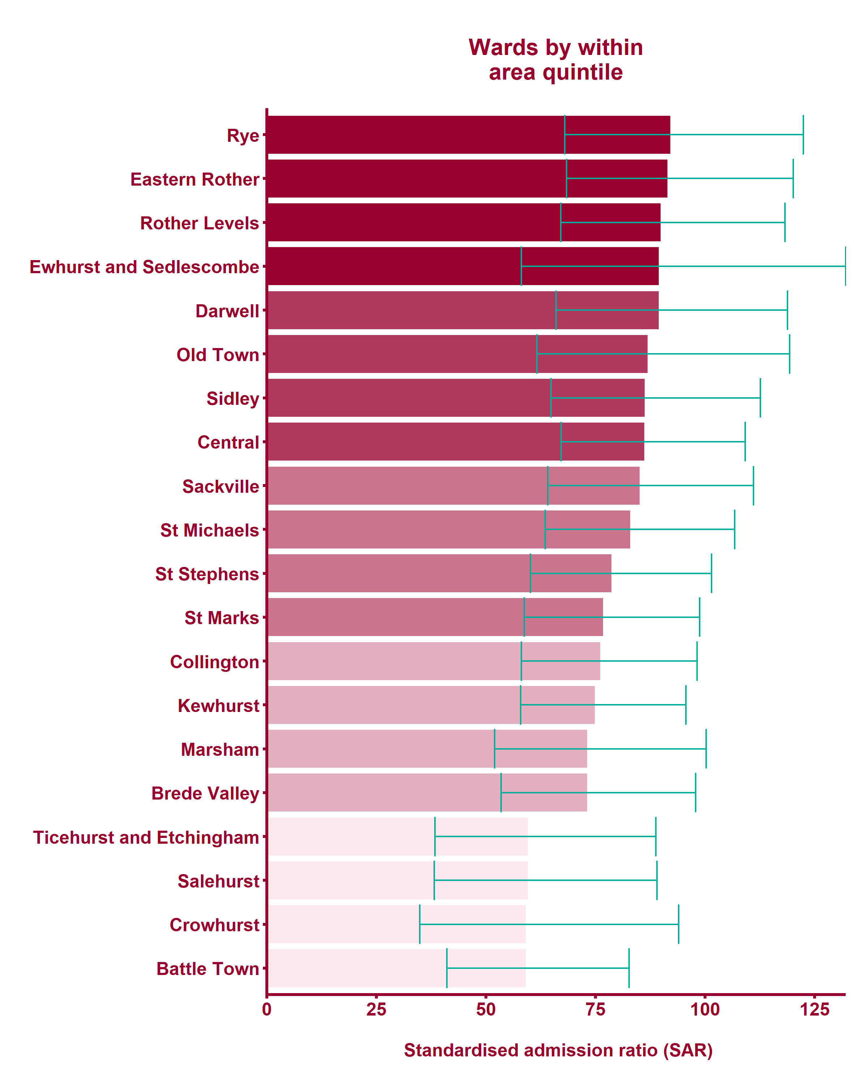
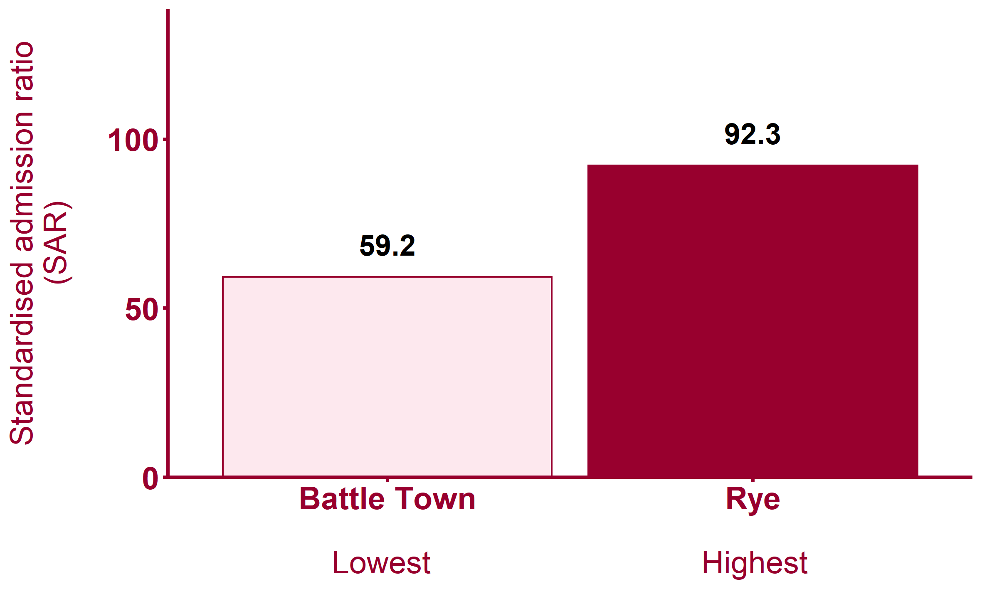
Emergency hospital admissions for stroke (2013/14 - 2017/18)
Health Inequalities in Rother Version 1.1 Released Jan 2020
Notes:
Note: maps show wards shaded by within-area quintile for each indicator. Where wards are shaded yellow this indicates that the data is missing from Local Health.
For metadata see Local Health tool at: www.localhealth.org.uk

Slide 32
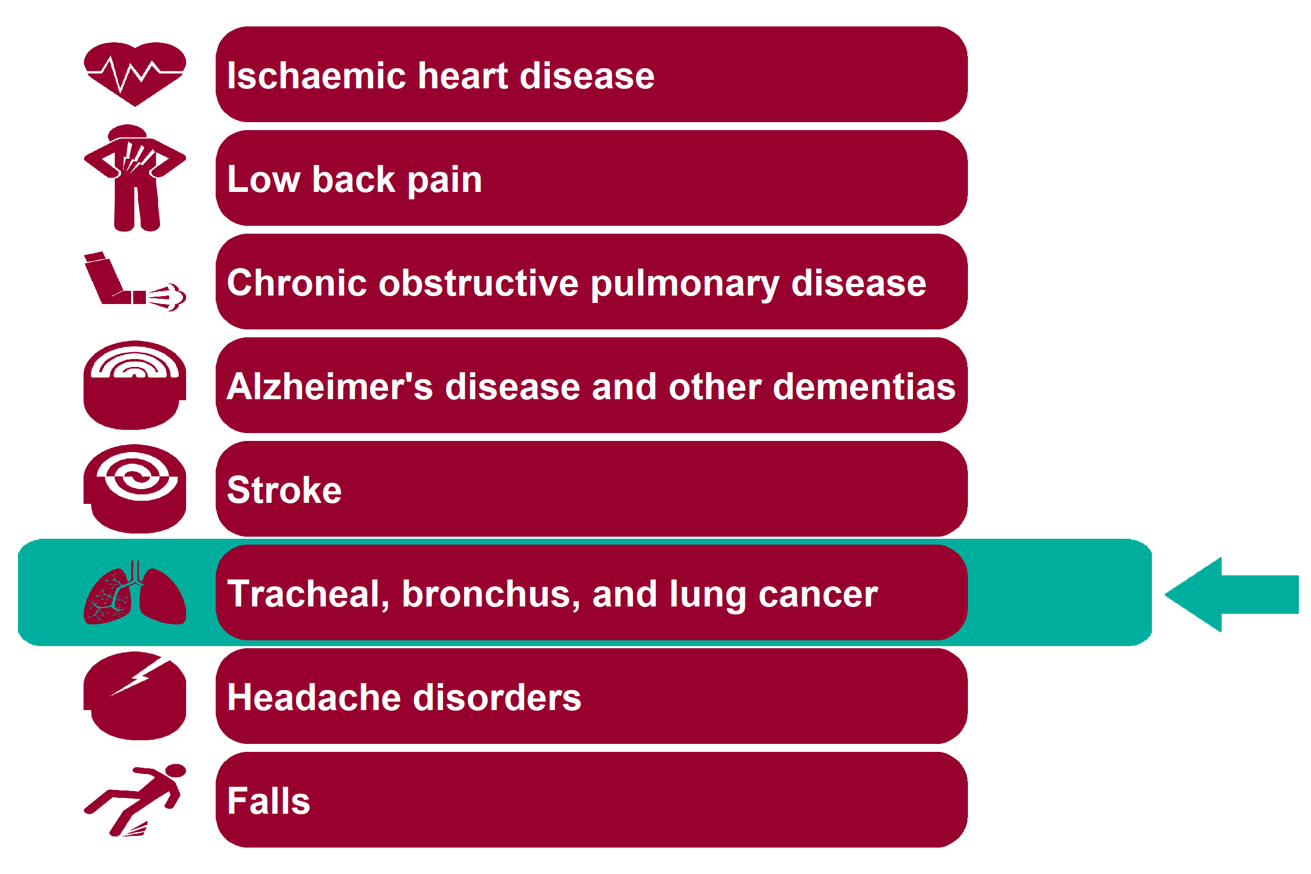
Global Burden of Disease: Tracheal, bronchus, and lung cancer
Health Inequalities in Rother Version 1.1 Released Jan 2020

Slide 33
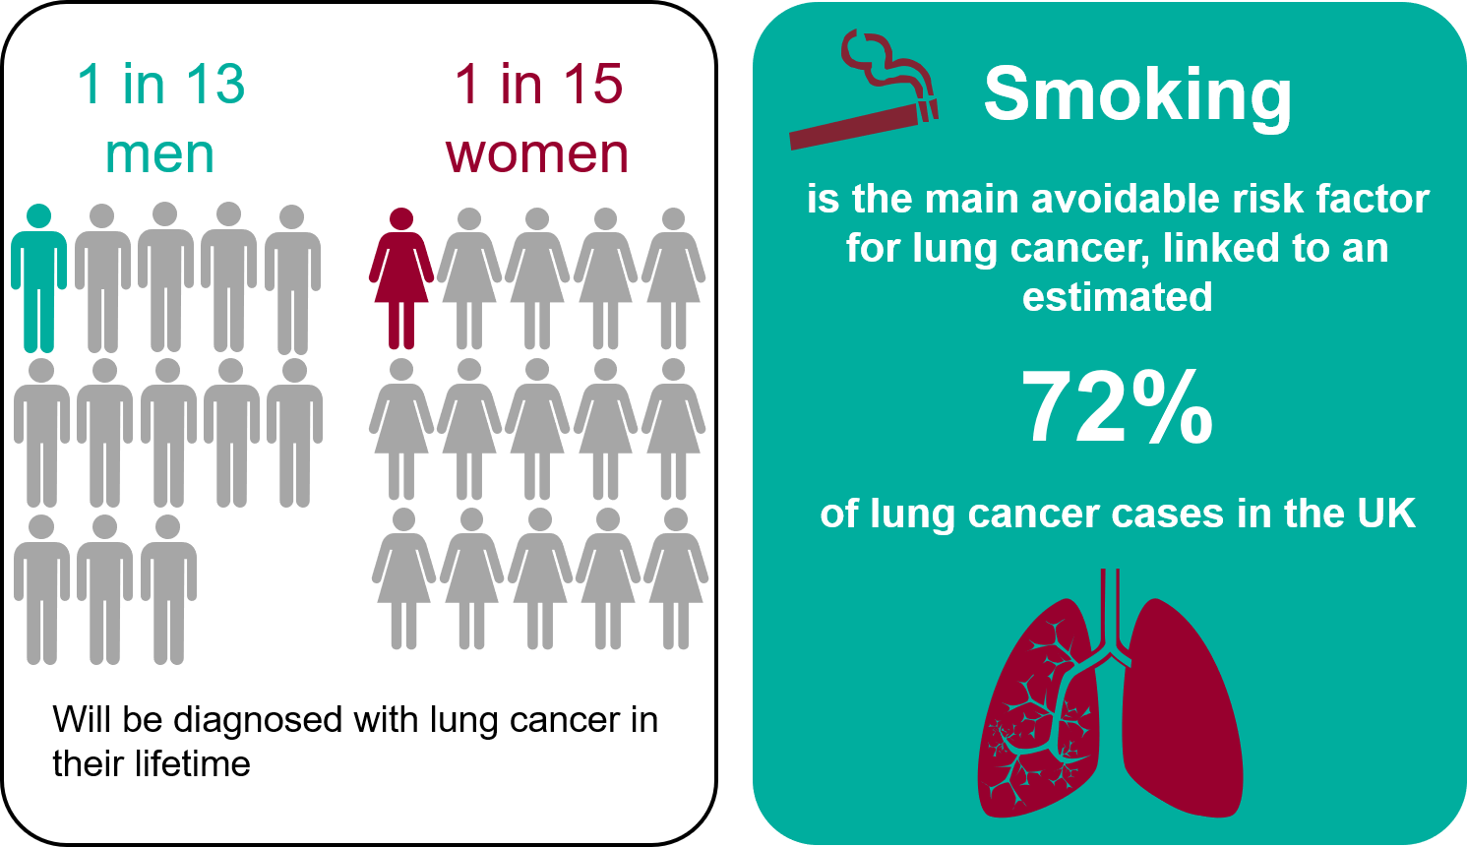
Lung cancer - National picture
Health Inequalities in Rother Version 1.1 Released Jan 2020
Notes:
1 in 13 UK males and 1 in 15 UK females will be diagnosed with lung cancer in their lifetime.
https://www.cancerresearchuk.org/health-professional/cancer-statistics/statistics-by-cancer-type/lung-cancer
Lung cancer (ICD10 C33-34) accounts for over 35,000 deaths in the UK each year accounting for nearly a quarter of all UK cancer deaths (22%).
Smoking is the main avoidable risk factor for lung cancer, linked to an estimated 72% of lung cancer cases in the UK.
Brown KF et al, British Journal of Cancer (2018) 118(8): 1130-1141.
Compared with the mean European 5-year relative survival, over 3,500 lung cancer deaths could be avoided each year.
Abdel-Rahman et al, British Journal of Cancer (2009) 101, S115-S124 (03 December 2009) https://www.ncbi.nlm.nih.gov/pubmed/19956155
Further cancer statistics can be found at the links below:
England - CancerData, https://www.cancerdata.nhs.uk/dashboard#?tab=Overview
Northern Ireland - Northern Ireland Cancer Registry, https://www.qub.ac.uk/research-centres/nicr/CancerInformation/official-statistics/
Scotland - Information Services Division Scotland, https://www.isdscotland.org/Health-Topics/Cancer/Cancer-Statistics/Lung-Cancer-and-Mesothelioma/
Wales - Welsh Cancer Intelligence and Surveillance Unit, http://www.wcisu.wales.nhs.uk/dashboard-data-5

Slide 34
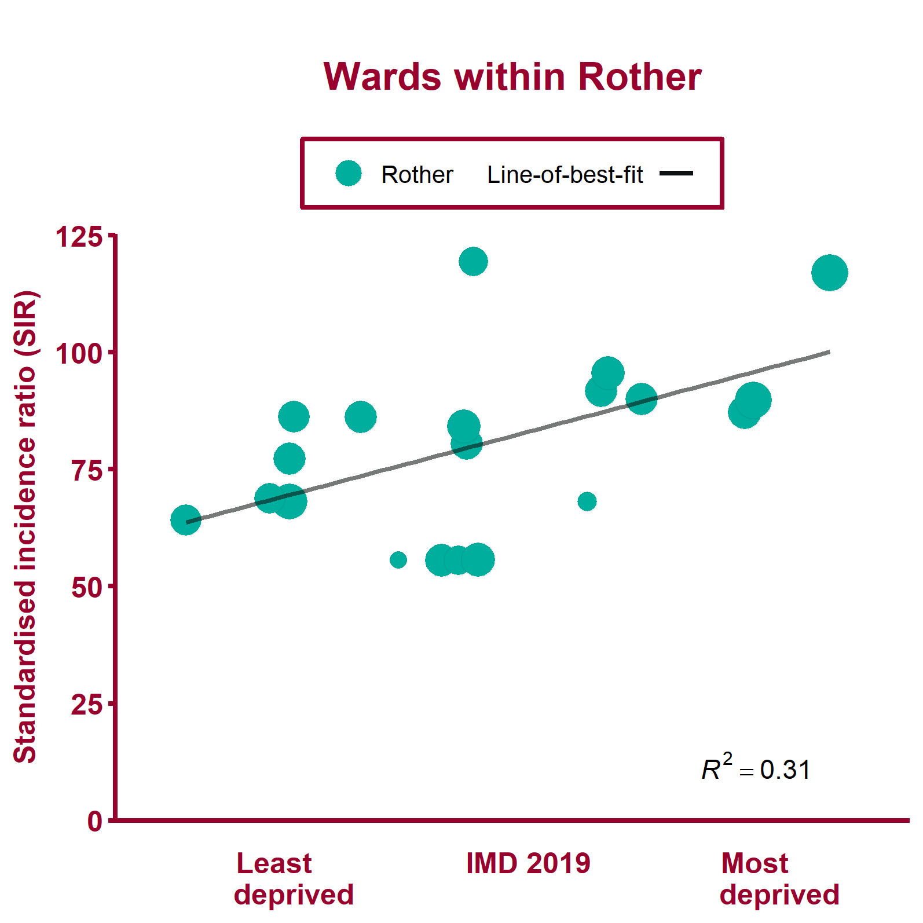
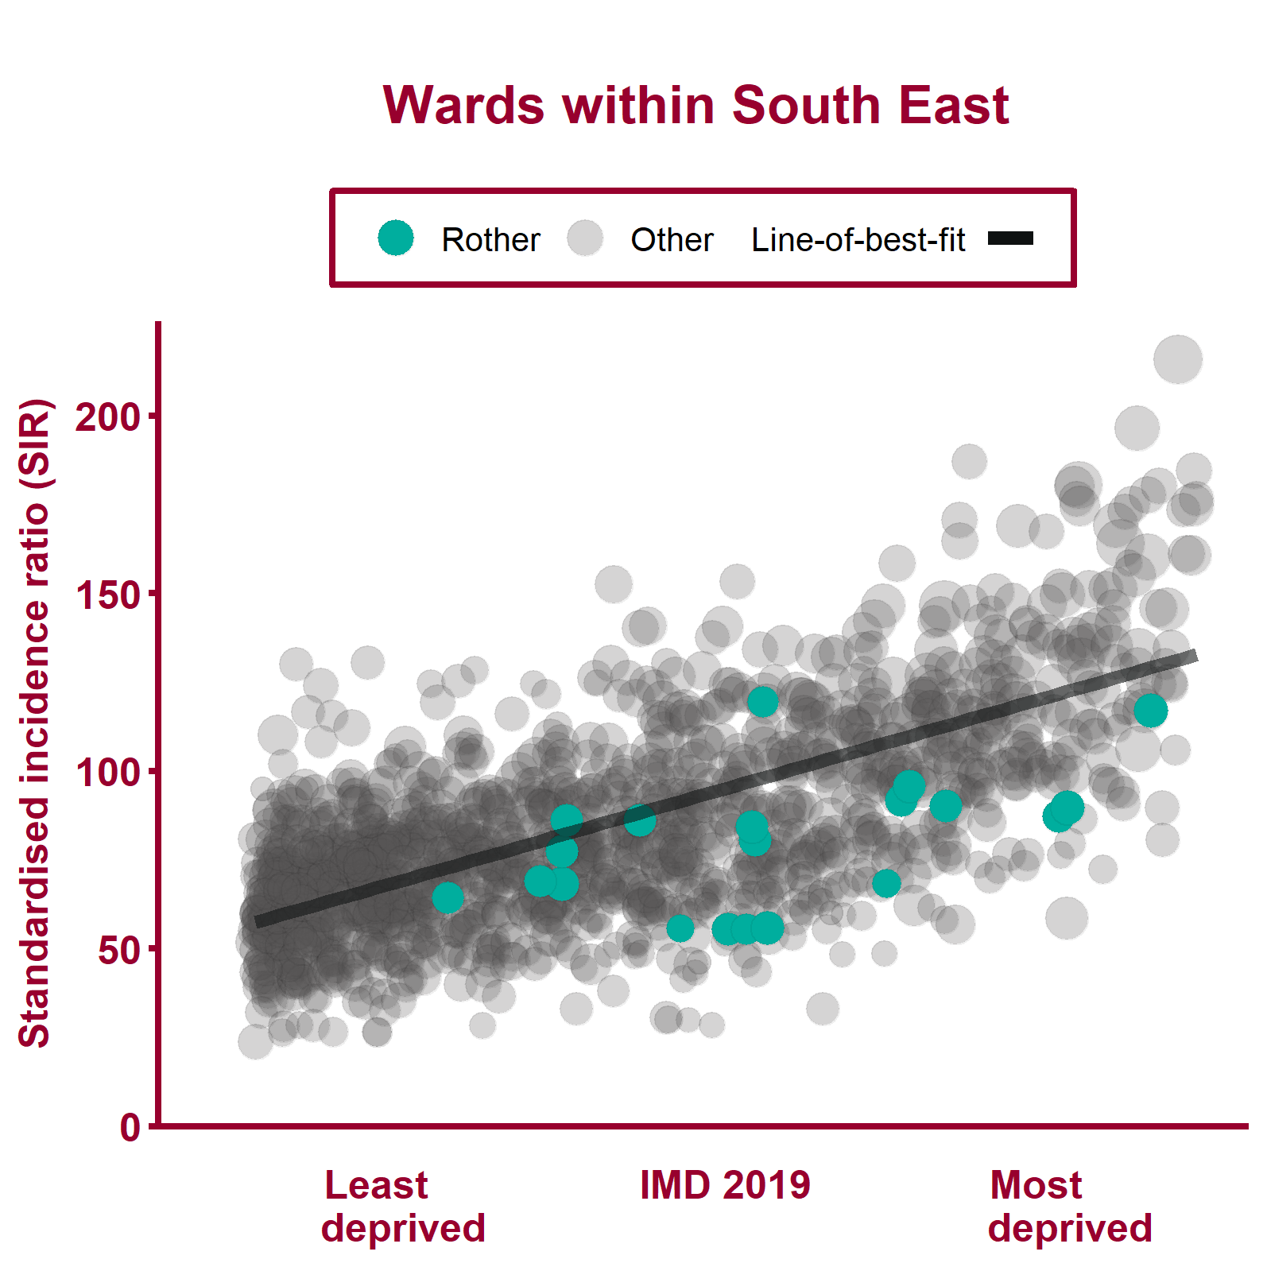
Incidence of lung cancer (2012 - 16)
Health Inequalities in Rother Version 1.1 Released Jan 2020
Notes:
Note: A different scale may be used for local data compared to regional data. The ward data points are sized according to their 2017 total population.
For metadata see Local Health tool at: www.localhealth.org.uk

Slide 35
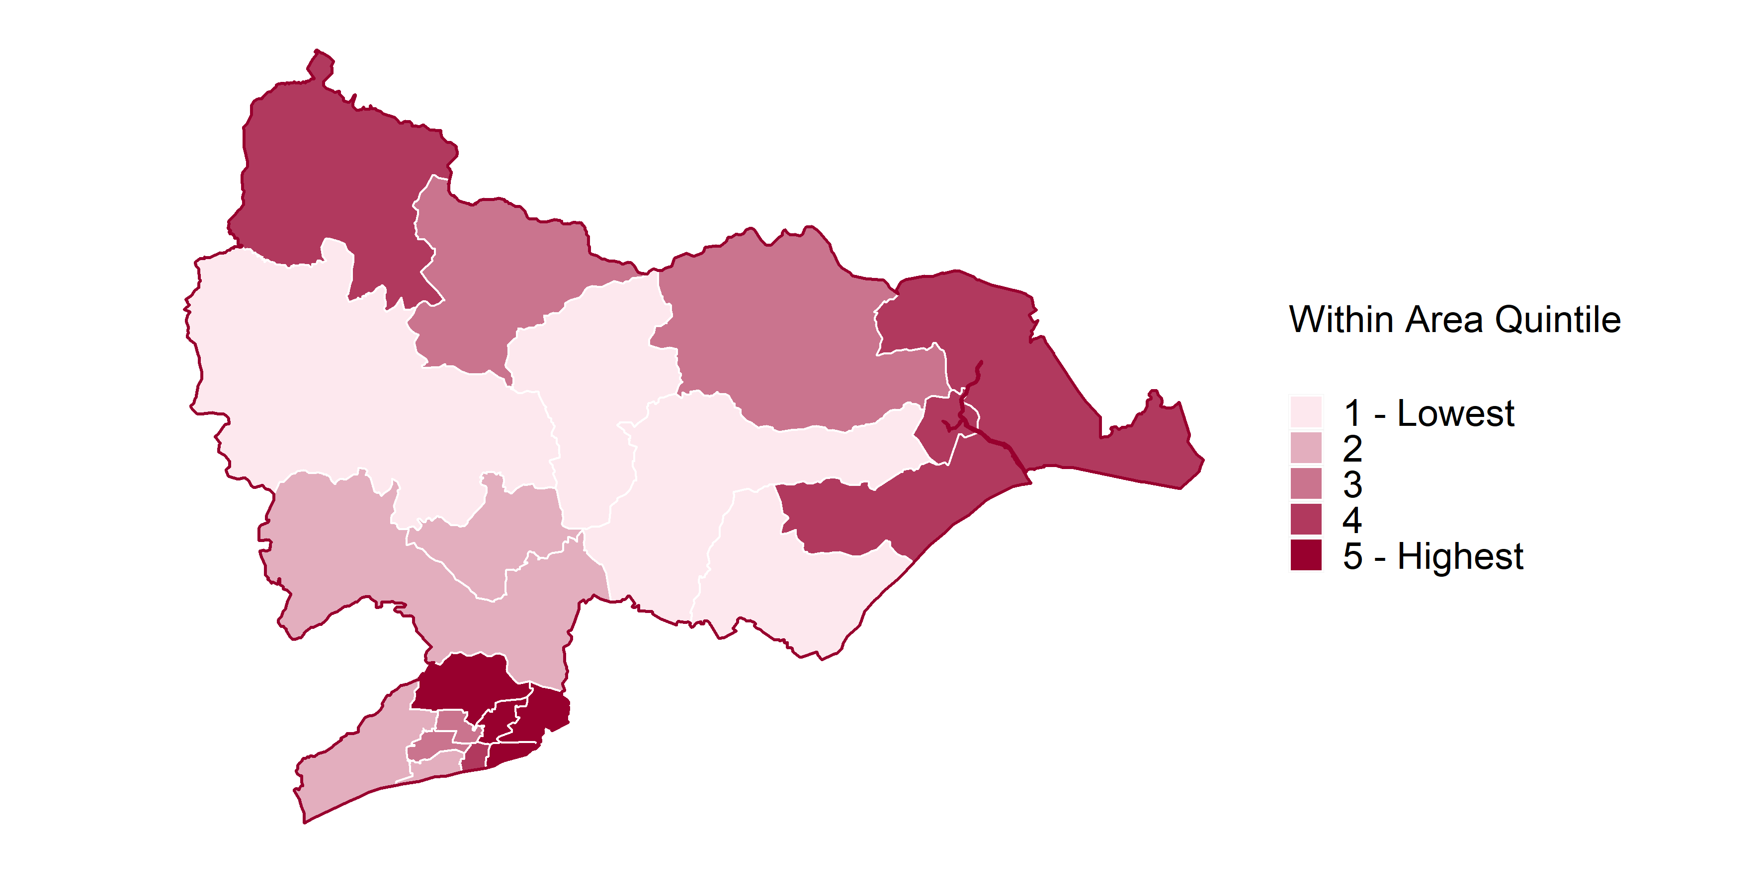
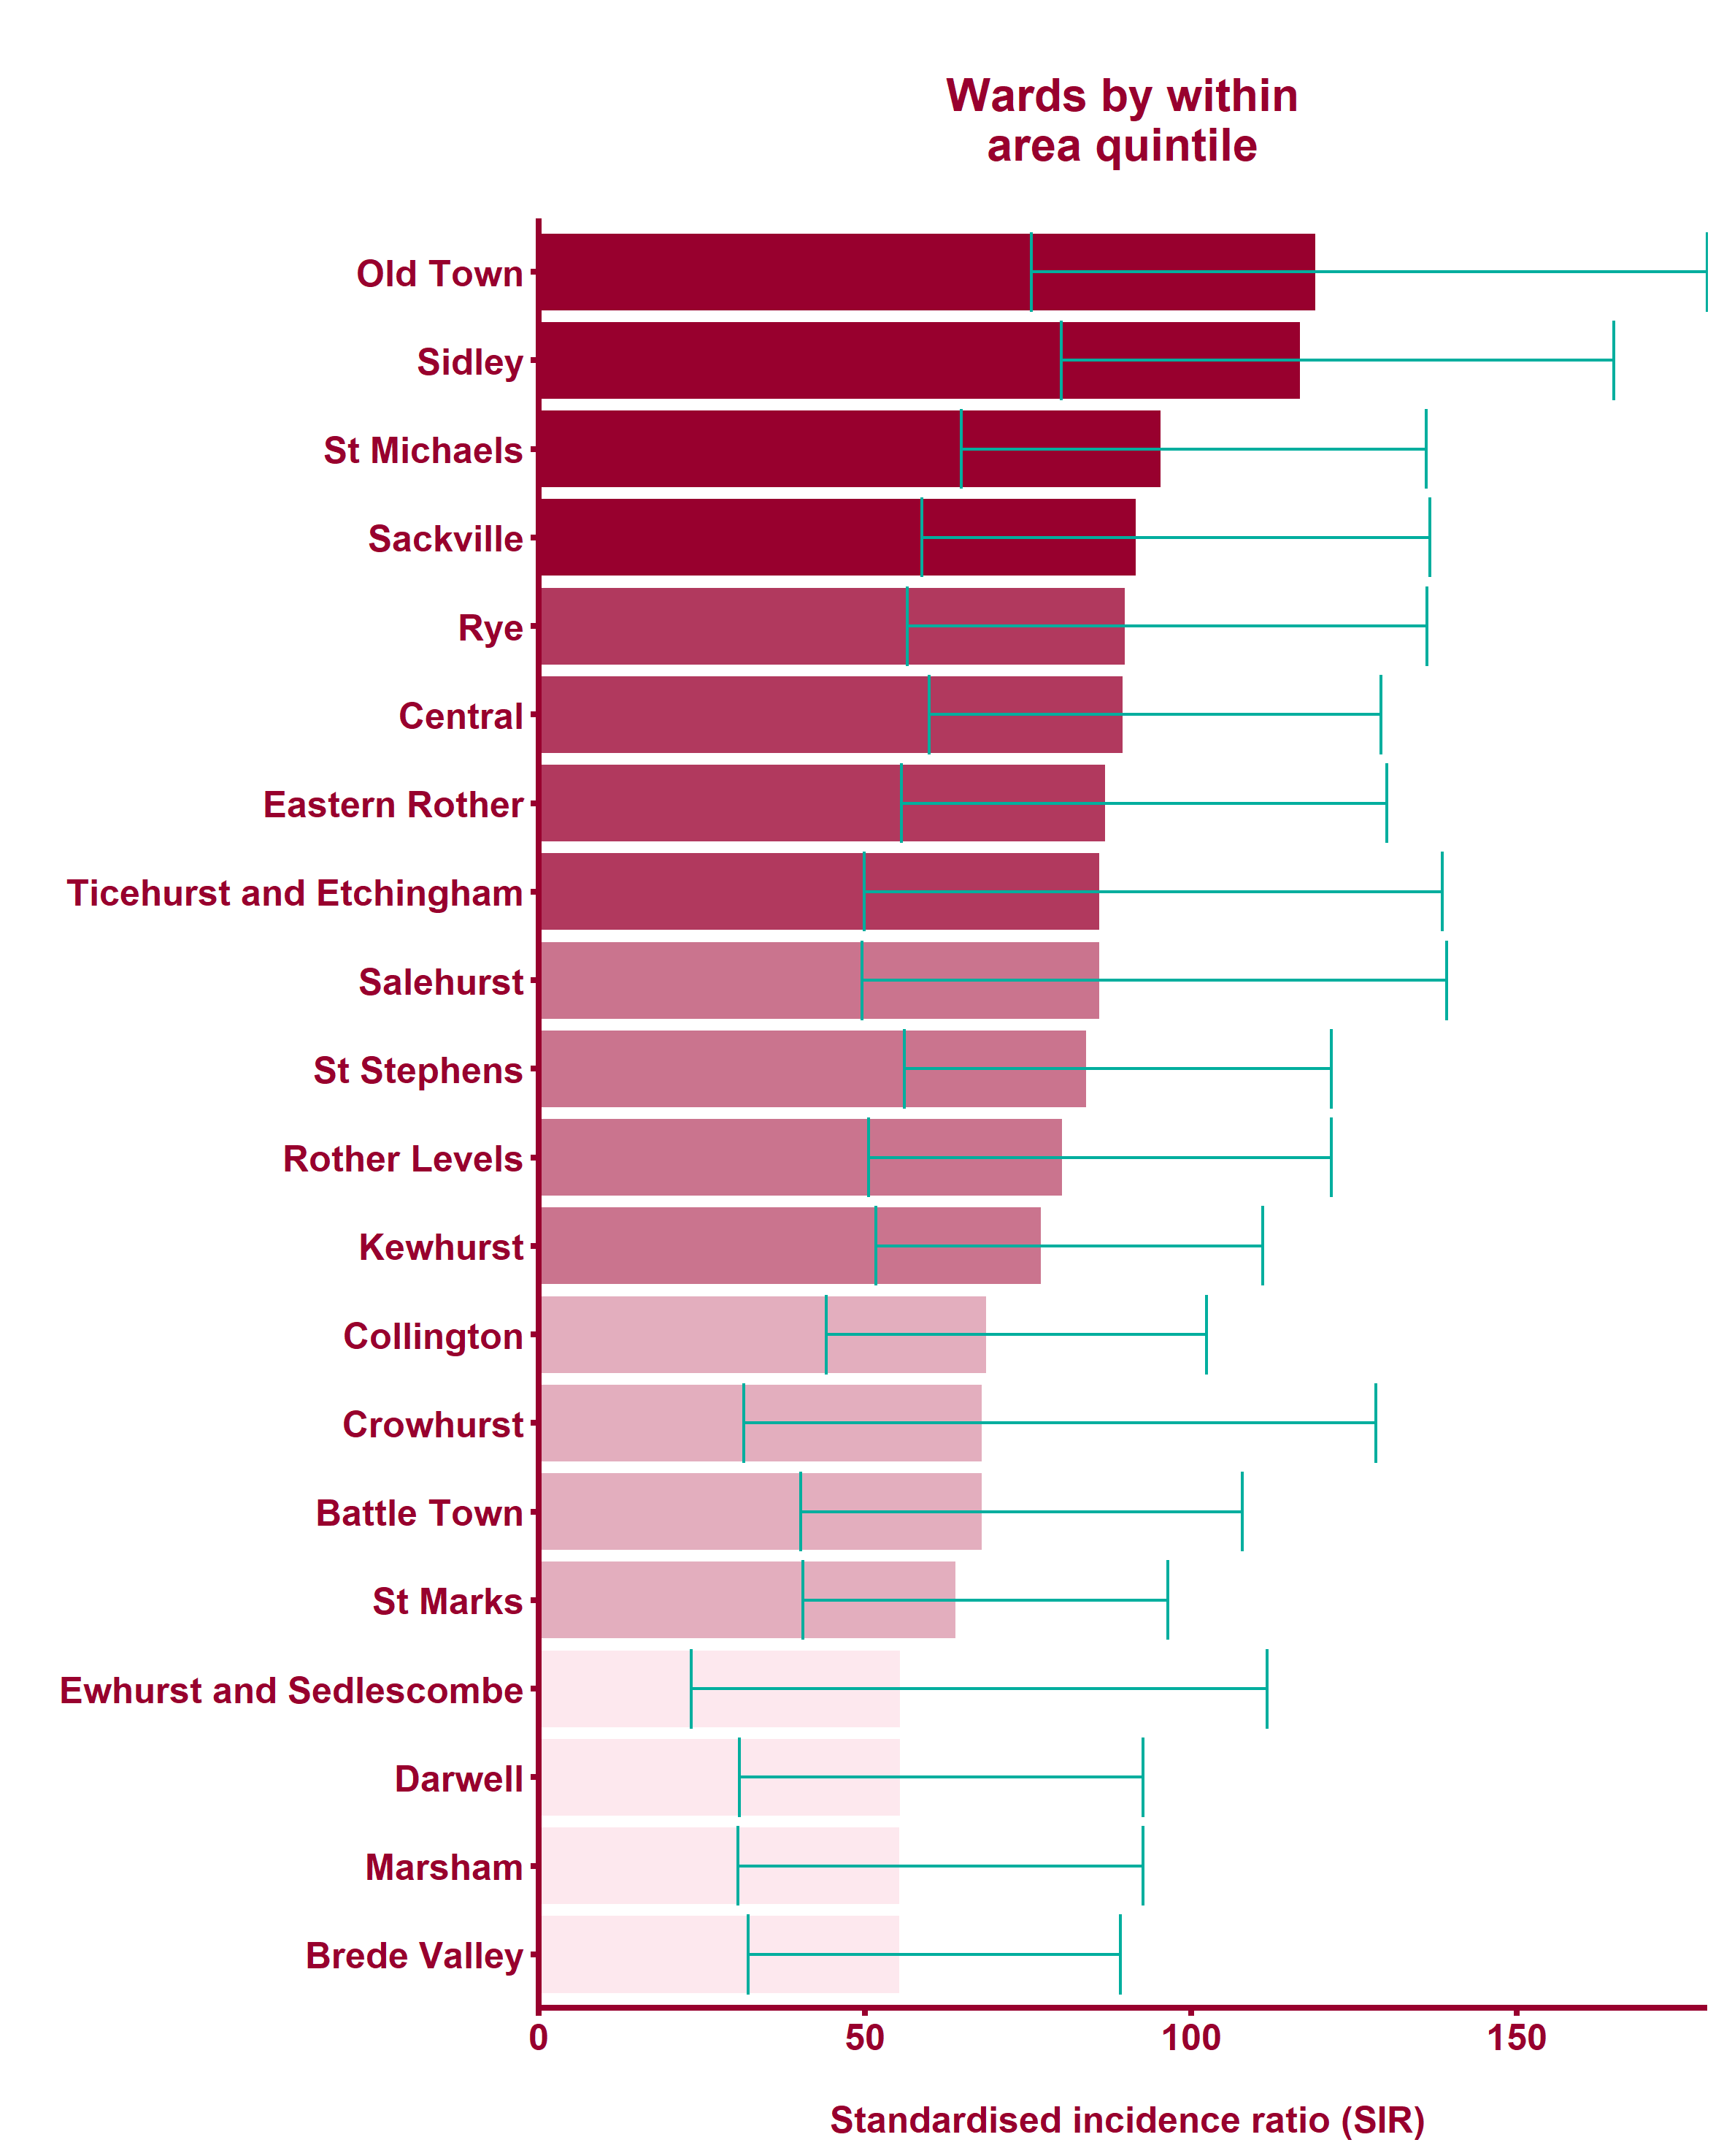

Incidence of lung cancer (2012 - 16)
Health Inequalities in Rother Version 1.1 Released Jan 2020
Notes:
Note: maps show wards shaded by within-area quintile for each indicator. Where wards are shaded yellow this indicates that the data is missing from Local Health.
For metadata see Local Health tool at: www.localhealth.org.uk

Slide 36

Global Burden of Disease: Headache disorders
Health Inequalities in Rother Version 1.1 Released Jan 2020

Slide 37

Headache disorders - National picture
Health Inequalities in Rother Version 1.1 Released Jan 2020
Notes:
Note: No local data on headache disorders is currently available from Local Health.
In GBD, 'headache disorders' is comprised of migraine and tension headache. Tension-type headache is more prevalent (36,129 per 100,000) than migraine (20,645 per 100,000), but, of the two, migraine has by far the biggest burden in terms of DALYs.
Source: GBD Compare, 2017.
https://vizhub.healthdata.org/gbd-compare/
2.3 million work days lost through sickness absence (recorded as headaches and migraines) in the UK.
Source: Labour Force Survey, 2017, ONS.
https://www.ons.gov.uk/employmentandlabourmarket/peopleinwork/employmentandemployeetypes/datasets/sicknessabsenceinthelabourmarket

Slide 38

Global Burden of Disease: Falls
Health Inequalities in Rother Version 1.1 Released Jan 2020

Slide 39

Falls - National picture
Health Inequalities in Rother Version 1.1 Released Jan 2020
Notes:
For people aged 60+, women are more likely to fall than men - 29.1% of women and 23.5% of men had a fall in previous 2 years.
Source: Gale C, Cooper C and Sayer A, 2016, Prevalence and risk factors for falls in older men and women: The English Longitudinal Study of Ageing, Age and Ageing; 45: 789-794.
https://www.ncbi.nlm.nih.gov/pmc/articles/PMC5105823/#afw129C4
Unaddressed fall hazards in the home are estimated to cost the NHS in England £435 million.
Source: Nicol S, Roys M, Garrett H, BRE. The cost of poor housing to the NHS [Internet]. BRE Trust; 2016.
Available from: www.bre.co.uk/filelibrary/pdf/87741-Cost-of-Poor-Housing-Briefing-Paper-v3.pdf.
Emergency admissions are higher for older people.
Source: Public Health Outcomes Framework, Emergency hospital admissions due to falls in people aged 65 and over - aged 65-79, 2017/18, England; Emergency hospital admissions due to falls in people aged 65 and over - aged 80+, 2017/18, England.
https://fingertips.phe.org.uk/profile/public-health-outcomes-framework
References and evidence to support falls prevention:
National Falls Prevention Coordination Group, 2019. Strength and Balance Quality Markers-supporting improvement.
https://www.gov.uk/government/publications/strength-and-balance-quality-markers-supporting-improvement
National Falls Prevention Coordination Group, 2017. Falls and Fractures consensus statement and resource pack.
https://www.gov.uk/government/publications/falls-and-fractures-consensus-statement
Royal College of Occupational Therapists, 2019. Adaptations without delay.
https://www.rcot.co.uk/news/rcot-launch-adaptations-without-delay-report
All Our Health-Falls Prevention (updated July 2019)-Information and resources for health professionals.
https://www.gov.uk/government/publications/falls-applying-all-our-health/falls-applying-all-our-health
Public Health England and Centre for Ageing Better. 2018. Muscle and bone strengthening and balance activities (MBSBA) for general health benefits in adults and older adults: summary of a rapid evidence review for the UK Chief Medical Officers' update of the physical activity guidelines.
https://assets.publishing.service.gov.uk/government/uploads/system/uploads/attachment_data/file/721874/MBSBA_evidence_review.pdf
Centre for Ageing Better, 2019. Raising the bar on strength and balance: the importance of community-based provision.
https://www.ageing-better.org.uk/publications/raising-bar-strength-balance

Slide 40


Emergency hospital admissions for hip fracture, ages 65+ (2013/14 - 2017/18)
Health Inequalities in Rother Version 1.1 Released Jan 2020
Notes:
Note: A different scale may be used for local data compared to regional data. The ward data points are sized according to their 2017 total population.
For metadata see Local Health tool at: www.localhealth.org.uk

Slide 41



Emergency hospital admissions for hip fracture, ages 65+ (2013/14 - 2017/18)
Health Inequalities in Rother Version 1.1 Released Jan 2020
Notes:
Note: maps show wards shaded by within-area quintile for each indicator. Where wards are shaded yellow this indicates that the data is missing from Local Health.
For metadata see Local Health tool at: www.localhealth.org.uk

Slide 42

Health inequalities within Rother for national strategic priorities
The following slides include additional indicators (not already
analysed) considered to reflect national strategic priorities for which
data is available in Local Health at ward level
Health Inequalities in Rother Version 1.1 Released Jan 2020
Notes:
NHS Long Term Plan: longtermplan.nhs.uk

Slide 43


Deaths from circulatory disease, under 75 years (2013 - 17)
Health Inequalities in Rother Version 1.1 Released Jan 2020
Notes:
Note: A different scale may be used for local data compared to regional data. The ward data points are sized according to their 2017 total population.
For metadata see Local Health tool at: www.localhealth.org.uk

Slide 44



Deaths from circulatory disease, under 75 years (2013 - 17)
Health Inequalities in Rother Version 1.1 Released Jan 2020
Notes:
Note: maps show wards shaded by within-area quintile for each indicator. Where wards are shaded yellow this indicates that the data is missing from Local Health.
For metadata see Local Health tool at: www.localhealth.org.uk

Slide 45


Incidences of all cancers (2012 - 16)
Health Inequalities in Rother Version 1.1 Released Jan 2020
Notes:
Note: A different scale may be used for local data compared to regional data. The ward data points are sized according to their 2017 total population.
For metadata see Local Health tool at: www.localhealth.org.uk

Slide 46



Incidences of all cancers (2012 - 16)
Health Inequalities in Rother Version 1.1 Released Jan 2020
Notes:
Note: maps show wards shaded by within-area quintile for each indicator. Where wards are shaded yellow this indicates that the data is missing from Local Health.
For metadata see Local Health tool at: www.localhealth.org.uk

Slide 47


Deaths from respiratory diseases, all ages (2013 - 17)
Health Inequalities in Rother Version 1.1 Released Jan 2020
Notes:
Note: A different scale may be used for local data compared to regional data. The ward data points are sized according to their 2017 total population.
For metadata see Local Health tool at: www.localhealth.org.uk

Slide 48



Deaths from respiratory diseases, all ages (2013 - 17)
Health Inequalities in Rother Version 1.1 Released Jan 2020
Notes:
Note: maps show wards shaded by within-area quintile for each indicator. Where wards are shaded yellow this indicates that the data is missing from Local Health.
For metadata see Local Health tool at: www.localhealth.org.uk

Slide 49


Hospital stays for self harm (2013/14 - 2017/18)
Health Inequalities in Rother Version 1.1 Released Jan 2020
Notes:
Note: A different scale may be used for local data compared to regional data. The ward data points are sized according to their 2017 total population.
For metadata see Local Health tool at: www.localhealth.org.uk

Slide 50



Hospital stays for self harm (2013/14 - 2017/18)
Health Inequalities in Rother Version 1.1 Released Jan 2020
Notes:
Note: maps show wards shaded by within-area quintile for each indicator. Where wards are shaded yellow this indicates that the data is missing from Local Health.
For metadata see Local Health tool at: www.localhealth.org.uk

Slide 51


Hospital stays for alcohol-related harm, Broad definition (2013/14 - 2017/18)
Health Inequalities in Rother Version 1.1 Released Jan 2020
Notes:
Note: A different scale may be used for local data compared to regional data. The ward data points are sized according to their 2017 total population.
For metadata see Local Health tool at: www.localhealth.org.uk

Slide 52



Hospital stays for alcohol-related harm, Broad definition (2013/14 - 2017/18)
Health Inequalities in Rother Version 1.1 Released Jan 2020
Notes:
Note: maps show wards shaded by within-area quintile for each indicator. Where wards are shaded yellow this indicates that the data is missing from Local Health.
For metadata see Local Health tool at: www.localhealth.org.uk

Slide 53


Hospital stays for alcohol-related harm, Narrow definition (2013/14 - 2017/18)
Health Inequalities in Rother Version 1.1 Released Jan 2020
Notes:
Note: A different scale may be used for local data compared to regional data. The ward data points are sized according to their 2017 total population.
For metadata see Local Health tool at: www.localhealth.org.uk

Slide 54



Hospital stays for alcohol-related harm, Narrow definition (2013/14 - 2017/18)
Health Inequalities in Rother Version 1.1 Released Jan 2020
Notes:
Note: maps show wards shaded by within-area quintile for each indicator. Where wards are shaded yellow this indicates that the data is missing from Local Health.
For metadata see Local Health tool at: www.localhealth.org.uk

Slide 55


Obese children, Reception Year (2015/16 - 2017/18)
Health Inequalities in Rother Version 1.1 Released Jan 2020
Notes:
Note: A different scale may be used for local data compared to regional data. The ward data points are sized according to their 2017 total population.
For metadata see Local Health tool at: www.localhealth.org.uk

Slide 56



Obese children, Reception Year (2015/16 - 2017/18)
Health Inequalities in Rother Version 1.1 Released Jan 2020
Notes:
Note: maps show wards shaded by within-area quintile for each indicator. Where wards are shaded yellow this indicates that the data is missing from Local Health.
For metadata see Local Health tool at: www.localhealth.org.uk

Slide 57


Obese children, Year 6 (2015/16 - 2017/18)
Health Inequalities in Rother Version 1.1 Released Jan 2020
Notes:
Note: A different scale may be used for local data compared to regional data. The ward data points are sized according to their 2017 total population.
For metadata see Local Health tool at: www.localhealth.org.uk

Slide 58



Obese children, Year 6 (2015/16 - 2017/18)
Health Inequalities in Rother Version 1.1 Released Jan 2020
Notes:
Note: maps show wards shaded by within-area quintile for each indicator. Where wards are shaded yellow this indicates that the data is missing from Local Health.
For metadata see Local Health tool at: www.localhealth.org.uk

Slide 59

Further health inequalities strongly associated with deprivation in Rother
Some other indicators show a particularly strong association with
deprivation (rank of IMD 2019 score) locally
The following slide lists those indicators most strongly associated
with deprivation locally, with the top three (not already analysed)
explored further
Health Inequalities in Rother Version 1.1 Released Jan 2020

Slide 60

Health inequalities within Rother
(Sorted by R-squared value)
Health Inequalities in Rother Version 1.1 Released Jan 2020
Notes:
Top 15 Local Health indicators listed by strength of R-squared value
The three highlighted are further explored in the following slides

Slide 61


Emergency hospital admissions for all causes (2013/14 - 2017/18)
Health Inequalities in Rother Version 1.1 Released Jan 2020
Notes:
Note: A different scale may be used for local data compared to regional data. The ward data points are sized according to their 2017 total population.
For metadata see Local Health tool at: www.localhealth.org.uk

Slide 62



Emergency hospital admissions for all causes (2013/14 - 2017/18)
Health Inequalities in Rother Version 1.1 Released Jan 2020
Notes:
Note: maps show wards shaded by within-area quintile for each indicator. Where wards are shaded yellow this indicates that the data is missing from Local Health.
For metadata see Local Health tool at: www.localhealth.org.uk

Slide 63


GCSE Achievement (2013/14)
Health Inequalities in Rother Version 1.1 Released Jan 2020
Notes:
Note: A different scale may be used for local data compared to regional data. The ward data points are sized according to their 2017 total population.
For metadata see Local Health tool at: www.localhealth.org.uk

Slide 64



GCSE Achievement (2013/14)
Health Inequalities in Rother Version 1.1 Released Jan 2020
Notes:
Note: maps show wards shaded by within-area quintile for each indicator. Where wards are shaded yellow this indicates that the data is missing from Local Health.
For metadata see Local Health tool at: www.localhealth.org.uk

Slide 65


Life expectancy at birth for males (2013 - 17)
Health Inequalities in Rother Version 1.1 Released Jan 2020
Notes:
Note: A different scale may be used for local data compared to regional data. The ward data points are sized according to their 2017 total population.
For metadata see Local Health tool at: www.localhealth.org.uk

Slide 66



Life expectancy at birth for males (2013 - 17)
Health Inequalities in Rother Version 1.1 Released Jan 2020
Notes:
Note: maps show wards shaded by within-area quintile for each indicator. Where wards are shaded yellow this indicates that the data is missing from Local Health.
For metadata see Local Health tool at: www.localhealth.org.uk

Slide 67
Feedback
We would be very interested to hear your views on these Health Inequalities Slides
If you would like to let us know your thoughts, or have any questions, then please contact your regional LKIS team at the address below:
LKISSouthEast@phe.gov.uk
Health Inequalities in Rother Version 1.1 Released Jan 2020

