Slide 1
Patterns and trends in child obesity in
East Sussex
A presentation of 2022 to 2023 NCMP data at local authority level
PHA-OHID@dhsc.gov.uk
March 2024

Slide 2
National Child Measurement Programme
The National Child Measurement Programme (NCMP), established in 2006, collects annual measurements of the height and weight of over one million children in reception (aged 4 to 5 years) and year 6 (aged 10 to 11 years) in primary schools across England.
This slide set presents data from the 2022 to 2023 academic year showing the patterns and trends in the prevalence of overweight and obesity among reception and year 6 children in East Sussex.
The number of children measured in East Sussex in 2022 to 2023 was 4,845 in reception, and 5,245 in year 6. The participation rate in East Sussex in 2022 to 2023 was 94.3% in reception children and 91.4% for children in year 6.
Trend data for participation rates, total participation and split by school year group, in the NCMP from academic years ending 2011 to 2023 is available in
the Obesity Profile.
2

Slide 3
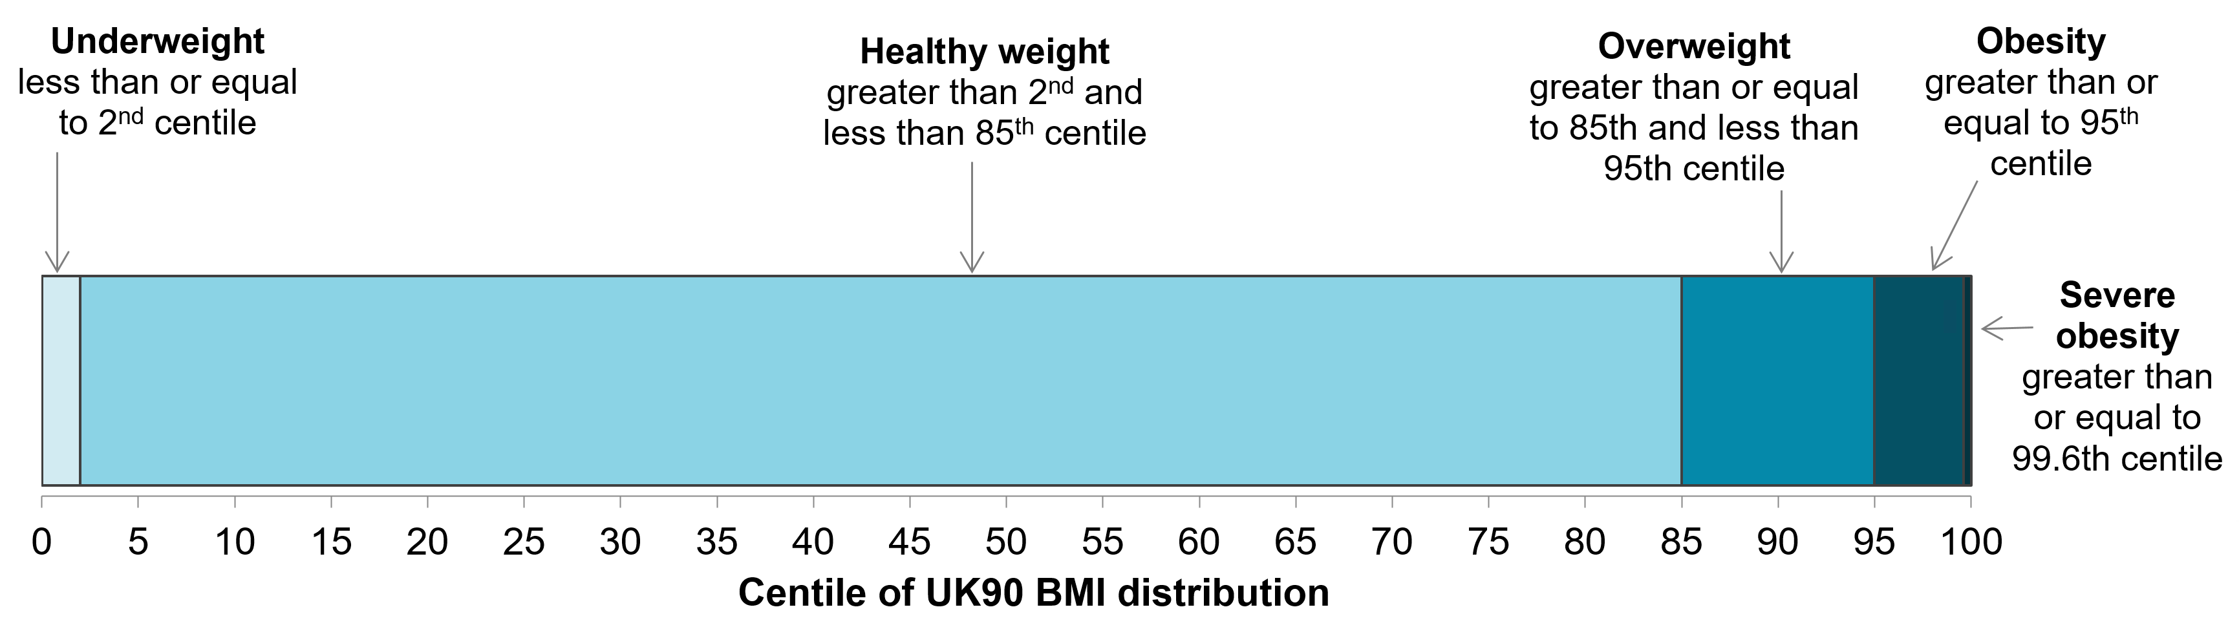
Child body mass index classification
Definitions for population monitoring
For population monitoring purposes, a child’s body mass index (BMI) is classed as overweight or obese where it is on or above the 85th centile or 95th centile, respectively, based on the British 1990 (UK90 ) growth reference data. The population monitoring cut offs for overweight and obesity are lower than the clinical cut offs (91st and 98th centiles for overweight and obesity) used to assess individual children; this is to capture children in the population in the clinical overweight or obesity BMI categories and those who are at high risk of moving into the clinical overweight or clinical obesity categories. This helps ensure that adequate services are planned and delivered for the whole population.
1
1 Cole TJ, Freeman JV, Preece MA. Body mass index reference curves for the UK, 1990. Archives of Disease in Childhood 1995 73:25-29.
3

Slide 4


Prevalence of overweight (including obesity) in East Sussex by age
National Child Measurement Programme 2022 to 2023
In 2022 to 2023, 22.1% in reception (aged 4 to 5 years) were overweight or living with obesity
In 2022 to 2023, 32.6% in year 6 (aged 10 to 11 years) were overweight or living with obesity
4

Slide 5


Prevalence of obesity in East Sussex by age
National Child Measurement Programme 2022 to 2023
In 2022 to 2023, 8.6% in reception (aged 4 to 5 years) were living with obesity
In 2022 to 2023, 19.3% in year 6 (aged 10 to 11 years) were living with obesity
5

Slide 6
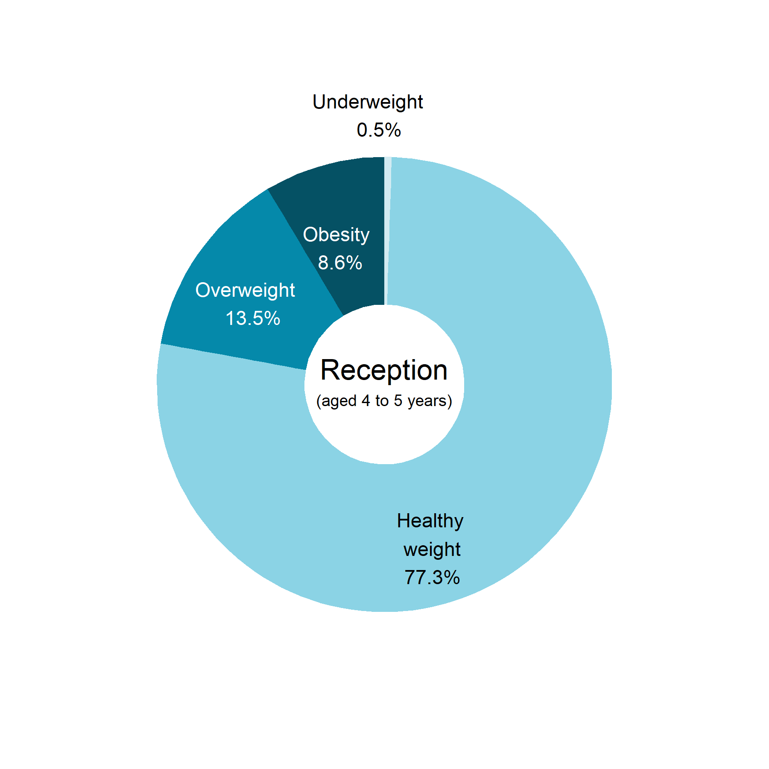
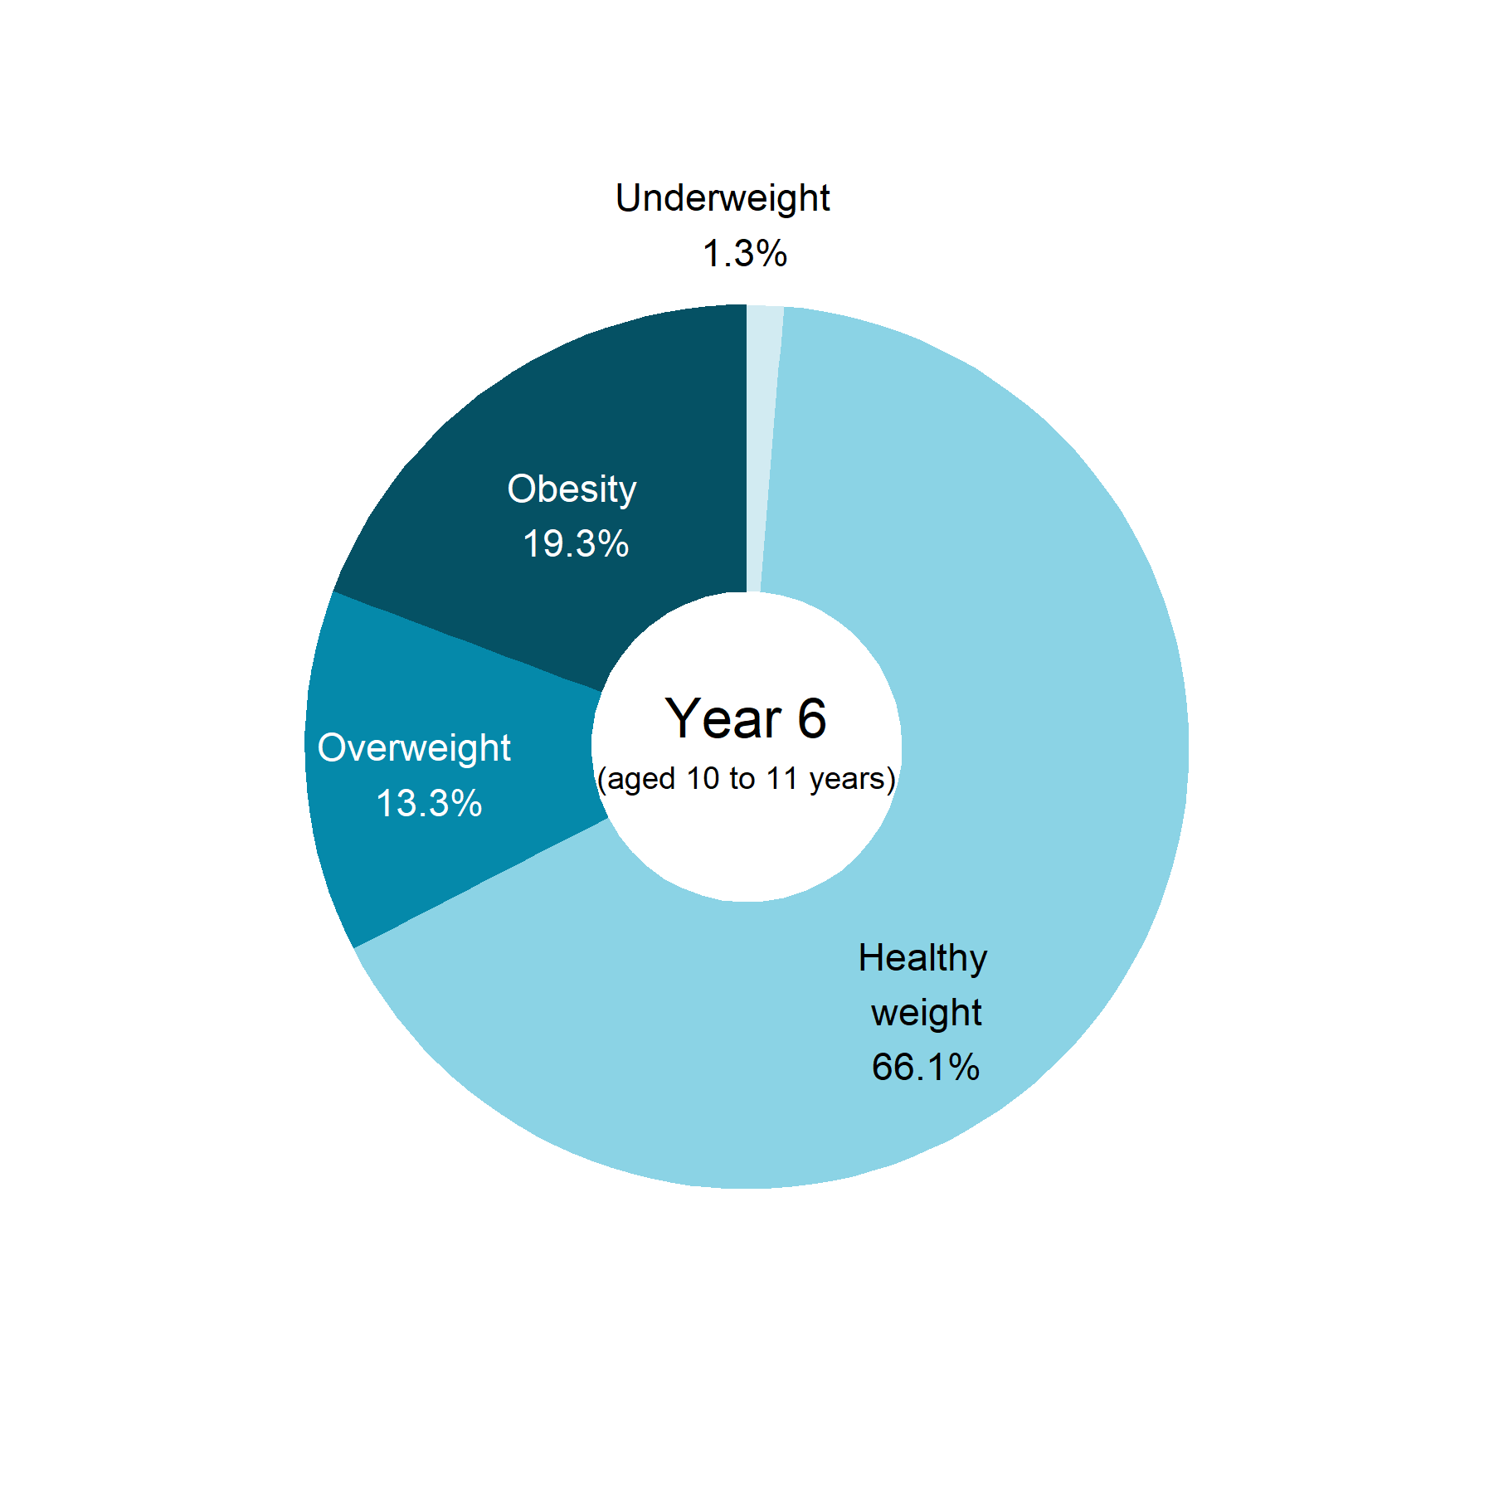
BMI status of children by age in East Sussex
National Child Measurement Programme 2022 to 2023
Totals may not sum due to rounding
6

Slide 7
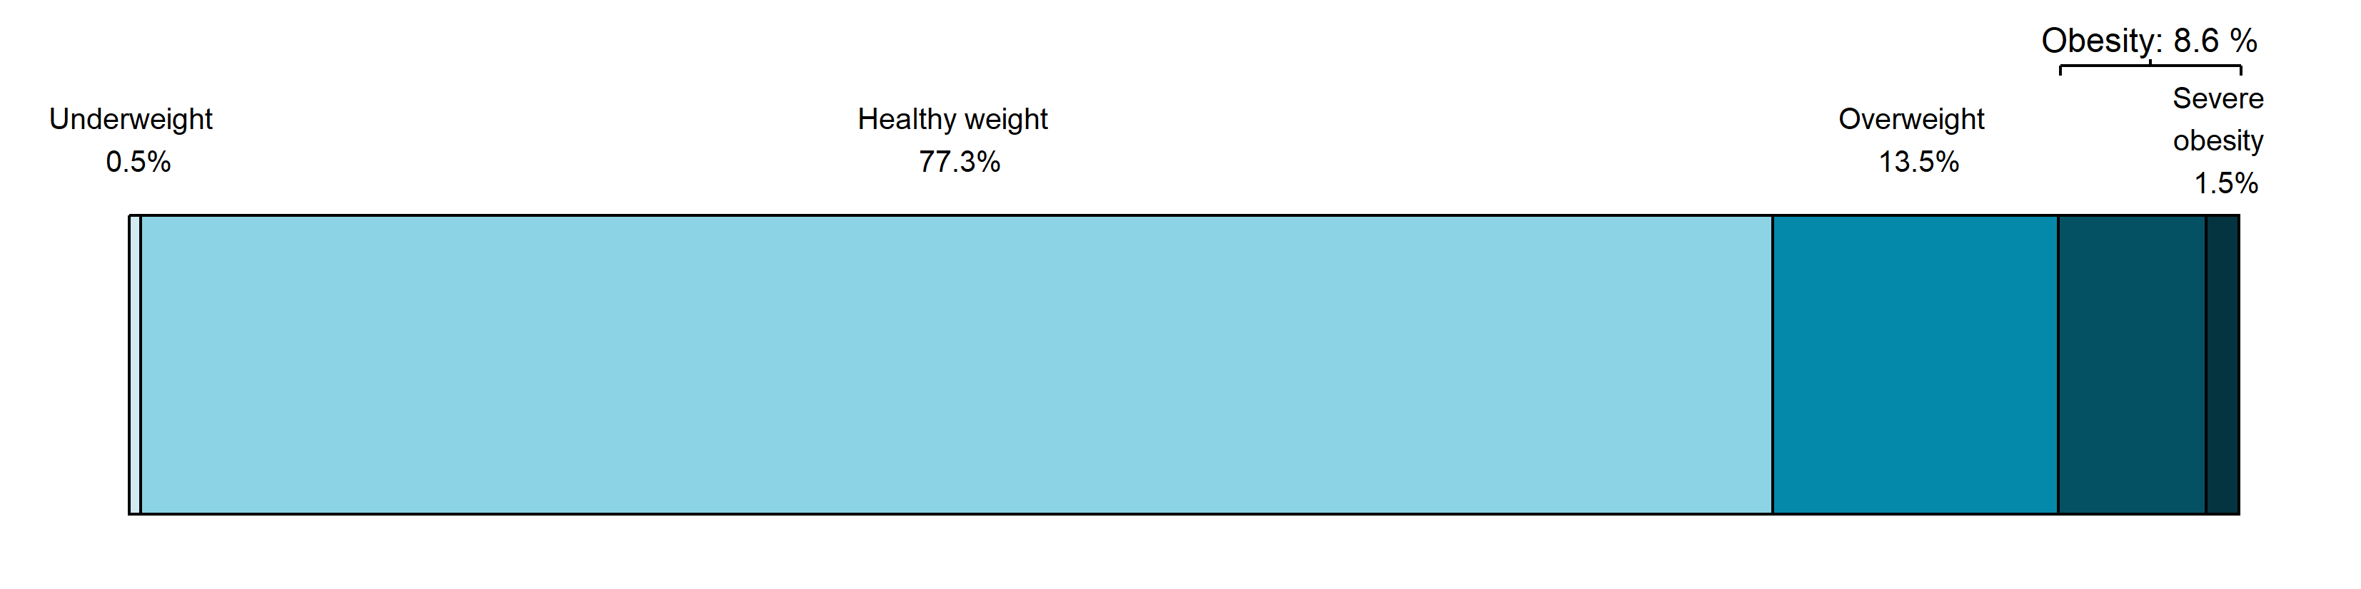
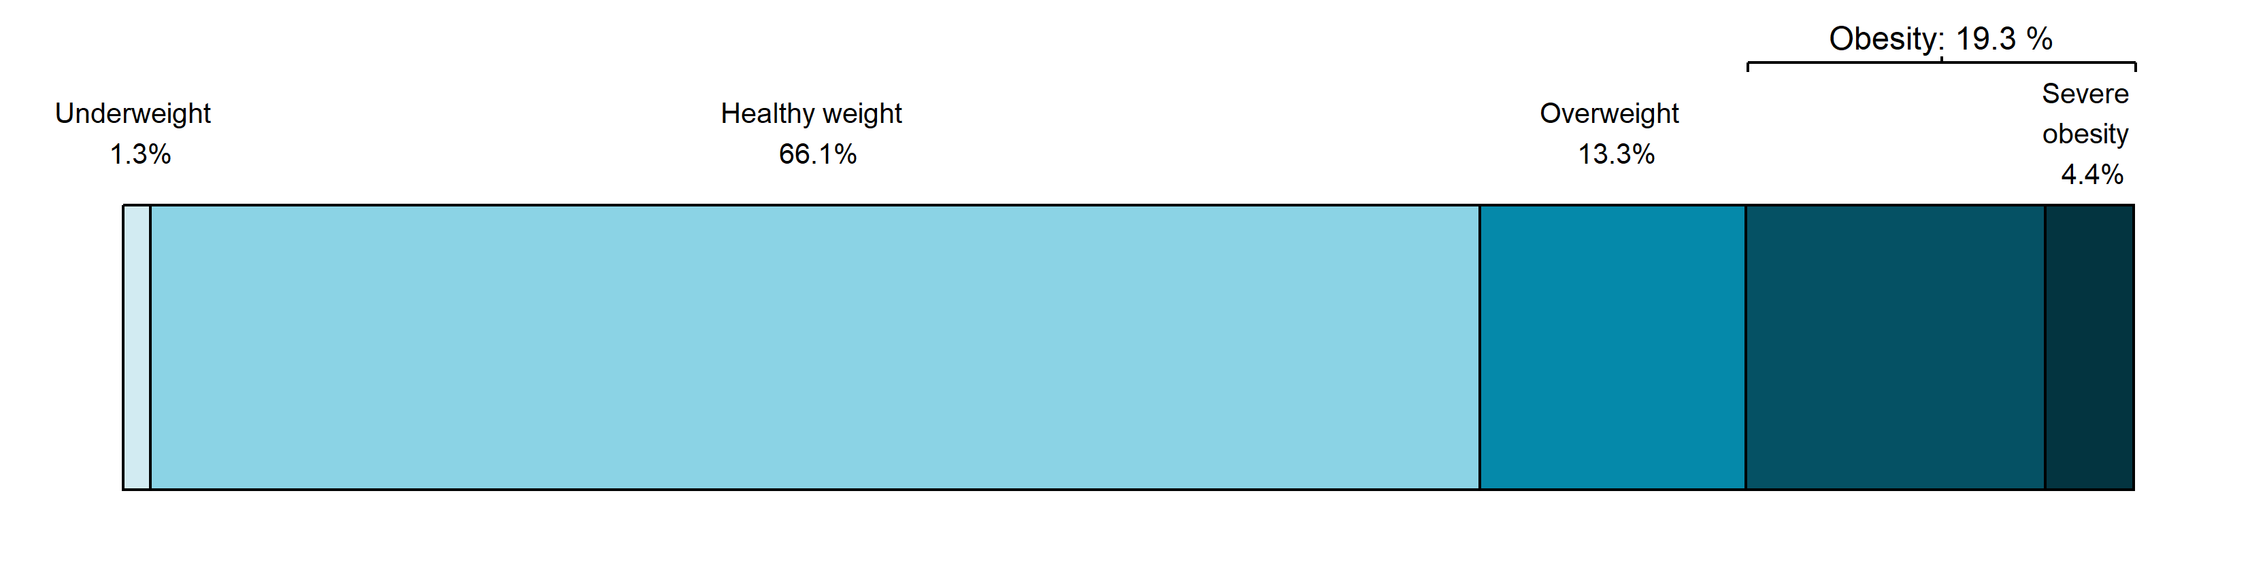
BMI status of children by age in East Sussex
National Child Measurement Programme 2022 to 2023
Reception
(aged 4 to 5 years)
Year 6
(aged 10 to 11 years)
Totals may not sum due to rounding
7

Slide 8
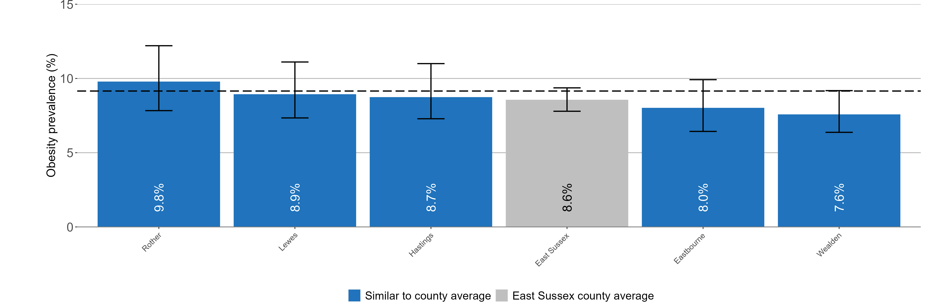
Child obesity in East Sussex District Authorities
Prevalence of obesity, National Child Measurement Programme 2022 to 2023
Children in reception (aged 4 to 5 years)
England: 9.2%
England value shown as a dashed line on the chart
95% confidence intervals are shown
8

Slide 9
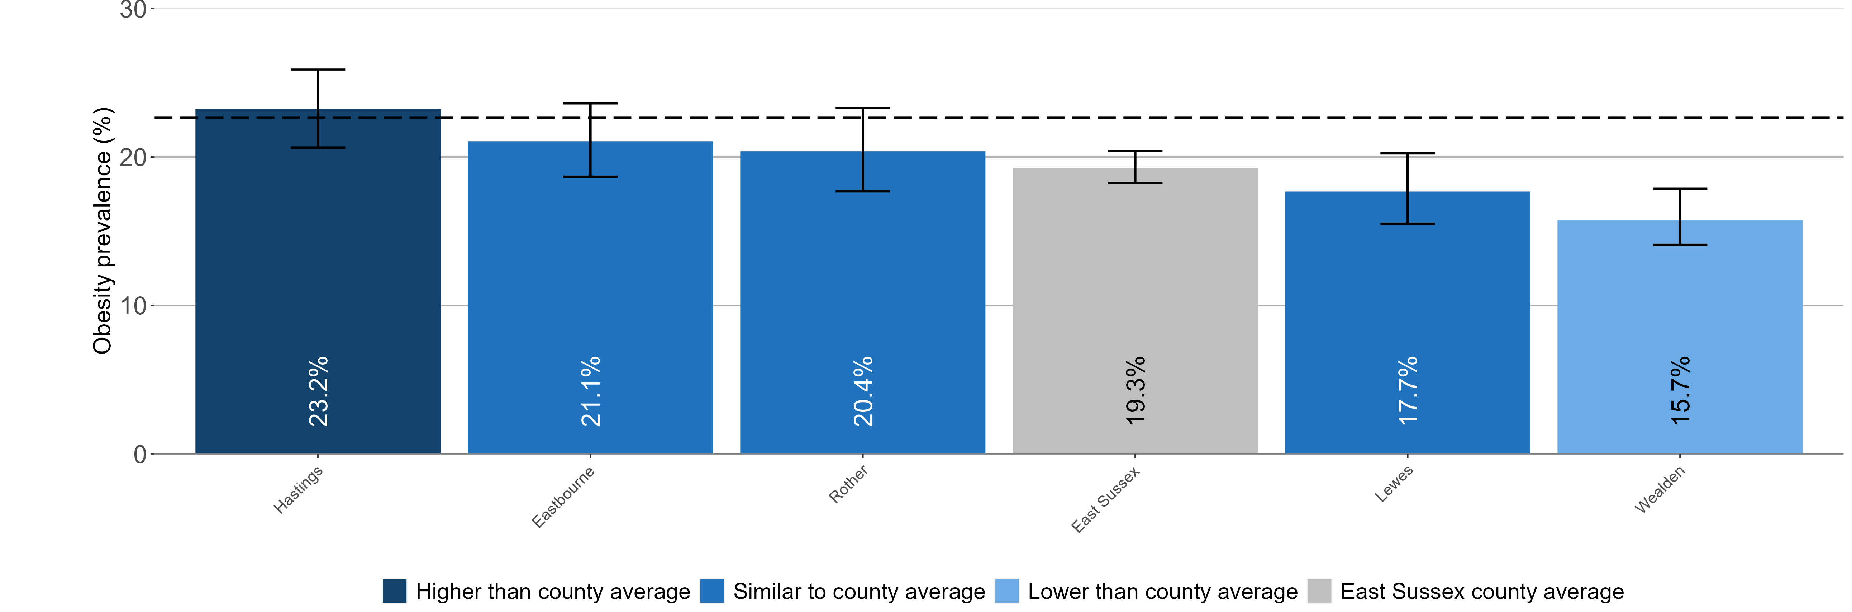
Child obesity in East Sussex District Authorities
Prevalence of obesity, National Child Measurement Programme 2022 to 2023
Children in year 6 (aged 10 to 11 years)
England: 22.7%
England value shown as a dashed line on the chart
95% confidence intervals are shown
9

Slide 10
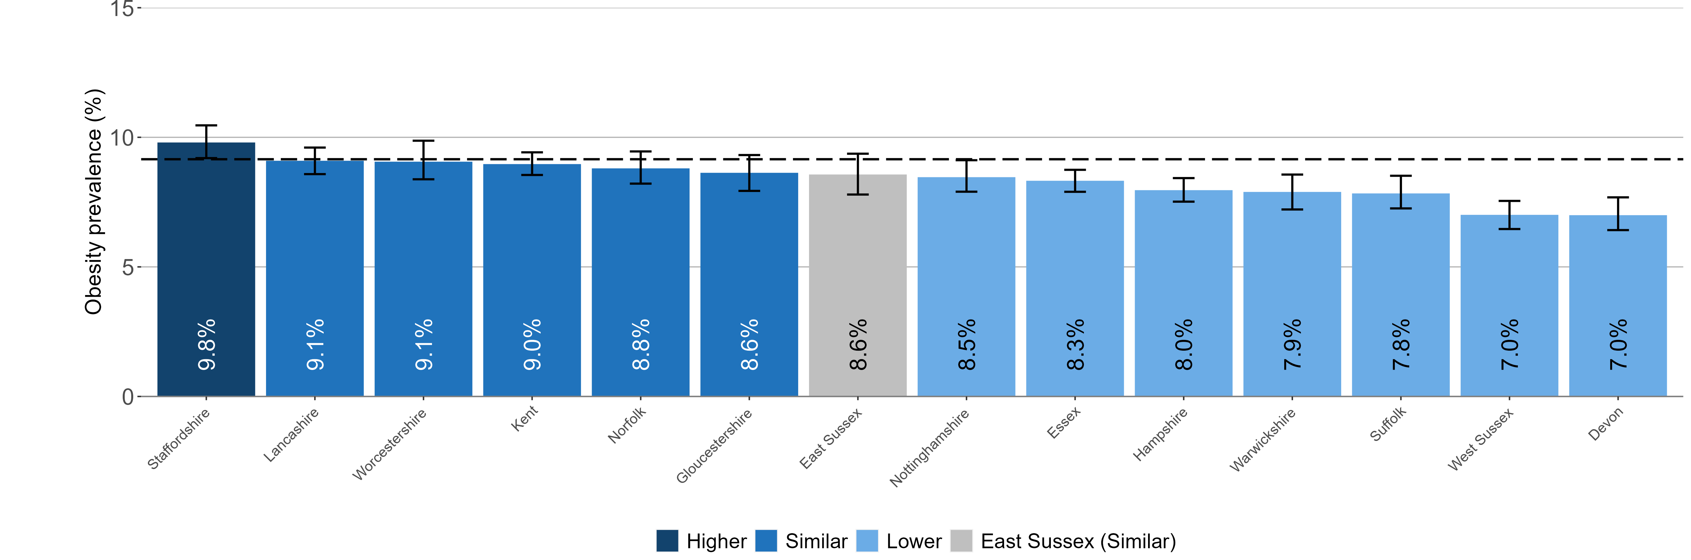
Child obesity in East Sussex
Prevalence of obesity, National Child Measurement Programme 2022 to 2023
East Sussex compared to its statistical nearest neighbours, CIPFA 2021
Children in reception (aged 4 to 5 years)
England: 9.2%
CIPFA lookup not available for geographic areas that were created since April 2023
Local authorities are compared to England value shown as a dashed line on the chart
95% confidence intervals are shown
10

Slide 11
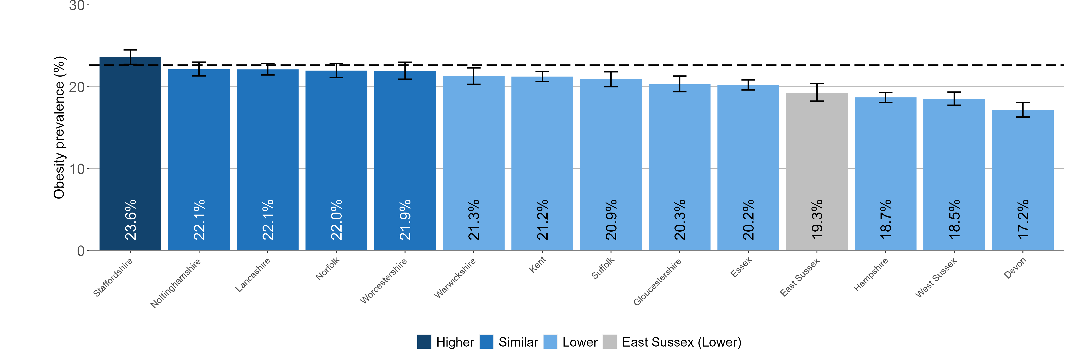
Child obesity in East Sussex
Prevalence of obesity, National Child Measurement Programme 2022 to 2023
East Sussex compared to its statistical nearest neighbours, CIPFA 2021
Children in year 6 (aged 10 to 11 years)
England: 22.7%
CIPFA lookup not available for geographic areas that were created since April 2023
Local authorities are compared to England value shown as a dashed line on the chart
95% confidence intervals are shown
11

Slide 12
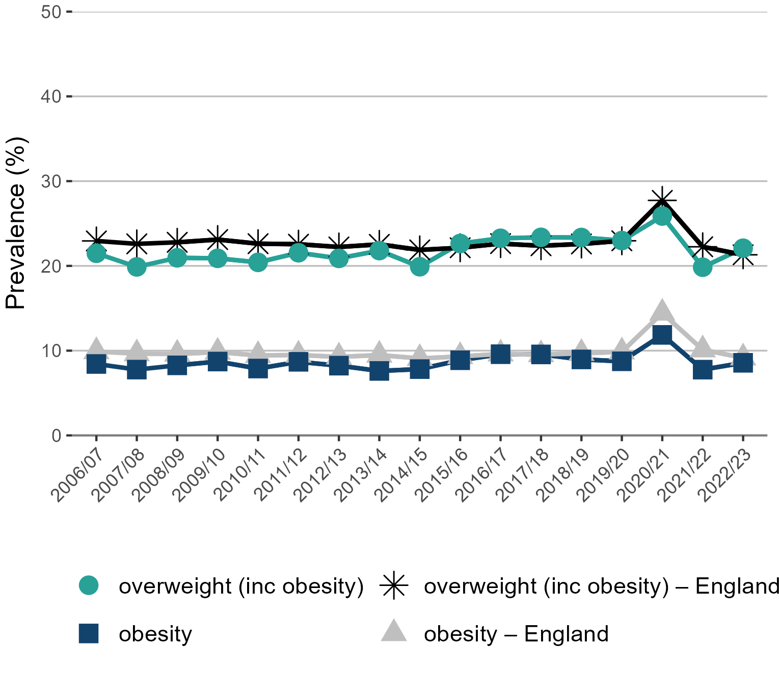
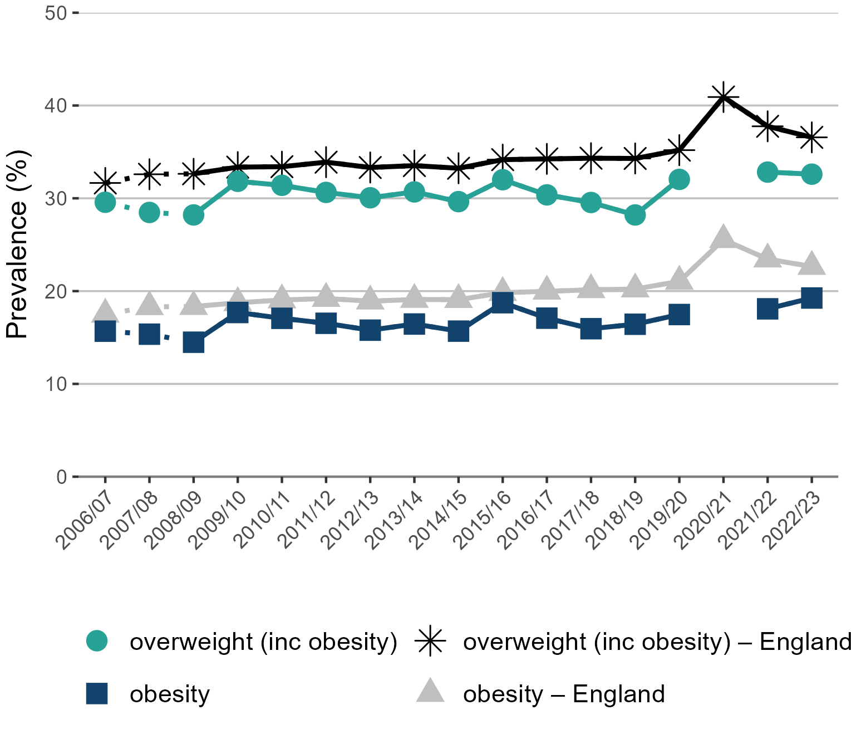
Trend in the prevalence of obesity and overweight (including obesity) by age in East Sussex
National Child Measurement Programme between 2006 to 2007 and 2022 to 2023
Children in reception (aged 4 to 5 years)
Children in year 6 (aged 10 to 11 years)
Missing data point denotes missing data for 2020 to 2021
Note: for Year 6, comparisons are not possible with the first years of the NCMP (2006 to 2007 and 2008 to 2009) as low participation levels led to underestimation of obesity prevalence
12

Slide 13
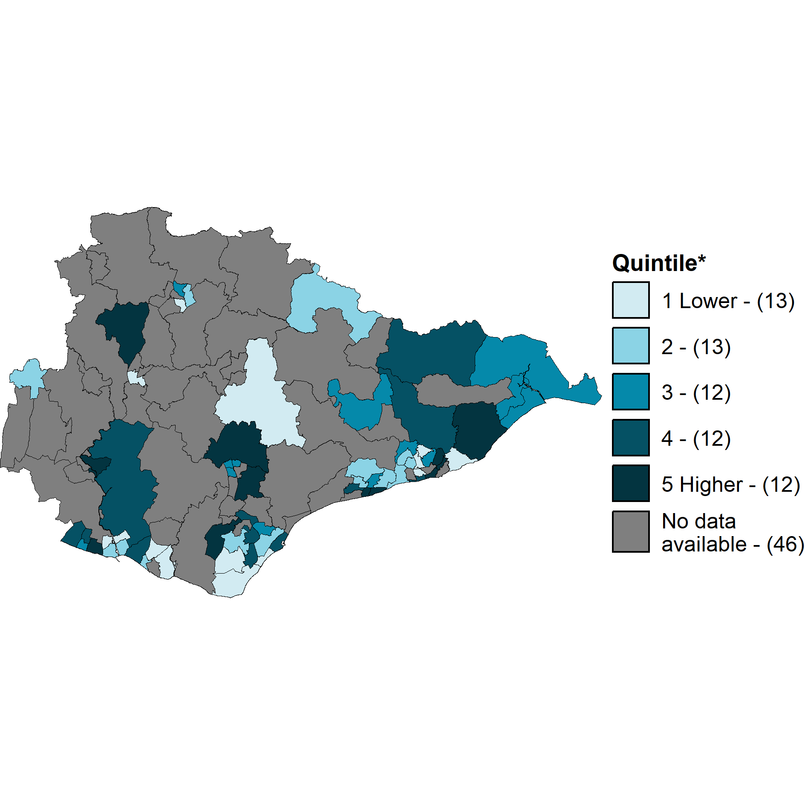
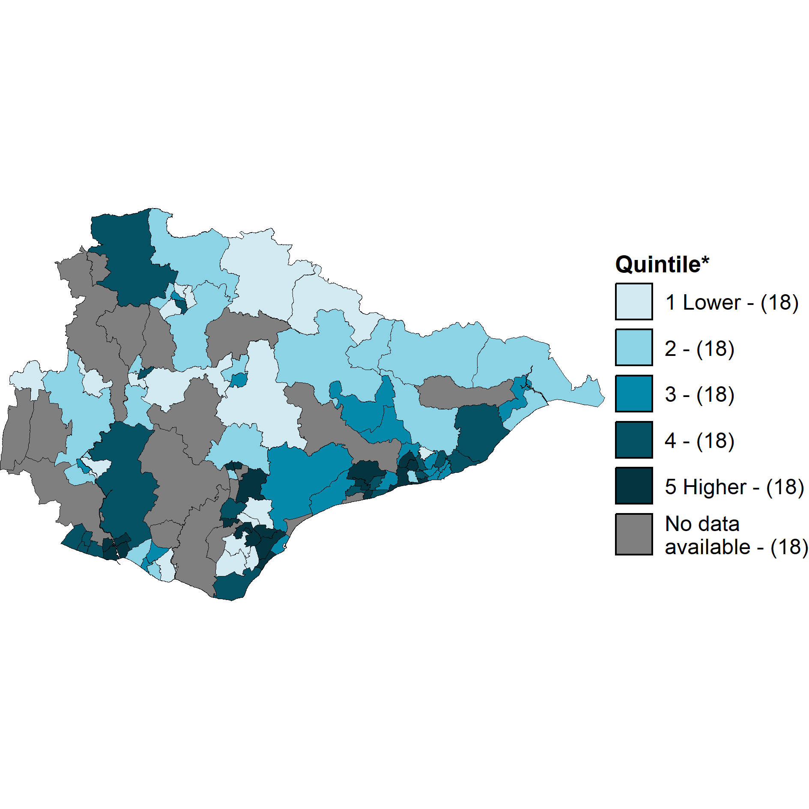
Prevalence of obesity in East Sussex wards
National Child Measurement Programme
Children in reception (aged 4 to 5 years)
Children in year 6 (aged 10 to 11 years)
Contains Ordnance Survey data © Crown copyright and database right 2024.
Contains National Statistics data © Crown copyright and database right 2024.
Contains Ordnance Survey data © Crown copyright and database right 2024.
Contains National Statistics data © Crown copyright and database right 2024.
Data combined 3-years, (2019 to 2020, 2021 to 2022, and 2022 to 2023), see note on slide 18
Ward boundaries 2021
* Number of wards in each quintile is shown in brackets in the map legends
13

Slide 14
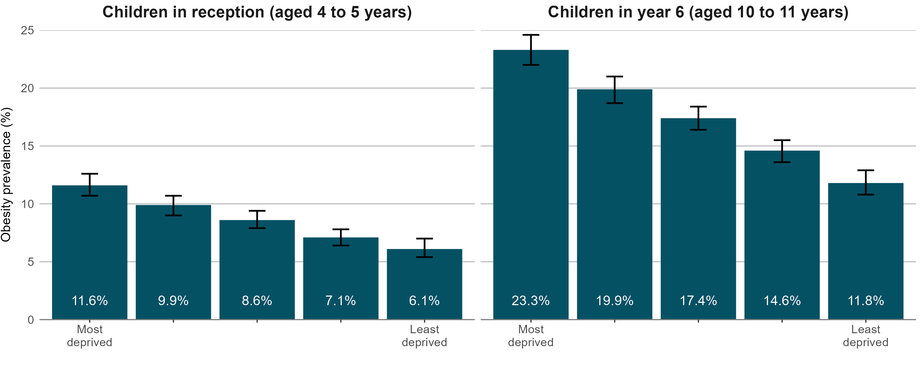
Obesity prevalence by deprivation and age in East Sussex
National Child Measurement Programme
Index of Multiple Deprivation 2019
Index of Multiple Deprivation 2019
Data combined 5-years, (2017 to 2018, 2018 to 2019, 2019 to 2020, 2021 to 2022, and 2022 to 2023), see note on slide 18
95% confidence intervals are displayed on the chart
14

Slide 15
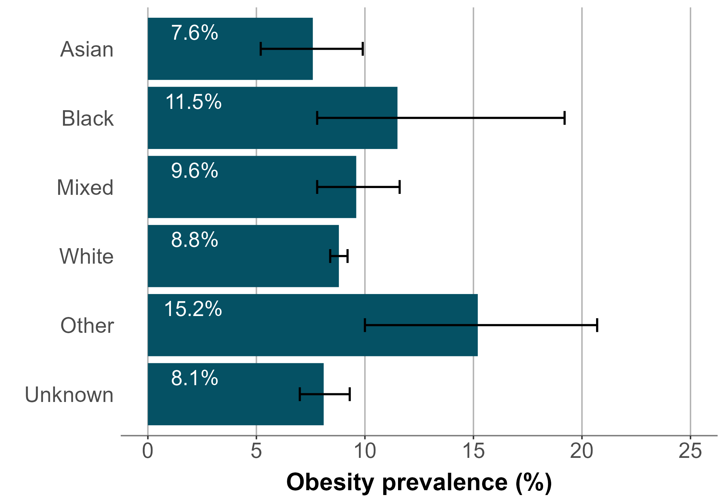
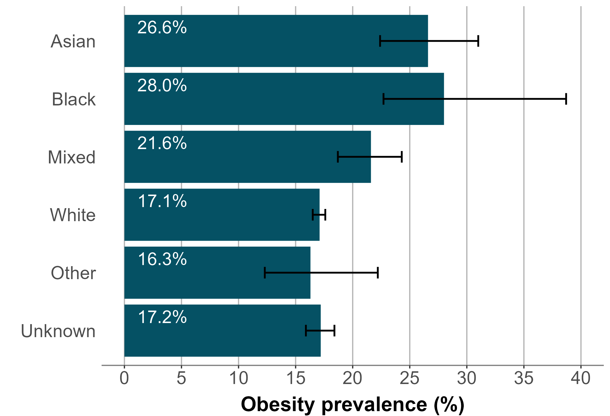
Obesity prevalence by ethnic group in East Sussex
National Child Measurement Programme
Children in reception (aged 4 to 5 years)
Children in year 6 (aged 10 to 11 years)
Data combined 5-years, (2017 to 2018, 2018 to 2019, 2019 to 2020, 2021 to 2022, and 2022 to 2023), see note on slide 18
95% confidence intervals are displayed on the chart
15

Slide 16
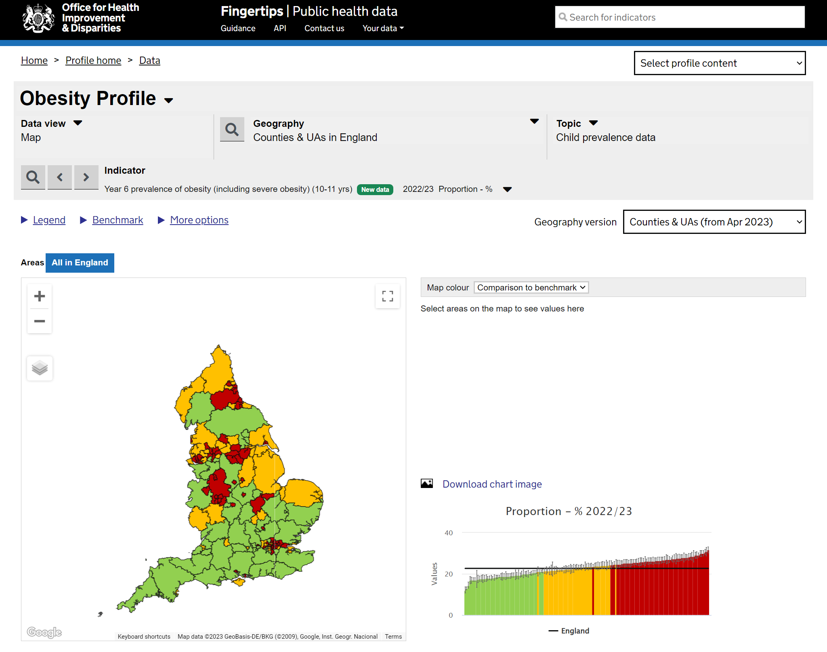
Obesity Profile on Fingertips
The Obesity Profile on Fingertips displays data from the National Child Measurement Programme.
Indicators on the prevalence of underweight, healthy weight overweight, obesity, and severe obesity are shown for England, regions, upper and lower tier local authorities, Integrated Care Boards, electoral wards, and middle super output areas.
Inequalities data is also displayed showing differences in prevalence by sex, ethnic group, and deprivation.
http://fingertips.phe.org.uk/profile/national-child-measurement-programme
Screenshot of webpage
16

Slide 17
Impact of the COVID-19 pandemic on NCMP data collection
The 2019 to 2020 NCMP data collection stopped in March 2020 when schools were closed due to the Covid-19 pandemic. In a usual NCMP collection year, national participation rates are around 95% (over a million) of all eligible children, however in 2019 to 2020 the number of children measured was around 75% of previous years. Despite the lower than usual number of measurements, analysis by NHS England confirms that figures at national and regional level are directly comparable to previous and future years.
The 2020 to 2021 NCMP had a delayed start due to the COVID-19 pandemic. Local authorities were still able to collect enough data to enable the production of national and regional estimates of prevalence by body mass index (BMI) category. Around 300,000 children (25% of previous full measurement years) were measured but the sample was not fully representative of the child population. Therefore weighting was used in the analysis to produce valid estimates of prevalence that could be compared to data from previous and future years. Further information on the 2020 to 2021 data collection and weighting methods
The 2021 to 2022 NCMP was the first data collection since the COVID-19 pandemic that was unaffected by school closures and other public health measures. Over 1.17 million children were measured in which is 92% of all children that were eligible to take part. This participation rate, though high, is lower than pre-pandemic years where participation had been at 95% since the data collection in 2014 to 2015. This is likely to be due to resourcing issues within some local authorities during the pandemic recovery process.
is available in the NHS England report.
17

Slide 18
NCMP methodology note
Describing an area as similar, higher or lower
For the data in this slide pack a local authority value is described as similar, higher or lower based on statistically significant differences from the England value. Statistical comparisons are undertaken by comparing the confidence intervals of a local authority value to see if they overlap with the England value, with non-overlapping confidence intervals being considered as statistically significantly different. Where the England value lies within the confidence interval of a local authority it is described as similar. Where the England value is higher than the confidence interval, local authorities values are described as higher and where the value is lower than the confidence interval, local authorities values are described as lower.
Data quality issues for three and five year grouped data
In the three and five year grouped NCMP data, for ward level and local authority inequalities data, we would expect around 33% and 20% respectively of data from each contributing year. Data points are flagged if less than 20% (for 3-year data) or less than 10% (for 5-year data) of data is from 2019 to 2020. The data is still considered to be reliable even with a small amount of data from 2019 to 2020. Further information on the contribution of 2019 to 2020 data to three and five year combined data is available As only a small number of areas collected robust data in 2020 to 2021, no data from 2020 to 2021 is included in the three and five year grouped data analysis.
from the Obesity Profile.
Missing data in the first year of NCMP
2006 to 2007 data is missing for some local authority areas in the trend data due to low completion of child postcode in the first year of NCMP measurement which results in a child record not being allocated to a local authority of residence.
18

