Slide 1

COVID-19 East Sussex
A TWO YEAR VIEW OF THE PANDEMIC
Data up to 31st March 2022
Public Health Intelligence

Slide 2
Contents
Additional Information:
This report provides the context of COVID-19 in East Sussex, plus a snapshot of the local data up to 31st March 2022. Each update supersedes the last.
This report will be updated quarterly.
For the latest COVID-19 data there is a weekly local surveillance report released on the East Sussex County Council coronavirus web pages and there are links throughout this presentation to the latest nationally available information.
Slide Title Slide
Policy and event timeline 3
COVID-19 5
Who is at risk? 7
Local context - summary 8
Our population 9
Our health and care organisations 13
Need in East Sussex 14
    Clinically extremely vulnerable 14
Community Hub contacts 15
    Local surveys 16
    Food access 29
Economic impact 30
Where people are spending time 31
COVID-19 in East Sussex – summary 32
COVID-19 in England 33
COVID-19 in East Sussex - testing 34
Cases in East Sussex 35
Long COVID 39
Infection rates 41
Vaccinations 42
COVID-19 Hospitalisations 44
Deaths 47
Vulnerable groups (national data) 47
East Sussex mortality data 53
Vulnerable groups (local data) 56
Places of death 58
Wider impacts of the pandemic 61

Slide 3
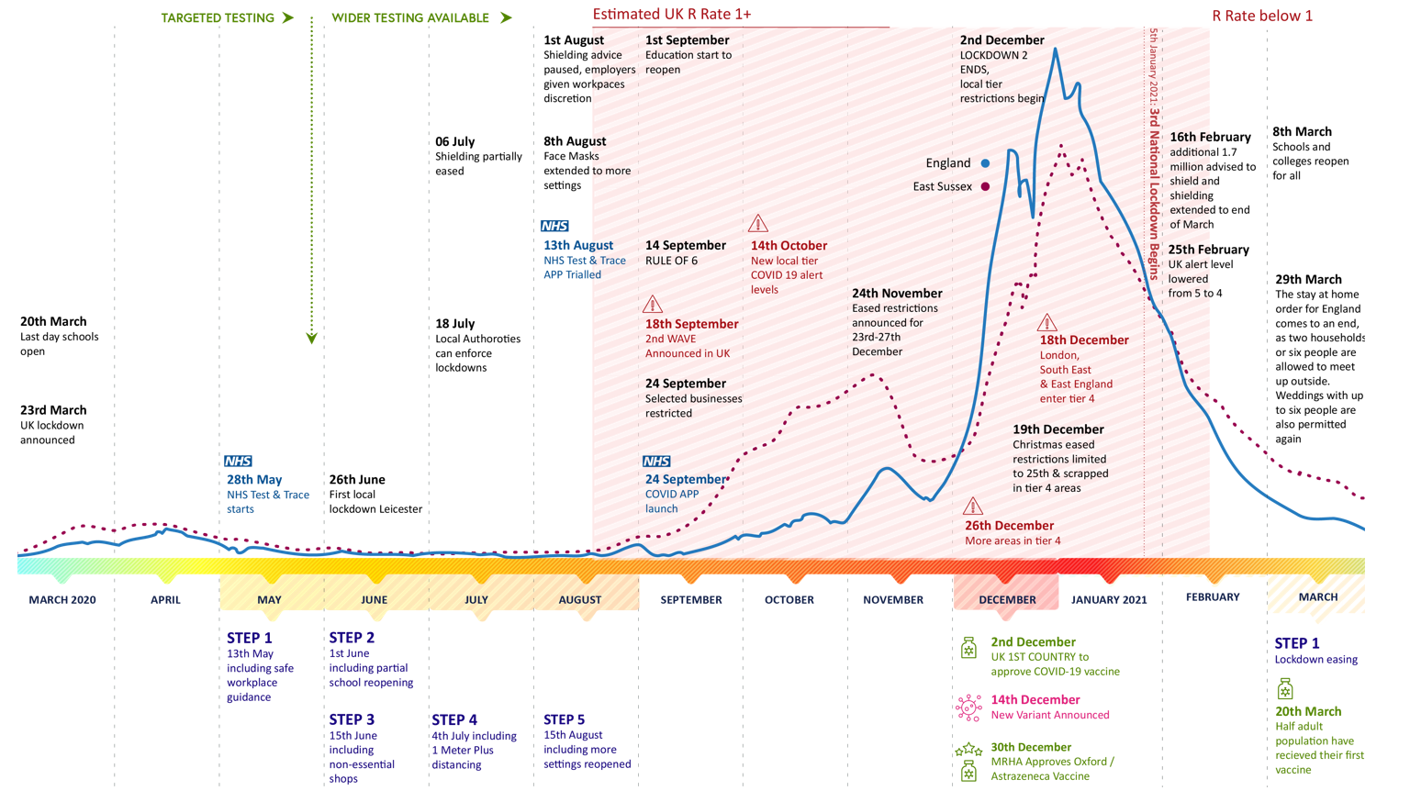
Policy & Event Timeline March 2020 to March 2021

Slide 4
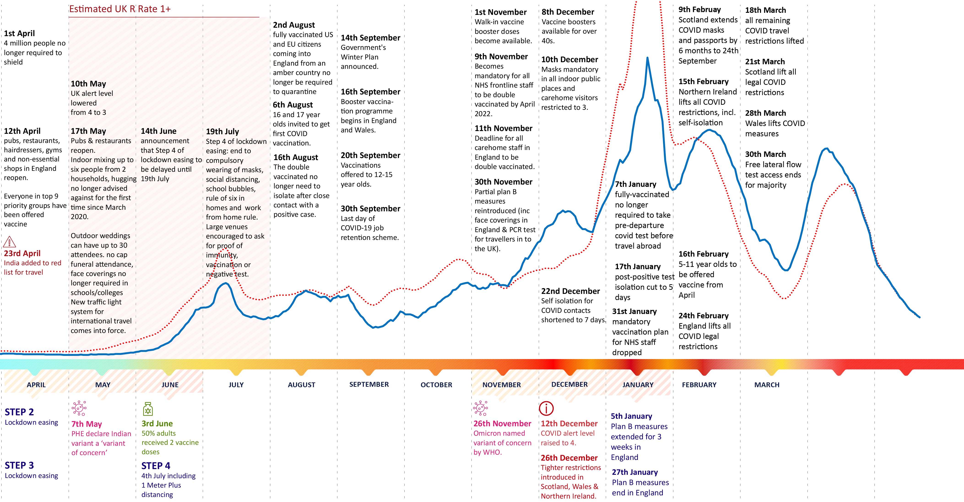
Policy & Event Timeline April 2021 to March 2022

Slide 5













COVID-19
The main symptoms of COVID-19 are:
  a high temperature
  a new, continuous cough
  Shortness of breath
  Fatigue
  Loss of appetite
  Loss of smell
  Loss of taste
  Headache
  Sore throat
  Blocked/runny nose
  Loss of appetite
  Diarrhoea
  Feeling/being sick
People with COVID-19 may have one or more of these symptoms.
Clinical Presentation of COVID-19:
In general, adults with SARS-CoV-2 (COVID-19) infection can be grouped into the following severity of illness categories. However, the criteria may overlap and a patient’s clinical status may change over time:
Asymptomatic (approx. 30% all cases) individuals testing positive for COVID-19 but who have no consistent symptoms
Of those who develop symptoms:
Mild (approx. 40% cases) for most people, COVID-19 is a mild infection with core symptoms of a fever and a dry cough, but without shortness of breath, lasting approximately a week. Other symptoms include: fever; cough; sore throat; malaise; headache; muscle pain; nausea; vomiting; diarrhoea; loss of taste/smell
Moderate (approx. 40% cases) non-severe inflammation, most notably in the lungs (pneumonia) and evidence of lower respiratory disease.
Severe (approx. 15% cases) Individuals who have hypoxia (problems with the level of oxygen in the blood) and/or severe pneumonia
Critical (approx. 5% cases) critical disease with life-threatening complications including acute respiratory distress syndrome (ARDS), sepsis, septic shock, cardiac disease, thromboembolic events, such as pulmonary embolism and multi-organ failure
Source: PHE COVID-19: epidemiology, virology and clinical features | gov.uk and COVID-19: long-term health effects | gov.uk

Slide 6
Long COVID: national evidence
Broad case definitions for COVID-19:
Acute COVID-19 Signs and symptoms of COVID-19 for up to 4 weeks.
  Ongoing symptomatic COVID-19 Signs and symptoms of COVID-19 from 4 to 12 weeks.
Post-COVID-19 syndrome (Long COVID) Signs and symptoms that develop during or after an infection consistent with COVID-19, continue for more than 12 weeks and are not explained by an alternative diagnosis.
Prevalence of Long COVID
Evidence from the Office of National Statistics (ONS) Coronavirus (COVID-19) Infection Survey (CIS), contributed to the UK Health Security Agency (UKHSA) estimates of rate of transmission of COVID-19 and provides evidence of the socio-demographic characteristics of people and households who have contracted COVID-19. The evidence below is based on 368,857 responses to the CIS, collected over the four-week period ending 5 March 2022, and weighted to represent people aged two years and over living in private households in the UK.
Key findings suggest that, as of 5th March 2022, of those who reported having had COVID-19:
An estimated 1.7 million people living in private households in the UK were experiencing self-reported long COVID symptoms
Of those with self-reported long covid:
  422,000 (24%) first had it less than 12 weeks previously
  1.2 million (69%) first had it at least 12 weeks previously
  784,000 (45%) first had it at least one year previously
  74,000 (4%) first had it at least two years previously
1.1 million people (67%) who reported having long COVID said it adversely affected their day to day activities, with 322,000 saying it limited them a lot.
Fatigue was the most common symptom (51%), followed by shortness of breath (34%)
As a proportion of the UK population, prevalence of self-reported long COVID was greatest in:
  people aged 35 to 49 years,
  females,
  people living in more deprived areas,
  those working in social care, teaching and education or health care,
  those with another activity-limiting health condition or disability.
Persistent health problems reported following acute COVID-19
Respiratory symptoms
(e.g. cough/ shortness of breath)
Liver and kidney dysfunction
Clotting disorders and thrombosis
Enlarged lymph nodes
Skin rashes
Cardiovascular symptoms
(e.g. chest tightness)
Loss or change of smell or taste
Mental health problems
(e.g. depression, anxiety)
Inflammatory disorders
(e.g. multi-sensory inflammatory syndrome)
Gastrointestinal disturbance with diarrhoea
Continuing headaches
Fatigue, weakness and sleeplessness
Post COVID syndrome long covid | england.nhs.uk

Slide 7
At risk – national picture
RISK FACTOR | IMPACT
Age | Diagnosis rates and mortality risk increase with age
Sex | Risk of dying is higher in males than females
Deprivation | People who live in deprived areas have higher diagnosis rates and death rates than those living in less deprived areas – especially among people of working age.
Ethnicity | Risk of dying higher in ethnic minority groups than in White ethnic groups (highest in Black ethnic groups and Bangladeshi ethnicity, but also people of Chinese, Indian, Pakistani, Other Asian, Caribbean and Other Black ethnicity) The latest available data can be found on slides 46 and 47
Occupation | Men working as security guards, taxi drivers and chauffeurs, bus and coach drivers, chefs, sales and retail assistants, lower skilled workers in construction and processing plants, and men and women working in social care, nursing auxiliaries and assistants had significantly high rates of death from COVID-19.
Inclusion health | Increased deaths among people born outside the UK and Ireland (including people with no recourse to public funds) and higher diagnosis rate among rough sleepers. Research suggests >260 deaths of homeless people were stopped by preventative measures such as use of hotels and infection control measures in hostels during the first wave.
Living in a care home | There have been 2.3 times the number of deaths in care homes than expected – from COVID-19 and other causes.
Co-morbidities | Diabetes (43% of death certificates where COVID-19 was cited in the Asian group and 45% in the Black group), hypertensive diseases, chronic kidney disease, chronic obstructive pulmonary disease and dementia; an increased risk of adverse outcomes in obese or morbidly obese people.
Geography and population density | Areas with highest population density have the highest death rates.
Air pollution | Higher mortality risk was identified in neighbourhoods with worse overall air quality than areas with better air quality.
Disability | Increased risk of mortality among disabled people compared to non-disabled people. This may be linked to associated risks such as age, higher likelihood of infections through carers or care homes, or other risk factors such as diabetes, living in more deprived conditions, or experience of barriers to care.
Lifestyle factors | Increased risk of infection and mortality linked to obesity and walking pace, and higher rates of hospitalisation and mortality in smokers than non-smokers.
Learning disabilities | The death rate for people with Learning Disabilities is 2.3 times the rate of the general population. If adjusting for under-reporting, this rises to 3.6 times. The rate increases further for people with learning disabilities in residential care, likely reflecting greater age and disability in these settings.
Being unvaccinated | Vaccination has been found to reduce COVID-19 transmission to other people, and is estimated to have prevented over 7 million infections and 27,200 deaths up to June 2021. Evidence indicates that 2 weeks after receiving a booster vaccine, protection against symptomatic COVID-19 infection is over 90%.
Source: PHE, COVID-19: review of disparities in risk and outcomes disparities_review.pdf | publishing.service.gov.uk

Slide 8
Local context: summary
This page provides a summary of the data shown in slides 9 to 31
Compared to England, East Sussex has:
an older, ageing population: over 65s represent a quarter of the population and this is projected to rise by another 8.2% by 2025
a significantly lower population who are non-White British or have English as a second language.
a lower % of LSOAs in the most deprived quintile, but large variation within the county, with Hastings significantly worse than England across a range of wider factors influencing health, including deprivation.
a higher % of people working in skilled trades and caring/leisure occupations.
a higher % of people on primary care registers for hypertension, depression, kidney disease, COPD and dementia.
a significantly lower proportion of keyworkers who are from ethnic minority populations
Local needs during the pandemic:
The government has now ended shielding patient lists and advice to shield for clinically extremely vulnerable people. Before guidance changed there were about 38,000 people clinically extremely vulnerable (at greatest risk of severe cases of COVID-19)
There are currently 15 foodbanks in East Sussex
18,877 more people claiming universal credit (UC) in March 2022 than in March 2020
14.4% working age people were receiving either UC or Job Seekers Allowance (JSA) in March 2022
There has been a 47% increase in working age people claiming JSA and UC compared to in March 2020
117,500 (34.5%) working aged people in East Sussex supported by government employment schemes during the whole pandemic:
  86,400 employments furloughed
  31,100 Self Employed Income Support Scheme (SEISS) claims

Slide 9
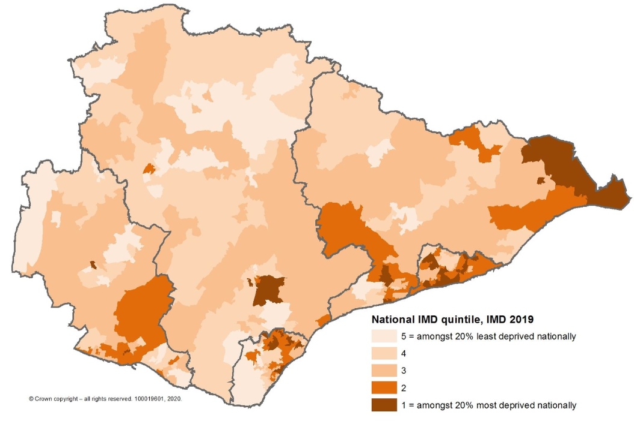







Our population: context setting
Ageing population (2020)
Total population
558,852
Deprivation (IMD, 2019)
14%
Gender
in most deprived quintile
Female
52%
Male
48%
Similar to England
8.2% increase
in the proportion of the East Sussex population aged 65+
Ethnicity (2011,%)
By 2025
 | East Sussex | England & Wales
British and Northern Irish | 91.7 | 80.5
Irish | 0.8 | 0.9
Gypsy or Irish Traveller | 0.2 | 0.1
Other White | 3.4 | 4.4
White and Black Caribbean | 0.4 | 0.8
White and Black African | 0.2 | 0.3
White and Asian | 0.5 | 0.6
Other Mixed | 0.4 | 0.5
Indian | 0.4 | 2.5
Pakistani | 0.1 | 2
Bangladeshi | 0.2 | 0.8
Chinese | 0.4 | 0.7
Other Asian | 0.7 | 1.5
African | 0.3 | 1.8
Caribbean | 0.1 | 1.1
Other Black | 0.1 | 0.5
Arab | 0.1 | 0.4
Any other ethnic group | 0.2 | 0.6
4.3% people
will be aged 85+ compared to 2.7% in England
Occupation (June 20-21)
% on primary care disease registers (2020/21)
 | East Sussex | England
Skilled trades | 13% | 9%
Caring / Leisure Other services | 13% | 9%
Sales | 7% | 7%
Plant / Machine | 5% | 6%
Living in a care home
300
care homes
68
have nursing level care
of which
Care home beds
17.2
per 100 aged 75+
(9.4 per 100 aged 75+ in England)

Slide 10
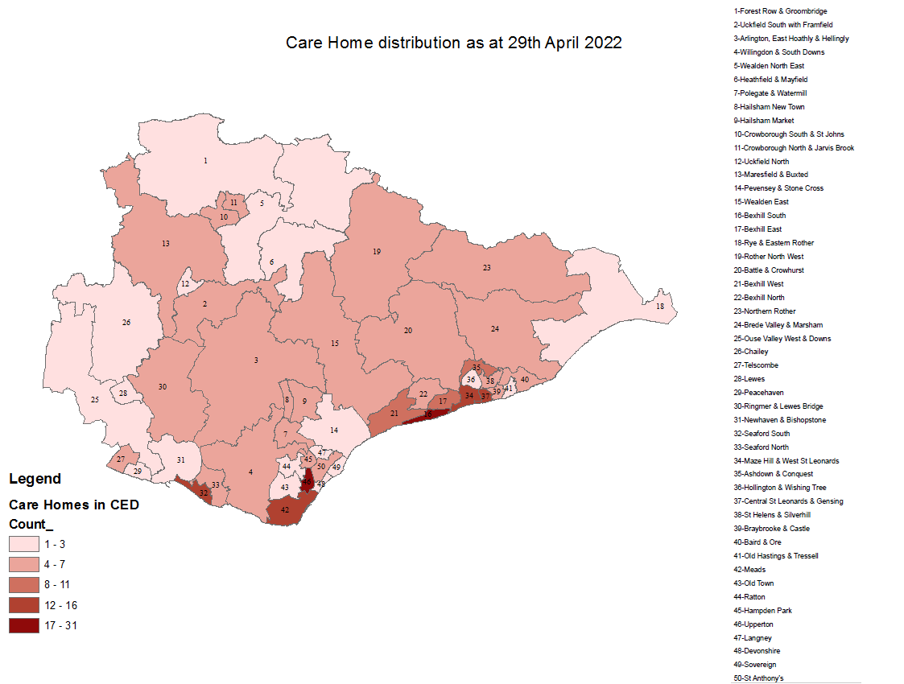
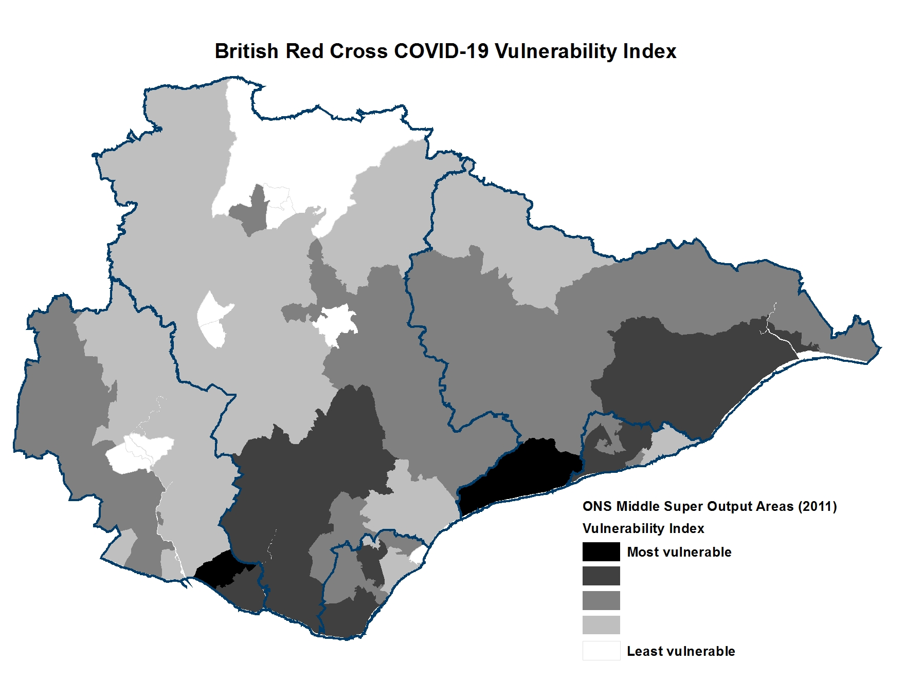
Our population: Vulnerable People
Vulnerable people
COVID-19 vulnerability index | The British Red Cross combines multiple sources of data to identify vulnerable areas and groups within Local Authorities and neighbourhoods. The Index currently maps clinical, demographic and social vulnerabilities and health inequalities. This map shows COVID-19 vulnerability in East Sussex as at May 2020
Care Home Distribution in East Sussex
300 Care homes / Approximately 8,041 beds
Hastings has 17.2 care home beds per 100 people aged 75+
the second highest rate in the South East

Slide 11
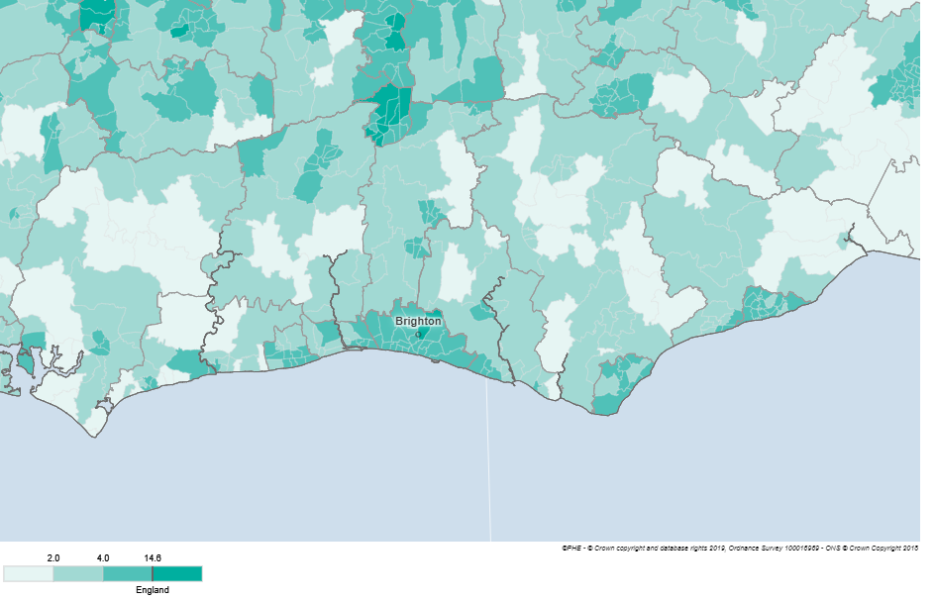
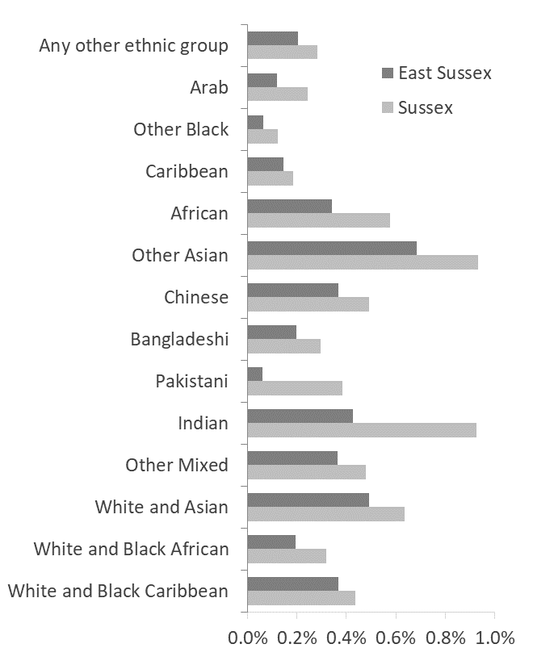
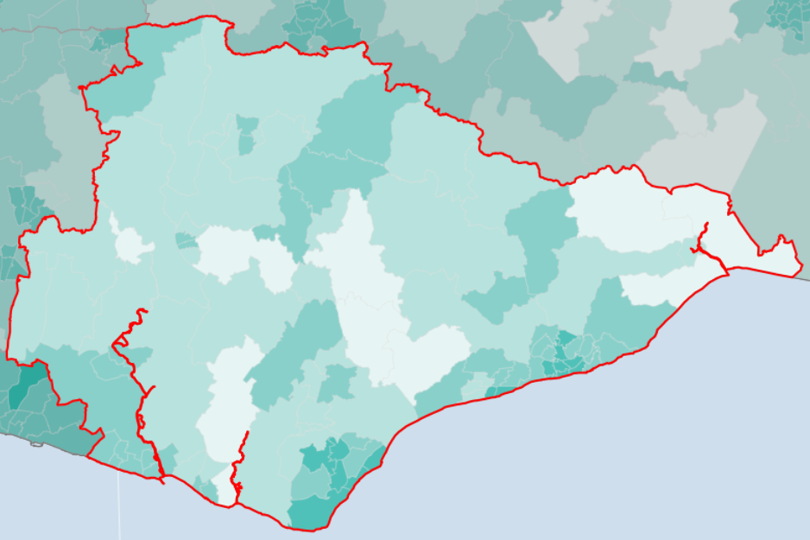
Our population: ethnicity, census, 2011
SUSSEX: Number of people stating their ethnicity as not White (any White category), Census 2011
EAST SUSSEX: Number of people stating their ethnicity as not White (any White category), Census 2011

Slide 12
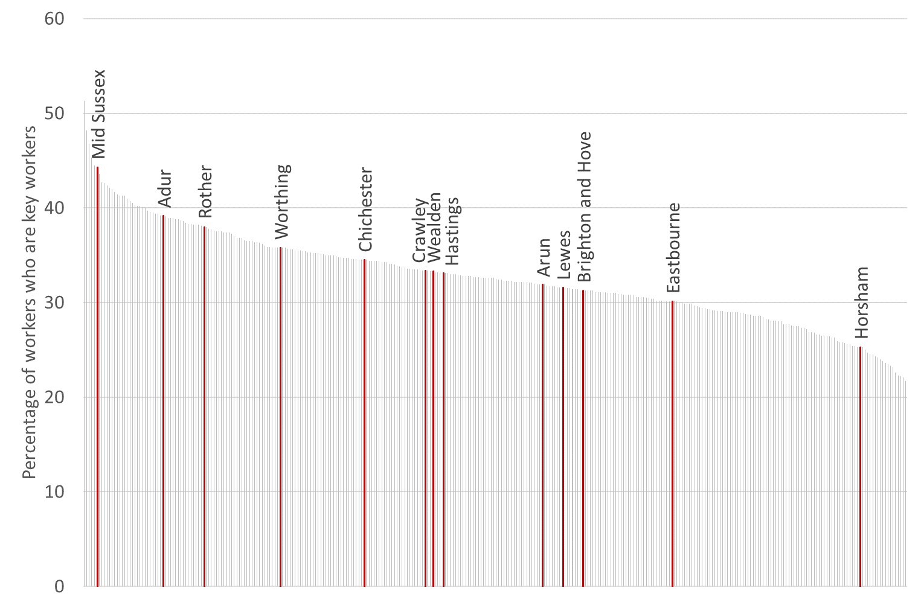
Our population: keyworkers
Percentage of workers who are estimated to be key workers by lower tier local authority, 2019
The Office for National Statistics (ONS) can give an indication of the number of people who were employed in 2019 in key worker occupations and key worker industries, based on an interpretation of UK government guidance. This includes sectors in health and social care, education and childcare, key public services, local and national government, food and other necessary goods, public safety and national security, transport and border, and utilities communication and financial services.
This analysis is based on various sources (the Annual Population Survey, the Labour Force Survey and the Annual Survey of Hours and Earnings)
The Brighton and Hove Public Health team commissioned extra breakdowns of these survey results for Brighton & Hove, East Sussex and West Sussex
Percentage of key workers who are non-White
Percentage of key workers who are female
Percentage of key workers at moderate risk (People with certain health conditions (such as asthma, heart disease and diabetes)
Source: Produced by Public Health Intelligence, Brighton and Hove City Council

Slide 13
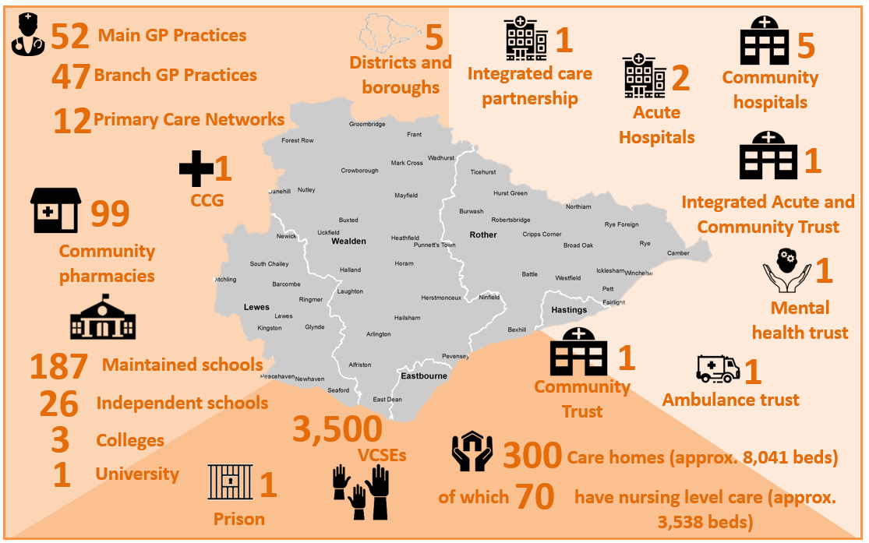
Our health and care organisations
There has also been a significant response from community organisations across the county supporting the Community Hubs to meet community need.

Slide 14

Need In East Sussex: clinically extremely vulnerable
Clinically Extremely Vulnerable
In April 2021, the government took the decision to end the option of advising CEV individuals to shield. The Shielded Patient List (SPL) was closed along with the Shielding Programme as a contingency support offer in September 2021. This means people previously identified as CEV will not be advised to shield in the future and the government will not be providing specific national guidance for them to follow. This also means that individual’s details will no longer be held on the SPL.
People defined as clinically extremely vulnerable (CEV) were classified as at greatest risk of severe illness from COVID-19 and were advised to shield by the government during lockdown periods. People were identified as CEV if they had an underlying health condition and/or weak immune system, including: solid organ transplant recipients; specific cancers; severe respiratory conditions; people at significantly increased risk of infections; people on immunosuppression therapies; and women who are pregnant with significant heart disease. People were also added to the Shielded Patient List by a clinician or GP if deemed at higher risk of serious illness.
37,926
8,277 As at 13th July:
(22%) CEV had an allocated Adult Social Care team or worker..
CEV as at 13th July 2021
Clinically vulnerable
Classified as at increased risk of severe cases of COVID-19 including: those aged over 70 years; those under 70 with an underlying health condition; and those who are pregnant
An estimated 190,000-210,000 people are clinically vulnerable: >1/4 are estimated to be in Wealden.
Source: Ministry of Housing, Communities & Local Government

Slide 15
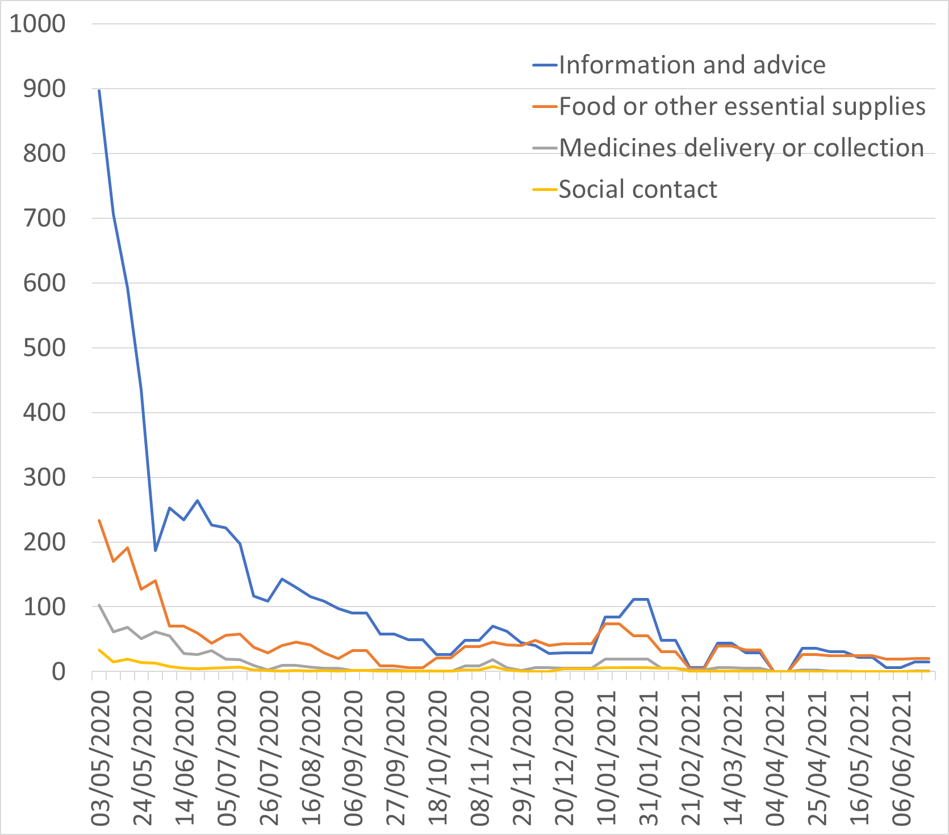
Community Hub contacts
Community Hubs help people affected by the pandemic who have no one else to turn to. The trained Hubs staff listen to needs and put people in touch with the group or person best placed to help locally. They provide: supporting people with options to access food and essentials; organising a volunteer to help collect food, essentials or prescriptions; linking to support for coping with the impact of coronavirus; and referring to local befriending services.
Community Hubs are a partnership between the voluntary sector, health service, County Council and District and Borough Councils in East Sussex.
Eastbourne: Lewes and Eastbourne Councils, 01323 679722
Hastings: Hastings Borough Council, 01424 451019
Lewes: Lewes and Eastbourne Councils, 01273 099956
Rother: Rother District Council, 01424 787000 (option 4)
Wealden: Wealden District Council, 01323 443322
Key support needs (weekly average contacts rounded to the nearest 1)
7,324 | People contacted the community hubs as at 20th June 2021
Reporting of community hub support needs was paused at the end of June 2021

Slide 16






East Sussex Together survey: COVID-19 – How are you being affected by COVID-19?
A survey of 10,000 East Sussex residents was conducted on behalf of East Sussex County Council in June 2020 to look how the COVID-19 virus was affecting peoples lives, finances and well-being. The survey ran for two weeks during June 2020 and was advertised online, through email, via social media and with partner organisations.
Adults : 10,355 respondents | Female 51% | Male 47% | Other/ No Answer 2%. Age: <18 1% | 18-24 5% | | 25-34 8% | 35-44 12% | | 45-54 18% | >54 54%
Community: more than one in three people (35%) said they felt closer to their community as a result of the virus. A similar number (36%) felt there was no change and a slightly smaller number (28%) said they felt more distant.
Finances: one in 10 people (10%) said their household income had been greatly reduced by the pandemic and a further one in four (26%) said they had suffered some reduction. The main reason for this was change in earnings. 55% experienced no change and 8% had seen an increase in their finances, with the main reason for this being change in living costs.
Health and Care: the biggest concern, chosen by almost half (47%) respondents was their health. The next greatest areas of concern were finances (20%), education (15%) and crime and safety (7%). Over half (57%) of people would not currently be confident sending a relative to live in a care home, and only 9% would feel confident.
Education: more parents of school-age children said they would be confident sending their children to school than not. Of these, 42% were confident, 40% were not and 12% were unsure.
Local economy: improving the economy was the single biggest local priority for the future (chosen by 30% of people). This was closely followed by quality of life (24%), by public services and by the environment (both 17%) and then by education (12%).

Slide 17
Healthwatch surveys: COVID-19 - Health and Wellbeing during COVID-19
Healthwatch East Sussex, the local independent health and care watchdog launched a survey in May 2020 to explore the direct and indirect impacts of the lockdown, social distancing measures and changes to services on people’s health and wellbeing. The aim of the survey was to capture a snapshot of people’s experiences to inform the COVID-19 response, and identify any longer-term effects from the crisis. Analysis identifies that:
Adults : 1,209 respondents | Female 884 | Male 309 | Other/ No Answer 16
Ethnicity: was broadly in line with census data for East Sussex as a whole.
Children: 970 respondents | Female 619 | Male 318 | Other/ No Answer 33
Ethnicity: 78% identified as White British, with higher rates Mixed White & Asian, Other Mixed Background, Indian and Other Asian Background than census data for East Sussex as a whole.
 | Key findings:
67% | Identified anxiety about the future as most common issue experienced more often since the outbreak. | 39% | Identified physical activity as most common issue undertaken less often since the outbreak.
40% | Identified becoming serious ill with COVID-19 as the issue they were most anxious about | 48% | Had concerns about emotional/ physical wellbeing during the outbreak, 16% had sought help
25% | Felt it is difficult to get clear government guidance on actions to take during the pandemic | 13% | Felt they were having some difficult or not coping at all well during the COVID-19 crisis
55% | Were receiving treatment/care, and 46% of these had experienced changes or disruption to services. For 20% it had a significant impact | 7% | Experienced changes or disruption to social care services. For 49% it had a significant impact
 | Key findings:
66% | Identified virtual connections as most common issue undertaken more often since the outbreak. | 43% | Identified fast food/takeaways as most common issue undertaken less often since the outbreak.
65% | Strongly agree that they feel safe at home | 19% | Felt it was difficult or very difficult to understand what was happening during the outbreak
45% | Felt they were coping well but with some worries during the COVID-19 crisis | 6% | Felt they were having some difficult or not coping at all well during the COVID-19 crisis
23% | Had experienced changes or disruption to health services or treatment, and for 8% of these it had a significant impact | 85% | Felt confident/very confident accessing healthcare for non-covid-19 related treatment or worries

Slide 18
Healthwatch surveys: COVID-19 – digital and remote consultations
The Healthwatch in Sussex public survey on digital consultations final report focused on establishing people’s experiences of digital or remote consultations during the COVID-19 period and their expectations and preferences for service redesign and delivery in the restore and recovery stages post COVID-19. This survey and the Sussex CCG‘s survey on NHS communications with patients (which contained many of the same questions) provided a combined sample of 2,185 people in June-July 2020, and the following
headline findings:
37% | chose not to make an appointment during the pandemic despite having a need to access health, social or emotional care. |  | 63% | Who had a remote appointment had a phone appointment.
79% | Didn’t make an appointment because they felt their condition wasn’t serious enough (42%) or didn’t want to burden the NHS (28%). |  | 80% | who had phone, video and online appointments during the pandemic were satisfied or very satisfied with phone appointments (76% with video and 79% with online).
30% | were not happy to have remote emotional and mental health support, including counselling and therapy. This rose to 44% of people with longstanding and serious mental health conditions. This rose to 44% of people with longstanding and serious mental health conditions. |  | People with disabilities | were less happy to have any form of remote appointment than those without disabilities
phone | appointments were preferable to video/online for triage, medication, GP, test results and emotional and mental health support. |  | Younger people | were generally happier to receive phone, video and online appointments compared to older people.

Slide 19
Healthwatch surveys: COVID-19 – Care Home family and friend support
The Pan-Sussex Healthwatch ‘Care Home Families & Friend Support project’, sought to explore family and friends’ experiences of care homes during the COVID-19 pandemic, engaging 64 families and 4 professionals in August and September 2020.
During the pandemic, family members/friends:
recognise the challenges care homes face due to COVID-19, yet their experiences during the pandemic significantly varied across care homes.
had greatly varied experiences of receiving up to date information on the health of their relative/friend, and of COVID-19 infections within the care setting.
broadly understand and accept the reasons for care homes restricting visiting arrangements.
reported being frustrated/distressed when they had received no communication from care homes or care home residents during the pandemic.
had significantly less contact with those living in care homes, which has substantially impacted on the health and wellbeing of family members/friends and those in care homes.
greatly valued the efforts many care homes had made to facilitate communication between family members/friends and their relatives or friends.
are concerned about how sustainable the already limited visiting arrangements will be during the winter, given the use of outdoor spaces to facilitate visits.
found a major barrier to communication to be where there were technical issues or resident capacity/health issues preventing telephone or video calls.
have found absence of physical contact with those in care homes particularly difficult.
expressed concern about gaps in support due to health services being prevented from visiting, and from additional care they would provide during a visit.
note that arranging new care home placements, admission and settling in has been a particular challenge,
report that the period following a friend or relative moving into a care home, can be a time of isolation and poor mental wellbeing.
Feel the Government failed to provide comprehensive, timely guidance to care homes during COVID-19, which has negatively impacted on care home provision and residents’ family members/friends experiences.

Slide 20
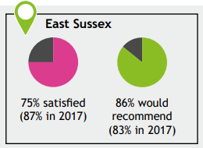
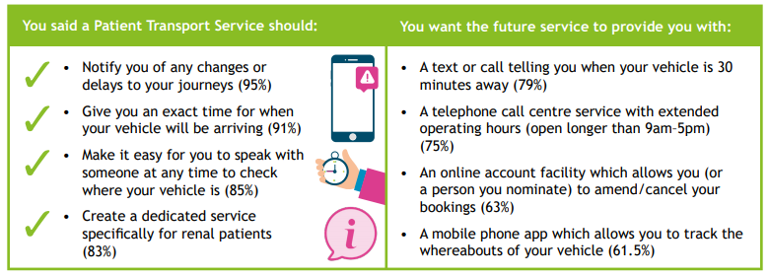
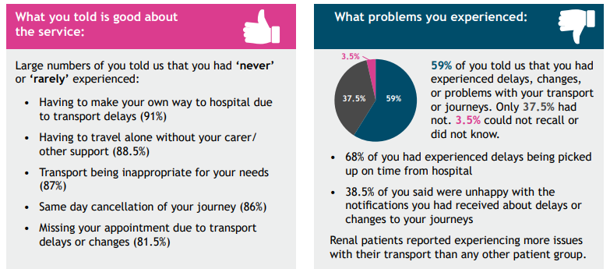
Healthwatch surveys: COVID-19 – Access to transport services
In September 2020, local Healthwatch collected views on non-emergency patient transport services from 130 people across Sussex. A report has been provided to NHS commissioners. 50% respondents were from East Sussex. Finding include:
Overall, 75% people said they were ‘very satisfied’ or ‘satisfied’ with the service (lower than in 2017, 87%)
86% people said they were ‘very likely’ or ‘likely’ to recommend family and friends to apply for the service (higher than in 2017, 83%)

Slide 21
Healthwatch surveys: COVID-19 – Experiences of health and care in 2nd Lockdown
In February 2021, Healthwatch in Sussex launched a report based upon public feedback on health and care services during the second COVID-19 lockdown in November and December 2020. Healthwatch in Sussex recognise that this report is being released at a time of extreme pressure for the NHS in Sussex due to high rates of COVID-19 infection and hospital admissions. Key themes and issues include:
Quality of care
Those who had an appointment or used a service received high quality, professional and responsive care. A minority were reluctant to access services due to transmission concerns. Infection prevention/control precautions were not always clearly identified.
Communications
Public information did not always reflect service changes causing more anxiety. Mixed messages were given on service availability and access. Some information lacked detail. Some GP/Dental websites/out-of-hours messages were out of date or lacked detail.
Emotional / mental wellbeing
Issues included raised anxiety for patients awaiting appointments, results or further treatment, or seeking to access services. Keeping a positive work/home life balance is challenging, as well as changes to young people’s routines
Covid-19 vaccinations
Queries on COVID-19 vaccines and the vaccination process mainly focused on how distribution would be prioritised and the likely timeframe for the rollout.
GP Services
Broadly positive experience once GP had been accessed. Many struggled to get timely access to GP appointments, with delays common. GP preference for phone and video appointments caused anxiety for people with Autism, learning difficulties, and lack of familiarity with the technology.
Dentistry
Many found access to NHS dentistry challenging. Feedback indicated a lack of NHS dentists accepting new patients, long delays, removal from client lists without knowledge, extra charges to cover PPE, and perception of prioritising private patients.
Hospital services
Most feedback was on outpatient services, with the majority positive about their treatment. Issues identified included timely communication and follow-up which caused anxiety for some who were waiting for test results and appointments.
Community services
Timely access to specialist support services, especially face-to-face contact for people with multiple or complex needs, were problematic in the lockdown. Demand for community support such as Food Banks continued to rise
Care homes and carers
Key themes for Care Homes centred on the impact of visiting restrictions on both residents and their loved ones. The availability and cost of PPE was raised, as were the mental and physical effects on care home staff and carers.

Slide 22
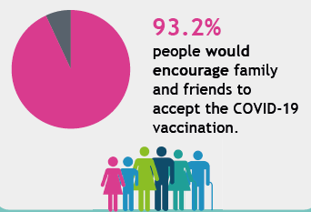
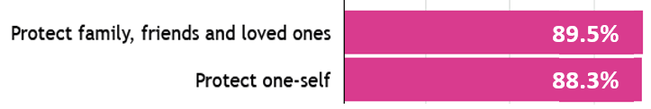
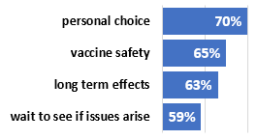
Healthwatch surveys: COVID-19 – Experiences and views of COVID-19 vaccinations
Healthwatch East Sussex ran a survey in February and March 2021 to explore: the direct experiences of people who have been vaccinated against COVID-19, and the views and preferences of those yet to be invited for their COVID-19 vaccination, including likelihood of acceptance. The survey received 1,855 responses: 1,558 (84%) who had received a vaccination and 297 (16%) who had not.
Those who have received COVID-19 vaccinations (1,558 people)
Those who have not received COVID-19 vaccinations (297 people)
97.5%
1 in 5 identified an issue impacting on their ability to attend vaccination, including: seeking time from employers; personal caring responsibilities; transport issues; and cost of travel.
12% of vaccination recipients had a post-vaccination concern, most commonly about side-effects, and the long-term effects of the vaccines
61% (180) Would or were likely to accept a vaccination
39% (117) Would not, were unlikely or had declined a vaccination
92% would definitely accept and 8% are undecided but likely to accept
36% Would definitely not accept and 24% are undecided but unlikely to accept. 40% had declined.
Reasons for not having the COVID-19 vaccination
Reasons for not having the COVID-19 vaccination
The next most frequent responses include ‘combating the COVID-19 virus’, ‘It’s the responsible thing to do’ and ‘Getting back to normal as soon as possible’.

Slide 23
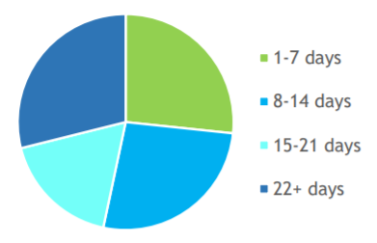
Healthwatch surveys: COVID-19 – Experience of rapid COVID-19 hospital discharge
Healthwatch Sussex ran small scale qualitative engagement in July 2021 to better understand patient and family and friend experience of the more rapid discharge from hospital, and the impact this has on the patient’s future care at home. The engagement involved semi-structured interviews with 45 people who had been discharged from hospital in April 2021, 15 from East Sussex, 15 from West Sussex and 15 from Brighton and Hove. The research was intended as a pilot to inform potential further steps, and was reviewed against the findings in the Healthwatch England/Red Cross Report published on 27 October 2020.
KEY FINDINGS
Early discharge planning:
26 people (56%) do not remember having any information about hospital discharge
Feedback suggests due to infection control measures no written information was given
Home assessments after discharge:
42 people (93%) felt ready to go home, but some, particularly those living alone, felt unprepared for coping at home.
Most comments around care arrangements after leaving hospital were positive.
32 people (84%) did not get a follow-up telephone call or visit to see how they were after their hospital stay from or on behalf of the hospital, possibly due to going into care home/rehab facility
Engagement and Choice:
4 out of 10 patients spoke of post-discharge plans with staff
79% of family carers were told the person was being discharged, but often seemingly for collection purposes only.
Communication and information sharing:
Half of family carers had been given a point of contact in the hospital, however some experienced difficulty accessing information or talking to the patient.
28 of 36 people found the information given at discharge on self care helpful
GENERAL OBSERVATIONS
Disorientation of care journey: Several people found it difficult to know when they had gone into hospital, when discharged and how long they had been in hospital. That appeared to be either because they confused by their hospital experience (not due to their mental capacity), or had been in and out of hospital and/or had rehab so had difficulty remembering dates. Nearly half had been in hospital more than a fortnight, and less than a quarter for a planned procedure/appointment.
Acuity of poor health: On the whole, participants seemed to be older and in very poor health.
Proof of concept: The report concludes that the evidence indicates the importance of having a way of finding out if changes are right for patients as well as for managing the demand and flow of patients in hospital.

Slide 24
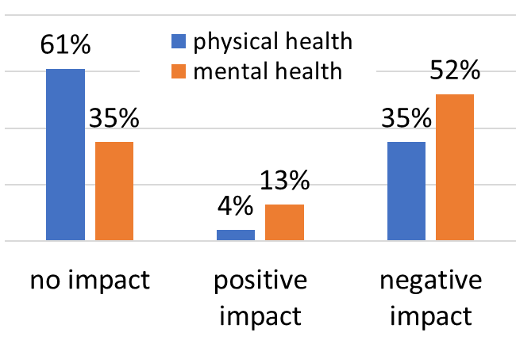
Healthwatch surveys: COVID-19 – Youth Voice and Participation: Enhancing the COVID-19 Vaccination Programme in East Sussex
Young Healthwatch East Sussex ran small scale engagement between September 2021 and January 2022. In response to changes in NHS eligibility in late 2021 meaning that young people aged 16- 18 became eligible to be immunised against COVID-19, consultations were undertaken with Young Healthwatch volunteers about what they are experiencing and observing in youth communities. The research was intended to establish a core group of young volunteers, conduct engagement to gather insight into youth vaccination efforts, to co-produce guidance for decision-makers with children and young people, and to collate insight and recommendations from youth engagement to inform health and care work locally. The full report includes vaccine uptake strategies and recommendations.
KEY FINDINGS: vaccination and COVID-19
Getting vaccinated (n=28)
85% knew about the vaccination service,
68% got information about it from their family
36% booked their vaccination through the NHS website, and 26% at a walk in clinic
33% had their second jab at the same venue, 55% at a different venue
¾ got their vaccination with a parent, carer or guardian
87% felt comfortable during the appointment. The main reasons for those not feeling comfortable were nerves and being in a clinical space.
79% were given aftercare advice, but a further 12.5% felt the advice wasn’t appropriate
The main motivations for getting vaccinated were to protect vulnerable people close to them (37.5%) and to protect themselves (37.5%).
KEY FINDINGS: Issue and barriers to vaccination for young people
Access to vaccination sites
Location is a significant issue and potential barrier for young people to access their vaccination appointments, with walk-in centre closure making access harder.
Patient Transport Support Systems are important for young people as a means to
decreasing reliance on parent/carers and increasing flexibility of times to get vaccinated. them.
Spread of misinformation
Concern over unofficially circulated information on social media platforms spreading misinformation and creating a lack of clarity for young people around the risks of vaccinations. Communication should focus on accessible scientific evidence and research for young people so they can make informed choices.
Parental consent
While the need for parental consent was understood, some young people were concerned their parent or carer would not make an informed choice to protect their child from COVID-19. It was suggested robust information is circulated to families via schools and colleges, and that young people have more say in their health and care, e.g. via Gillick Competency principles.
NHS Communications
More timely reminders about booster vaccinations would help as reminders are often sent too soon after the second dose when there is a three month gap between vaccinations. Also, young people noted the increase in scam messages which causes confusion and distrust.
Impacts of COVID-19 on health (n=28)
Positive impacts – included lower social anxiety, appreciation of family, more time for healthy eating and hobbies, and developing online friendships
Negative impacts – included social anxiety, tiredness, weight gain and less exercise, and disconnection.
Only 17% definitely knew where to get support if needed.

Slide 25
VCSE Alliance survey: COVID-19 - Wider impacts of COVID-19
Since March 2020, members of the VCSE Alliance in East Sussex(chief officers from 15 key strategic VCSE organisations) have been capturing the direct and indirect impacts of the pandemic on those in the county. Intelligence gathered May and July 2020, suggest that some of the impacts of COVID-19 include:
Overarching issues: Barriers created by ‘digital divide’, increased interaction with friends / family / community, information overload and confusion, vulnerable becoming invisible, complexity of needs
Social Isolation/loneliness: Impact particularly on those living alone, older ages, and shielding. More anxiety due to lost contact, and low confidence to re-engage.
Stress and anxiety: around personal / family wellbeing, being at home more, the ‘unknown’ (exacerbated by conflicting information). Leads to poor sleep, less chance to unwind, enforced behaviour change and poor mental wellbeing
Education and training: Increased stress: uncertain timescales of school closures, fear about exams, home learning, reintegration into school, access to support services, isolation of children, balancing childcare / work, impact on employment. Noted benefits of informal learning
Housing, Reduced: access to housing options means more stuck in temporary accommodation with challenged social distancing due to communal areas, fears over longer term options for rough sleepers and homeless.
Community facilities: Many temporarily closed leading to loss of revenue, uncertain long-term viability. Restricted social and cultural activities increasing isolation. Concern over reopening, insurance requirements, and reliance on volunteers who may be vulnerable/shielding.
Food and essentials: Confusion over shielding system and food parcels, significant increase in foodbank use (hard to meet demand), food access issues for those on low incomes not eligible for support, higher costs, forced reliance on support, supermarket delivery challenges.
Money and debt: Card payments for shops rather than cash can be problematic for some, hard to get cash for shopping deliveries if isolating, lost earnings due to furlough, job loss or working hour reductions impacting on ability to pay for food, bills, IT costs and services.
Health and care services: Access challenges (incl. number limitations affecting people with carers), treatment delays and longer term backlog, self-treating, withdrawal of face-to-face services, concerns about visual health, implications of low attendance e.g. for cancer treatment
Employment and benefits: Concerns over duration of furlough and increased likelihood of redundancy, competition for employment, increased caseload delaying benefit processes. Anecdotally home-based working has improved work-life balance for some.
Carers Anxiety: if carer gets ill, delays in official guidance for carers, difficult access to PPE, confusion over support (care workers but not carers have priority access to shopping), increased anxiety, depression, isolation and mental wellbeing concerns.
Safeguarding Confusion: over referral procedures for community enquiries about older friends/ neighbours, lack of opportunity to check on people face-to-face, lockdown challenges regarding domestic violence situations.

Slide 26
University of Brighton Survey: COVID-19 - impacts on individuals and communities
The University of Brighton was commissioned by East Sussex County Council to explore the impacts of COVID-19 on individuals and communities. 25 people were interviewed between December 2020 and March 2021 including: those furloughed or made unemployed due to the pandemic, people working from home, single parents, people who have been shielding, people with disabilities, young people (18+) in education, and women who have been pregnant during the pandemic. Key findings suggest an impact on:
family: included feelings of claustrophobia and disruption which was compounded by home-schooling and parent(s) working at home. These were mostly temporary, with people adapting either workspaces or taking particular steps to respect the needs of others.
friends: For many people, friendship groups reduced. Most friends seen in person were on a one-to-one basis, with social media used for wider groups . More positively, some people reported becoming closer to friends and reconnected with friends.
leisure: Several people had increased physical activity, mostly in the first lockdown with the warmer weather. Others had stopped social activities such as choirs, book-clubs, and going to the pub.
jobs and finances: Impacts on people’s jobs included more working at home, reduced income (particularly for self-employed), changes in job role, and increased work pressures. Some people had become unemployed due to the pandemic. Those furloughed were grateful for the opportunity to be paid while enjoying time at home and pursuing new interests.
health behaviour: positive health-related behaviours were reported for those with more time and flexibility due to working at home or being furloughed (such as new fitness regimes or home cooking). A minority drank more alcohol than usual, increased food consumption and smoked more to relieve stress.
education: frustrations included learning online, missing face-to-face contact and final year ending early
mental health: Mental health impacts ranged from frustration through to increased anxiety needing interventions. People were fearful about being infected and passing on the infection to vulnerable adults, with mental health worsening in lockdowns and when knowing someone with COVID-19. Some used exercise to improve mental health, while others wrote down worries; invested in online courses; spent time with; improved diet; and used daily routines involving online or telephone calls and trying to leave the house.
health and social care appointments: Remote appointments were largely seen as a suitable, more convenient alternative to face-to-face appointments. Phone appointments were preferred over video, although video was useful in some circumstances (assuming technology worked)

Slide 27





Amaze Survey: COVID-19 - Experiences of parent carers in East Sussex
Amaze is a charity supporting children and young people with special educational needs and disabilities (SEND) and their families. In April 2021, Amaze surveyed 36 families about the effect of lockdown on children’s learning and the support families need around home schooling and keeping healthy and well. Key findings included:
High levels of stress and anxiety including about getting COVID-19, protecting the family, supporting home-learning, coping with Pas/respite, child’s worsening health/mental health, loss of income, and impact on siblings.
Missing school/college majority of families whose child had an EHCP chose not to send them to school because of the risk, despite many being offered a place. A third said the school place offered didn’t meet their or their child’s needs.
Needing support with home learning there were examples of good support but majority with an EHCP stated they were not getting support they needed through COVID-19, and the majority on SEN support stated they were only partially getting the support needed.
Worsening of child/family mental health for the majority due to lack of access to services/activities normally used. Some young people benefitted from relaxed routine and informal learning.
Concern about child’s progress and future linked to lack of access to therapies or contact with other health services. There were also concerns over delayed assessment and diagnosis and about children falling further behind in school making reintegration harder.

Slide 28
Institute for Employment Studies: COVID-19 – Impact of lockdown on education provision in Sussex
In July-October 2020, the Institute for Employment Studies (IES) undertook a qualitative study of 20 education providers and organisations across Sussex to explore the impact of Covid-19 lockdown measures on all levels of education provision. This research was for the Sussex Learning Network Uni Connect Programme, which targets disadvantaged students in areas where progression into higher education (HE) is lower than expected, with the aim of closing the gap and increasing the number of learners residing in these areas. Key findings include:
Experience at start of lockdown
Variable attendance for eligible vulnerable/keyworker pupils
Partial reopening and transitions
Variable reopening in June 2020. Primary schools opened for some years, secondary schools generally just for year 10. College re- openings varied from targeting groups to giving pupils the choice to return.
Plans for 2020/21 academic year
Workforce issues and wider support
Primary school prioritised pupil wellbeing for attendees.
Secondary schools taught in-school and remote pupils the same curriculum
All settings introduced: hygiene/ distancing and online learning (variable quality)
Main reasons for lack of remote learning engagement were lack of access to IT and quiet space
School resources differed - some loaned laptops and sent food parcels, others had charity support and provided workbooks
Academic college subjects were more suited to online learning than vocational/arts subjects
All education providers planned for all students to return in September 2020.
Very few education providers utilised the Job Retention Scheme.
Primary schools reported pupils exhibiting lower resilience.
Colleges planned to identify knowledge gaps and provide workshops to support students catching up.
Lockdown, school closures and remote teaching felt to have a profound negative impact on SEND/EHCP pupils: they would have more difficulty catching up; their social skills had been set back and there were additional stresses at home due to lockdown.
Varying safety measures introduced in schools: primary and secondary schools intended to introduce bubbles systems; while some colleges alternated pupils for remote and in-class teaching
Secondary schools planned to focus on core subjects to enable catch up from the disruption
Transitions from primary to secondary schools, and from year 11 to college/university were significantly affected
Final year BTEC, A-level and further education pupils were negatively affected by exam cancellations and initial downgrading in algorithmically generated results, including A-level students missing out on university places.
All providers noted an increase in workload for teaching staff moving lessons online and ensuring availability or resources
Varying experiences of staff wellbeing: increased anxiety; physical health issues due to time on computers; difficulties balancing work and childcare; while some staff enjoyed working from home and felt ‘safe’. Variable staff wellbeing support, with most relying on peer support.
Support from Local Authorities felt to be better than national government, with national messages confusing and u-turns making implementation difficult.
Recommendations
The research recommended a need for:
IT equipment and access for more learners, and particularly disadvantaged learners
Developing offline resources to support students without access to IT equipment
additional monitoring of attendance and engagement for certain groups of students
a focus on wider wellbeing of students
engaging and working with community groups to reach those less engaged with learning
support for students going through key education transitions, (Years 6, 11 and 13)
timely and appropriate support from central and local government

Slide 29
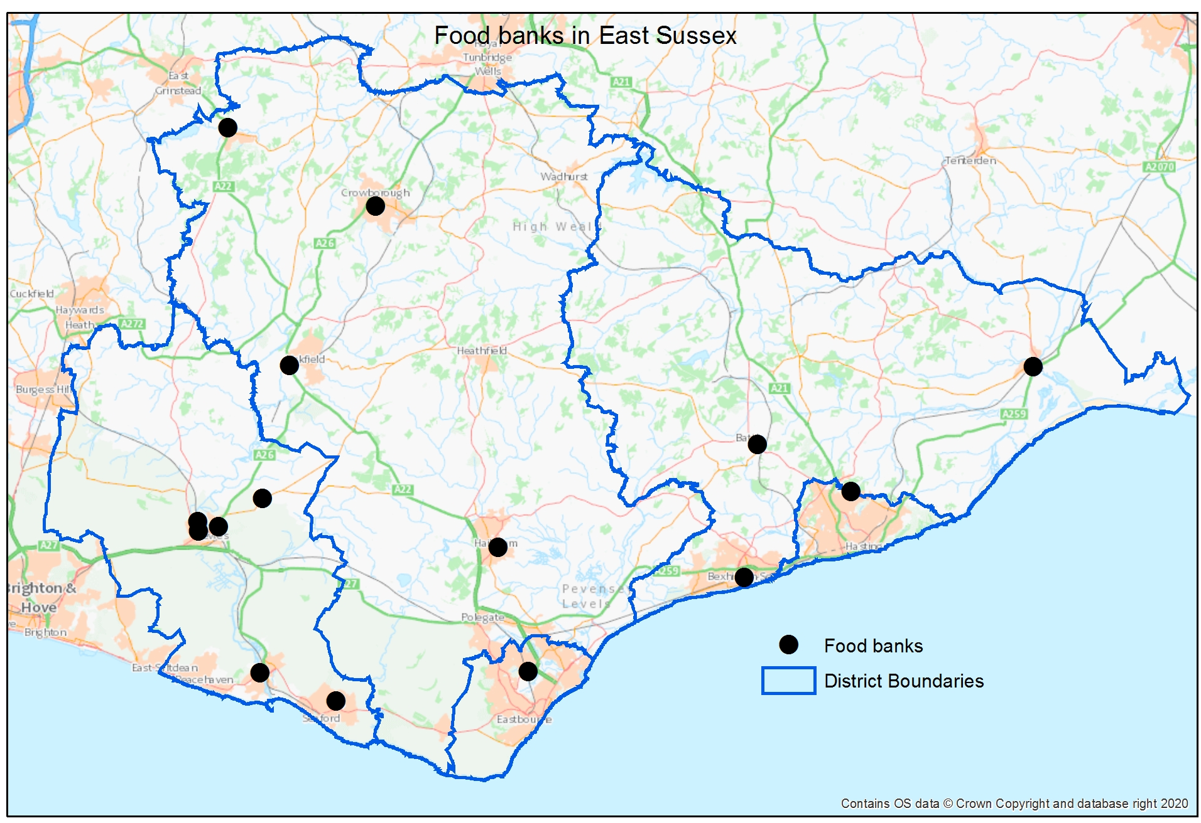
Need: Food Access
The provision of both government and ESCC food boxes ceased when shielding paused at the end of July 2020. The information below shows the final numbers in need of food boxes at this time.
Cumulative number of households receiving government food boxes
As at 31st July 2020 when provision of food boxes ceased:
1,847people received a government foodbox in the final week before shielding paused.
5,940 Households had received at least one government food box
Households receiving ESCC food boxes
This data is no longer reported
180
28
4
Map of foodbanks in East Sussex
There are 15 foodbanks in East Sussex
Food security in East Sussex
East Sussex County Council is working in collaboration with the voluntary and community sector to develop local Food Partnerships across East Sussex. These partnerships focus on building food security and sustainability. This means ensuring that all people in East Sussex always have physical, social and economic access to sufficient, safe and nutritious food which meets their dietary needs and food preferences for an active and healthy life.
The food partnerships are taking a place-based approach, developing a strategy/action plan based on local needs and context, as these are different in each area. However, food partnerships also feed into the East Sussex Healthy Weight Partnership and its whole system plan to increase healthy weight across the county. This supports a system-wide approach to addressing food security and related health and wellbeing needs of our communities.
Hastings and Rother food network - admin@hastingsvoluntaryaction.org.uk
Eastbourne and Wealden food partnerships - info@3va.org.uk
Lewes District food partnership - enquiries@sussexcommunity.org.uk

Slide 30
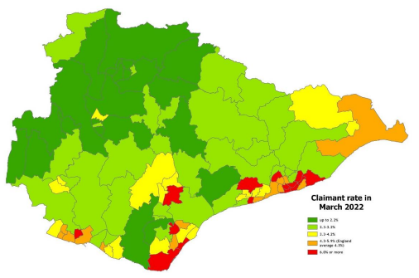
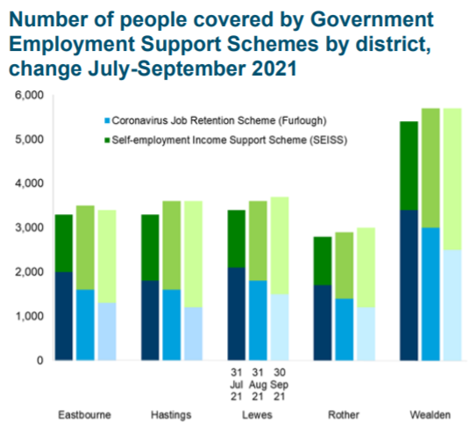
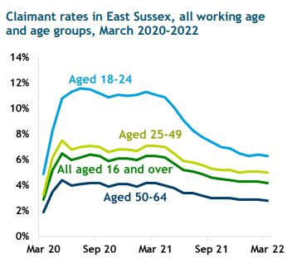
Need: Economic Impact in East Sussex
Government Employment Support Schemes
In spring 2020, the government announced two schemes to support people who work for businesses unable to trade because of the COVID-19 restrictions. The Coronavirus Job Retention Scheme (CJRS, otherwise known as the Furlough scheme) enabled companies to furlough employees rather than terminate their employment, paying 80% of people’s wages, up to a maximum of £2,500 per month. The scheme, was amended and includes ’flexible furlough’ where the employee can undertake some work for their employer. The Self-Employment Income Support Scheme(SEISS) was set up by the government to provide support for those who are self-employed.
14.4% working age population were receiving either JSA or any UC (including those in work and searching for work) in March 2022
Universal Credit (UC) Claimants
45,044 (14.2%) working age people were claiming UC in March 2022, up 339 since February
+18,877 UC claimants compared to March 2020
36% of claimants were working
117,500 (34.5%) working age people in East Sussex were supported by government schemes during the whole of the pandemic
Job Seekers Allowance (JSA) and Universal Credit Claimants
86,400
Employments furloughed
4.2% (13,405) working age people were claiming JA and UC (searching for work) in March 2022, a 47% increase since March 2020.
Claimants by ward (pre-2018) in March 2022
31,100
SEISS claims
The data below shows those supported as at 30th September 2021 when the furlough scheme and grant applications for the final SEISS grant closed.
6.3% 18-24 year olds claiming UC/JSA in March 2022, down from 11% in March 2021, but up from 4.9% in March 2020
As at 30th September 2021:
7,800 people were furloughed
11,500 people were claiming SEISS
4.7% working aged women were supported by government schemes
7.5% working aged men were supported by government schemes
Majority of people furloughed were aged 45 or over.
Little difference in proportion of the population on government support schemes in each District/Borough
At 6.6%, Hastings has the second highest claimant rate in SELEP and SE region and Eastbourne the joint third highest
29 wards have rates above England
East Sussex Research and Information Team, Unemployment in Brief April 2022

Slide 31
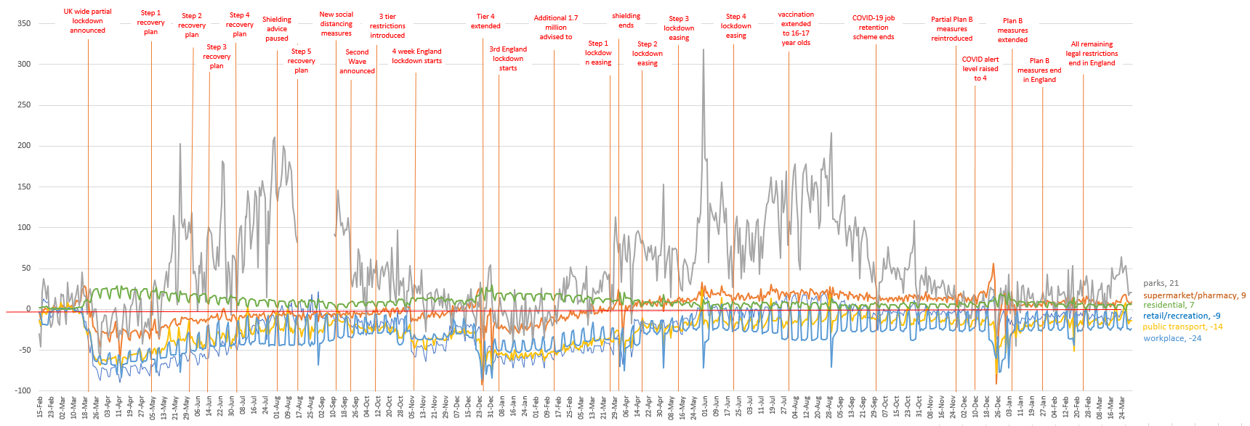
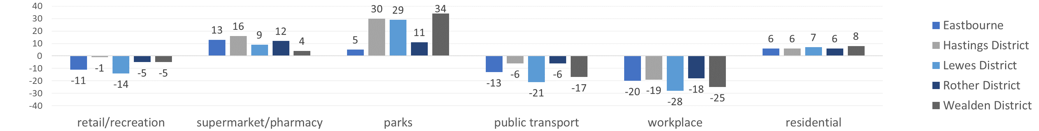
East Sussex: where people are spending time
East Sussex movement trends: up to 31st March 2022
The Community Mobility Reports show movement trends by region, across different categories of places.
These reports are created by Google with aggregated, anonymized sets of data from users who have turned on the Location History setting, which is off by default.
Movement trends by District and Borough: as at 31st March 2022:
(The baseline (0) is the median value from the 5‑week period Jan 3 – Feb 6, 2020)
Source: Google, Data period: up to 31st March 2022

Slide 32
COVID-19 in East Sussex: summary UP TO 31st March 2022
This page provides a summary of the information shown in slides 33 to 63
Cases
As at 31st March 2022 East Sussex had a similar percentage of individuals testing positive with a PCR test (22%) than England (22%).
As at 31st March 2022 there have been 157,341 confirmed cases of COVID-19 in East Sussex.
Overall, East Sussex has experienced a lower cumulative rate of confirmed cases (21,241 per 100,000) than England (26,126 per 100,000)
Hastings and Eastbourne have seen the highest case rates within the county, with Rother the lowest.
Overall East Sussex saw a sharp increase in cases from December 2020 to February 2021, from June to July 2021 and from December 2020 to January 2022 and in March 2022, mirroring the national trend
10-49 year olds are over represented in the case data compared to other age groups in East Sussex
Confirmed cases of COVID-19 in both rural and urban areas increased between February 2022 and end of March 2022
As at 10th April 2022, there had been 1,906 referrals to the Post COVID Assessment Service (PCAS) for long-COVID
Approximately 15-20% of new long-COVID cases require services.
Emergency admissions for COVID-19 have been highest in Hastings (274 per 100,000) and Eastbourne (258 per 100,000) and Lowest in Wealden (184 per 100,000)
Despite record infection levels, hospital admissions and deaths remain lower in the third wave than during the second wave peak
There is a clear association of higher rates of emergency admissions for COVID-19 with increasing deprivation
Vaccination
Vaccination uptake is higher in older age groups where people have had longer to accept the invitation.
All districts and boroughs have a smaller proportion of the population unvaccinated than nationally, but Eastbourne and Hastings have a higher proportion unvaccinated than regionally
Despite local initiatives, Hastings Borough has consistently the lowest vaccination uptake in East Sussex, with half of the 10 local areas with lowest uptake in Hastings
Deaths
As at 31st March 2022 there have been 2,062 deaths from COVID-19.
As at 1st April 2022, Rother has the highest cumulative crude death rate at (403 per 100,000 population) and Lewes the lowest (232 per 100,000).
71% of deaths in the third wave have been in those aged 75 or over, compared to 81% in the second wave and 85% in the first wave
There have been a significantly higher rate of community deaths (excluding deaths for those who lived or died in a care home or died in a hospice) in the most deprived quintile than all other quintiles.
As at 31st March 2022, 56% of all COVID-19 deaths had been in hospital (1,158), and 35% in a care home (732)
Wider impacts of the pandemic
There has been a significant increase in anxiety levels in East Sussex during the pandemic in comparison to before COVID-19.
All areas except for Eastbourne had an increase in premature mortality in 2020 compared 2019, and rates are by far the highest in the most deprived quintile
A weekly local surveillance report is released on the East Sussex County Council coronavirus web pages

Slide 33
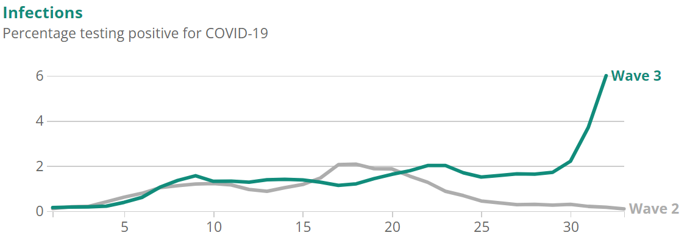
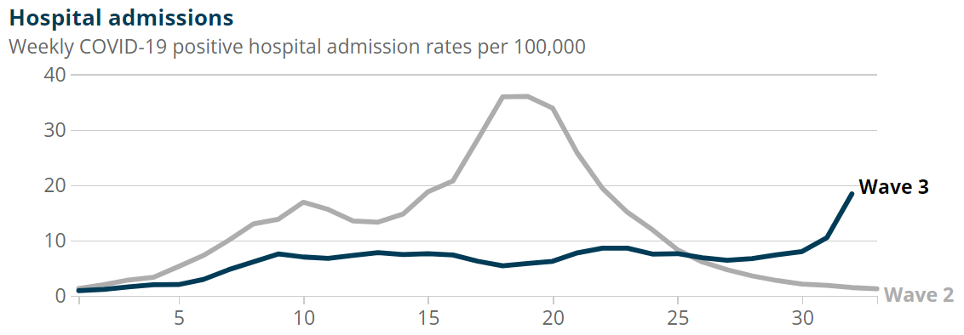
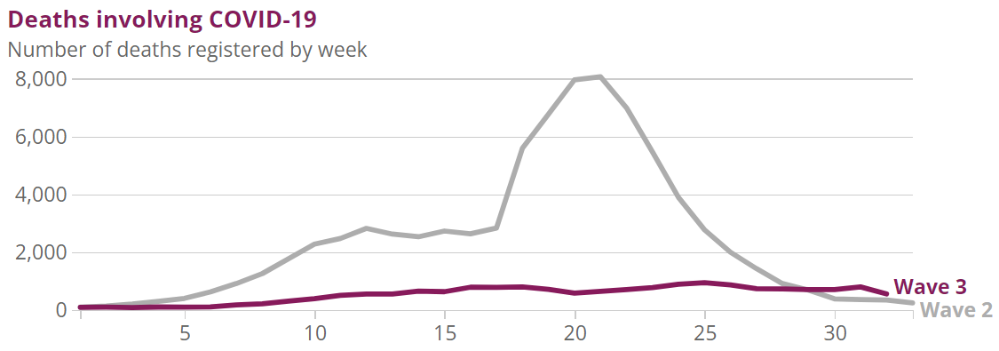
COVID-19 In England – Infections, admissions and deaths in waves 2 and 3
The following graphs show the estimated percentage of the population testing positive for COVID-19, the number of hospital admissions per 100,000 people, and number of deaths involving COVID-19, England during Wave 2 and Wave 3 of the pandemic. The ONS data estimates dates for the second wave as 7 September 2020 to 24 April 2021, and the start date for the third wave as 26 May 2021. All figures are provisional and subject to revision. The bottom axis shows the number of weeks through each wave of the pandemic.
Despite record infection levels, hospital admissions and deaths remain lower in the third wave than during the second wave peak
As at 31st December 2021 in England:
the positivity rate was the highest recorded at 6%
There were 18.4 hospital admissions per 100,000 people (week ending 2 January 2022)
There had been 557 deaths to date during the third wave
In comparison, when the positivity rate was at its highest level in the second wave (2%):
The hospital admission rate was twice as high (36.7 per 100,000)
The number of deaths was around 10 times higher (5,597 deaths).

Slide 34
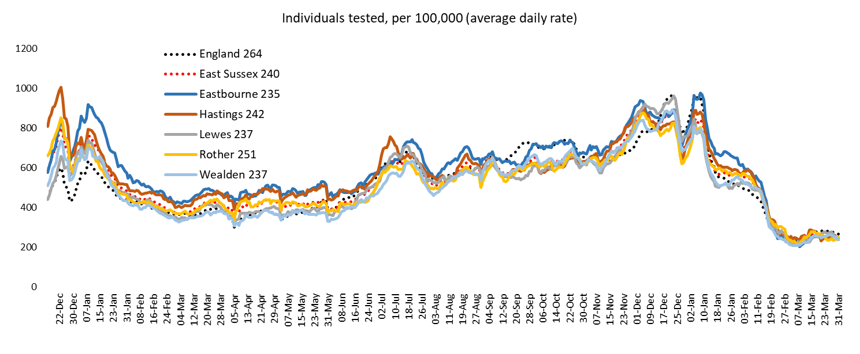
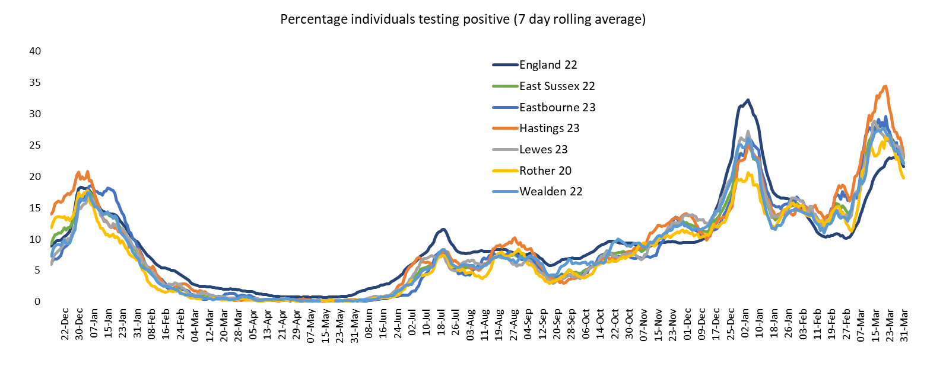
COVID-19 Testing – 1st October 2020 to 31st March 2022

Slide 35
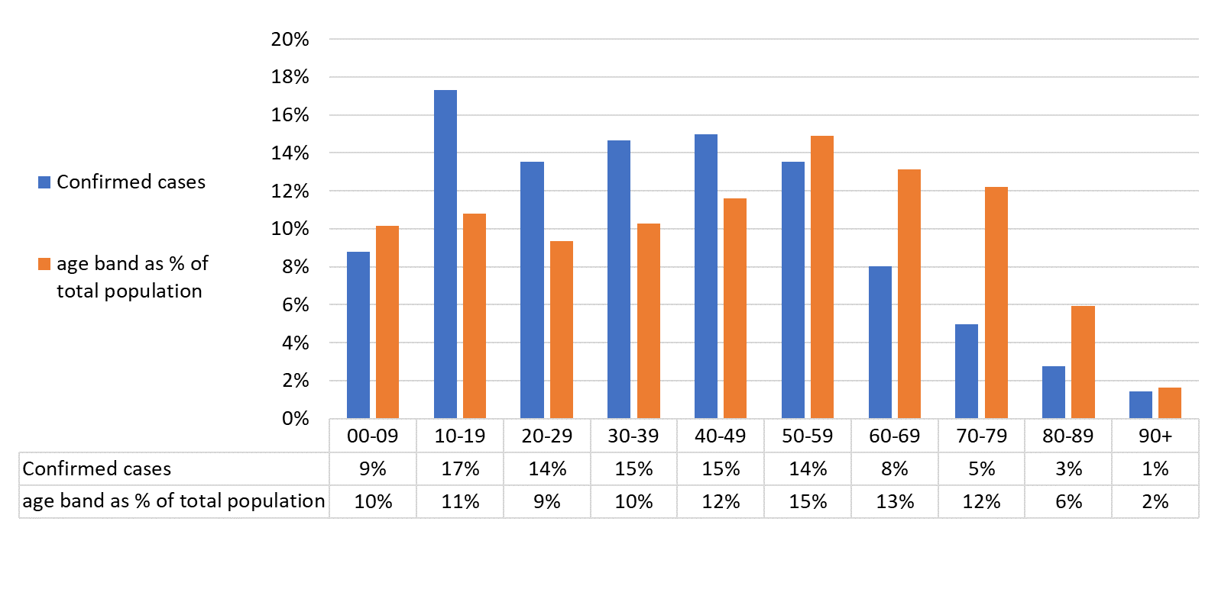
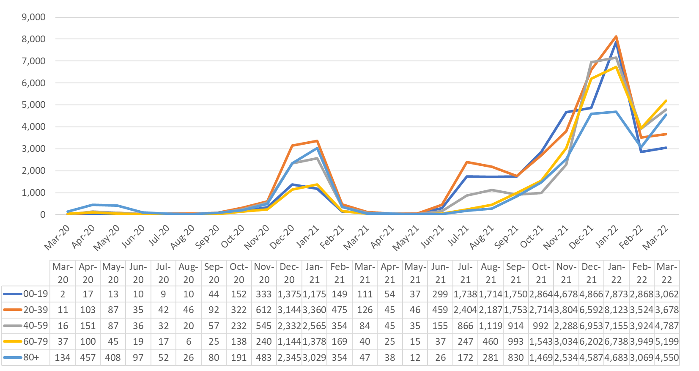
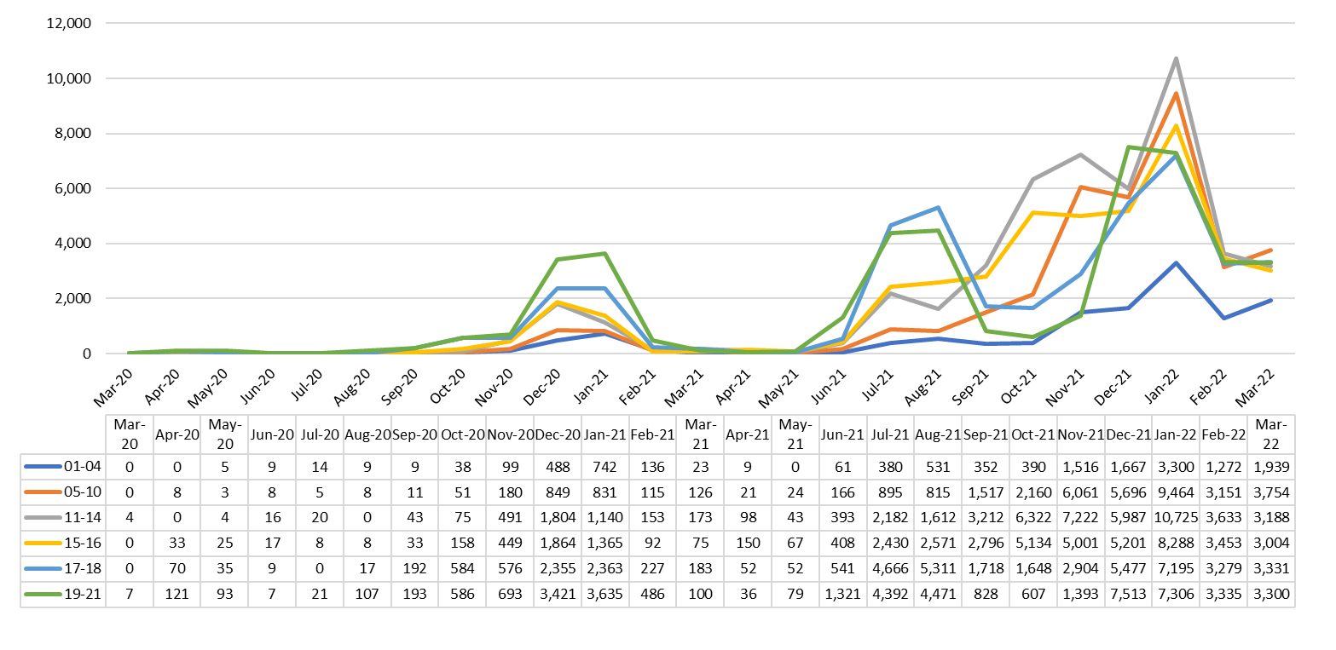
East Sussex cases: by age
On the 18th May 2020 the eligibility for accessing a COVID-19 test was extended so that everyone in the UK who was showing symptoms of COVID-19 was eligible to book a swab test. Unless otherwise stated, data below is for March 2020 to 31st March 2022
Comparing the age profile of confirmed cases to the overall resident population in East Sussex
10-19 year olds remain the group with the highest overall case rate of any age group (45,333 per 100,000)
Since January 2022:
cases in 1-19 year olds have halved from 33% to 16%,
cases among those aged 60+ have more than doubled from 12% to 27%
There remains a higher incidence of COVID-19 among 10-49 year olds than we would expect
Rate of confirmed cases per 100,000 population by age
Rate of confirmed cases per 100,000 population among 1-21 year olds
The data above excludes residents who tested positive while outside East Sussex (such as university students)
Notes:
s

Slide 36
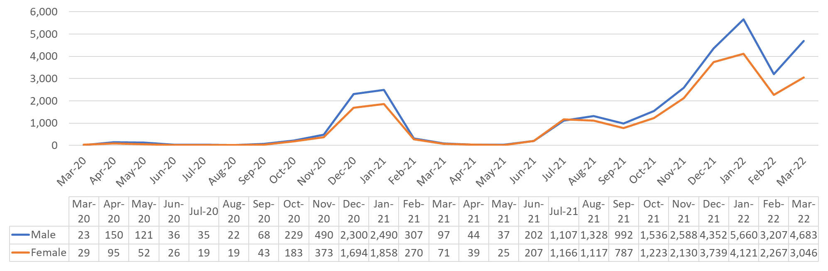
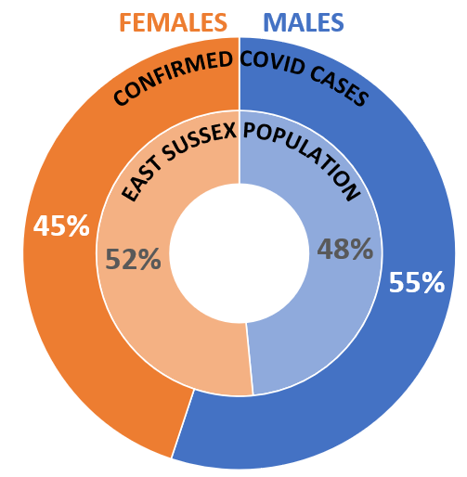
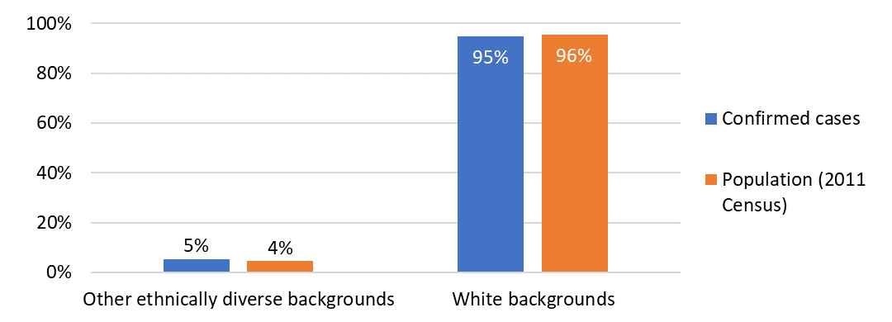
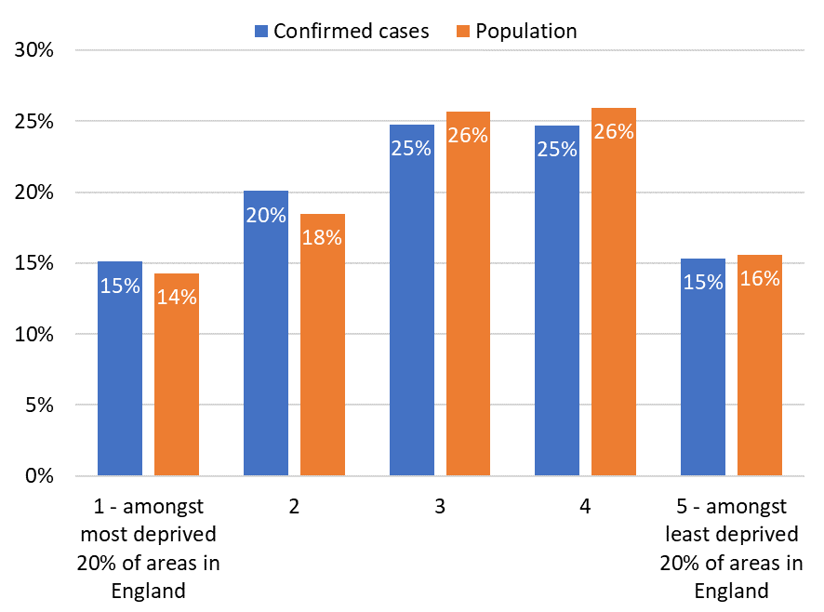
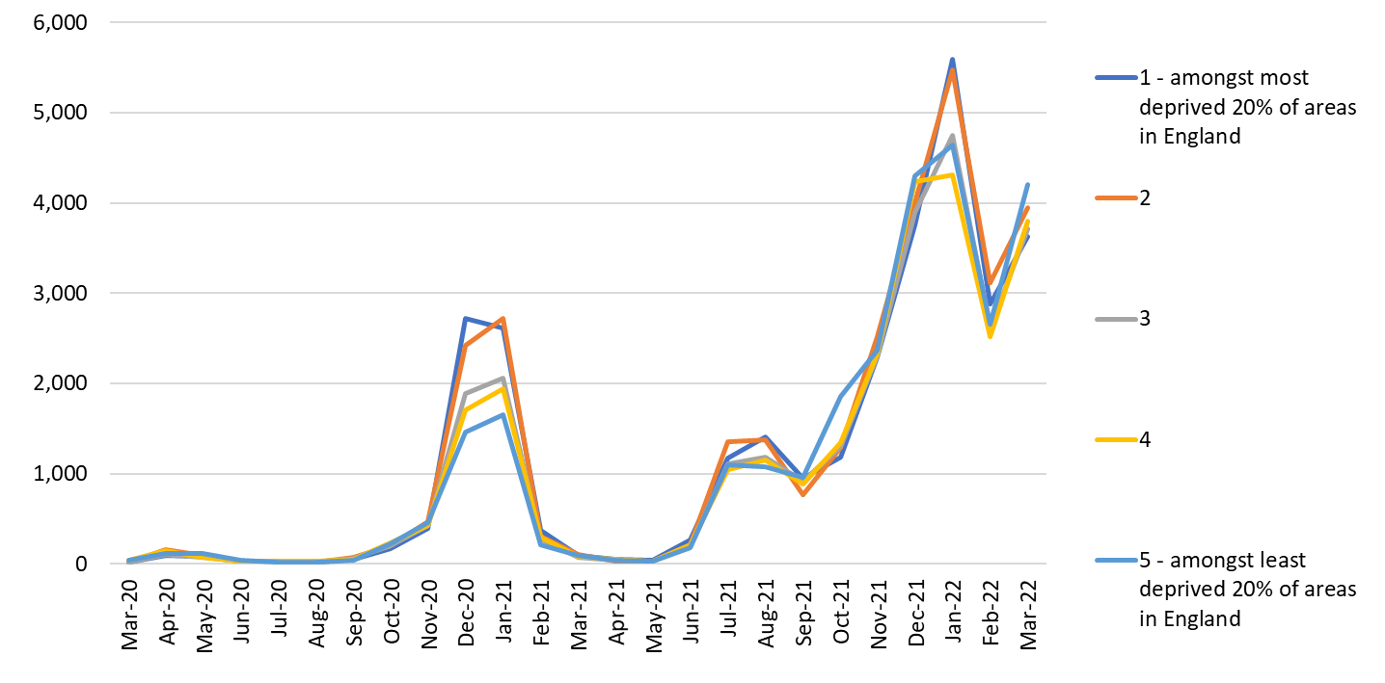
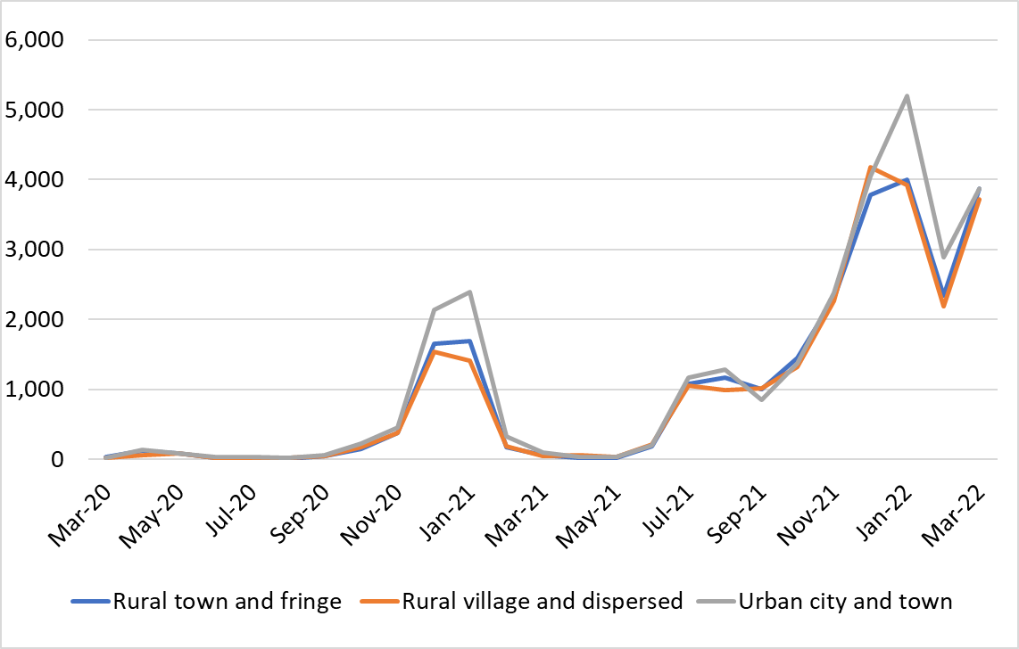
Cases: East Sussex in detail
On the 18th May 2020 the eligibility for accessing a COVID-19 test was extended so that everyone in the UK who was showing symptoms of COVID-19 was eligible to book a swab test. Unless otherwise stated, data below is for March 2020 to 31st March 2022
Rate of confirmed cases per 100,000 population by gender
Percentage of confirmed cases by ethnicity (‘other ethnically diverse populations’ relates to those stating their ethnicity as not ‘White’)
Percentage of overall confirmed cases by deprivation quintile
Rate of confirmed cases per 100,000 population by deprivation quintile
Rate of confirmed cases per 100,000 population by rural urban classification
The data above excludes residents who tested positive while outside East Sussex (such as university students)

Slide 37
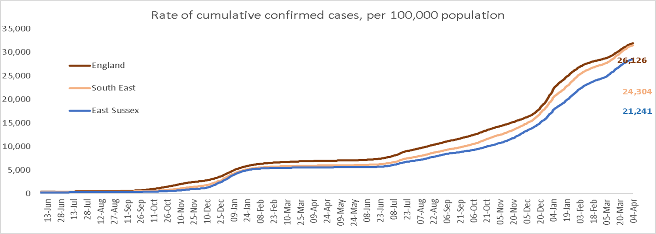
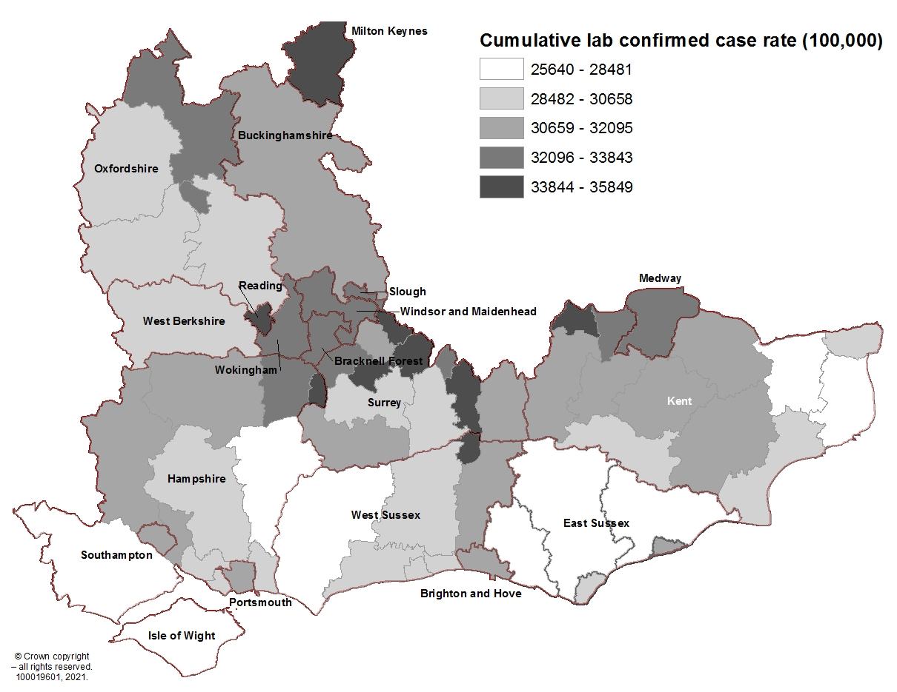
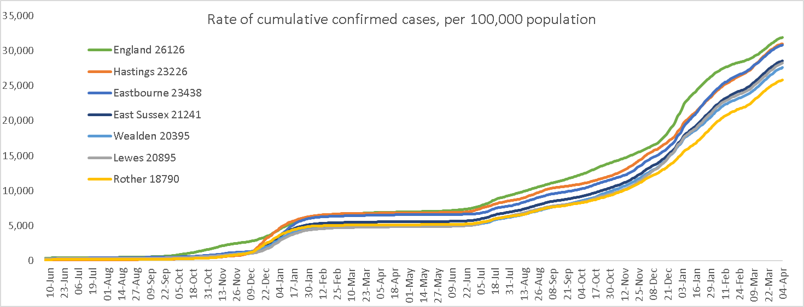
Cases
Up until 31st March 2022, East Sussex has had 157,341 COVID-19 cases
Cumulative confirmed cases per 100,000 patients up 4th April 2022
Cumulative confirmed cases (crude rates) for the South East, 1st April 2022
Rate of cumulative confirmed cases per 100,000 patients up to 4th April 2022 by District and Borough
Source: Public Health England.

Slide 38
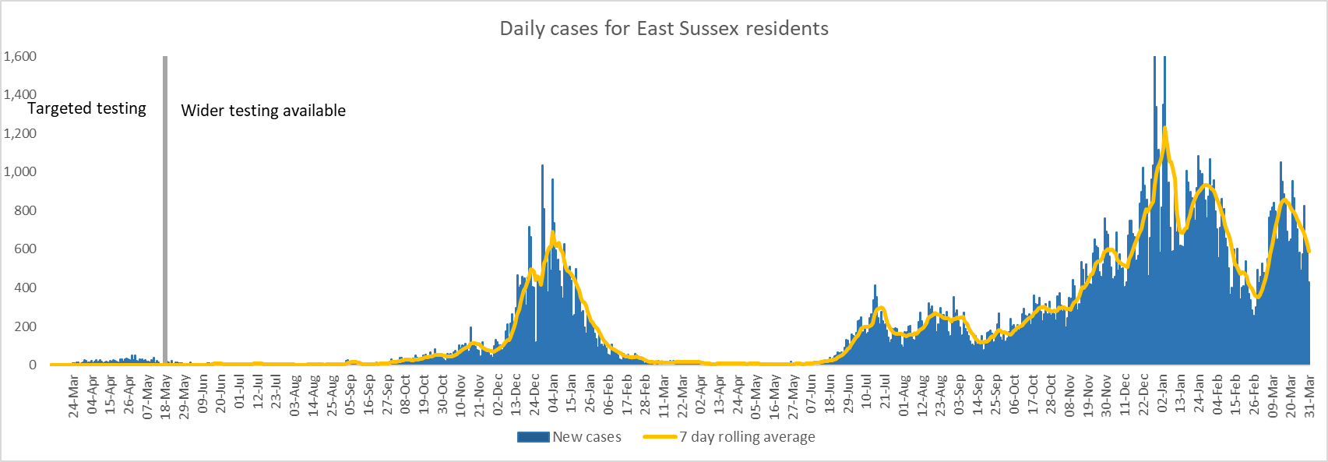
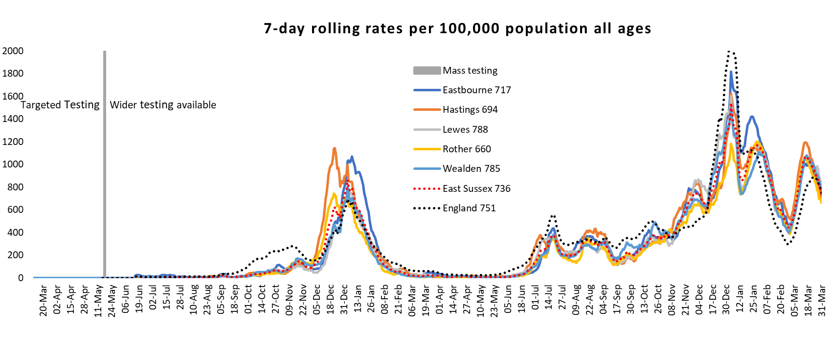
East Sussex confirmed cases by day of test: March 2020 to 31st March 2022
UK Government, data period: 31st March 2022

Slide 39
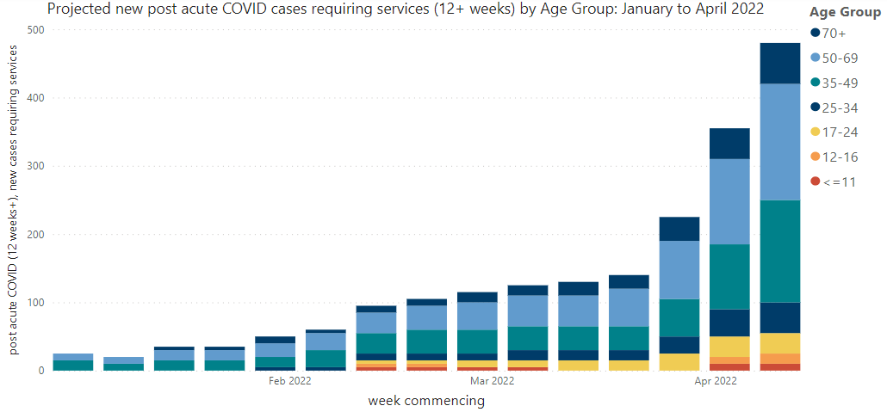
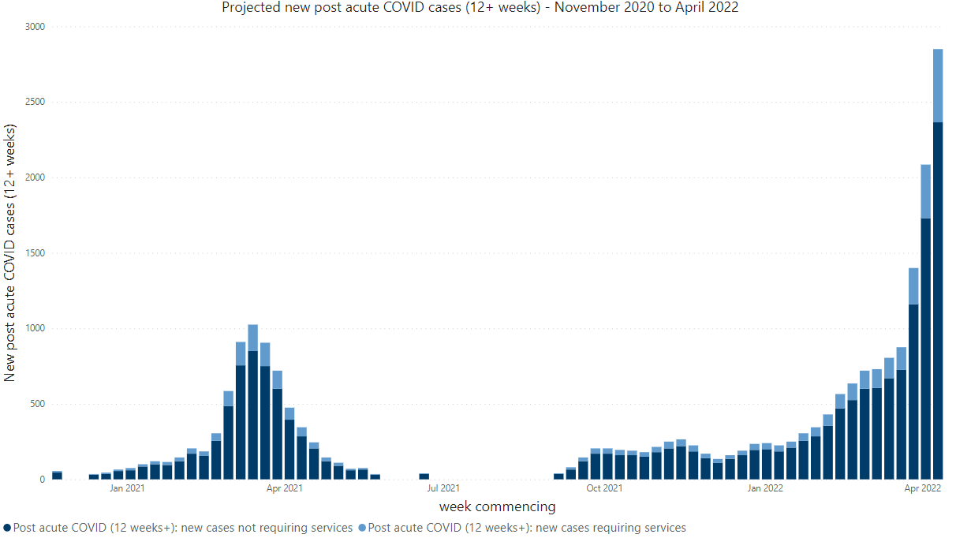
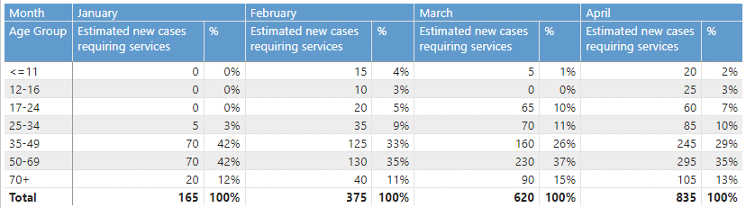
Long COVID in Sussex: National modelling
Post acute COVID Model: estimated new cases in East Sussex
Post-COVID-19 syndrome is defined as signs and symptoms that develop during or after an infection consistent with COVID-19 that continue for more than 12 weeks and are not explained by an alternative diagnosis. The UK Health Security Agency (UKHSA) have published a model identifying initial need for services by forecasting new cases of post acute COVID and those which require services. This applies estimated prevalence of ongoing symptoms following COVID-19 published by ONS to Nowcast daily infection estimates and lab confirmed COVID-19 cases. The model does include the impact of vaccination, Delta or Omicron variants and repeat episodes of COVID-19. Due to changes in community testing, UKHSA are currently reviewing the model and planning to develop a new model. These charts therefore have not been updated and the data should be used with caution.
Projected new post-acute COVID cases (12+ weeks): November 2020 to April 2022
Projected new post-acute COVID cases requiring services by age group: January to April 2022
An estimated 15-20% of new cases of post-acute COVID require services.

Slide 40
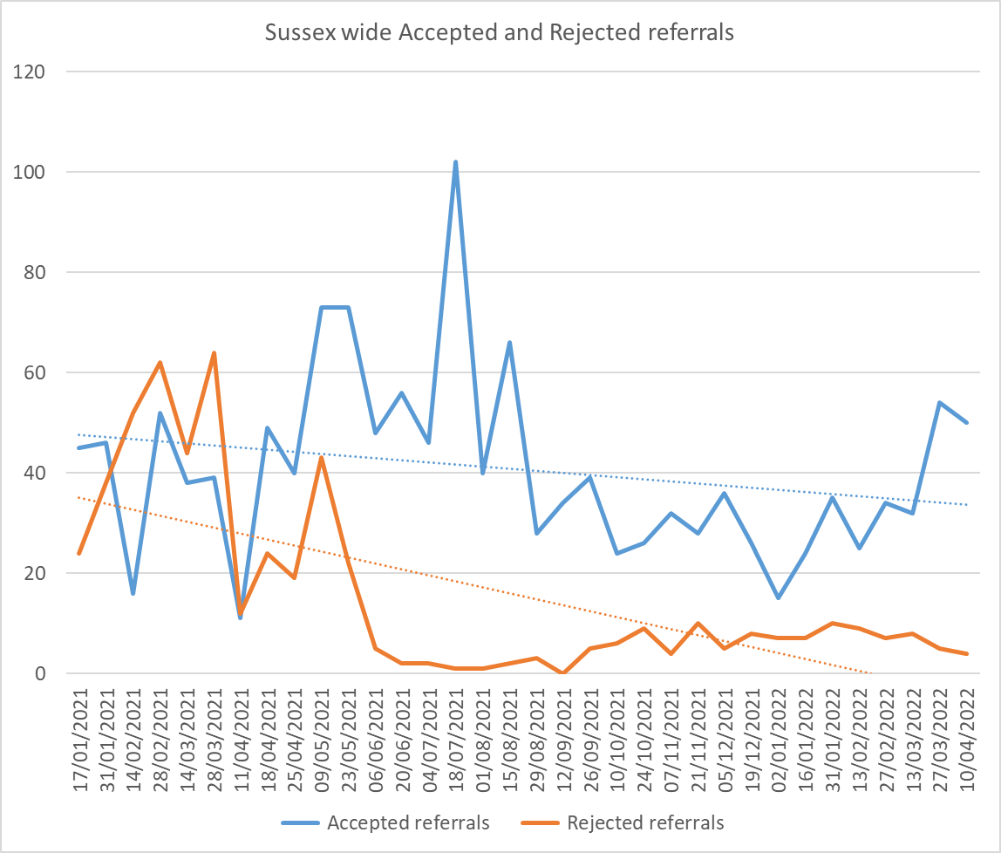
Long COVID in Sussex
Post COVID Assessment Service (PCAS): Data 17th January 2021 to 10th April 2022
There is no data available relating to Long COVID at a county level, although the Sussex-wide, Post Covid Assessment Service (PCAS), which is provided by East Sussex Healthcare NHS Trust (ESHT) and Sussex Community NHS Foundation Trust (SCFT), is receiving an increasing number of referrals. The majority of referrals received are via GPs.
Pathways followed once a patient completes their assessment in PCAS
1,906 referrals to PCAS
Pathway | Total
Rehabilitation | 953
Specialist | 390
Digital Interface | 275
Other Onward Referral | 103
Self- Management | 81
Work | 50
Social Care/Community/Voluntary | 41
TOTAL | 1,993
554 referrals to PCAS received by ESHT,
77% accepted
1,352 referrals to PCAS received by SCFT,
71% accepted

Slide 41
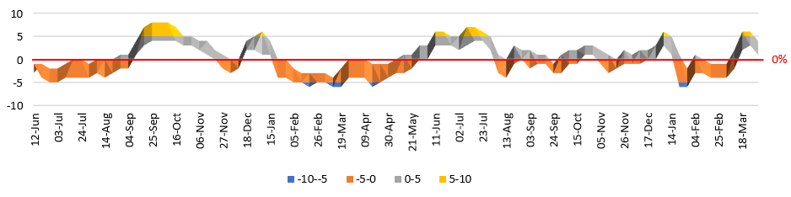
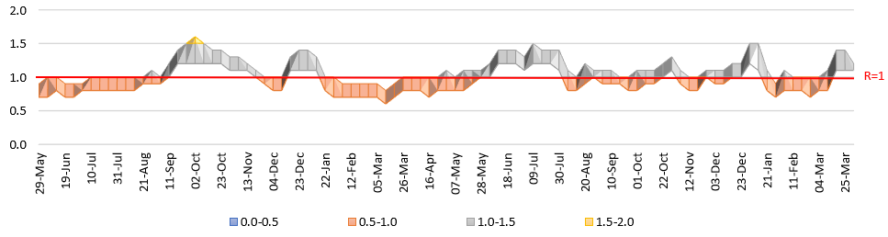
Infection rates
‘R’ number
1.1-1.2 estimated R number range for the England as at 1st April 2022
1.0-1.2 estimated R number for the South East as at 1st April 2022
The reproduction number (R) is the average number of secondary infections produced by 1 infected person
Calculating the R number is very complex and involves data from lots of different sources, including data on confirmed cases, hospital admissions, deaths, contact pattern surveys, household testing surveys and many more
Various models are developed to ensure experts are not tied to one possible view
When these are all put together and interpreted by experts they give regional and national R numbers
It is not currently possible to calculate below region level
Growth rate
England: 1% to 4% estimated growth rate as at 1st April 2022
South East: 0% to 3% estimated growth rate as at 1st April 2022
The growth rate is an approximation of how quickly the number of infections are changing day by day.
If the growth rate is greater than zero (+ positive), then the disease will grow. If the growth rate is less than zero (- negative) then the disease will shrink.
England trend
England trend
UK Government, Data period 1st April 2022

Slide 42



Vaccination: uptake for persons aged 12 years and over in East Sussex, as at 31st March 2022
Trend by vaccination dose for East Sussex
Source: Vaccinations in the UK | Coronavirus in the UK (data.gov.uk)
The 10 local areas (MSOAs*) with the highest percentage unvaccinated
Vaccination status by district and borough in East Sussex
*Middle Layer Super Output Area, each contains on average 8,000 residents. There are 69 MSOAs in East Sussex

Slide 43


Vaccination: uptake for persons aged 12 years and over in East Sussex, as at 31st March 2022
Source: Vaccinations in the UK | Coronavirus in the UK (data.gov.uk)
Vaccination status by Ethnic Group in East Sussex
Vaccination status by age group in East Sussex
Ethnic Group | Number of people unvaccinated
Asian or Asian British | 1,276
Arab | 10
Black or Black British | 866
Mixed | 1,300
Other Ethnic Groups | 1,860
White | 47,655
Not Stated | 18,393

Slide 44


COVID-19 Hospitalisations: Sussex
Confirmed COVID-19 patients in hospital beds (7 day average): 23rd March 2020 to 31st March 2022
Mechanical ventilation beds that are occupied by COVID-19 patient (7 day average): 2nd April 2020 to 31st March 2022
* On the 1 April 2021 Western Sussex Hospitals NHS Foundation Trust (WSHT) and Brighton and Sussex University Hospitals (BSUH) merged to become University Hospitals Sussex NHS Foundation Trust (UHST). These charts shows UHST data for the whole period

Slide 45


COVID-19 Hospitalisations: Emergency admissions due to COVID-19 by pandemic wave
Weekly emergency admissions due to Covid-19, March 2020 - February 2022
Between 1st March 2020 and 28th February 2022 there were 2,875 admissions to hospital due to COVID-19 for East Sussex residents.
2,745 (95%) of these occurred during waves 1-3 with the highest number in wave 2
Wave 1 | Wave 2 | Wave 3
23/03/20-30/05/20 | 07/09/20-24/04/21 | 26/05/21 to date
 |  | Source: ONS
Age profile of admissions due to Covid-19 by wave
Profile of admissions due to Covid-19 by wave
Wave 1 had the oldest age profile and wave 3 the youngest
In Wave 3 more than 1 in 10 admissions primarily due to Covid were in under 30s
Persons admitted in wave 3 generally had fewer co-morbidities recorded in their admission compared to the previous waves
 | Wave 1 | Wave 2 | Wave 3
Number of admissions | 366 | 1570 | 809
% male | 55% | 55% | 55%
% Under 30s | 3% | 2% | 12%
% 75+ | 53% | 42% | 32%
% 90+ | 11% | 9% | 5%
Other mentions on admissions record:
any cardiovascular disease | 67% | 63% | 52%
Hypertension | 15% | 16% | 12%
Nervous system disorder | 18% | 20% | 16%
Diabetes | 19% | 22% | 20%
Chronnic Kidney Disease | 16% | 16% | 13%
Dementia | 13% | 10% | 5%
COPD | 17% | 14% | 13%
Asthma | 9% | 12% | 12%

Slide 46



COVID-19 Hospitalisations: Emergency admissions due to COVID-19
East Sussex admission rate due to Covid-19 by district/borough , March 20 - Feb 22, directly age-standardised rate per 100,000 population
East Sussex admission rate due to Covid-19 by deprivation , March 20 - Feb 22, directly age-standardised rate per 100,000 population
There is a clear association of higher admission rates due to Covid-19 with increasing levels of deprivation. The admission rate for East Sussex residents who live in the 20% most deprived areas in England have more than double the admission rate for those who live in the least 20% deprived areas nationally.
Hastings and Eastbourne have significantly higher rates of admissions due to Covid-19 than Lewes, Rother and Wealden
Percentage of admissions with a Covid-19 diagnosis where admission is primarily due to Covid-19 (primary diagnosis)
Spring 2021 had the highest percentage of admissions for people with covid-19 who were in hospital for other reasons. In the beginning of 2022 around half of persons admitted to hospital with covid-19 were there for other reasons

Slide 47

Deaths: Ethnicity – National Modelling Wave 1 of the pandemic
In May 2021 the ONS updated and extended previous analysis of ethnic contrasts in COVID-19-related deaths by using linked data from the 2011 Census, death registrations, and primary care and hospital records to compare mortality in the first and second waves of the pandemic. This analysis assessed the extent that increased risk in some ethnic groups is explained by differences in the prevalence of certain pre-existing health conditions known to increase the risk of dying from COVID-19 between 24th January 2020 and 31 March 2021.
In Wave 1 of the pandemic (24th January 2020 to 11th September 2020), compared to those of White British ethnicity:
After adjusting for age (green bar),
males from all ethnic minority groups, and females from all ethnic minority groups other than Chinese and White Other were at greater risk of death involving COVID-19-193.7x higher rate of COVID-19-related death in males of Black African ethnicity and 2.6x higher rate in females
3.0x higher rate of COVID-19-related death in males of Bangladeshi ethnicity and 1.9x higher rate in females
2.7x higher rate of COVID-19-related death in males of Black Caribbean ethnicity and 1.8x higher rate in females
2.2x higher rate of COVID-19-related death in males of Pakistani ethnicity and 2.0x higher rate in females
After additionally adjusting for measures of disadvantage, occupation, living arrangements, and certain pre-existing conditions (blue bar),
substantially reduced excess COVID-19 mortality risk for most ethnic groups
Rates of COVID-19 mortality remained highest amongst the Black African group
Some groups (White Other, Mixed and Chinese for males; Bangladeshi, Black Caribbean, Mixed and Pakistani for females) were no longer at greater risk of COVID-19 mortality
Source: ONS: data 24th January 2020 to 31st March 2021, reported 26th May 2021

Slide 48

Deaths: Ethnicity - national modelling Wave 2 of the pandemic
In Wave 2 of the pandemic (12th September 2020 to 24th April 2021), compared to those of white British ethnicity
After adjusting for age (green bar),
Increasing difference in COVID-19 mortality for people of Bangladeshi and Pakistani ethnic backgrounds compared to the White British group
5.0x higher rate of COVID-19-related death in males of Bangladeshi ethnicity and 4.1x higher rate in females
3.4x higher rate of COVID-19-related death in males of Pakistani ethnicity and 2.8x higher rate in females
Although people from Black African and Black Caribbean ethnic groups remained at higher risk of COVID-19 mortality than White British people during the second wave, the magnitude of excess risk was reduced compared with the first wave.
After additionally adjusting for measures of disadvantage, occupation, living arrangements, and certain pre-existing conditions (blue bar),
Most Black and South Asian groups remained at higher risk than White British people in the second wave even after adjustments
People from the Bangladeshi and Pakistani ethnic groups had a higher excess risk of death in the second wave than in the first wave.
Differences in location, measures of disadvantage, occupation, living arrangements, and certain pre-existing health conditions explain a large proportion (but not all) of the excess COVID-19 mortality risk observed in some ethnic groups.
Source: ONS: data 24th January 2020 to 31st March 2021, reported 26th May 2021

Slide 49

Deaths: Ethnicity - national modelling Wave 3 of the pandemic
In Wave 3 of the pandemic (data showing 13th June to 1st December 2021), compared to those of white British ethnicity
After adjusting for age (light blue bar),
There was higher risk of COVID-19 death for all ethnic minority groups except the Chinese group, men from the Mixed ethnic group and women from the White other ethnic group compared with the White British ethnic group.
4.4x higher rate of COVID-19-related death in males of Bangladeshi ethnicity and 5.2x higher rate in females
3.5x higher rate of COVID-19-related death in males of Pakistani ethnicity and 4.3x higher rate in females
There was higher risk of COVID-19 death in people from Black Caribbean and Black African ethnic groups than White British people
After additionally adjusting for measures of disadvantage, occupation, living arrangements, and certain pre-existing conditions (mid blue bar),
most ethnic groups had a similar risk to people of White British ethnicity, however, similarly to the latter part of Wave 2, Bangladeshi and Pakistani groups are at higher risk of mortality even after adjustment.
2.2x higher rate of COVID-19-related death in males of Bangladeshi ethnicity and 2.1x higher rate in females compared to people of White British ethnicity
1.2x higher rate of COVID-19-related death in males of Pakistani ethnicity compared to people of White British ethnicity
People from Black Caribbean and Black African ethnic groups remained at higher risk of COVID-19 mortality than White British people
After fully adjusting, including vaccination status (darkest blue bar),
there was no evidence of greater risk of death involving COVID-19 compared with the White British ethnic group, suggesting that differences in vaccination coverage between the Black Caribbean and Black African ethnic groups and the White British ethnic group explain a large part of the excess risk.
Source: ONS: data 24th December 2020 to 1st December 2021, reported 26th January 2022

Slide 50





England: Cumulative age-standardised mortality rate per 100,000 person-years, for deaths involving COVID-19
Broad ethnic group
Deprivation decile, March 20 to February 2022
Ethnic group, March 2020 to February 2022 2021
These graphs show deaths where COVID-19 was mentioned anywhere on the death certificate. Rates are based on provisional populations for 2019 and provisional mortality data, and may be subject to revision.
Asian ethnic groups
Black ethnic groups
Region, March 20 February 2022
Source: Office for National Statistics mortality data and population estimates from ETHPOP projections produced for PHE. Ethnicity assigned from NHS Digital Hospital Episode Statistics. See 'Outputs by ethnic group in CHIME' .

Slide 51


National research: COVID-19 mortality and self-reported disability status
Risk factors for increased COVID-19 mortality
Disabled people are more likely to:
On average be older than non-disabled people.
have known health risk factors for severe COVID-19 such as obesity, and underlying health conditions
have contact with keyworkers including care home workers, health and social care, and carers
experience other risk factors including poverty and deprivation
The latest data from the ONS estimates of differences in coronavirus (COVID-19) mortality risk by self-reported disability status for deaths occurring between 24th Jan 2020 and 9 March 2022 in England, using linked data from the Office for National Statistics’ Public Health Data Assets.
Age-standardised mortality rates for deaths involving COVID-19, by sex and self-reported disability status, England: 24 January 2020 to 9 March 2022
Key findings show:
Significantly increased rates of deaths involving COVID-19 for both disabled and non-disabled people between the first and second waves of the pandemic
Significantly decreased rates of deaths between the second and third waves
Higher mortality rates in each wave of the pandemic for disabled people of both sexes compared with non-disabled people.
a significantly greater risk of death remains for all disabled people compared with non-disabled people across the three waves of the coronavirus pandemic after adjusting for wider socio-economic and demographic characteristics and vaccination status.
Compared with non-disabled men:
  1.4x greater risk of death for more-disabled men
  1.3 greater risk of death for more-disabled men
Compared with non-disabled women:
  1.6x greater risk of death for more-disabled women
  1.3 greater risk of death for more-disabled women
Self-reported disability and COVID-19 mortality
Research published in the Lancet has analysed population-level linked data on 29.3 million people from the 2011 Census, and the Office for National Statistics Public Health Data Asset, to estimate the association between disability and COVID-19 mortality. Key findings identified that, in comparison to non-disabled people, disabled people had:
Substantially higher mortality involving COVID-19 in both waves of COVID-19
Higher relative risk for disabled people who were: Younger, women, and had greater levels of activity limitation
Higher relative risk that was at least partially accounted for by a combination of adverse socioeconomic, demographic and health-related risk factors
COVID-19 mortality risk by disability and other socio-economic and demographic characteristics, England: 24 January 2020 to 9 March 2022

Slide 52

National data: Deaths by vaccination status
ONS data on deaths occurring between 1st January 2021 and 31st January 2022.
Vaccination status is assessed at date of death and includes those who:
Unvaccinated
vaccinated with first dose only, less than 21 days ago
vaccinated with first dose only, at least 21 days ago
vaccinated with first and second doses, less than 21 days ago
vaccinated with first and second doses, at least 21 days ago but less than six months ago
vaccinated with first and second doses, at least six months ago
vaccinated with first, second and third dose and or booster, less than 21 days ago
vaccinated with first, second and third dose and or booster, at least 21 days ago
Key findings: COVID-19-related deaths 1st Jan to 31st January 2021
The ASMR for deaths involving coronavirus (COVID-19) have been:
consistently lower since booster introduction in September 2021 for people who had received a third dose or booster at least 21 days ago, compared with unvaccinated people and those with a first or second dose.
consistently lower for all ages for those who had received a third dose or booster at least 21 days ago, compared with unvaccinated people.
lower for people who had received a second dose at least 21 days ago compared with unvaccinated people, until November 2021. From November 2021 to January 2022 the death rate increased, particularly in older age groups; possibly due to a change in the composition of the group with most people in older age groups having received a third dose or booster, or waning protection from prior vaccination.
higher for those who had received a second dose over six months ago than those who had received a second dose less than six months ago, indicating possible waning protection from vaccination over time.
The age-adjusted rates account for differences in age structure and population size but there may be other differences between the groups, particularly underlying health, which affect the mortality rates.
Monthly age-standardised mortality rates (ASMR) by vaccination status, deaths involving coronavirus (COVID-19)

Slide 53



Deaths
East Sussex deaths compared to 5 year average
2,062
deaths with COVID-19 registered on the death certificate as at 1st April 2022
East Sussex variance in deaths from 5 year average
1,231
Excess deaths from 17th April 2020 to 1st April 2022 compared to the 5 year average
Source: Office for National Statistics, Data period: Week ending 1st April 2022

Slide 54

Deaths with COVID-19 mentioned on the death certificate: rate per 100,000
Ranking of Crude Death rate of deaths Registered between 28th Feb 2020 and 15th April 2022 where the underlying cause of death was given as COVID-19

Slide 55



COVID-19 Deaths by District and Borough
Number of COVID-19 deaths by District and Borough
Cumulative COVID-19 crude deaths per 100,000 residents
400
300
200
100
0
District & Borough | Number of COVID-19 deaths as at 1st April 2022
Eastbourne | 430
Hastings | 351
Lewes | 326
Rother | 441
Wealden | 527
District & Borough | Crude rate of COVID-19 deaths as at 1st April 2022
Eastbourne | 342 / 100,000
Hastings | 342 / 100,000
Lewes | 232 / 100,000
Rother | 403 / 100,000
Wealden | 254 / 100,000

Slide 56


East Sussex: Mortality data - deaths involving COVID-19, registered up to the end of March 2022 - slide 1
This data profiles mortality in East Sussex: deaths registered up to the end of March 2022.
Wave 1 estimated 23rd March to 30th May 2020; Wave 2 estimated 7th September 2020 to 24th April 2021; Wave 3 estimated to have started 26th May 2021
COVID-19 mortality: Daily Deaths
COVID-19 mortality by age and sex
There have been 2,051 deaths with Covid-19 mentioned on the death certificate since the start of the pandemic (deaths registered up to end of March 2022). Most of these (n=1,983, 97%) occurred during the waves with the highest number in wave 2.
Daily COVID-19 deaths:
Wave 1 326 (16%);
Wave 2 1,376 (67%);
Wave 3 281 (14%)
COVID-19 mortality: underlying cause of death
The underlying cause of death is the disease or injury that initiated the train of events directly leading to death; or the circumstances of the accident or violence that produced the fatal injury. Conditions are only recorded on the death certificate if the certifying doctor or coroner believed they made some contribution to the death, either directly or indirectly.
There are differences in the profile of deaths by wave. Deaths in Wave 3 are slightly more prevalent in people who are male and younger compared to the previous waves.
In wave 1 over 9 in 10 covid-19 deaths were due to covid (underlying cause), with this decreasing with the subsequent waves. Wave 3 had fewer other mentions of dementia on the death certificate, but slightly more mentions of chronic kidney disease and COPD. Overall, wave 3 deaths had more co-morbidities recorded on the death certificate (in 99% of deaths) compared to the previous waves (95% of deaths)

Slide 57


East Sussex: mortality data - deaths involving COVID-19, March 2020 to 31st March 2022: slide 2
COVID-19 mortality: Community deaths
Local analysis of mortality data relating to usual place of residence and place of death has enabled consideration of ‘community’ deaths. Community deaths exclude those who lived or died in a care home or who died in a hospice. This allows us to look at COVID-19 in relation to the wider community impact outside of those known to be extremely vulnerable in high risk settings. This is a local measure developed by East Sussex Public Health, so there is no nationally comparable data.
Age-standardised East Sussex Covid-19 mortality rates by districts/boroughs, all deaths and community deaths (per 100,000)
This data profiles mortality in East Sussex from March 2020 to deaths registered up to the end of March 2022.
COVID-19 mortality by deprivation for community deaths
There is a clear association with deprivation and the rate of community COVID-19 deaths (deaths excluding those of people who lived or died in a care home or who died in a hospice). For all deaths and for community deaths, the rates increase with increasing levels of deprivation.
Age-standardised East Sussex Covid-19 mortality rates by deprivation, all deaths and community deaths
55% (1,119) of all COVID-19 deaths were community deaths
12% of community deaths were for those in retirement complexes/apartments/sheltered housing.
Community deaths increase with each wave. In Wave 1, (42%) of deaths were community deaths, rising to 73% in Wave 3.
Hastings has the highest covid-mortality rate for all deaths. However with care home and hospice deaths excluded, Eastbourne has the highest rate and Hastings the lowest (though not significantly different).
Community deaths in areas in East Sussex that are in the most deprived 20% in England are:
Over 2x compared to those in the least 20% deprived areas nationally
significantly higher rate than all other quintiles
NB: data from public health mortality files may not match the numbers of deaths as reported in publications by ONS. This is due to continuous data updating, frequency data is made available to local areas, and pressures within the Coroner service.

Slide 58

Places of COVID-19-related death: East Sussex
Week ending 1st April 2022
56%
hospital
35%
care home
8%
other

Slide 59


Settings: Care homes
736 COVID-19 deaths in East Sussex care homes as at 1st April 2022
(Weekly ONS deaths where place of death was a care home, by UTLA of residence)
Care Home deaths by district/borough
District / Borough | Totals
Eastbourne | 157
Hastings | 115
Lewes | 131
Rother | 177
Wealden | 156
Source: Office for National Statistics, Data period: Week ending 1st April 2022

Slide 60


Settings: Hospitals
1,164
COVID-19 deaths in hospitals as at 1st April 2022
Hospital deaths by district/borough
District & Borough | Totals
Eastbourne | 232
Hastings | 171
Lewes | 200
Rother | 234
Wealden | 327
Source: Office for National Statistics, Data period: Week ending 1st April 2022

Slide 61






Wider impact of the pandemic: Loneliness
In April 2021, the ONS released estimates of loneliness and personal well-being during the coronavirus (COVID-19) pandemic, and in comparison to the pre-pandemic period.
Levels of loneliness October 2020 to February 2021
Changes in wellbeing: April 2019-March 2020 and April 2020-September 2020
Percentage of people who felt lonely in the last 7 days: 14 October 2020 to 22 February 2021
Changes to mean life satisfaction
(how satisfied are you with your life nowadays?)
Changes to mean feeling worthwhile
(what extent do you feel things you do in life are worthwhile?
There has been a statistically significant decrease in life expectancy in England and the South East.
There has been a statistically significant decrease in people feeling the things they do are worthwhile in England.
Percentage of people who "often or always" felt lonely:
14 October 2020 to 22 February 2021
Changes to mean happiness
(how happy did you feel yesterday? Score of 0-10)
Changes to mean anxiety
(how anxious did you feel yesterday? Score of 0-10)
There has been a statistically significant decrease in people feeling happy in England.
There has been a statistically significant increase in people feeling anxious in England, the South East and East Sussex.

Slide 62


Wider impact of the pandemic: Health Inequalities – Emergency Admissions
Emergency admissions (all causes) , 2019 to 2021
Emergency admissions (all causes, all ages), directly age-standardised rate per 100,000 population, 2019 to 2021 for districts/boroughs
Emergency admissions (all causes, all ages), directly age-standardised rate per 100,000 population, 2019 to 2021 by deprivation
Across all years Hastings has the highest emergency admission rate and Lewes the lowest
In all areas the rate dropped in 2020 compared to 2019.
Compared to 2019, emergency admissions in 2021 are higher in Eastbourne and Wealden, slightly lower in Lewes, and are significantly higher in Hastings and Rother
Emergency admissions rates increase with increasing levels of deprivation
rates for all quintiles decreased in 2020 compared to 2019, to then increase again in 2021.
Compared to 2019, in the least deprived quintile in 2021 the emergency admission rate is slightly higher, but across the rest of the quintiles the rates for 2021 are slightly lower

Slide 63


Wider impact of the pandemic: Health Inequalities – Premature mortality
Premature mortality (deaths in under 75s) all causes, 2019 to 2021
Premature mortality (all causes, under 75s), directly age-standardised rate per 100,000 population, 2019 to 2021 for districts/boroughs
Premature mortality (all causes, under 75s), directly age-standardised rate per 100,000 population, 2019 to 2021 by deprivation
Premature mortality is highest in Hastings and lowest in Wealden.
All areas except for Eastbourne had an increase in premature mortality in 2020 compared to the previous year
Although not significantly different, premature mortality rates in Rother and Wealden have been increasing over the last 3 years.
Premature mortality increases with increasing levels of deprivation
With the exception of quintile 2, all other areas saw an increase in premature mortality in 2020 compared to the previous year.
In 2021, premature mortality increased further in quintile 4, with a significantly higher rate compared to 2019. For the second most deprived quintile, the 2021 rate was the highest it had been over the last 3 years (though not significantly different).
In the least deprived areas, premature mortality in 2021 is the lowest rate over the last 3 years (though not significantly different).

